Slide 1
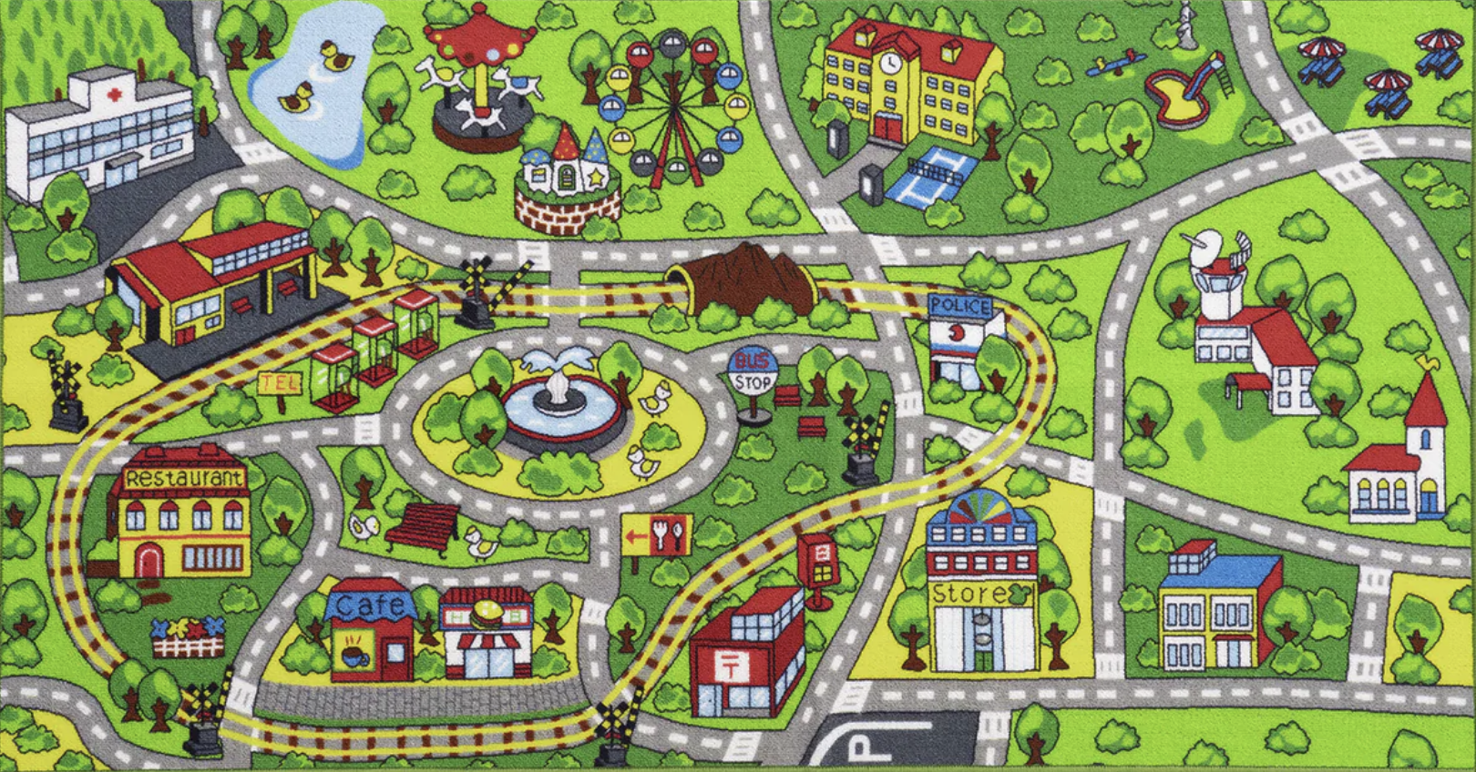
Smart Growth Matters
“It’s All Connected”
Notes:
FOR MORE RESOURCES: https://drive.google.com/file/d/1sJ3dcH6qadMAj5Wy1FG7Bo5Md76NVfct/view?usp=drive_link
nsmith@growsmartmaine.org
227 Water Street, Suite 208
Augusta ME 04330
207-250-0220
Nancy E. Smith
Chief Executive Officer
GrowSmart Maine
http://www.growsmartmaine.org

Slide 2
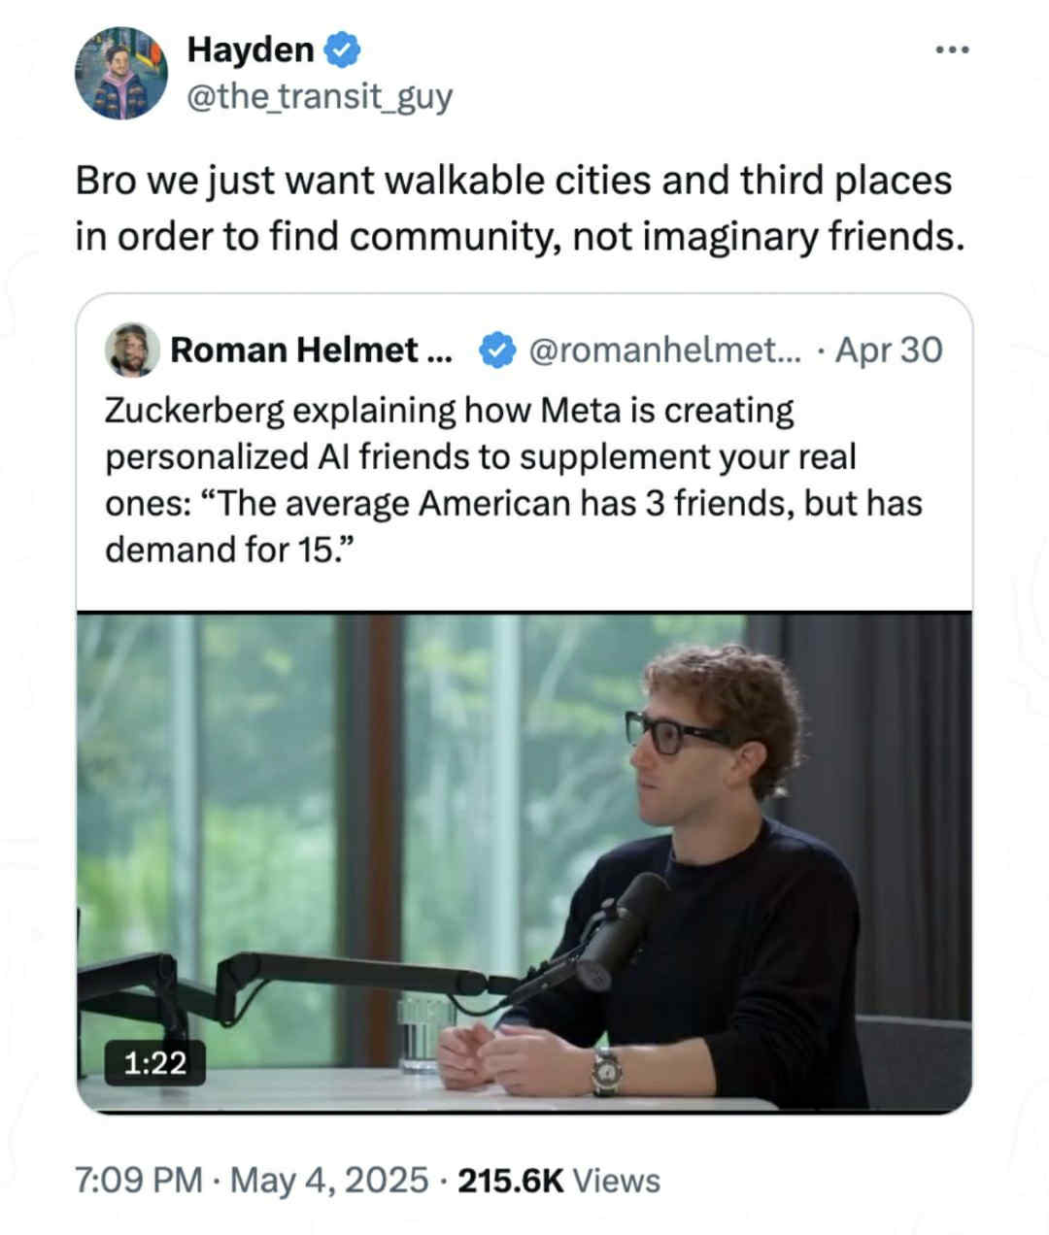
Notes:
Let’s strive for IRL, analog relationships. In Real Life relationships fostered in inviting community spaces.

Slide 3
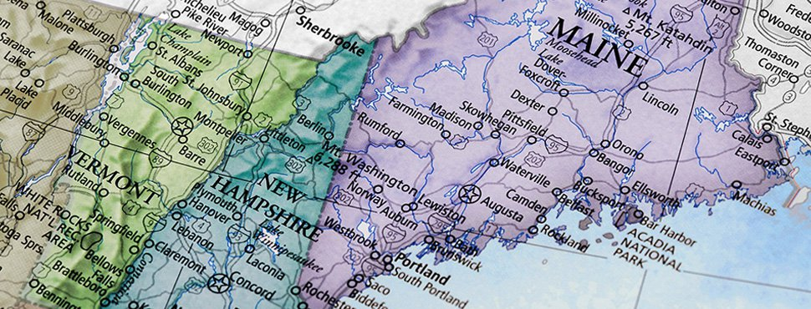

Why is someone from Maine talking to people in
New Hampshire?
Notes:
Our connections include
Wabanaki/Abanaki First People
Economies based in heritage industries that rely on our quality natural and built places
The New England Tradition of Home Rule vs. strong county government found elsewhere in the US
Challenges in advancing smart growth initiatives like affordable housing, infill development, and climate resilience
Rural landscapes with infrastructure more readily developed in our urban areas than rural settings
Aging population with vibrant people who need access to their neighbors and services

Slide 4
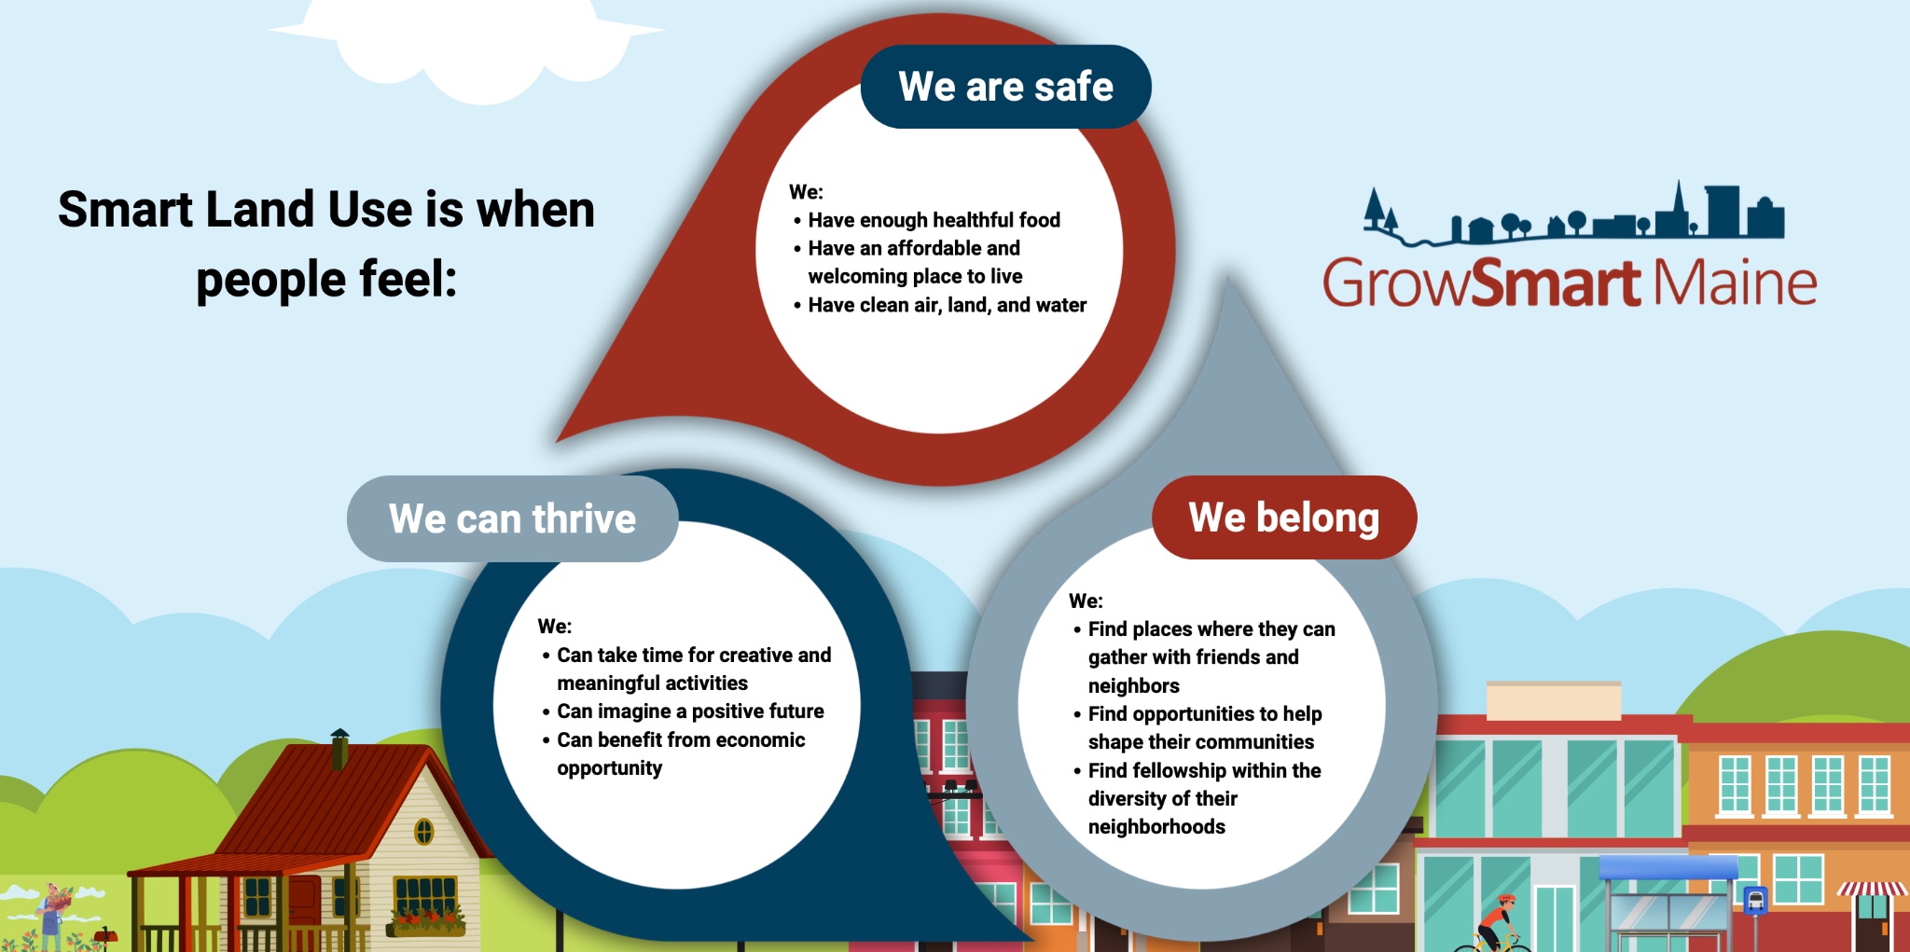
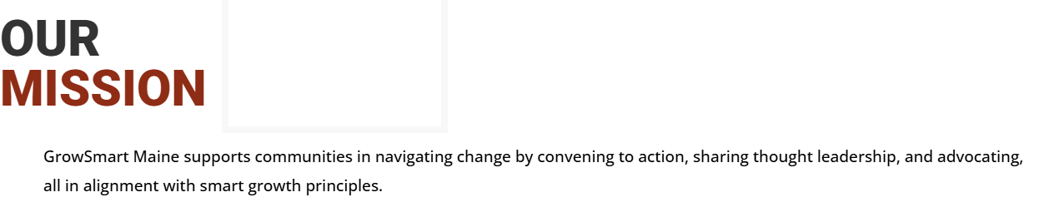
Notes:
They are Safe
Have enough healthful food
Local, small farms are a pillar in towns around Maine. Beyond just a way of life, these farms produce goods and products that nourish the surrounding community. Protecting farmland means protecting access to high quality, locally grown food.
Have an affordable and welcoming place to live
Housing is a human right - and affordable housing is critical for people to create happy, healthy and thriving lives for themselves and their families.
Have clean air, land, and water
Protecting the environment means protecting access to heritage ways of life, recreation, and industry around Maine. Our state was built on its abundance of clean natural resources and smart land use understands the importance of maintaining the environment from which we all benefit.
They Belong
Find places where they can gather with friends and neighbors
Social spaces are critical infrastructure in vibrant communities. They create places for connections that provide meaning in our lives.
Find opportunities to help shape their communities
Community vitality is dependent on the ability of its members to get involved. Creating or maintaining a spirit of volunteerism and the appropriate pathways for engagement leads to sustainable growth.
Find fellowship within the diversity of their neighborhoods
As in the natural world, diversity means strength and resilience. We all benefit from living in places with a broad diversity of perspectives, experiences, and ways of life.
They Can Thrive
Can take time for creative and meaningful activities
Beyond providing access for the things we need, smart growth in communities fosters the ability for people to pursue the activities that provide meaning in their lives.
Can imagine a positive future for themselves and others
Opportunity and hope undergird the path to our future as individuals and communities. Providing access to education, work, and recreation that inspires people to build fulfilling lives is the tide that raises all boats.
Can benefit from economic opportunity for themselves and their families
Economic opportunity unlocks the potential for personal and community growth. Supporting local businesses and investing in new and heritage industries allows for sustainable and equitable economic development.

Slide 5
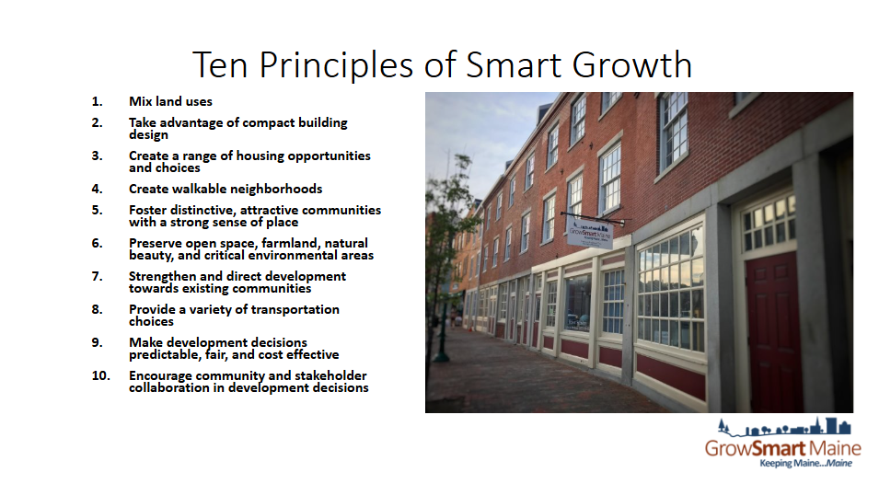
Notes:
Farmers’ Markets are examples of seeing the interdependence of vibrant downtowns where people are walking around with their wallets, and vibrant farms producing food, fiber, and more for their neighbors.
These are not competing interests; they are woven together.

Slide 6
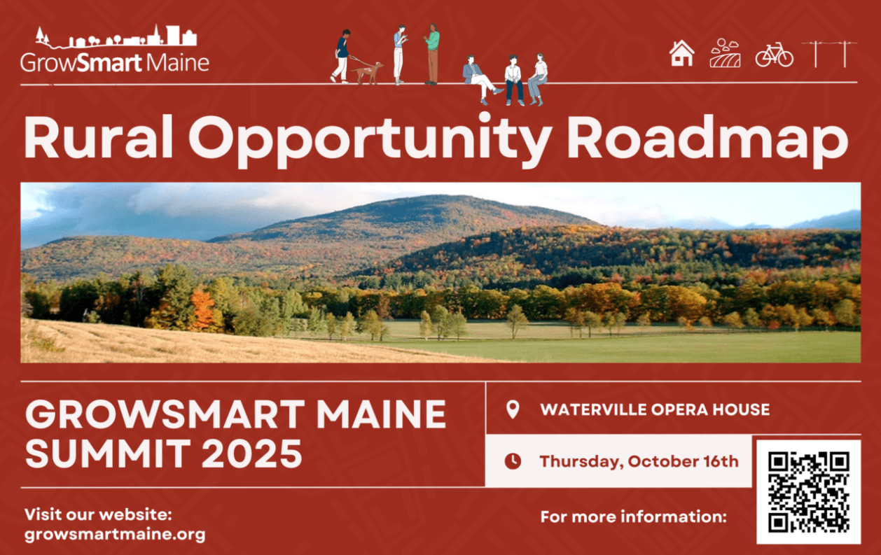
Notes:
Maine’s rural communities are defined by local heritage and spirit, and impacted, for better or worse, by the intersections of Federal, state, local policies and investments. This summit will delve into how Maine’s rural communities can navigate the complex interplay of federal, state, and local policies and investments to build resilient and prosperous futures, while preserving their distinct sense of place.
How do we navigate change?

Slide 7
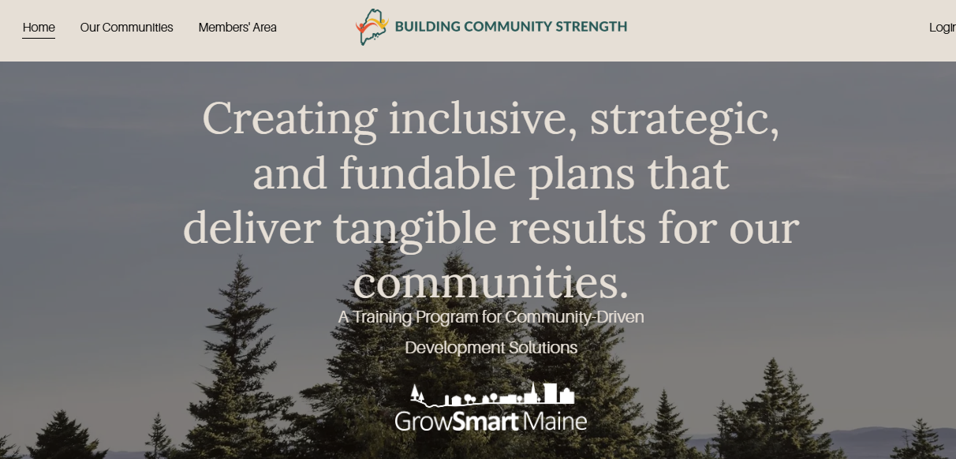
Notes:
Building Community Strength is a 3-year training program providing technical and financial assistance to ten rural communities across Maine ready to navigate these and related questions.
Six training modules are delivered through three platforms.
Planning 101
Housing Options for a Well-Rounded Community
Farm Viability and Farmland Protection
Economic Development
Community Resilience
Funding Research and Grant-Writing
Building relationships
Incremental successes: $5K grants to launch
Staying connected when 3-years is done
5-minute speed dating with resource orgs and congressional offices

Slide 8
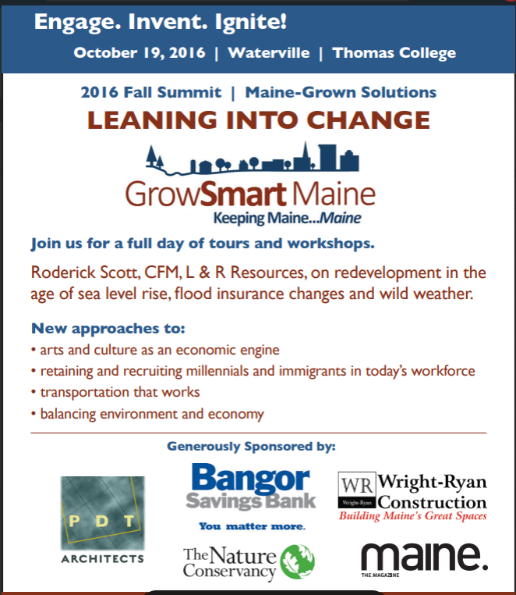
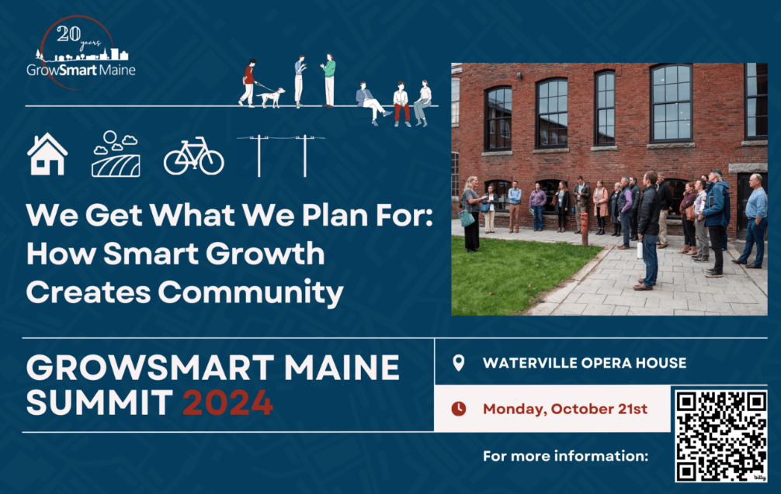

Notes:
How we think about infrastructure investments
Advocacy to:
Empower Public Transit Advisory Commission to make tangible recommendations to MaineDOT
Challenge the MaineDOT and Turnpike Authority in their singular focus on roads and bridges.
Policy Action 2025 Outcomes

Slide 9
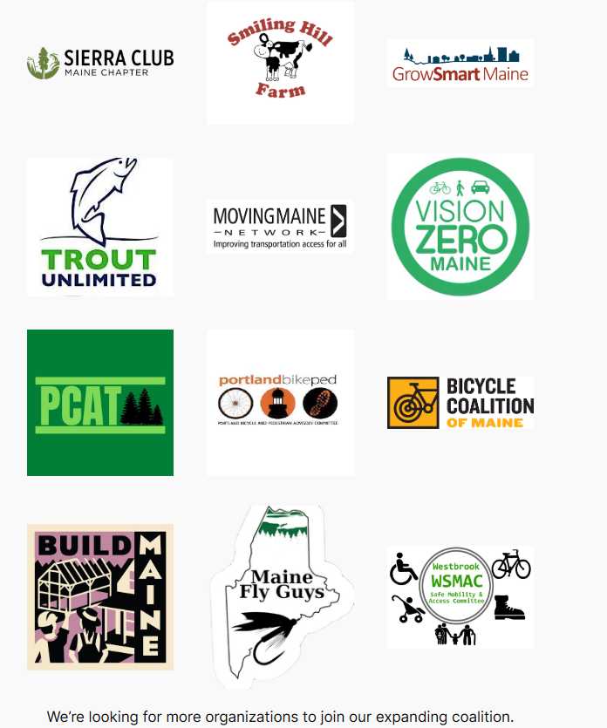
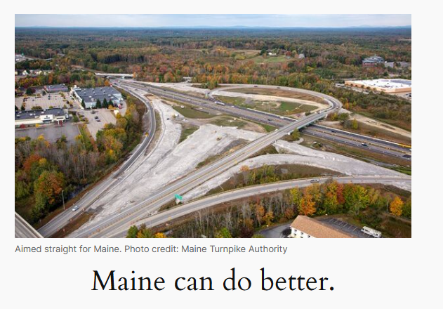
Mainers for Smarter Transportation
Notes:
Coalition with partners listed, but truly grassroots with people from Portland and the suburbs to the west, where a $330M four mile highway extension is currently in the “zombie project” status, as they suspend planning, sort of, while they wait or us to go away.
Tools: media, advocacy, community engagement led by community members that got the project stopped…for now.
Important perspective from Smart Growth America/Transportation for America as a key partner.

Slide 10
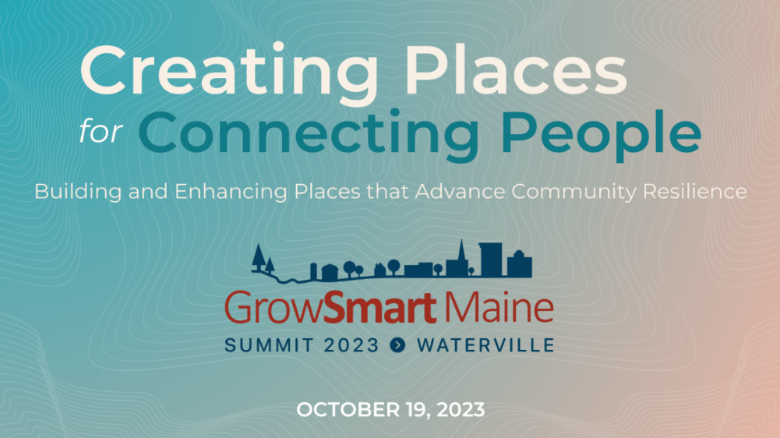
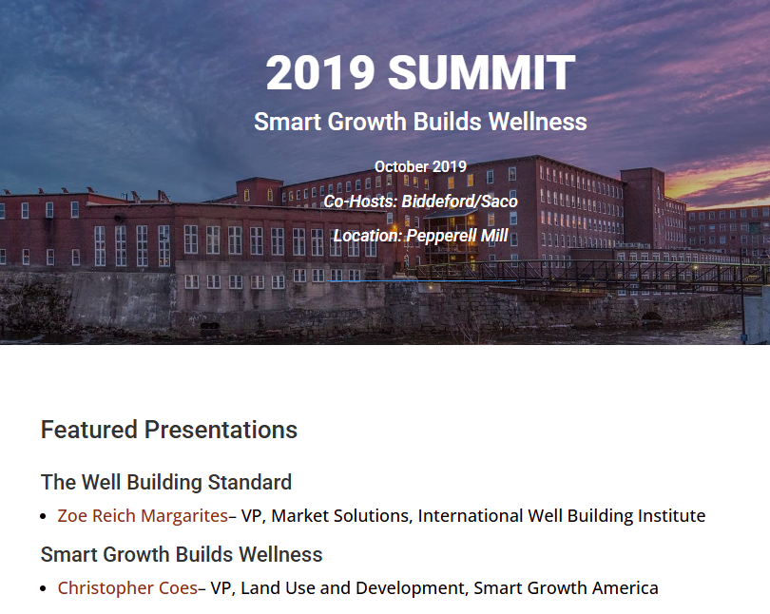

Notes:
We all need connection to other people. The recent public health crisis and our growing divisiveness have made it harder to support and maintain these connections.
But it is possible to create buildings, communities, and transportation systems that make connections easier.
Community Plates in the news: Connections through storytelling and food; and stories about our favorite foods
https://www.nbcnews.com/video/good-news-strangers-share-food-stories-with-potluck-suppers-in-rural-maine-245172293741
The personal wellness value of 3rd places is a foundational value of smart growth.

Slide 11
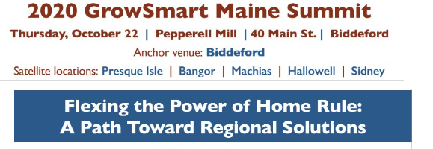
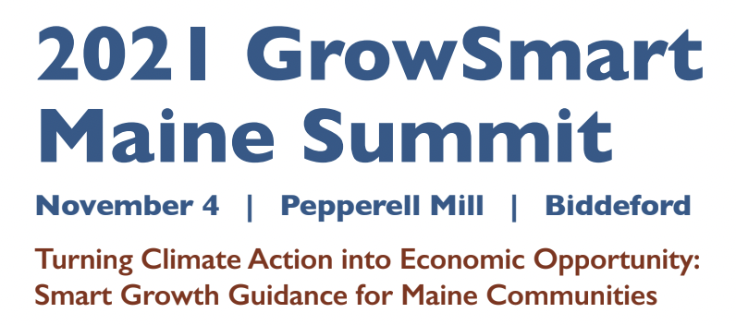
Notes:
Value of Home Rule self-determination vs. efficiency of statewide regulation….regional solutions
While local government can be described as a nimble testing ground for new concepts and
tools, there is often value and efficiency in regional and statewide approaches.
Home rule isn’t going away, nor should it.
Can we adapt this New England tradition for the coming decades?
Integrating layers of plans: municipal and regional comp plans, statewide plans for economic development, housing, climate resilience, national plans… Community trust is the foundation for moving them forward. This is again, relationships, and people.

Slide 12


IT’S ALWAYS ABOUT MONEY
Image:
Notes:
Fiscal and Financial implications of smart growth: for Municipalities and households.

Slide 13
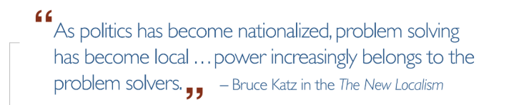

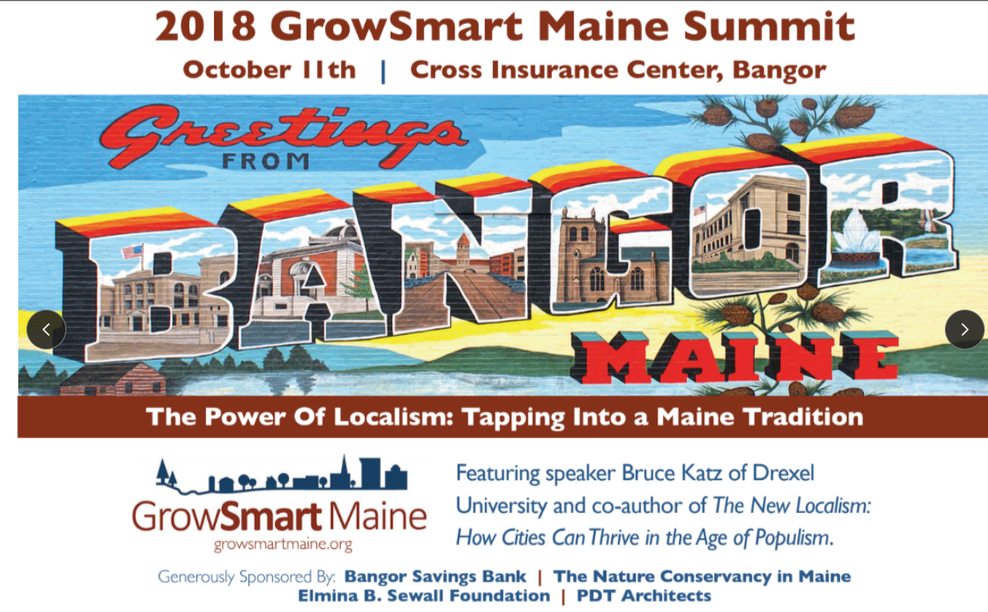
Notes:
Recent webinar: HOUSING & THE LOCAL PROPERTY TAX STRUGGLE: WHY BAD LAND USE POLICY EQUALS BAD MUNICIPAL FINANCIAL POLICY
Crumbling infrastructure, budget deficits, deferred maintenance, strained budget negotiations… These are symptoms of a chronic lack of funding that comes to a head annually during the municipal budget process. Breaking the cycle requires a fundamental rethink of the relationship between infrastructure, finance, land use – and housing plays a role.
Learn about the ‘whole-life’ cycle municipal budgeting model. When applied systemically, this alternative approach provides a platform for municipal budgeting that is based on a land use pattern that strengthens rather than erodes the tax base, positioning Maine communities for greater financial and land use security.

Slide 14

EXCEPT WHEN IT’S ABOUT RELATIONSHIPS
Notes:
We are human
To accomplish just about anything, you need partners.

Slide 15
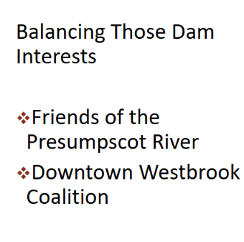
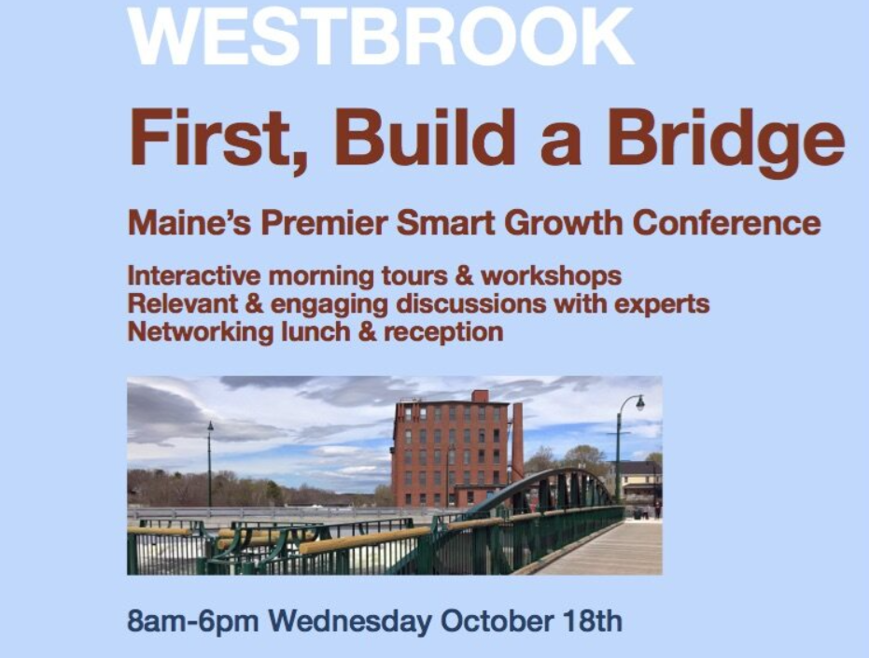
Notes:
Learning when and how to have difficult conversations
Be Kind and Direct.
Develop and nurture trusted relationships
Maine Alliance for Smart Growth is a network brought together by GrowSmart Maine with a proven interest in smart growth: supporting economically and culturally vital downtowns and the natural areas surrounding them – working farms and forests, open space and waterfronts.
While MASG operates under the idea that “if you’ve seen one rural town, you’ve seen one rural town”, there is value in a network that can share best practices, community updates, and create connections to helpful resources. Ushering in a more equitable, resilient future for Maine means that no community is left behind when it comes to decision-making that creates happier, healthier, more thriving places.
Housing Forward Communities
Goals of the Housing Forward Communities Program
Address housing concerns using terminology and communication strategies that make sense in the local context
Reframe housing as a tool and opportunity to meet broader community goals
Foster an engaged and proactive community with a “Housing Forward” mindset
Increase capacity and local ownership of housing challenges
Create a more welcoming environment for housing developments
Ensure sustained efforts on housing in rural towns in Maine

Slide 16

Notes:
As you build trusted relationships, include media outlets
From the 2019 Summit plenary session:
Judith Meyer, Executive Editor, Sun Media Group

Slide 17
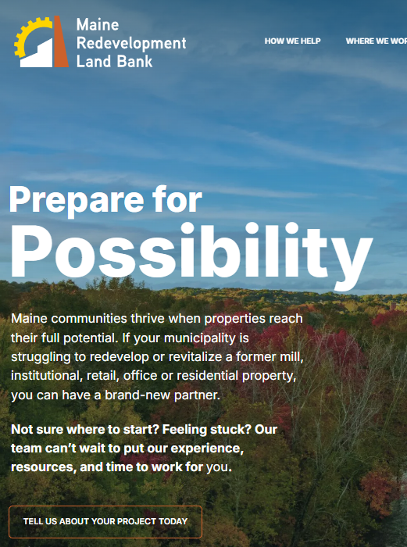
Notes:
Dollars and sense of smart growth
Proper solid waste management is crucial to prevent environmental contamination, protect public health, and promote a sustainable environment by reclaiming valuable resources from waste streams.
MRLBA serves as a centralized land bank for the entire state, collaborating with local governments and community groups to address properties that are:
Abandoned
Blighted
Functionally obsolete
Environmentally hazardous
A key function of the MRLBA is to act as a clearinghouse that helps municipalities overcome barriers to redevelopment, such as complex titles, tax liens, and environmental issues.
MRLBA dedicated nonlapsing fund through a waste handling fee of $5/ton for most items.

Slide 18
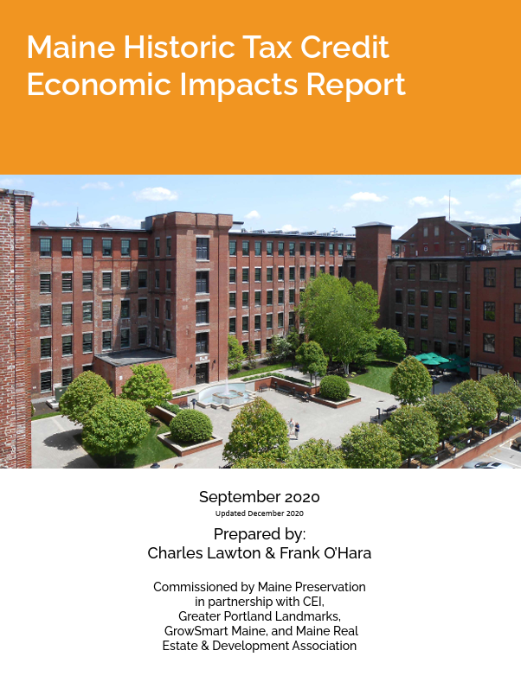
From 2009 to 2019,
106 projects were certified and placed in service in Maine.
• Generated $525 million in construction investment;
• Rehabilitated 3.6 million square feet of commercial and residential space;
• Created or preserved 1,911 housing units, of which nearly 1,300 were affordable;
• Generated 200-700 full-time-equivalent (FTE) jobs through construction spending alone annually for the past decade.
Notes:
Maine Historic Tax Credit Economic Impacts Report
The Maine Historic Tax Credit (HTC) incentivizes business and real estate owners and developers to rehabilitate and reuse income-producing historic buildings in Maine.
The tax credit encourages investment in downtown areas to spur revitalization, and to create affordable housing.
The net result is that a building owner or developer can receive a state tax credit of 25%, or 34% for affordable housing, of the cost of historic improvements for the rehabilitation and reuse of a building that is a “certified historic structure.”
Two changes since this report, passed in 2025:
Reduces the timeline for projects over $5M
Boosts credit for towns of less than 12,500 residents to 35% if one-third or more are residences, 10% boost if certified AH project.
Pending Legislation to include non-commercial (residential) properties (with owner income limit), increase small projects program eligible expenses to $1M, with increased tax credit for affordable housing.

Slide 19
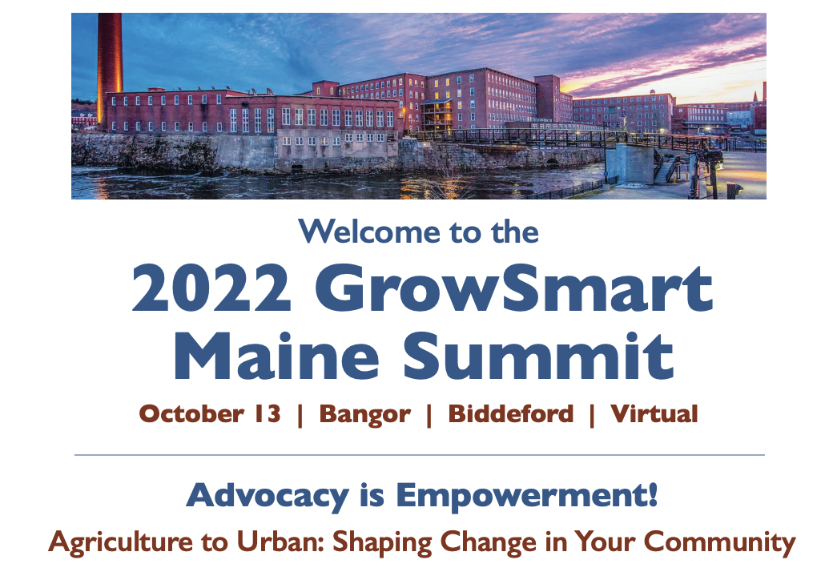
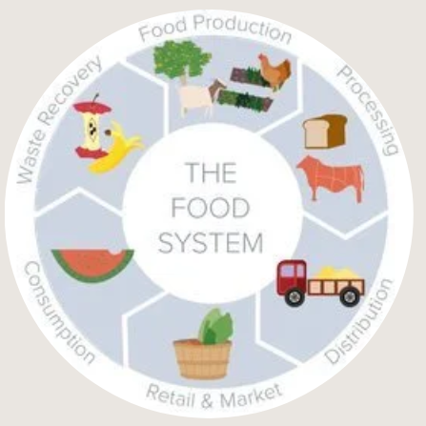
Notes:
FARMING and URBAN areas
John Piotti of American Farmland Trust paired with Mike McGinn of AmericaWalks spoke to the power of advocacy at all levels, for issues in rural, suburban and urban areas.Engaging in local, state, and federal policymaking is essential to your community’s success in navigating change.
Downeast Food Systems Partnership a platform bringing together a broad range of food system stakeholders together to: 1) Identify and build consensus on strategic food system priorities that will have the highest return for the Downeast Food System as a whole; 2) Develop sound project concepts based on those priorities; and 3) Secure investments and capacity to see them implemented.
Voluntary Municipal Farm Support Program
Opt in for both towns and farmers
Property tax exemption on structures including homes as critical farming infrastructure
In exchange for multi-year conservation easement on farmland
Changes in 2025 legislative session: LD 1450
Clarifies the goals for participating municipalities include reduction of fiscal burden that results from new development in rural areas.
Allows the municipal acceptance of farm applications to be by municipal officers, employees or their designees, rather than requiring a majority vote of the municipal legislative body
Shortens the conservation easement from twenty to 10 years

Slide 20
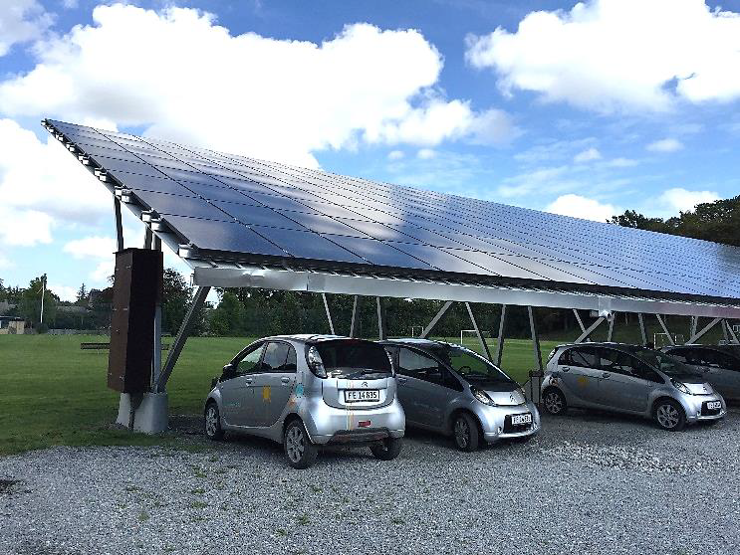
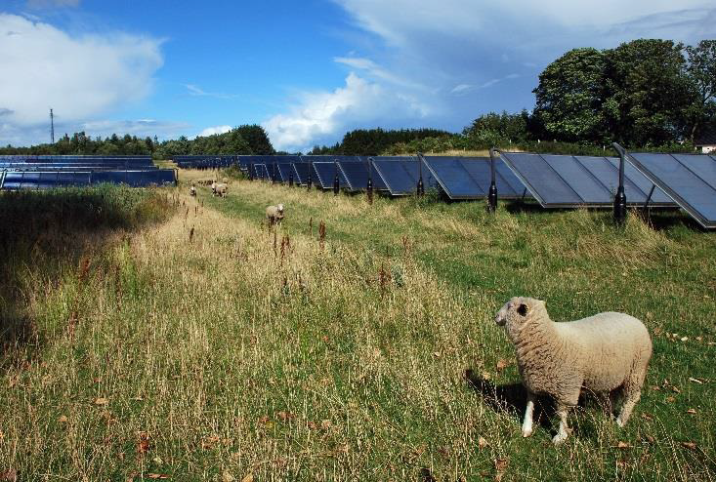
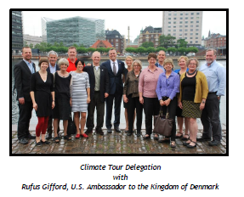
Notes:
Denmark Climate Tour 2015
From the report: Denmark has a Culture of Trust, Cooperation, and Innovation
How can we build trust in Maine?
• The key to building trust and cooperation in Maine lies in taking action at the community level. People know their local leaders and have a say in what local investments move forward.
• Maine lawmakers and citizens are practical people who can find solutions that work.
• A track record of public-private investing is already established in Maine. We can build on that to reduce dependence on imported oil and make Maine communities sustainable.
• Making the business case for sustainability is important. The City of Copenhagen brought in the
London School of Economics to help do this. We could bring in the University, Brookings or other
experts to help make the business case for action.

Slide 21
American and Maine Farmland Trust Guidelines
Protect “prime” and “farmland of statewide importance”
Use disturbed farm property
Dual-use, Integrate Farming
  (note those Danish sheep)
Preserve future use of farmland after decommissioning
Minimize grid connection damage to land
Provide power directly to farm
Promote Equity and Farm Viability
American Farmland Trust
Farms Under Threat 2040
Notes:
AFT Farms Under Threat 2040:
American Farmland Trust, in partnership with Conservation Science Partners and the Center for Sustainability and the Global Environment at the University of Wisconsin, Madison, projected how development and climate change will affect agricultural land under several different future scenarios. We mapped three contrasting development scenarios from 2016 to 2040, representing broad policy pathways that the country might take. These are:
Business As Usual: historical trends of low-density sprawl; farms are lost and fragmented
Runaway Sprawl: inefficient siting of new development; few farms remain near cities
Better Built Cities: Choose efficient growth patterns, denser and more liveable, more farms remain.
Explore the accompanying web mapping tool, designed to help Americans explore alternatives in development choices.
The benefits of well-planned solar siting policies are wide-ranging:
• Reduced competition between renewable energy generation and agricultural production.
• Cultivation of social and political acceptance of solar development.
• Protection of current and future agricultural land uses.
• Preservation of prime agricultural land and other important farmland.
• Economic growth for both the agricultural and solar sectors.
• Regulatory clarity for both farmers and solar developers.
• Improved permitting efficiency and reduced administrative costs.
• Accelerated deployment of renewable energy to reach clean energy goals.

Slide 22
Maine Audubon Guidelines
Target disturbed, degraded lands
Minimize impacts to sensitive wildlife habitats and high value natural resources
Maintain intact forest landscapes and wildlife corridors
Use wildlife-friendly fencing
Protect water quality; avoid erosion
When restoring site, maintain and restore native vegetation
Notes:
The benefits of well-planned solar siting policies are wide-ranging:
• Reduced competition between renewable energy generation and agricultural production.
• Cultivation of social and political acceptance of solar development.
• Protection of current and future agricultural land uses.
• Preservation of prime agricultural land and other important farmland.
• Economic growth for both the agricultural and solar sectors.
• Regulatory clarity for both farmers and solar developers.
• Improved permitting efficiency and reduced administrative costs.
• Accelerated deployment of renewable energy to reach clean energy goals.
RESOURCES:
GrowSmart Maine Municipal Tools for Solar Siting
Maine Best Solar Practices
Maine Audubon Model Solar Ordinance
MFT Balancing solar Development and Farmland Protection: A Solar Siting Guide for Maine Towns.
AFT Solar Modeling Reports
American Farmland Trust Recommendations State and Local Government To Advance Smart Solar Policy
American Farmland Trust NH Conversion of Ag Lands
American Farmland Trust NH Policy Scorecard Summary

Slide 23
Smart Growth Matters
“It’s All Connected”
Notes:
Links to Relevant Resources

