Slide 1
Energy Efficient Design Incentives
Matt O’Keefe, Unitil

Slide 2
What is NHSaves?
NHSaves is a collaboration of New Hampshire’s electric and natural gas utilities working together to provide NH customers with information, incentives, and support designed to save energy, reduce costs, and protect our environment statewide.

Slide 3
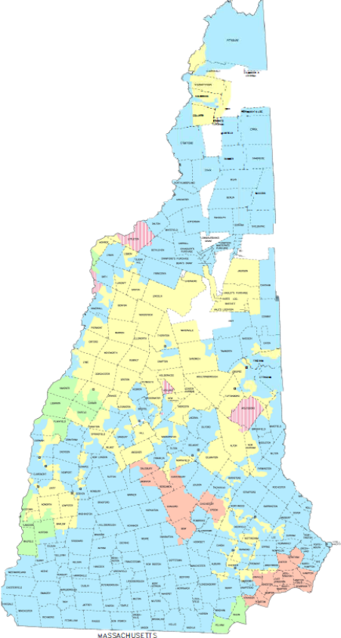
Electrical Territory Map
Eversource
Liberty Utilities
New Hampshire Electric Co-op
Unitil

Slide 4
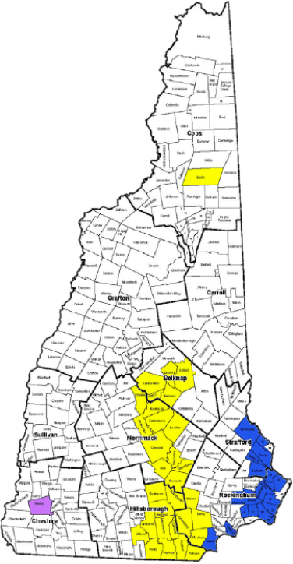
Gas Territory Map
Liberty Utilities
Unitil

Slide 5
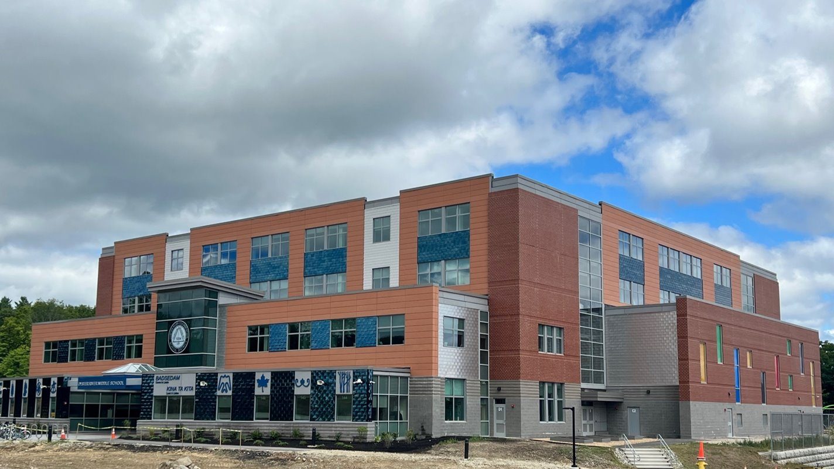


2025 New Building Major Renovation Participation Pathways
Net Zero & Low EUI Buildings | High Performance Buildings | Prescriptive Systems Projects

Slide 6
When Should Customers/Design Teams Reach Out?
Feasibility/Conceptual
Early in Design Process
Schematic Design (SD)
Design Development (DD)
Construction Document (CD)
Construction Bid
Construction

Slide 7

Path1: Zero Net Energy & Low EUI Buildings
Intent
Drive projects toward ZNE and low EUI in operation
Requirements
Engage utility ideally during the project’s feasibility or conceptual design phases but before 50% Schematic Design
ZNE, Zero Net Ready
Minimum 10,000 sf heated and cooled space
Achieve Target EUI or lower
Year-round occupancy

Slide 8
Zero Net Energy & Low EUI Buildings
Post Occupancy
Participation required through 1 year post-occupancy period
Final incentives based on performance
Technical Assistance
ZNE expert provided – participates from feasibility through design development
Incentives
Pre-approval at end of design based on design team’s model
Construction incentives: paid at end of construction
Post-occupancy incentives: paid after post-occupancy period

Slide 9
Zero Net Energy & Low EUI Buildings
EUI by Building Type
Building Type | Net Zero Site EUI Target
Hotel | 35
K-12 | 25
Library | 30
Office | 30
Fire/Police Station | 35
Site Specific | Case by case
Engage Early – During Concept, Feasibility or early Schematic Design is best

Slide 10
Zero Net Energy & Low EUI Buildings
Customer Incentives
Construction Incentive | Paid if project design achieves target EUI | $1.50/sf
Post Occupancy Incentive | Available after 1-year post-occupancy period if project achieves target EUI | $1.00/sf
Technical Assistance | Cost share with customer | up to $10,000
Please note: All incentives are subject to funding availability. Certain caps and restrictions may apply.

Slide 11

Monitor EUI Post Construction – Do Not Wait to Get Started
Building Occupancy (Sept. 2023)
First 12 Months of Operation
EUI = 45
EUI Verification Scope Begins
December 2024
Recommendations Implemented
Operating at 36 EUI
June 2025
Expected to be operating at 25 EUI
by Fall/Winter 2025
EUI
Building operating below 25 EUI
April 2024
Target EUI = 25
Operating at 23 EUI
June 2025
Building Occupancy (Feb. 2024)
EUI Verification Scope Begins
0 1 2 3 4 5 6 7 8 9 10 11 12 13 14 15 16 17 18 19 20 21 22 23 24 25 26 27 28 29
Months after Building Occupancy
Target (25 EUI)
School A (EUI)
School B (EUI)

Slide 12
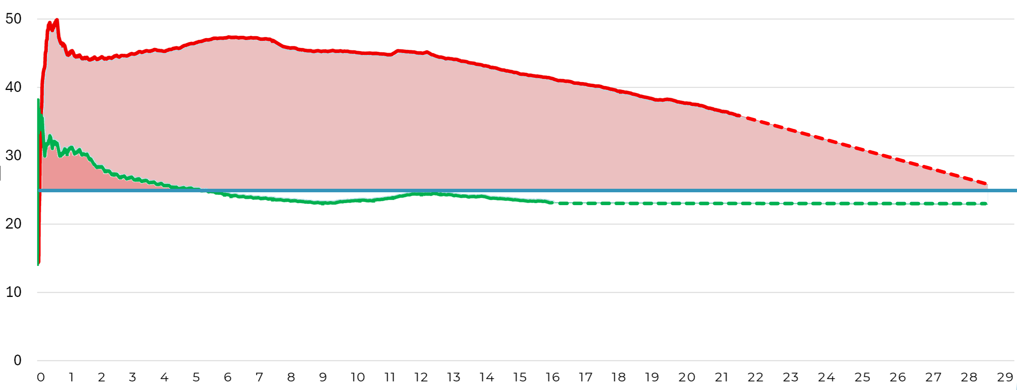
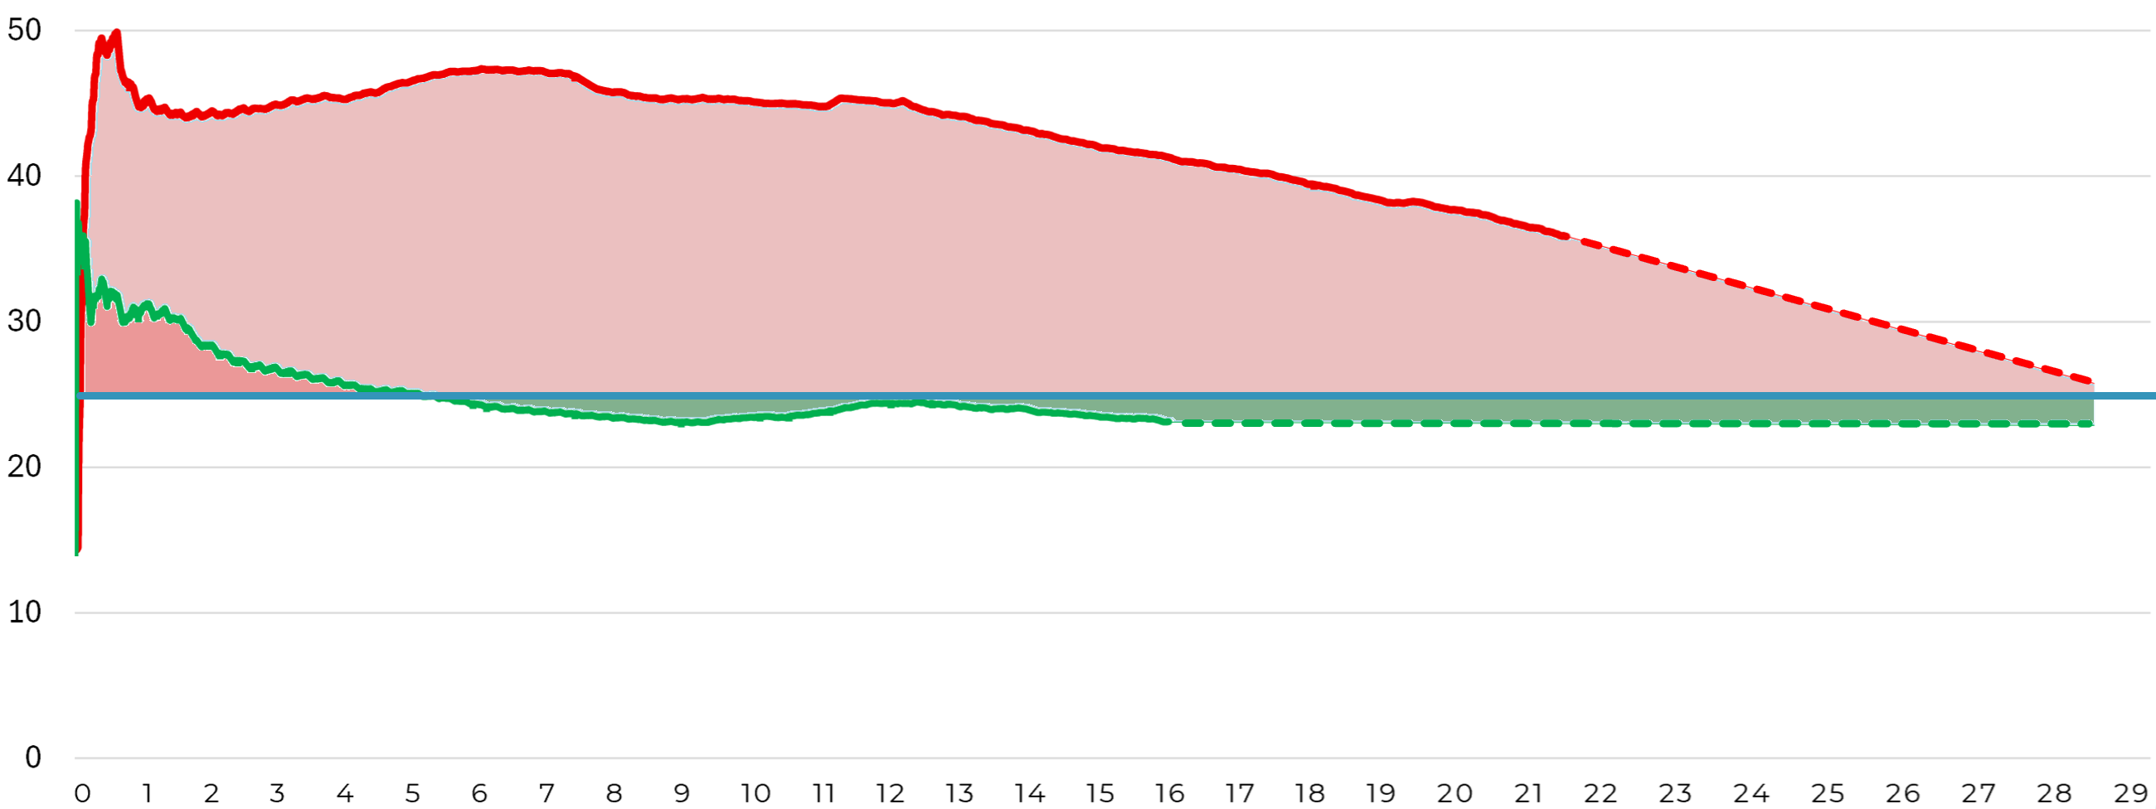
Monitor EUI Post Construction – Do Not Wait to Get Started
Building Occupancy (Sept. 2023)
First 12 Months of Operation
EUI = 45
EUI Verification Scope Begins
December 2024
Recommendations Implemented
Operating at 36 EUI
June 2025
Expected to be operating at 25 EUI
by Fall/Winter 2025
Cumulative Overspend = $21,000
Cumulative Overspend = $150,000
EUI
Building operating below 25 EUI
April 2024
Target EUI = 25
Cumulative Underspend = $37,000
Operating at 23 EUI
June 2025
Building Occupancy (Feb. 2024)
EUI Verification Scope Begins
Months after Building Occupancy
Target (25 EUI)
School A (EUI)
School B (EUI)

Slide 13
Example – Oyster River Middle School
Engaged Schematic Design
Target site EUI:
Design Charrette & energy modeling
147,000 Square feet
Geothermal heating/cooling
Walls R-34, Roof R-60

Slide 14
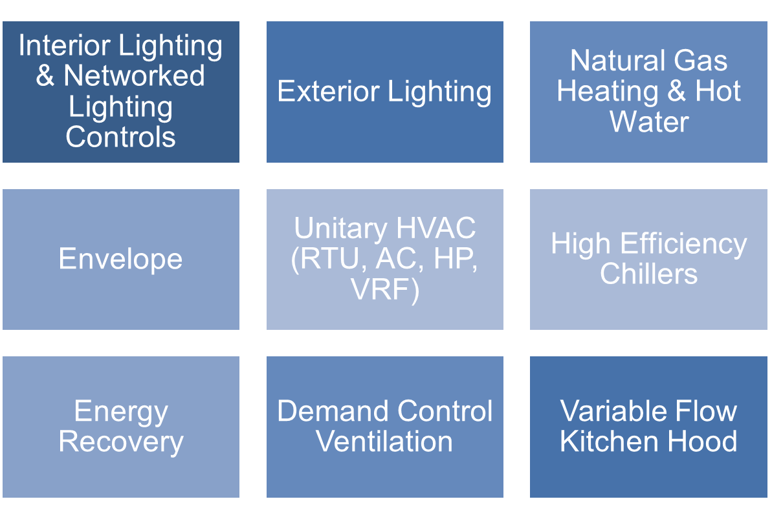

Path 2: High-Performance Buildings

Slide 15
High-Performance Buildings
Customer Incentives
Incentive Type | Rate
Electric | $0.40/kWh
Natural Gas | $2.00 therm
Technical Assistance | 100%
Please note: All incentives are subject to funding availability. Certain caps and restrictions may apply.

Slide 16
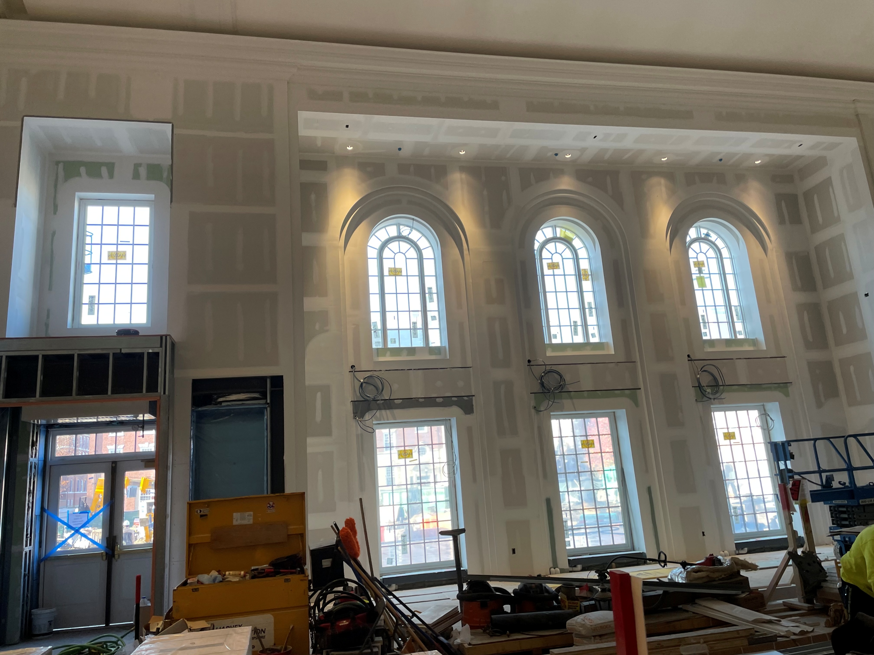
Example – Phillips Exeter Academy
Combined Dining Hall & Dormitory
Design Savings over Energy Code
DD Review; Modeled per CD set
80,000 Square feet
District Geothermal heating/cooling
ERU w/VAV; VRF serving offices

Slide 17
Path 3: Systems Pathway/Prescriptive Systems
Intent
Projects in advanced design or smaller size
Optimize equipment and systems for energy efficiency.
Requirements
Whole buildings projects if they engage Sponsors after the end of design development (late engagement)
Partial building projects
Technical Assistance
Case by case for custom measures
Incentives
Prescriptive and custom applications
Incentives paid upon construction verification

Slide 18
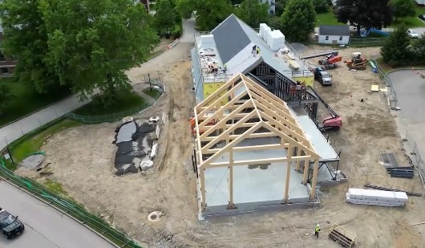
Example – St Paul’s School
Brand New Admissions Bldg
Design Savings over Energy Code
Modeled per CD set
16,000 Square feet
Prescriptive Incentives: HVAC/DHW
Custom Incentives: Envelope/Lighting

Slide 19
Michael Loughlin, Eversource
Eric Sandberg, NHEC
Michael.Loughlin@eversource.com
sandberge@NHEC.com
603-634-2022
603-536-8307
Bob Reals, Liberty
Matt O’Keefe, Unitil
Bob.Reals@libertyutilities.com
okeefe@unitil.com
603-216-3634
603-294-5116

Slide 20
Questions?

