Slide 1

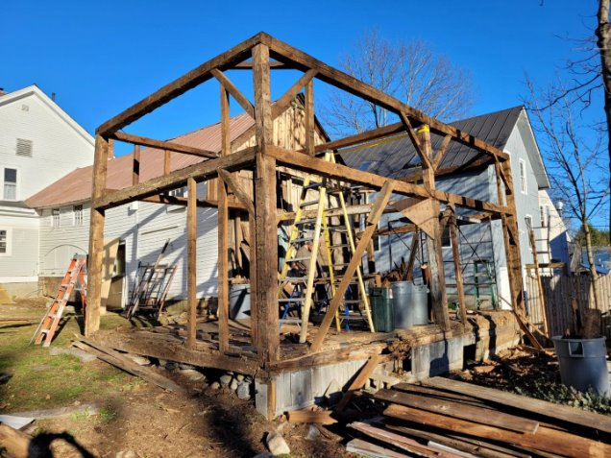
Deconstructing Deconstruction
Plan NH: Built to Last
September 17, 2025
Notes:
Good morning everyone.
Thank you to Anna and Amanda for inviting me to speak today and thank you all for being here to listen!
I love working in NH and am thrilled to be part of the conversation today.
My name is Emma Sabella and I am a WRC.
In a nutshell, I work with businesses to help them implement or develop waste reduction programs such as food donation, composting, and recycling.
Today I am going to talk mostly about our free services for construction material reuse and recycling.
I continue to learn from contractors on which recycling and deconstruction practices work best in the field and I have learned that we are not trying to reinvent the wheel, but rather, document and share methods and successes which is what I will do here today!
I will touch on CET's other waste reduction services briefly at the end of my presentation.

Slide 2
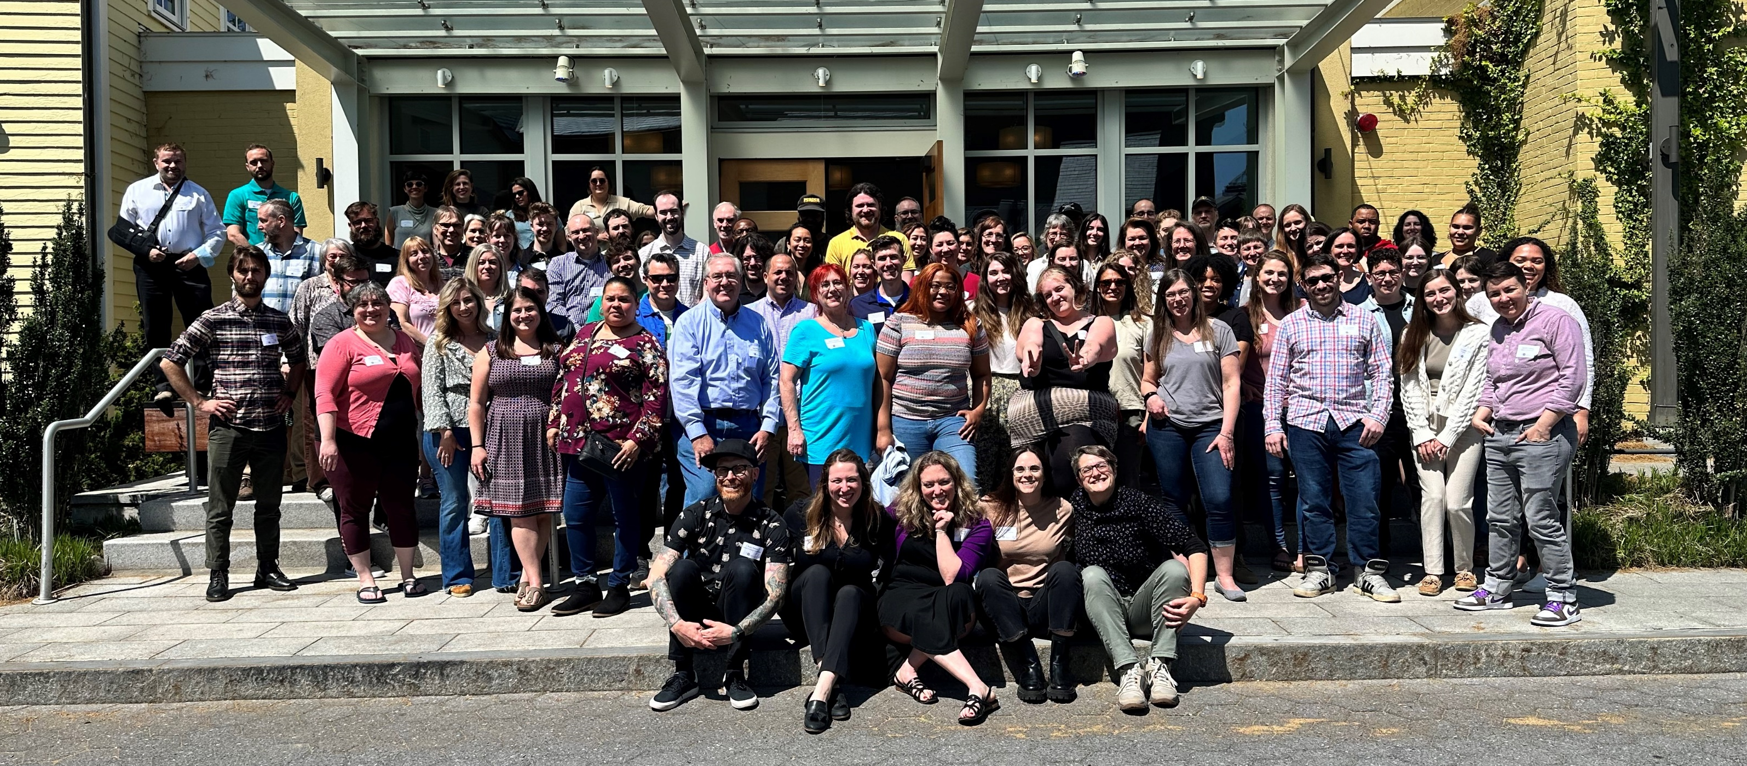

Our mission is to innovate, implement, and scale the environmental solutions that communities need to thrive.
Notes:
CET is a 50-year-old environmental non-profit that helps people and business save energy and reduce waste.
As I mentioned this presentation and my work at CET is on the waste side.
And here are all the brilliant people I get to work with everyday.
​

Slide 3















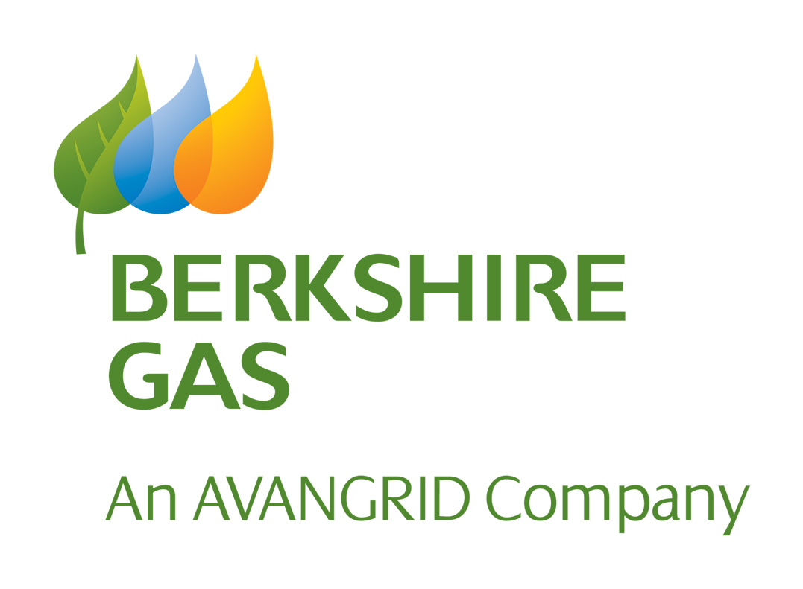

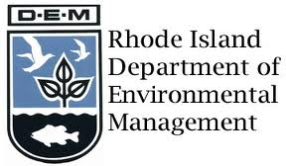
























CET Partners
Notes:
All our waste reduction services are provided at no cost thanks to federal, state, and private funding.
In New Hampshire, CET has a USDA Rural Utilities Services grant to assist businesses with wasted food as well as building owners, contractors, and architects with construction projects.
This grant is specifically for Rural Areas of NH which luckily covers most of the state.

Slide 4

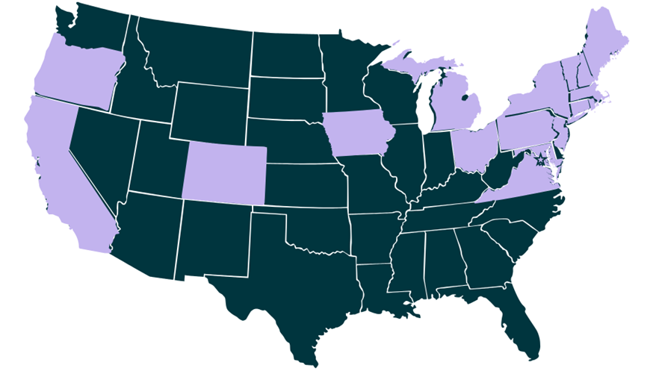
CET's Service Area
Construction Material Reuse and Recycling in:
CT, MA, & NH
Wasted Food Reduction in:
16 States and growing
70,000 tons of CO2 emissions avoided since 2013
Notes:
We provide construction material reuse and recycling consulting services in CT, MA & NH and we provide wasted food reduction services in 16 states and we are growing.

Slide 5

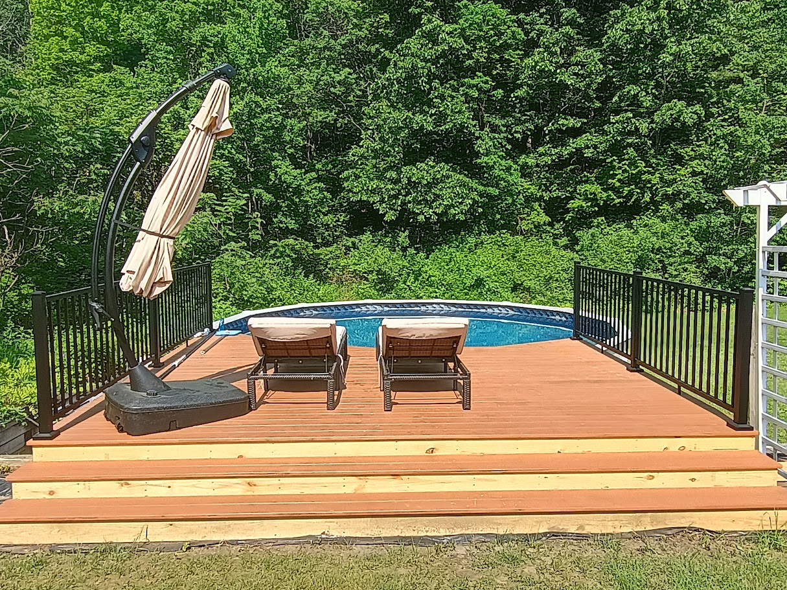


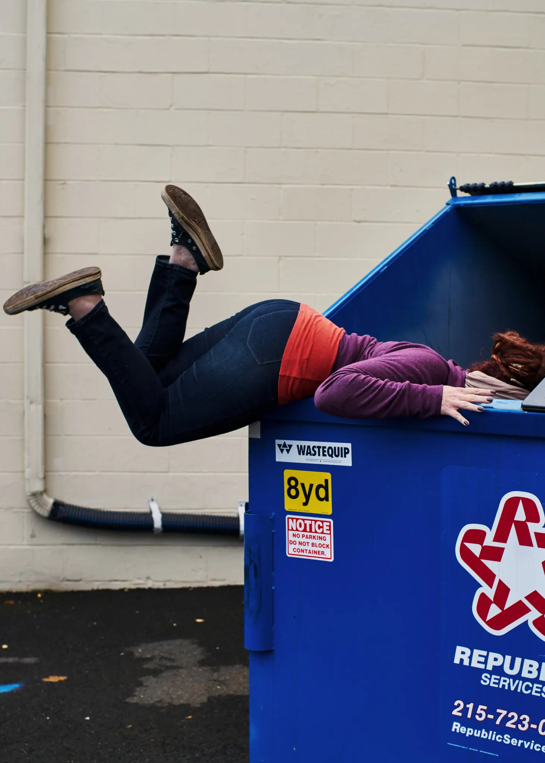
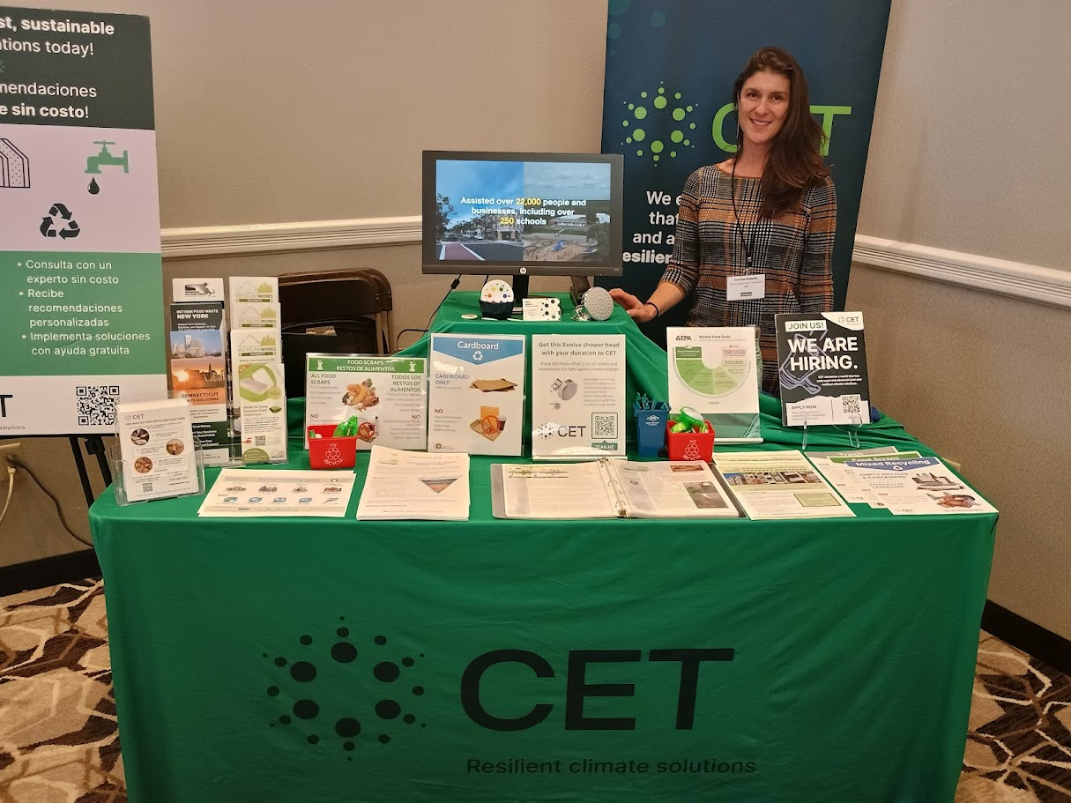
A little about me
Notes:
Before I dive in, I am going to share a little bit about myself and then I have some questions for you all.
I live in Greenfield, MA which is a small town in Western, MA.
Besides working for CET and dumpster diving, I absolutely love to travel.
The top photo is from the W trek in Patagonia which is in Chile and below that I am at a temple in Indonesia.
I also love gardening and swimming and recently got a new pool!
I have worked at CET for just about a decade and have been in the sustainability field for more than 20 years.
I've supported waste reduction at 1000's of businesses across all sectors such K-12 schools, universities, hospitals, manufactures, malls, multi-family and multi-purpose properties, event venues and even federal prisons.
Now I would like to get to know you all better.
So, with a show of hands, who here works only in NH?
Who here works in neighboring states?
Who here works in all of New England?
Anyone nation-wide?
Any sustainably folks in the room?
Last question - Does anyone addresses waste management in your line of work?
Thank you for answering my questions.
After this presentation, I truly hope you will be inspired to give a little more thought into diverting waste from the landfill and I challenge you to think about how this might fit into your business models.
OK, I only have 20 minutes, so let's get into it!

Slide 6
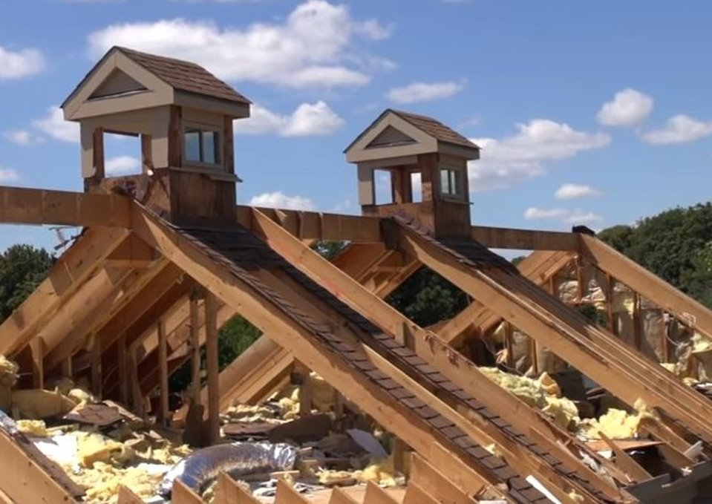
Defining Deconstruction
Demolition
“Unbuilding”
Construction & Demolition (C&D)
For more information: NHDES C&D Debris Blog
Notes:
Before I talk about deconstruction, let’s address demolition.
The historically common style for renovating or taking down a building is demolishing it.
Demolition involves tearing down a structure, putting its contents into dumpsters, and hauling it away.
From there it usually goes to a C&D processing facility, where some of the materials might be sorted out and recycled, but it is unlikely that anything will separated out for reuse.
In standard demolition projects, the legacy of the items inside of a building and the structural elements are lost.
Deconstruction is typically defined as “the unbuilding of a building in the way in which it was built.” With deconstruction, the materials can be salvaged and used onsite for the new project or taken off site to be donated or recycled.
Construction and Demolition is also known as C&D for short which I will use going forward.

Slide 7
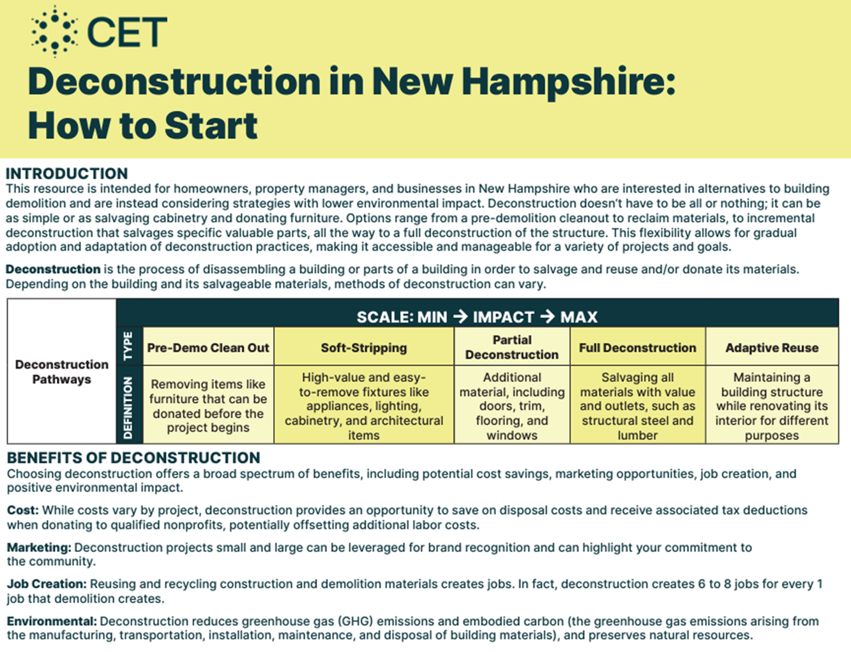
Notes:
Pictured here is a Guidance Document on how to implement a C&D material reuse and recycling plan into projects.
If anyone is interested in any of the resources I share today, I have a rack cards with a QR code to CET's NH page which hosts several resources.
Deconstruction is scalable, as you can see on the chart above.
We encourage people to start with the low hanging fruit and gradually scale up.
There are many benefits to C&D material reuse and recycling such as avoided disposal costs (because dumpsters are expensive!), tax incentives for donating materials, and of course it's good for the environment and community.
​
​

Slide 8
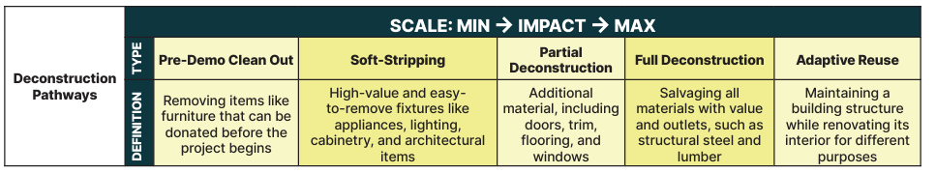
Deconstruction is scalable
Notes:
Although it is not yet common practice to completely unbuild a building, many projects can include one or more of the following:
Predemo cleanout – which is taking the loose items like furniture and office supplies that can be donated before the project begins (saves on disposal)
Soft strip high value or easy to remove materials like appliances, lighting, cabinetry and other valuable architectural items
Partial deconstruction – includes removing doors, trim, flooring and windows
Full deconstruction is salvaging all materials (of value) structural lumber, steel, and flooring,.
Adaptive reuse is maintaining the structure of a building while renovating the interior for a different purpose. I will share an example of this in a few slides.
In short “the greenest building is the one that already exists.”

Slide 9
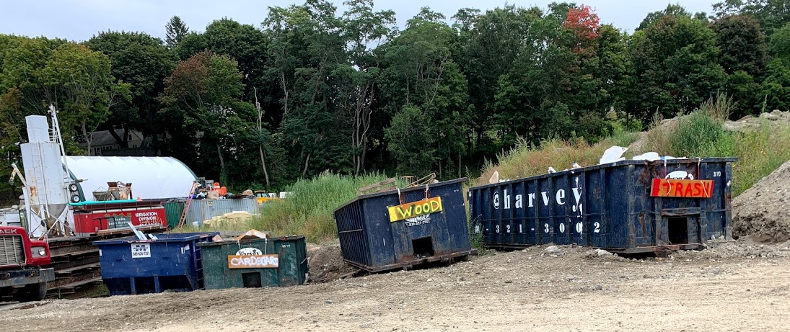
C&D Recycling and Source Separation
Notes:
After salvaging materials for reuse, we address materials that are not fit for reuse, but that can be diverted from the landfill for recycling.
C&D materials all mixed together in one dumpsters are challenging for recyclers to process.
We work with project managers to collect materials separately in designated dumpsters, which is known as source separation.
By source-separating materials, you can increase the overall recycling rate of the project. ​
Some haulers have said they will provide a discounted rate for collection, if materials such as carboard, bricks, gypsum wallboard, metal, and wood are separated into designated dumpsters.​
At the project shown in this photo, there were designated dumpsters for metal, cardboard, wood, and trash.
​

Slide 10
Why Deconstruction?
“The greenest building is the one that already exists.”
Resource conservation
Waste reduction
Cost savings
Historic preservation
Preserve embodied carbon
Community
Notes:
There are many reasons to deconstruct buildings versus demoing them. According to the delta institute up to 70% of materials in a home can be reused.
As I mentioned, deconstruction projects can save on disposal costs and builders can reap the benefits of tax incentives for donating to non-profit reuse outlets. ​
Many contractors we’ve worked with have received recognition for their work salvaging building materials. AND two projects were nominated for a statewide recycling award in MA.​
Of course, there are environmental benefits – capturing materials for someone else to use instead of purchasing brand new conserves resources.
Deconstruction also creates jobs and helps reuse stores offer discounted building materials to their communities! ​

Slide 11
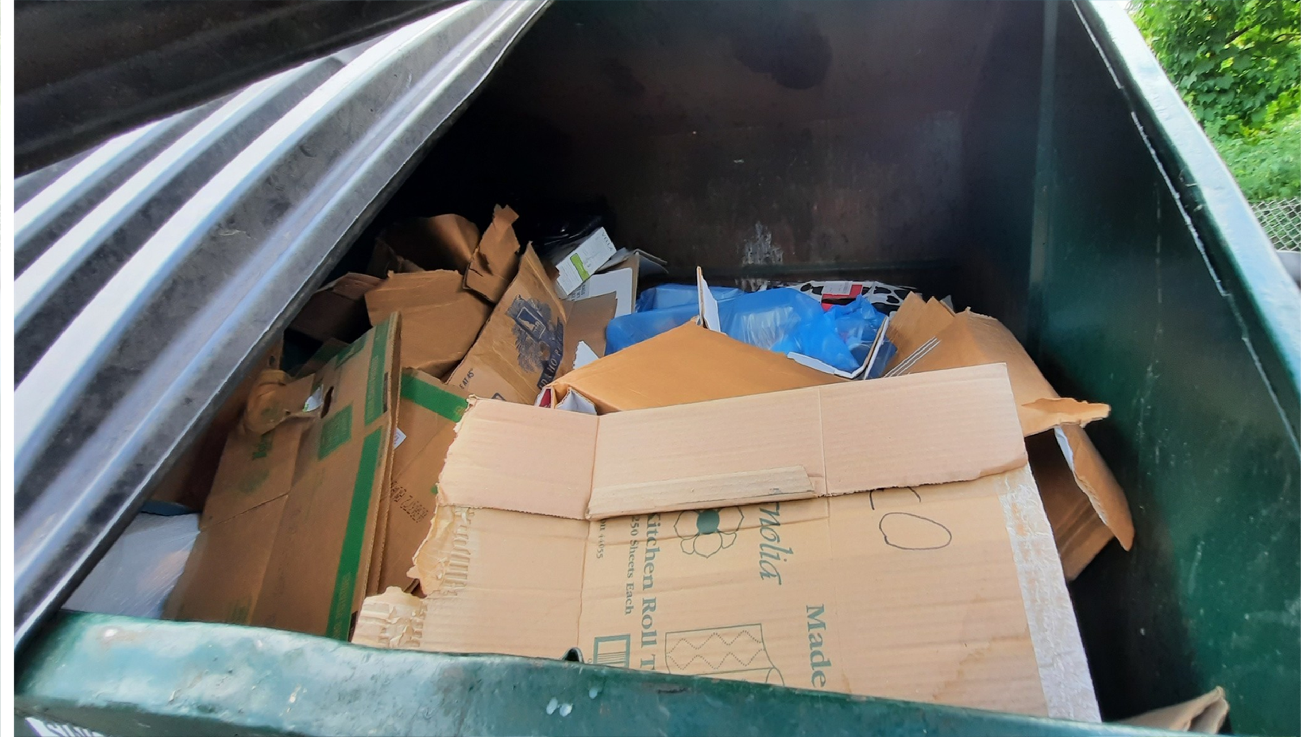
Construction Assistance – Available Now!
Help for contractors, building owners, architects, & homeowners:
Waste Management Plan
Building Specs
Material Reuse Outlets
C&D Recycling
Source Separation
For more info on specific Materials:
Visit our C&D guidance
Notes:
Again, CET can provide deconstruction technical assistance at no cost in rural areas of NH. Some services include:
Waste Management Planning
Building Specification considerations
Available Material Reuse Outlets
And C&D Recycling and Source Separation implementation assistance
Next I will share two success stories of deconstruction projects.

Slide 12
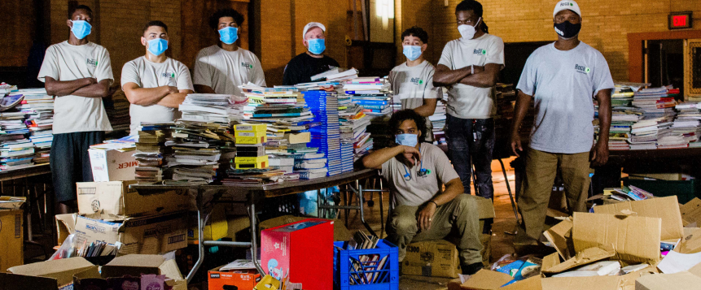
Elias Brookings School
Pre-demolition cleanout
23 tons recycled
10 tons reused
Home City Development, Inc.
Notes:
I want to highlight the Elias Brookings School in Springfield, MA, which was an abandoned school building that was adaptively reused.
Each classroom was renovated into small apartments and the developer (Home City Development) rescued 10 tons of reusable items from the school before pre-demo even began.
CET connected the developer to local reuse outlets to donate cabinets, dry erase boards, interior doors, metal chairs, books, and school supplies.​
Although labor was a bit higher for this project, the developer saved on disposal costs and 23 tons of material was recycled during pre-demo cleanout.
This developer and project was also showcased in the news which was a pretty cool shout out.

Slide 13

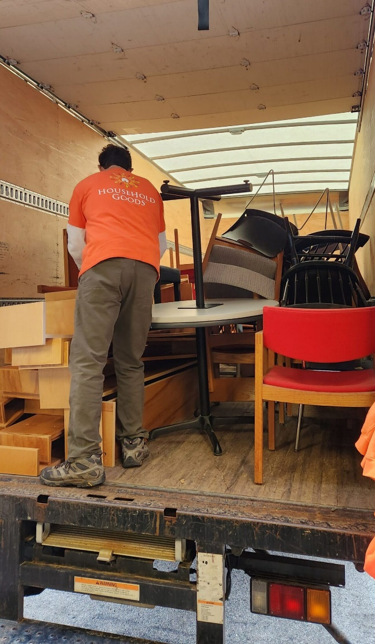
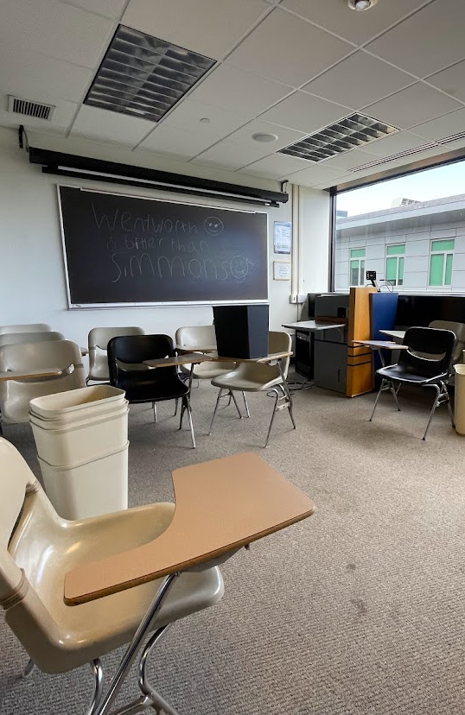
Simmons University
Excellent Timeline
Impressive
Metrics
One year of advanced planning and preparation from Summer 2021 to Spring 2022
12+ tons (24,000lbs) of material salvaged, including furniture, fixtures, and glassware items.
Notes:
This is Simmons university in Boston. Apart from the investment of time and labor, Simmons University incurred zero expenses for any of the project’s reuse solutions.
Some of the organizations that accepted items for reuse included:
Goodwill accepted clothing, shoes, dishware, and office supplies.
Boston Building Resources accepted desks, filing cabinets, and tables.
Household Goods accepted chairs, end tables, bookcases, and kitchen appliances.
With this project more than 12 tons of material was salvaged.
This story is a great example of how advanced planning is really key to the success of material reuse with deconstruction projects.
Best practice is to start planning 12 months in advance, if possible.

Slide 14
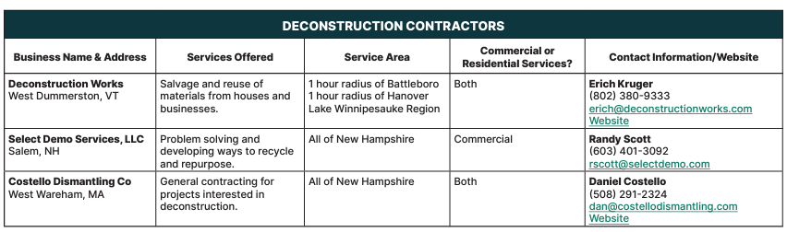
Deconstruction Contractors
Notes:
Here is a list of deconstruction contractors that service NH.

Slide 15
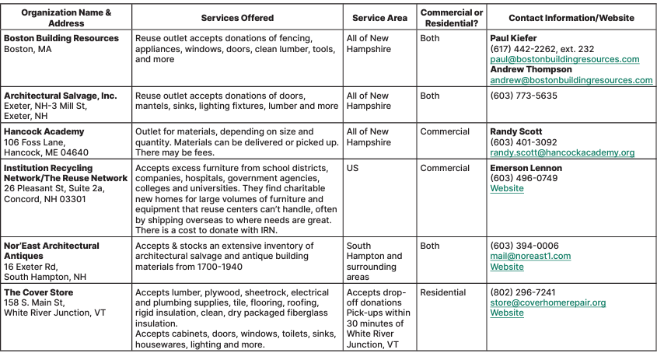
Building Material Reuse Outlets
Notes:
Here is a list of reuse outlets for material donation

Slide 16
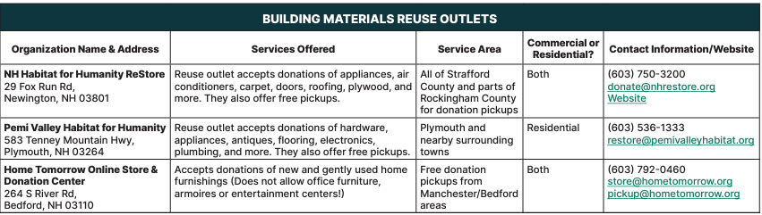
Building Material Reuse Outlets Continued
Notes:
This is the reuse outlet list continued.
And now I am going to pivot to recycling and food waste considerations.

Slide 17
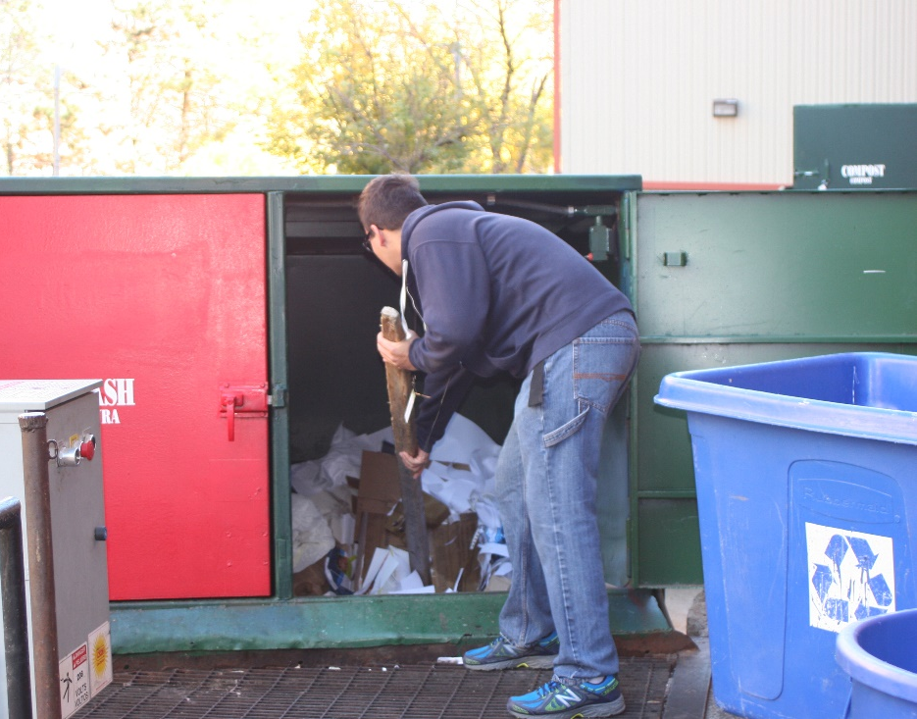
Outdoor Trash, Recycling, & Food Scrap Storage Considerations
Equipment
Space
Placement
Electrical hookup
Notes:
Outdoor storage for trash, recycling, and food scraps considerations should be taken into account in the design and planning stages of a reno or new building and not as an after thought.
Some important decisions need to made about what type of equipment to use such as dumpsters, compactors, or carts.
Will there be a loading doc, a corral, or will containers stand alone.
Where will storage containers be placed?
Is there sufficient room for trucks, and is the location easy to access and maintain snow removal.
And, does the space need a concrete pad, or electrical hook up for compactors.

Slide 18
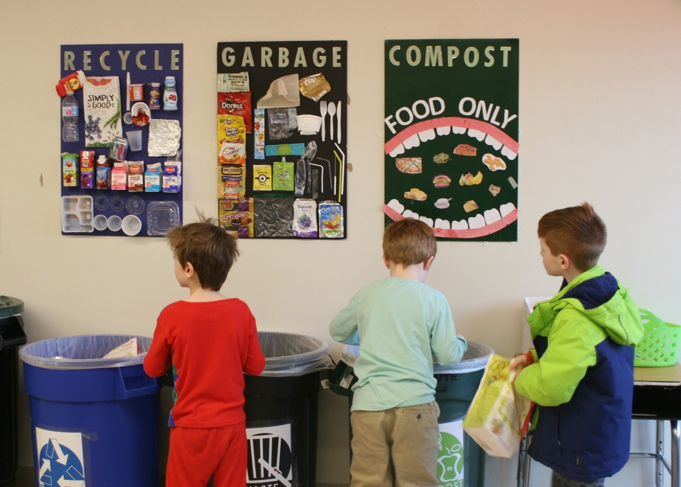
Indoor Trash, Recycling, & Food Scrap Storage Considerations
Space
Equipment
Placement
Notes:
Similar to outdoor considerations, it's important to plan ahead for waste collection indoors.
Here is a photo of a waste sorting station in an elementary school cafeteria.
This school has recycling, trash, and compost with colored bins and signs tailored to students.
Some other considerations include:
The aesthetic or style of the building. Will there be trash rooms, trash shoots, or stand alone bins?
Is there enough space for the number of trash, recycling, and compost bins needed.
And, there should be a clear path for the material to be transported to outdoor collection containers.

Slide 19

Wasted Food Considerations
Wasted Food Tracking
Wasted Food Prevention
Food Purchasing
Surplus Food Donation
Food Scrap Diversion
Notes:
Along with C&D and general recycling services, CET also provides wasted food reduction consulting.
We can’t get into all the details today but areas we address are:
How to track and prevent wasted food
Food purchasing considerations
How to safely donate surplus food
Food Scrap Diversion such as animal feed, composting, or anaerobic digestion

Slide 20
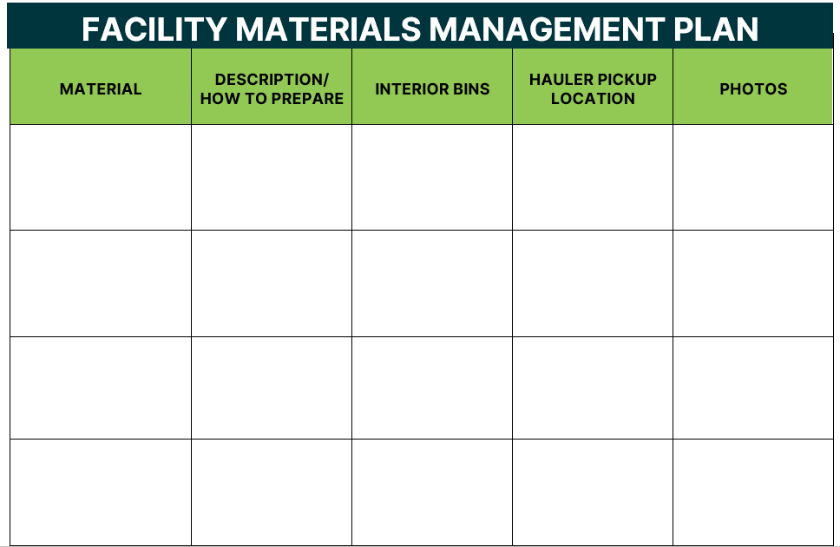
Notes:
Planning is a key step to successfully diverting materials from the landfill.
CET created this template to help communicate how materials are handled in buildings or onsite for projects.
It communicates how materials generated from the project will be handled, and which sub-contractors, haulers, vendors, and onsite staff will be responsible.

Slide 21
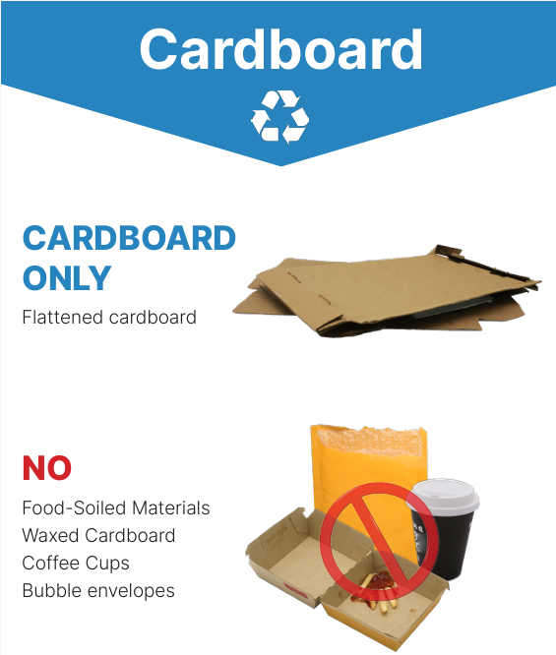
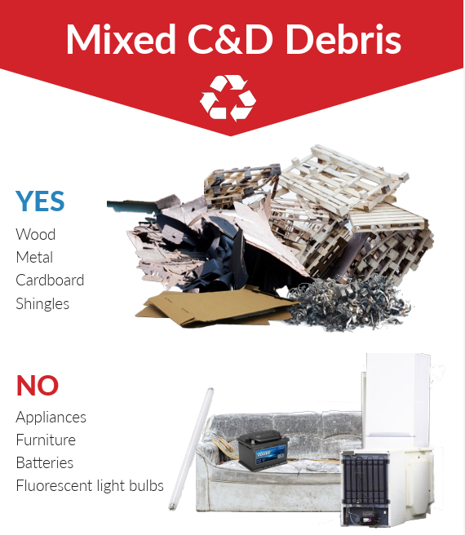
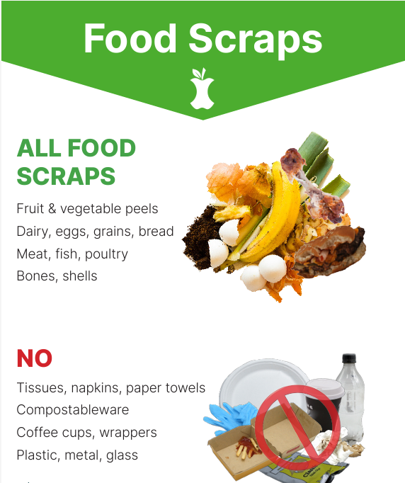
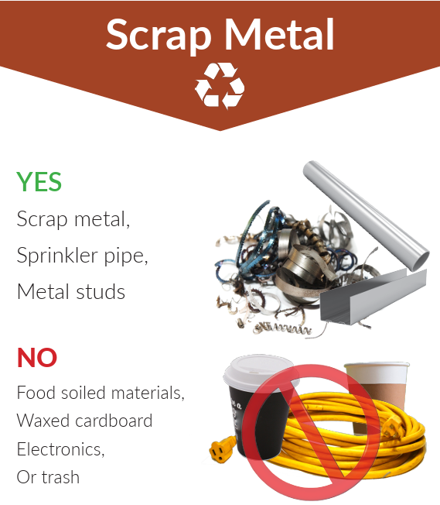
Notes:
Accurate and clear signage is a really important step when implementing any new waste reduction program.
This is an example of CET signage for scrap metal, cardboard, food scraps, and mixed C&D materials.
We can customize signs for different materials streams and translate them to any language.
The hauler you are working with may also be able to provide signs and labels for your containers.

Slide 22
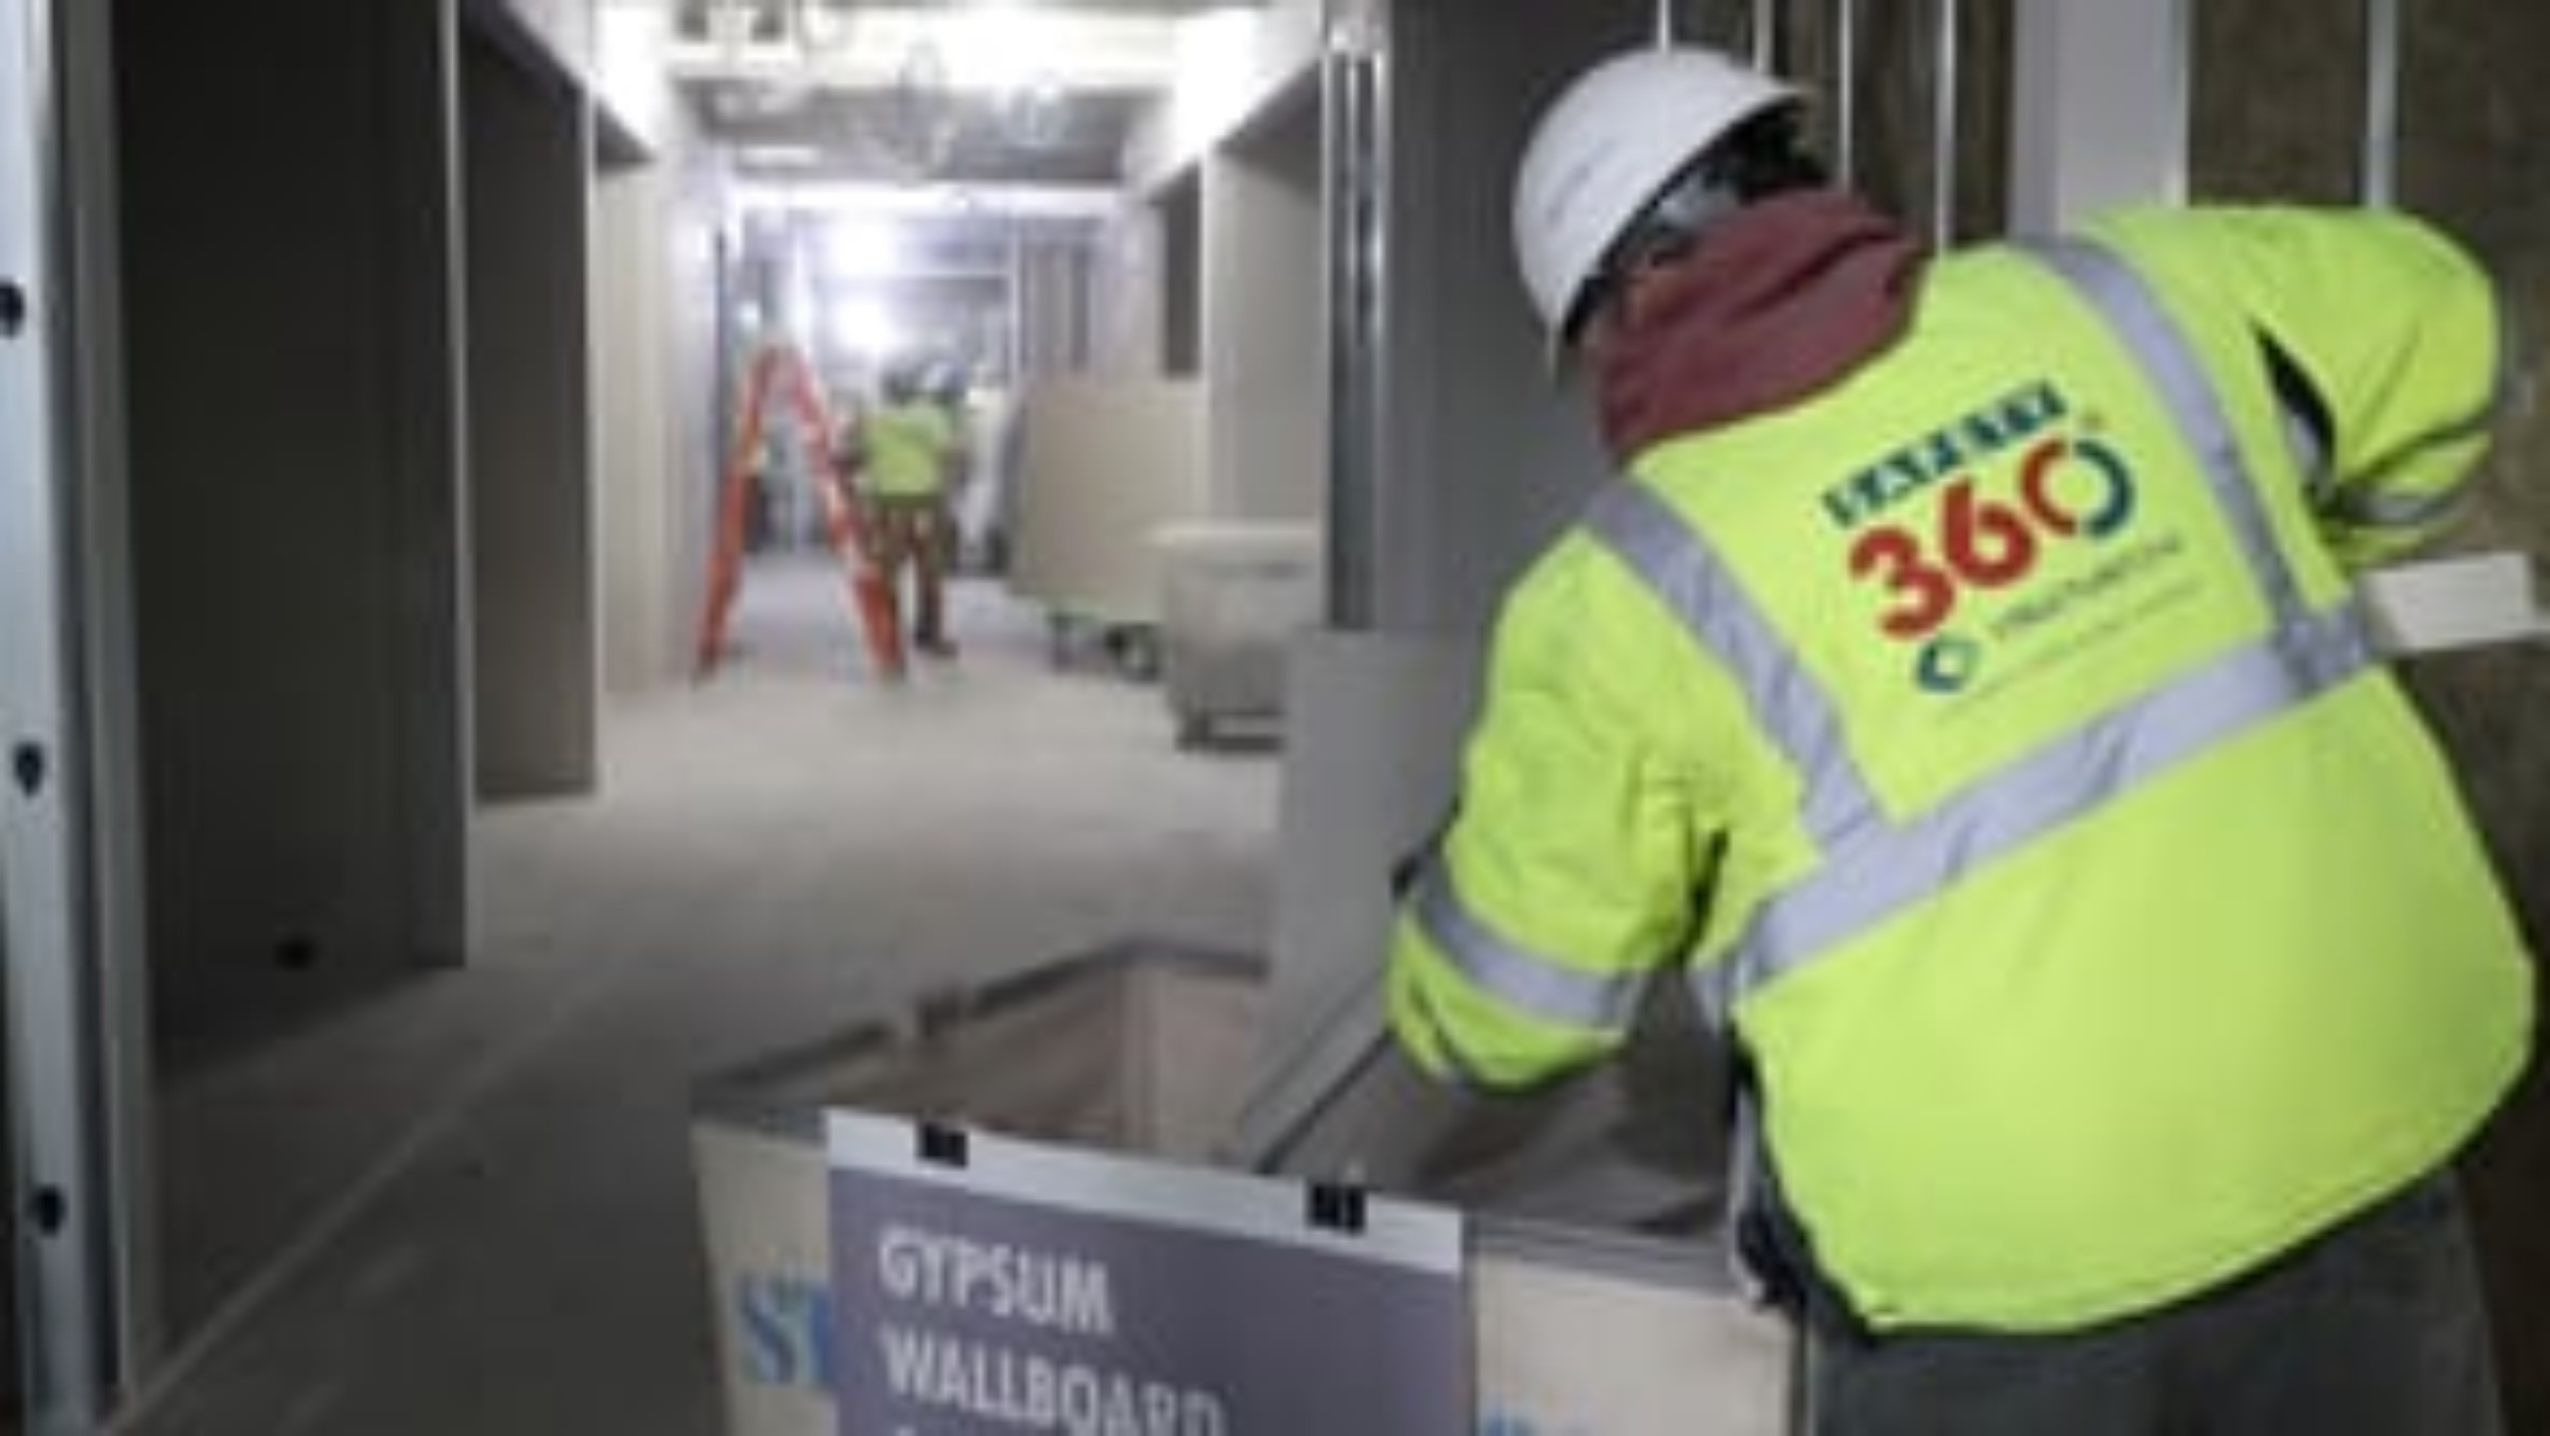

C&D Training Video –Structure Tone
Notes:
We created an instructional video featuring a renovation project in Boston with a company called Structure Tone that demonstrates source separation of C&D materials.
I am not going to play the video, but it is embedded in this presentation, which we can share out.
This is a great training video to show all key stakeholders involved in the project.

Slide 23
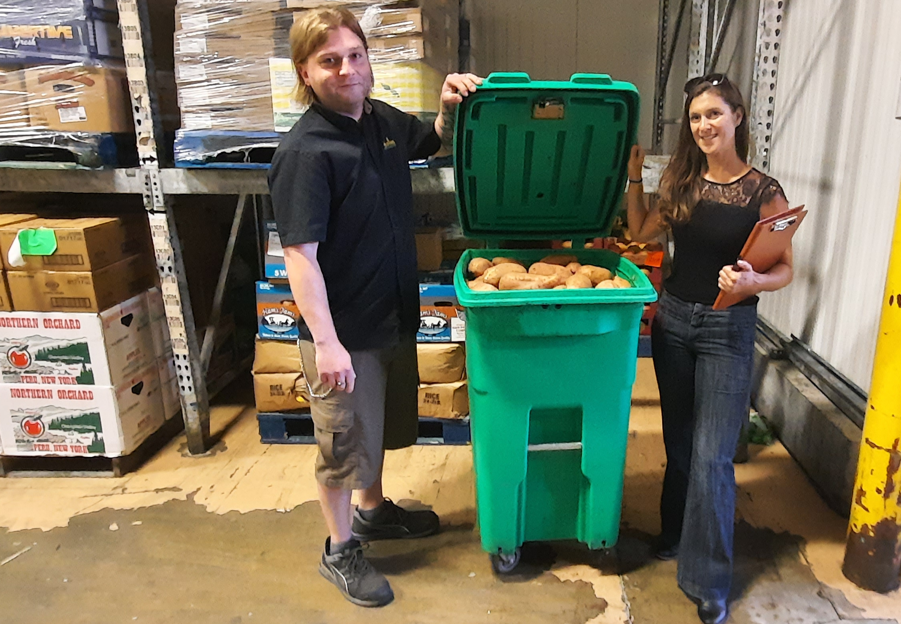
No-Cost
Technical Assistance
Waste Reduction Assessment
In-person or virtual visit to evaluate existing waste streams and learn about waste
reduction goals
Recommendations
Customized report of opportunities to prevent, recover, and divert waste
Follow up
Support through the implementation of new strategies, direct connections to service providers
Education
Signage, staff trainings, and more
MA | CT | RI | ME | NH
NY | NJ | PA | MD | OH
Notes:
Here’s what our free technical assistance looks like:
1st step is to set up a site evaluation for a waste reduction assessment, which can be done in-person or remotely
Then we develop a customized recommendation report identifying opportunities to prevent, recover or otherwise divert materials from landfill or incineration.
Based on whichever measures & solutions the business decides to implement, we then work with them to ensure a successful roll-out
And we can assist with everything from implementing source separation, staff training, signage, reviewing quotes from haulers, to support with right –sizing dumpsters and trash math.

Slide 24
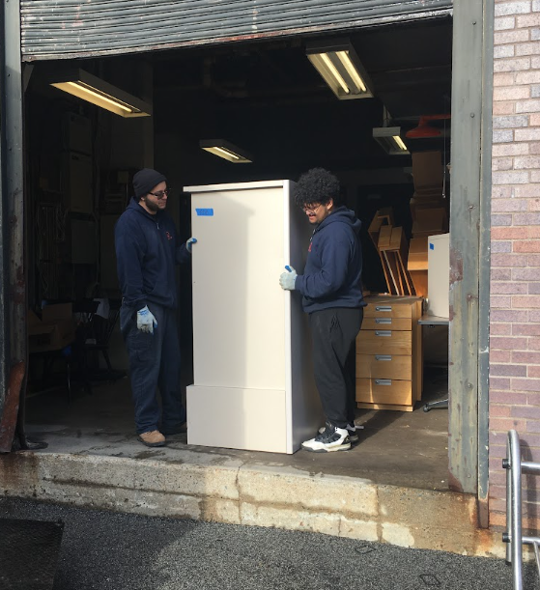
THANK YOU!
Emma Sabella
Senior Waste Reduction Consultant
413.387.2045
Emma.Sabella@cetonline.org
cetonline.org
Notes:
This concludes my presentation.
There is my contact information.
I also have business cards to share and again the rack cards are also here.
Thank you so much for listening and I hope you learned something about waste reduction that you can take with you and implement right away in your line of work.

