Slide 1


Plan NH Fall Conference Integrating solar into planning, design, and construction
September 17th, 2025
• David Webb, NH Commercial Sales Lead

Slide 2


Agenda
Intro to ReVision Energy
NH’s Clean Energy Landscape
Commercial Solar Outlook
Project Examples

Slide 3
About ReVision

Slide 4






Solar • Heat Pumps • EV • Battery

Slide 5
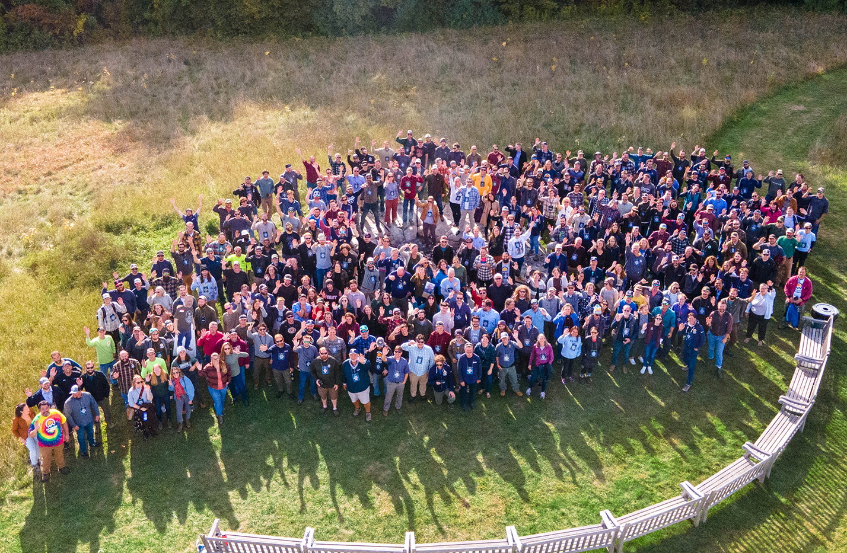


420
Employee
Owners

Slide 6


Locations
Montville, Maine
South Portland, Maine (HQ)
Enfield, New Hampshire
Brentwood, New Hampshire
North Andover, Massachusetts
Westfield, Massachusetts

Slide 7
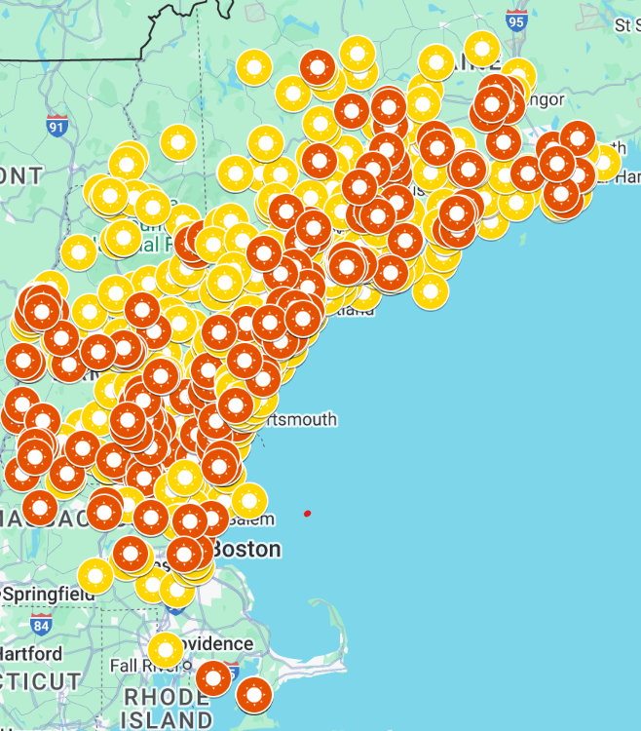
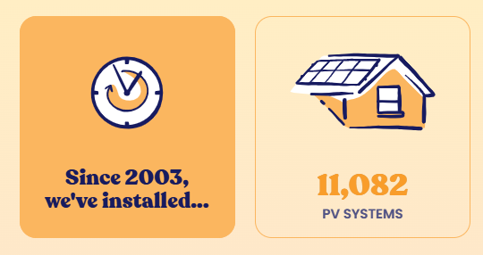
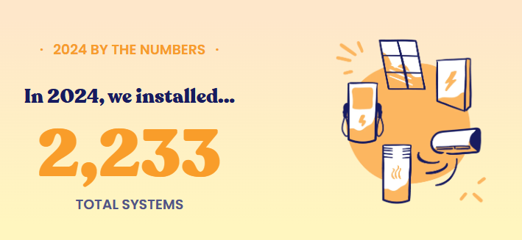
500+ Commercial Solar Projects in New Hampshire

Slide 8









Awards & Affiliations

Slide 9
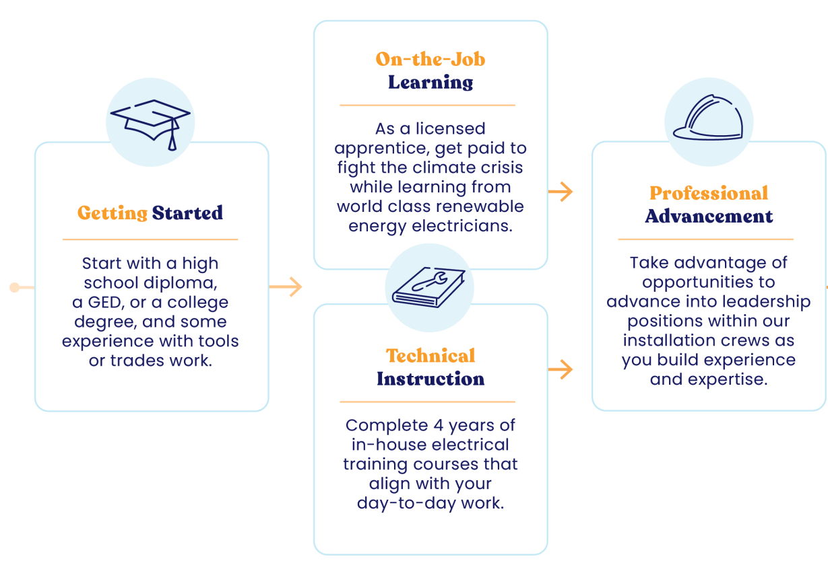
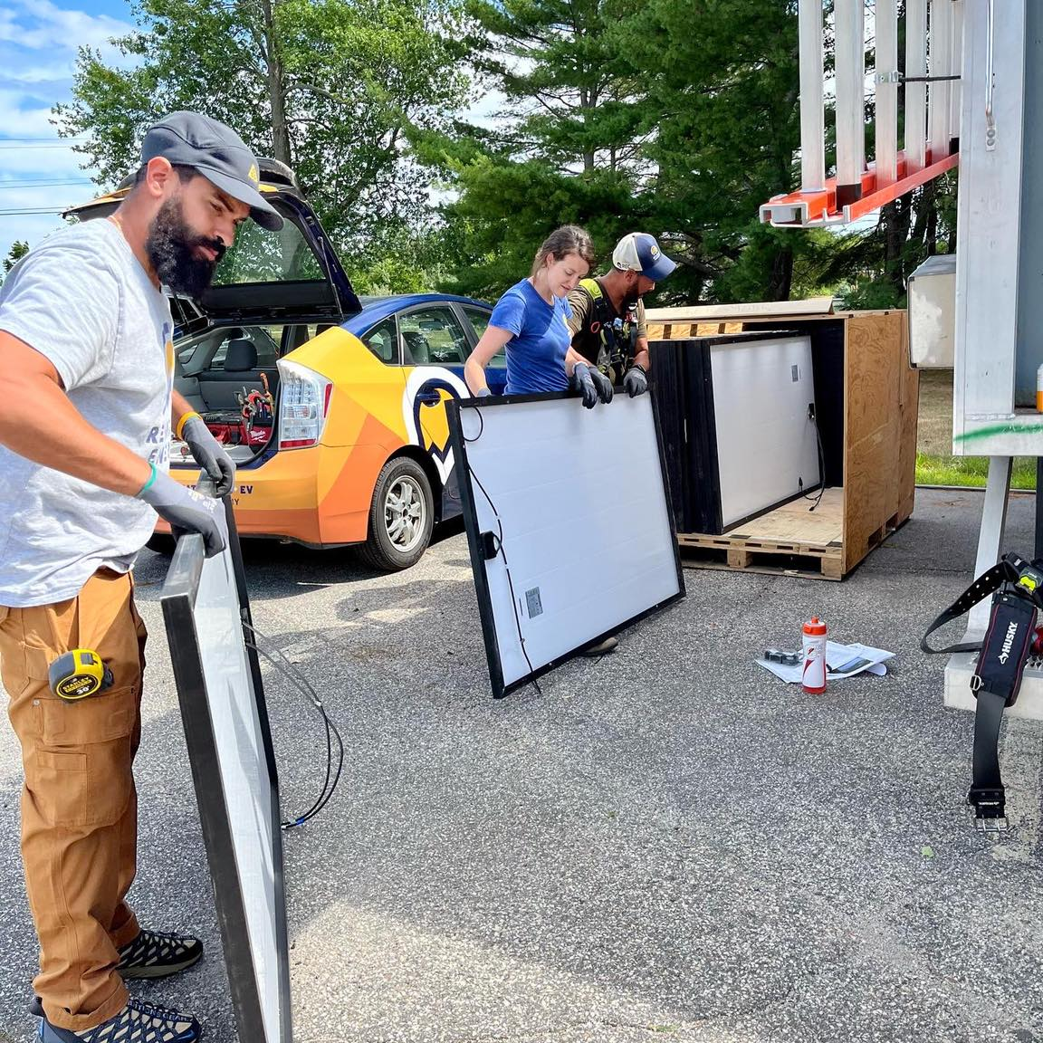

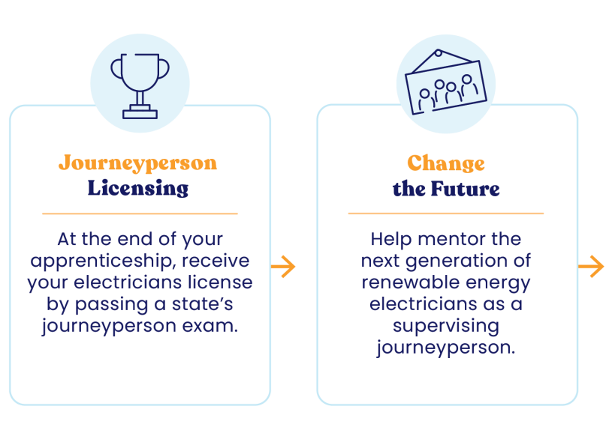


ReVision Energy
Electrical Apprenticeship Program
Career Pathway

Slide 10

NH’s Clean Energy Landscape

Slide 11
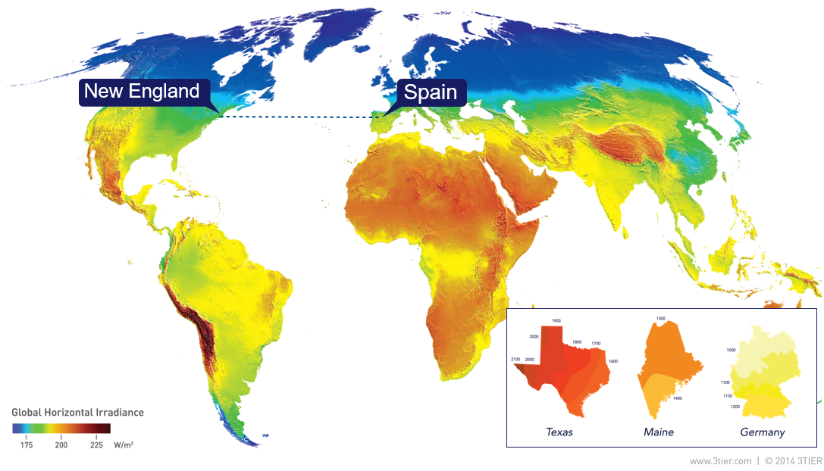




The Opportunity
2.04%
15.38%
26.61%
Source: Solar Energy Industries Association (SEIA) Q1 2025, Percentage of State's Electricity from Solar
Notes:
Enough sun hits the earth in one hour to power the world for a year – sheer abundance

Slide 12
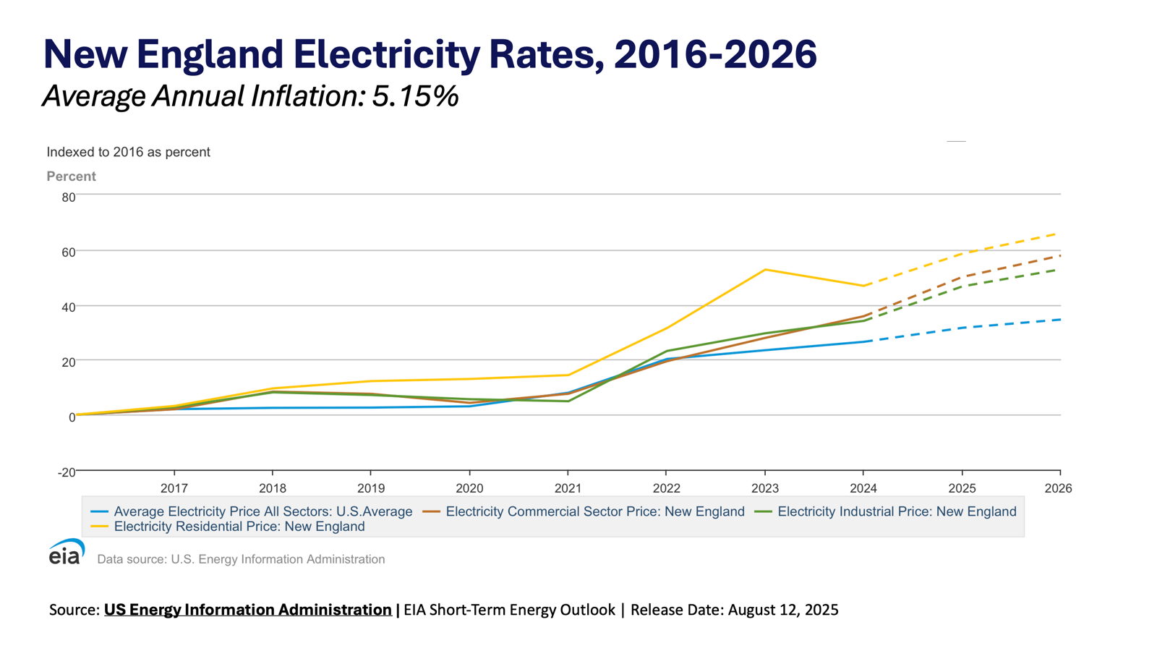

Slide 13
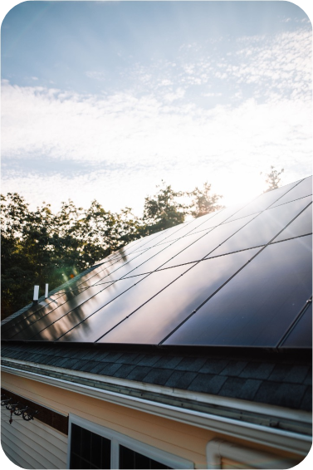

Commercial Solar Outlook

Slide 14

Policy Changes 2025 and Beyond
Residential Investment Tax Credit (25D) eliminated
Commercial Investment Tax Credit (ITC) much more challenging after 2025
Foreign Entity of Concern requirements
NH State Rebate Renewable Energy Fund redirected into General Fund

Slide 15


Projects & Case Studies

Slide 16
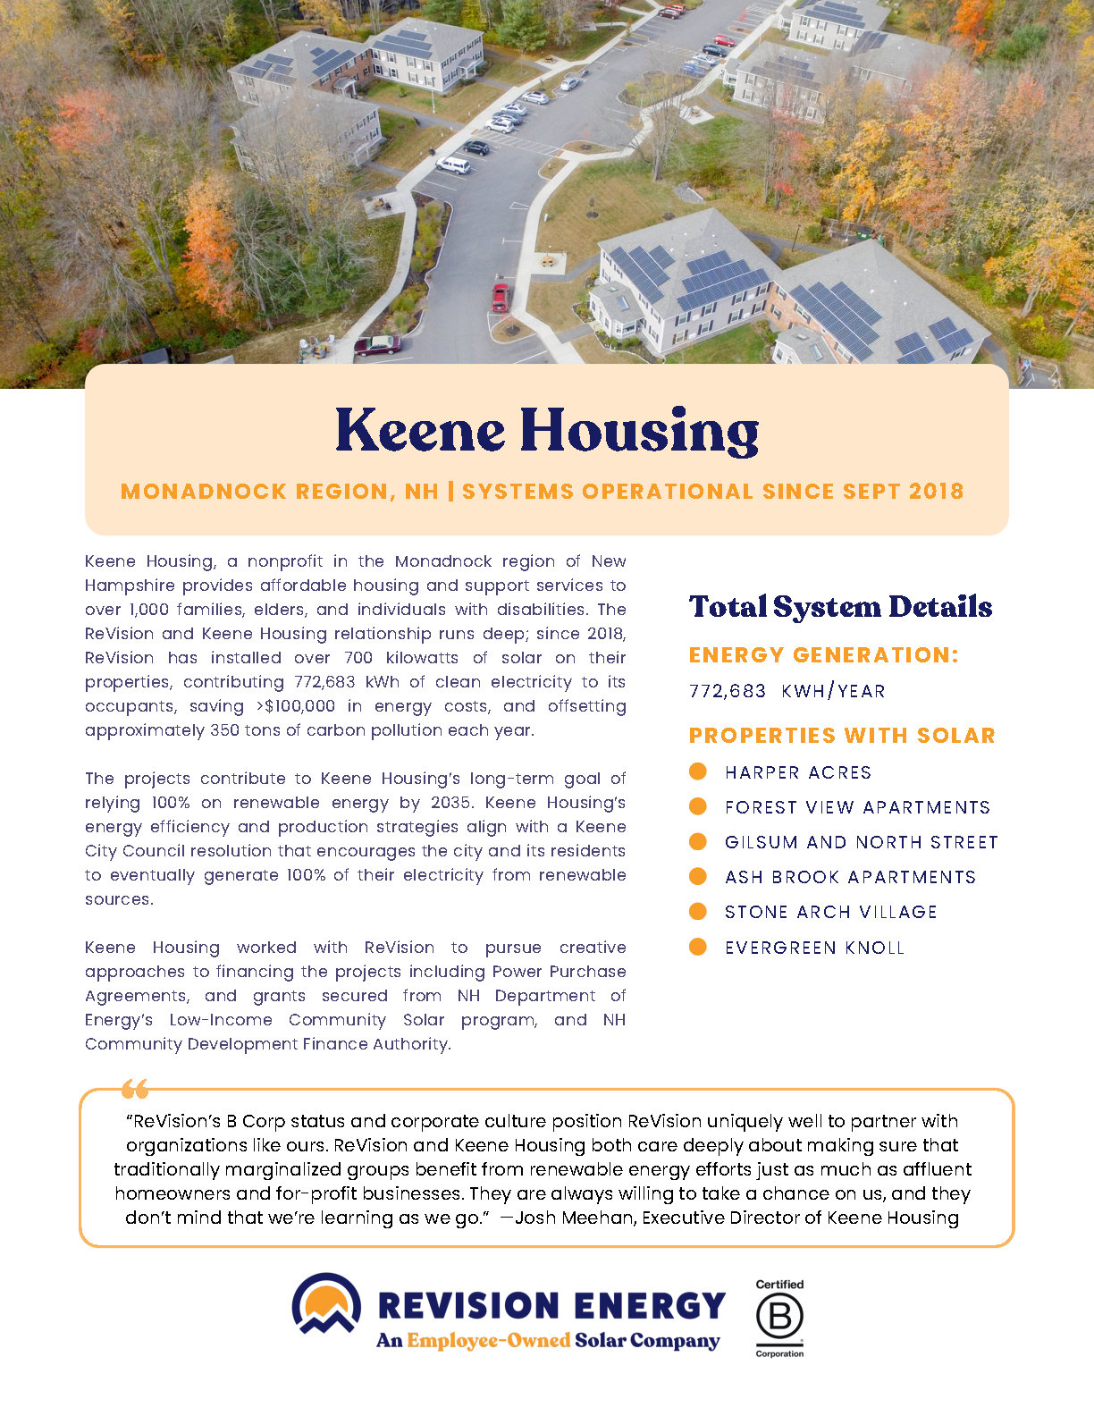
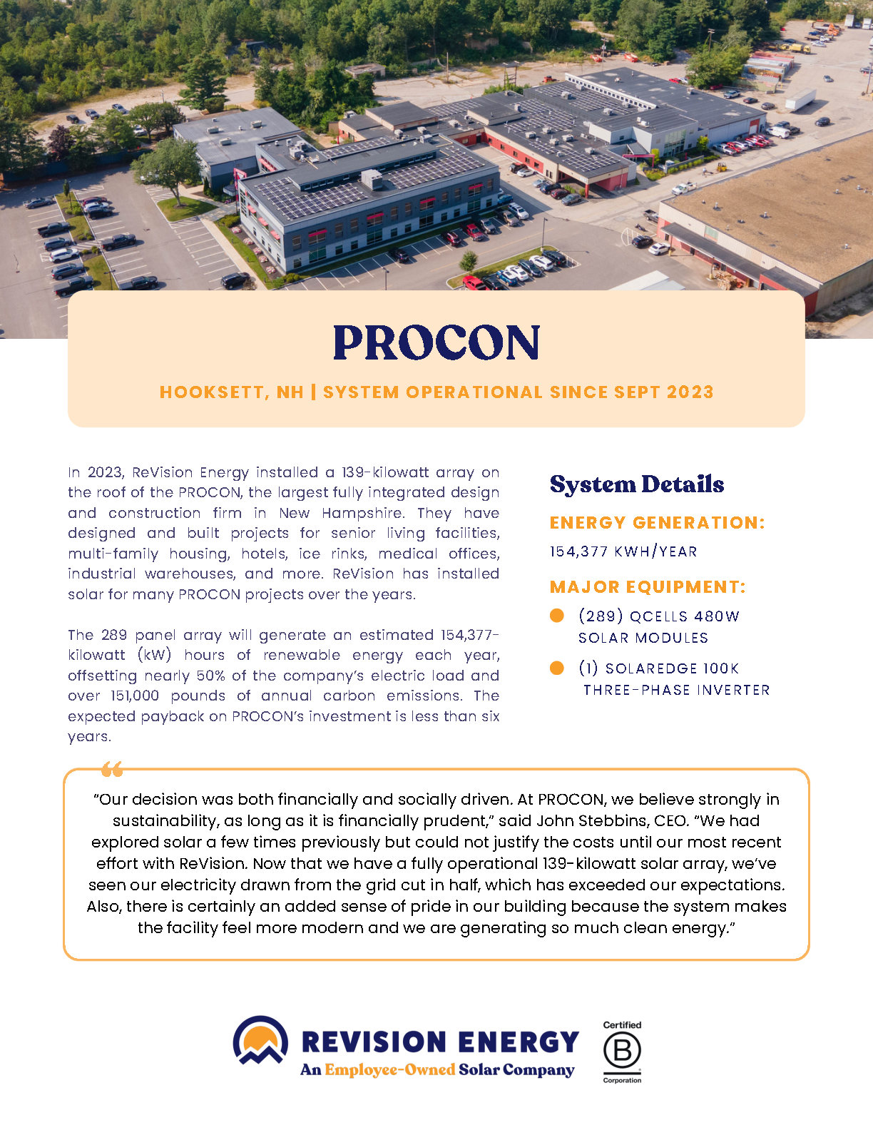

Slide 17
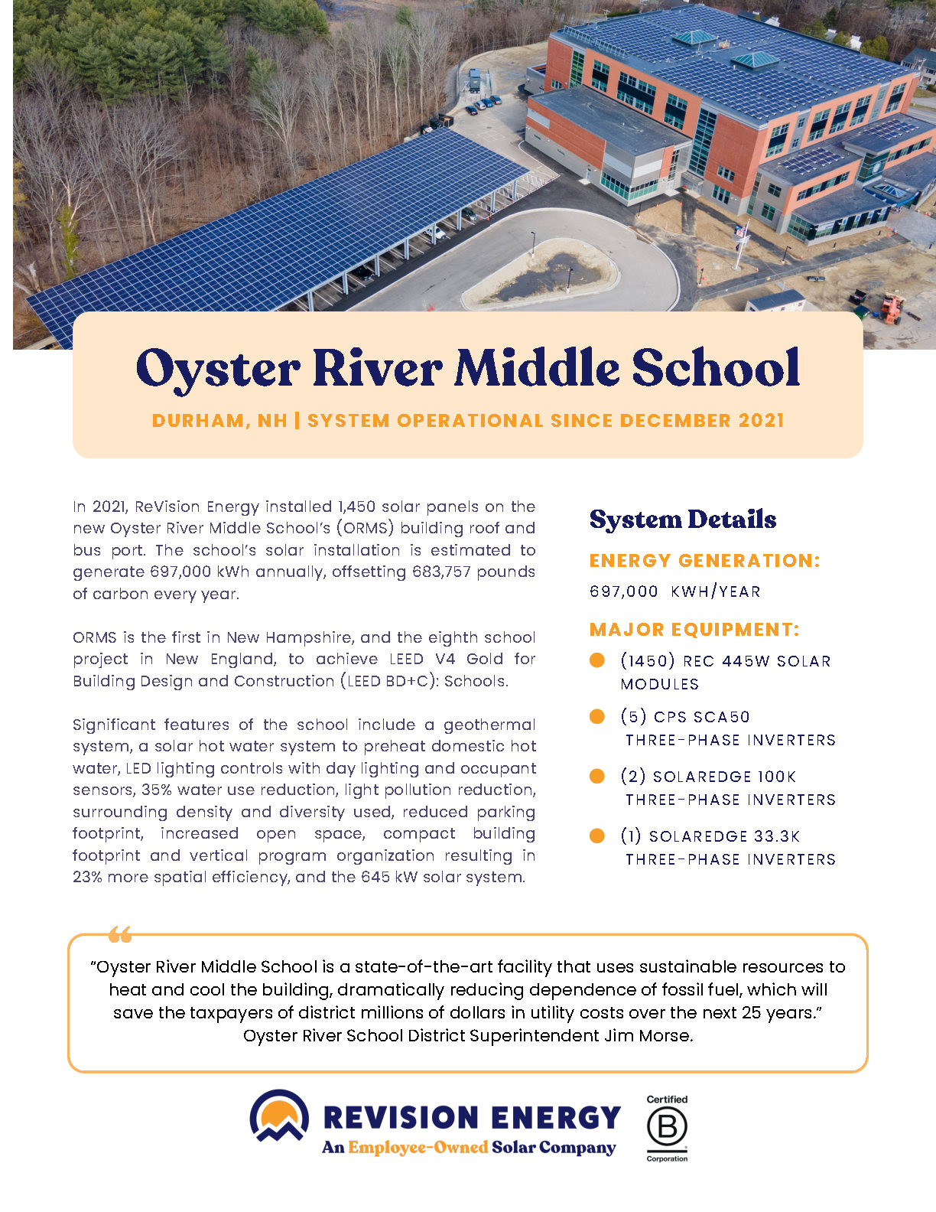
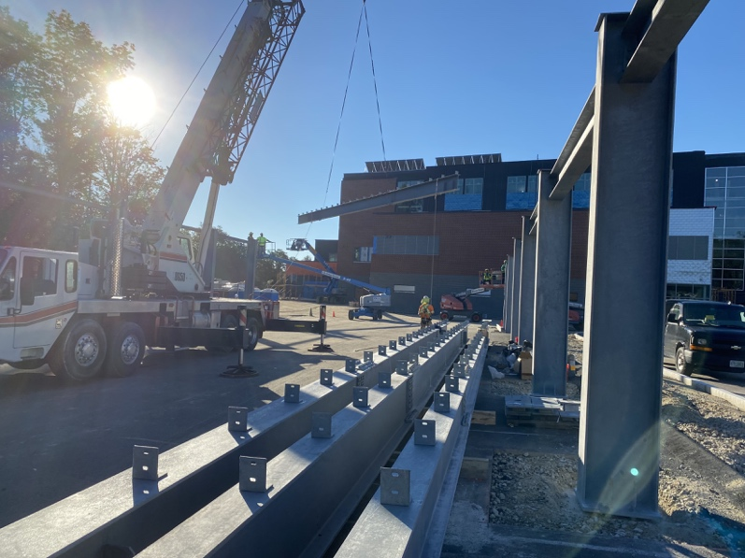
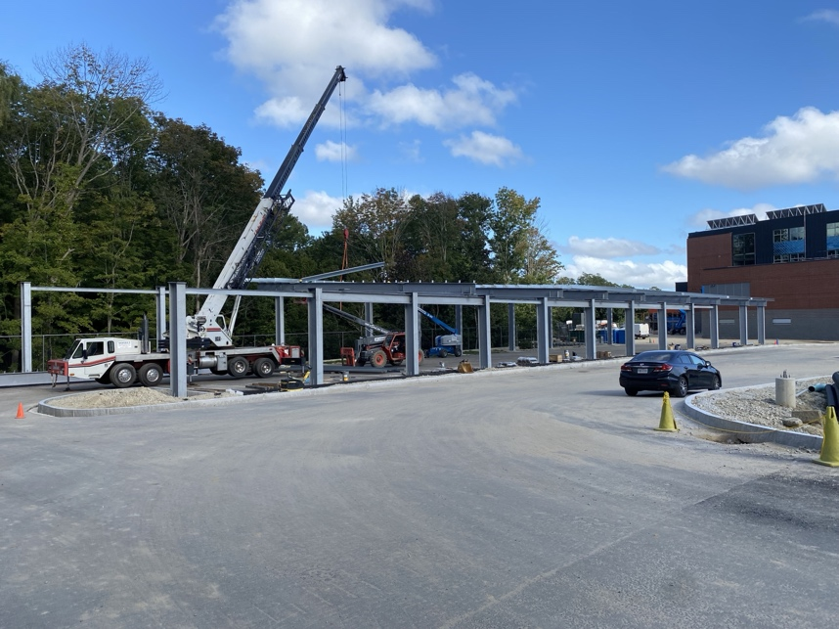
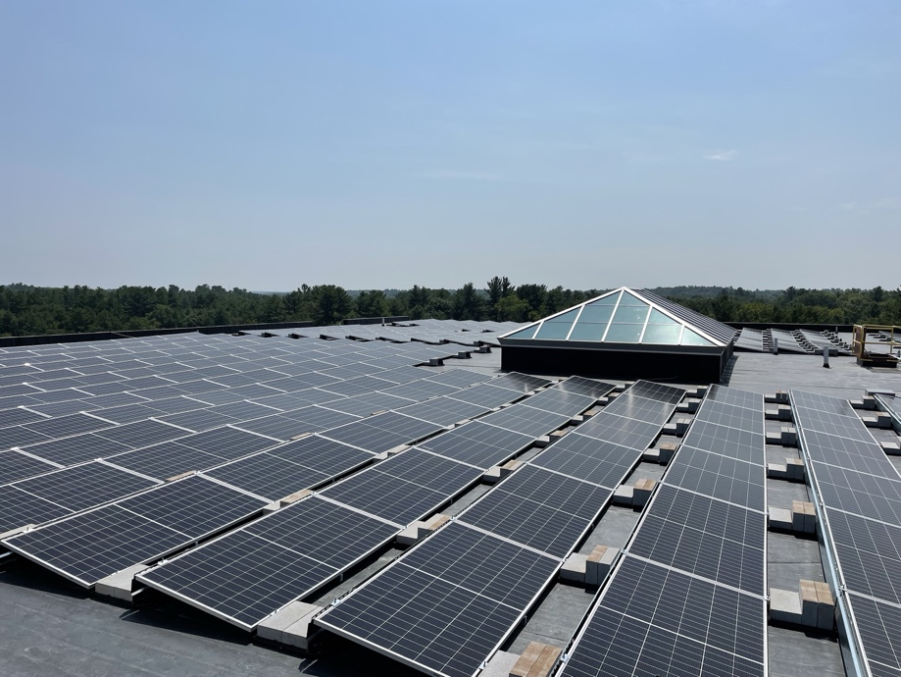
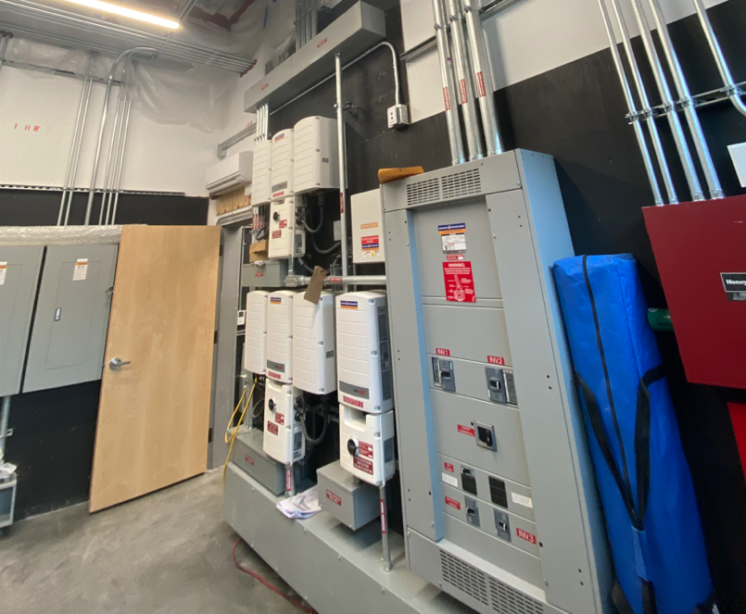

Slide 18
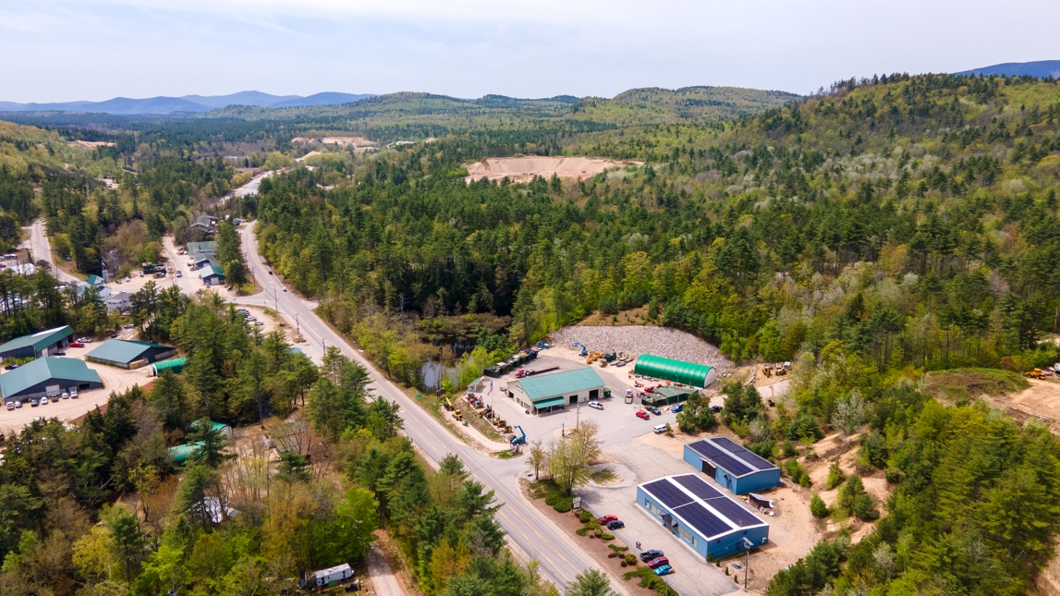
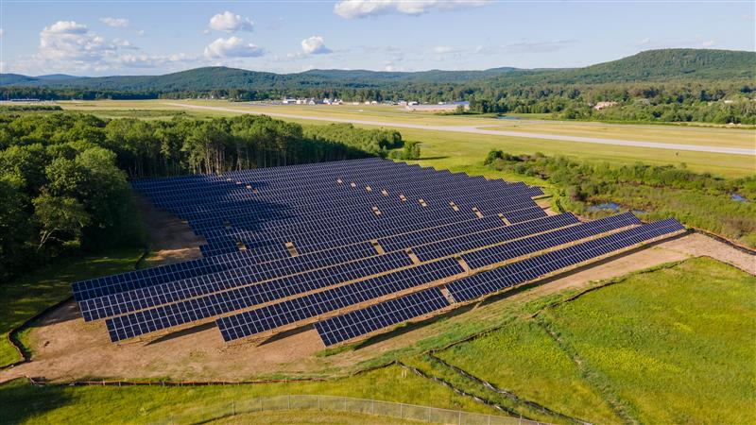

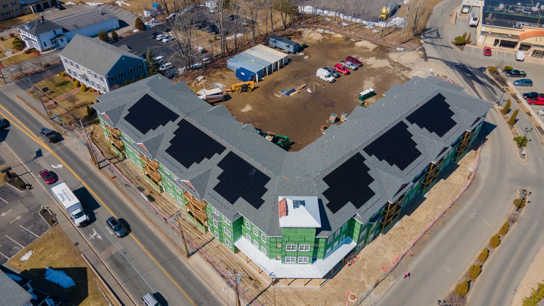
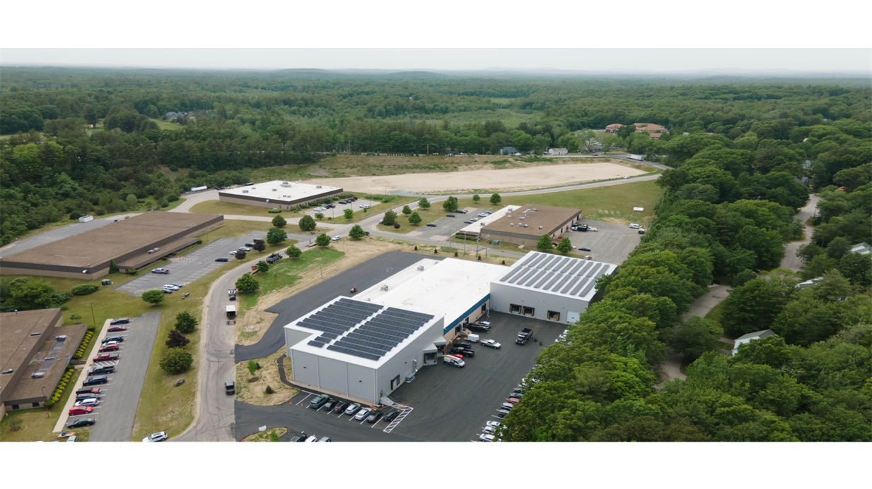
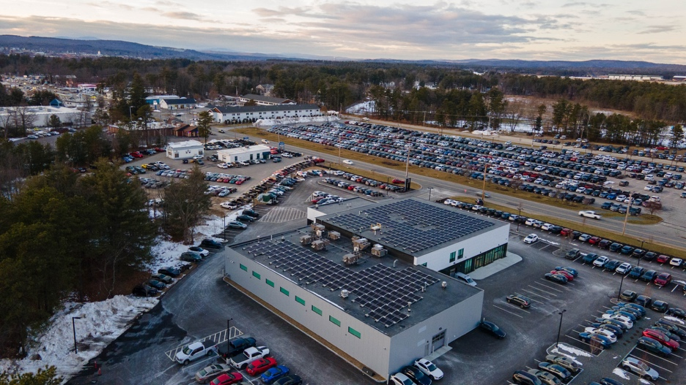
Recent Projects
Ambix Manufacturing
Keene Wastewater Treatment
Grappone Mazda
Depot and Main Apartments
PromoCentric

Slide 19
The 30% ITC has been the foundation of commercial solar projects since 2005, but without the incentives, projects will continue to pencil out.

Slide 20

Include solar in your next project!

Slide 21
Thank you!
For more info, please contact:
dwebb@revisionenergy.com
603-218-2922

