Slide 1


Solid Waste Minimization Difficult to Handle Materials
Joe Knapik, MS, CIH, CSP
www.airpf.com
888.SAFE AIR
Notes:
The global construction industry is a major contributor to solid waste, generating billions of tons of material annually. Much of this waste, from concrete and wood to plastics and insulation, ends up in landfills, creating significant environmental and economic burdens. By adopting a circular economy approach, we can shift away from a linear "take-make-dispose" model towards one that prioritizes minimization, reuse, and recycling. This presentation will explore the critical challenges in construction waste management and offer actionable strategies to improve sustainability and efficiency.

Slide 2

RPF Environmental is a full-service
Environmental Health and Safety company:
Indoor Air Quality & Mold Concerns
Asbestos Management
Worker Exposure Analyses- Noise & Chemicals
Safety Training & Audits
Written Safety Programs
Among other EHS services
www.airpf.com
888.SAFE AIR
Notes:
RPF Environmental is your one-stop shop for all of your Environmental Health and Safety needs, whether you’re on a construction site, in a school, factory, health care facility, or real estate development. For more than 32 years, RPF Environmental’s experienced and qualified health and safety professionals have been assisting companies with a wide range of Industrial Hygiene services including mold inspection, water testing, and OSHA compliance.
We are also available to be your onsite Environmental Health and Safety partner to provide: safety audits, trainings, environmental and safety plans, respiratory protection, and machine guarding among other things.
That is to say that you can contact us to assist you with ANY and ALL of your environmental health and safety needs.

Slide 3
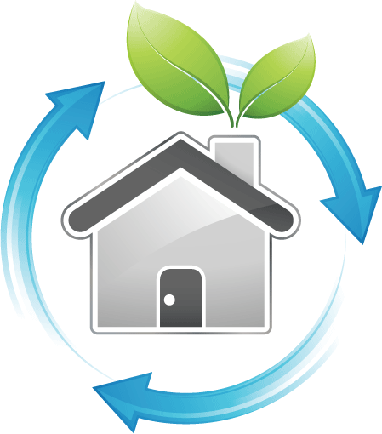
Goals & Challenges
Minimizing Hazardous Materials
Improving Circularity
Addressing Landfill Pressure
Evolving Trends
Notes:
RPF will be co-presenting w/ CET. CET will do extensive presentation on recoverable materials – masonry, wood, steel – so we’ll focus on the things “no one wants”)
Our presentation today focuses on four key challenge areas in construction sustainability:
We'll examine the opportunities for minimizing waste generation during both the planning and operational phases of a project.
This involves moving beyond basic recycling to embrace more innovative strategies like repurposing and alternative uses for "difficult-to-handle" materials. We will delve into what makes a material truly recyclable, considering both its inherent properties and the logistical and chemical challenges of the recycling process. For example, expanded polystyrene (EPS) is technically 100% recyclable, but its low density and transportation costs can make it economically unfeasible to recycle on a large scale.
With limited landfill space and increasing public and regulatory pressure, we'll discuss the implications of landfilling construction waste, including leachate contamination and the trend toward "zero landfill" requirements from project specifiers and owners.
We'll look at new and emerging technologies and market opportunities for construction waste, such as co-processing in cement kilns and the use of engineered waste fuels. We will also touch on the impacts of future regulations, such as those related to PFAS, and how they may reshape waste management practices.
This presentation will also address the unique challenges posed by hazardous building materials like asbestos, lead, and PCBs, and explore the limited, yet crucial, minimization opportunities available for these legacy contaminants.
By the end of this session, you'll have a better understanding of how a proactive, holistic approach to waste management can lead to significant environmental benefits, cost savings, and improved project outcomes.

Slide 4
What makes something recyclable?
Material Composition
Collection and Logistics
Market Demand and Economic Viability
Chemical Intensity and Process
Notes:
Material Composition: The intrinsic recyclability of a material is determined by its chemical and physical properties. For a material to be considered recyclable, it must be possible to reprocess it into a usable raw material without a significant degradation of its properties (EPA, 2024). For example, materials like steel and aluminum can be recycled infinitely without a loss of quality, while others like certain plastics degrade with each reprocessing cycle.
Collection and Logistics: An effective and economically viable collection system is a crucial factor. Materials must be collected in a way that minimizes contamination and aggregation, as this is often the most significant challenge. The sheer bulk and low weight of certain materials, such as expanded polystyrene (EPS), can make transport to a recycling facility too expensive to be profitable, even if the material is technically 100% recyclable (GBC, 2024).
Market Demand and Economic Viability: For recycling to be a sustainable practice, there must be a market for the recycled material. If there's no demand for the recycled product, the material will likely end up in a landfill, regardless of its recyclability. The cost of collecting, sorting, and reprocessing must be lower than the value of the resulting recycled material (AIA, 2023).
Chemical Intensity and Process: The recycling process itself must be feasible and not overly complex or resource-intensive. Some materials, while technically recyclable, require complex chemical processes or a significant amount of energy to be broken down and reformed, which can make the process less environmentally friendly or economically viable than using virgin materials (SMACNA, 2021).
References:
AIA (American Institute of Architects). (2023). AIA Materials Knowledge Resource.
EPA (Environmental Protection Agency). (2024). Sustainable Materials Management.
GBC (Green Building Council). (2024). LEED v4.1 Enhanced IAQ Strategies.
SMACNA (Sheet Metal and Air Conditioning Contractors’ National Association). (2021). IAQ Guidelines for Occupied Buildings Under Construction.

Slide 5
Four challenge areas for construction sustainability
Hazardous Building Materials and impacts on sustainability
Keys for optimizing construction waste management for other difficult to handle materials
Planning for landfill constraint and LF avoidance goals/requirements
Evolving Trends
Notes:
Hazardous Building Materials and impacts on sustainability
Are there minimization opportunities in abatement and disposal?
Building Repurposing – minimization opportunities, challenges and implications
Keys for optimizing construction waste management for other difficult to handle materials
recoverable materials – masonry, wood, steel – so we’ll focus on the things “no one wants”)
Planning for landfill constraint and LF avoidance goals/requirements
Landfill leaching
Long term monitoring
Increasing trend toward “zero landfilling” from specifiers/Owners
Waste Bans
Evolving Trends
Residuals for energy and co-processing in cement
Impacts in the new environment – improve planning for solid waste management in the “built” facility

Slide 6
5 R’s & What Can We Do with these types of materials?
Refuse
√Reduce
Repurpose
√Recycle/Alternative Uses - Reprocessing
Reuse
Notes:
We have few options for these materials – disposal is the easiest, but there are ways to reduce/reprocess some

Slide 7
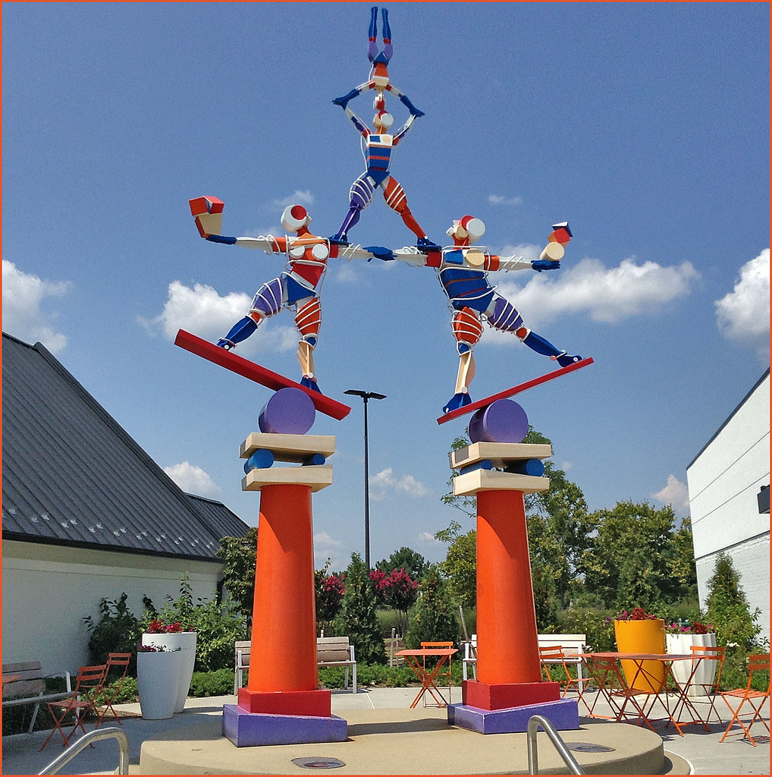
Balancing Act
Quantity
Quality
Logistics
Markets
  Segregating, handling, pre-processing and logistics to final locations
  Alternative Use technologies can be very specific and have high quality specifications
  And … we just don’t want some things to fall apart too easily …
Notes:
It’s a balancing Act between quantity, quality, logistics and markets
Additional costs for segregating, handling, pre-processing and logistics to final locations
Alternative Use Re-Processing technologies can be very specific and have high quality specifications
And … we just don’t want some things to fall apart too easily

Slide 8
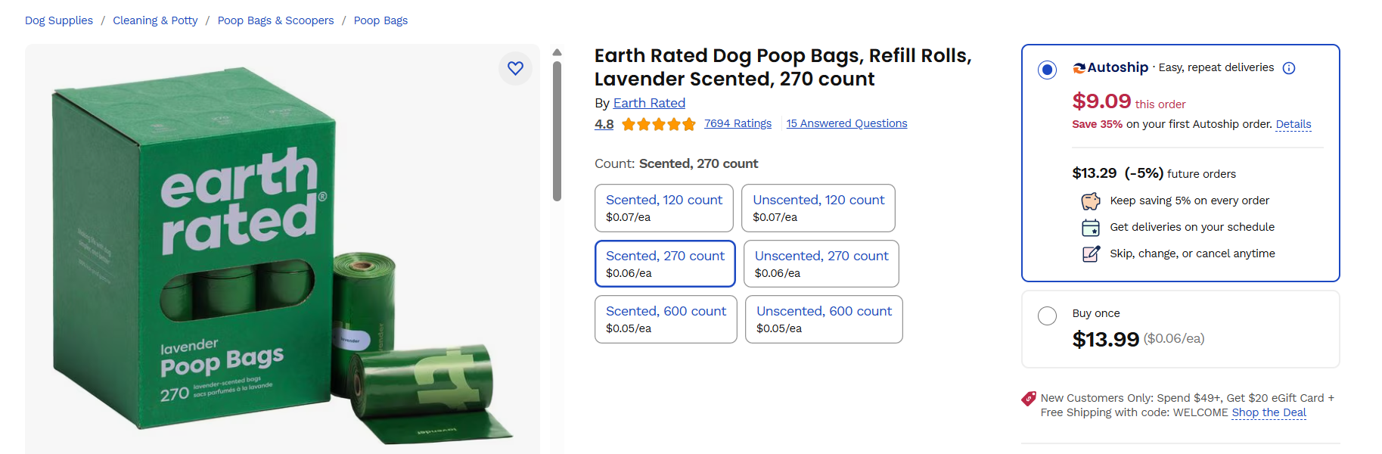
Notes:
Imagine if the true cost of poly went up by 10X to cover all impacts….??? Is this the best use of “fossil” carbon?
Another example of things we don’t want to fall apart!!!

Slide 9
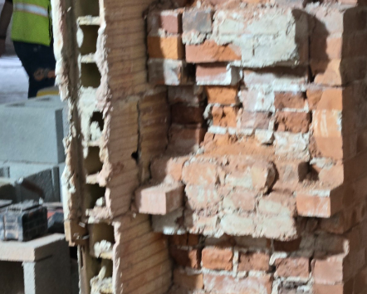
The Legacy – Hazardous Building Materials
  When are they a problem?
    Confidence - be sure of the “negative” and control for “overestimating the positive”
    Project sequencing can be like “peeling an onion” be ready to update findings as demolition & deconstruction proceeds
Notes:
Initial evaluations can favor a “stop” when we get a hit approach – That can be OK, but not always
Teams need to be alert to conditions as they are revealed and stop to check before risking contamination

Slide 10
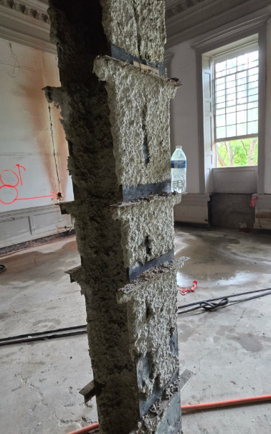
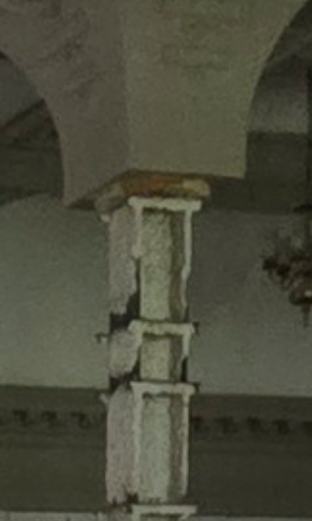
The Legacy – Hazardous Building Materials
    Regulatory applicability
    Cost – Benefit of remedial and disposal resources
    Perception, Operations & Maintenance
    Get the characterization right and the wastes to a minimum
Notes:
(Speaker notes for pix above – note ornate interior finish on right, before getting to the fireproofing, the column reveal needs to be analyzed – if nonACM, it can be opened for further inspection)
Characterizations can happen at the point of landfilling, or worse, after. Be sure to get characterizations correct.

Slide 11
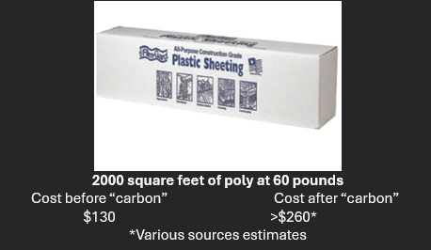
Asbestos – Minimization Opportunities
    Limited – “no safe limit” & adds volume (and embedded energy) through secondary materials (poly)
    Options and regulatory structure exist to manage “in place” but not commonly considered in renovation work – no cut off dates
    Improve inspection/assessment to improve certainty that material streams contain asbestos, rather than using “presumptions”
Notes:
RPF estimates our summer abatement season involved more than 500,000 square feet of “regulated areas” – generally required at least 2 plies of 6 mil poly sheeting on wall and flooring surfaces.
We have been managing asbestos in place in our vintage building stock for 40 years under a variety of programs – it can be done and done safely.

Slide 12
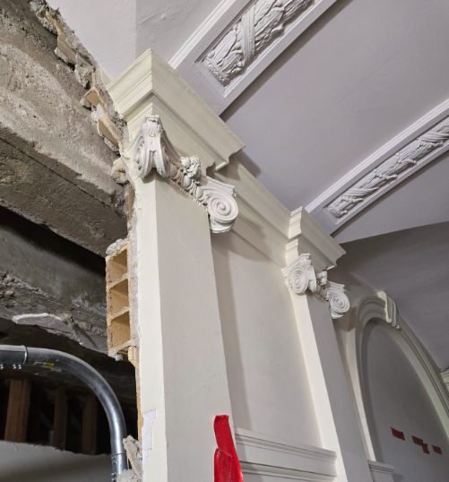
Lead – Minimization Opportunities
    Limited – better than Asbestos/PCBs
    General demolition and Lead Based Paint (LBP) components
    Consequence – still lead
    Selective deconstruction – doesn’t have to be lead abatement; allowances for worker protection and process control – minimize the regulated stream
    Advantages – potential to recover / reuse architectural/dimensional materials
    Improvement – chemical coating removal
Notes:
Lead containing materials can be managed in place during and after construction to allow for historical preservation, cost management, and other expediencies
There are options for construction crews to work around and with lead materials safely

Slide 13
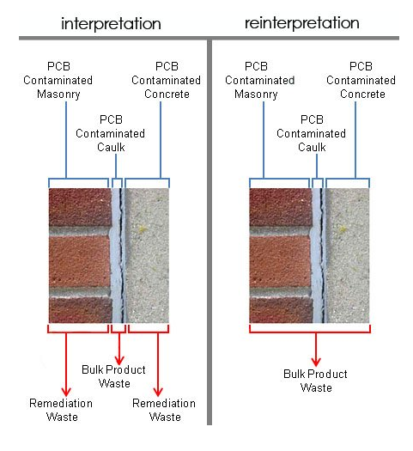
PCBs – Minimization Opportunities
    Limited – what level of confidence?
    Thin line between waste differentiators (PCB Bulk Product vs PCB Remediation )
Reinterpretation – improved handling and greater efficacy in project flows.
    Often commingled with other HBM (asbestos/lead)
Notes:
We can get “surprised” by PCBs

Slide 14
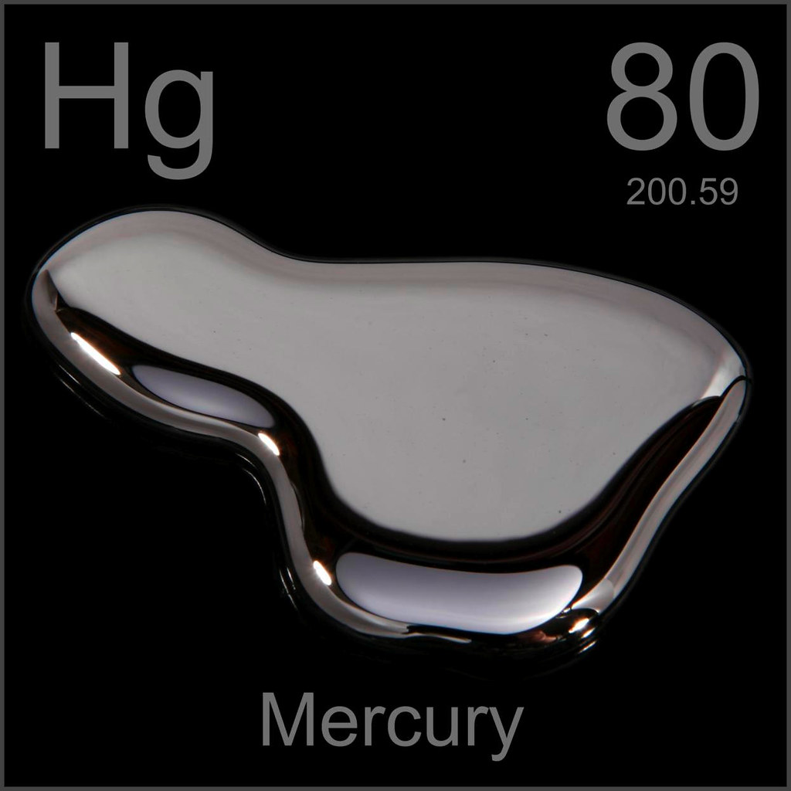
Mercury
    Blessedly less common in paints and coatings
    Mostly found in switches, lighting systems
    Purpose specific

Slide 15
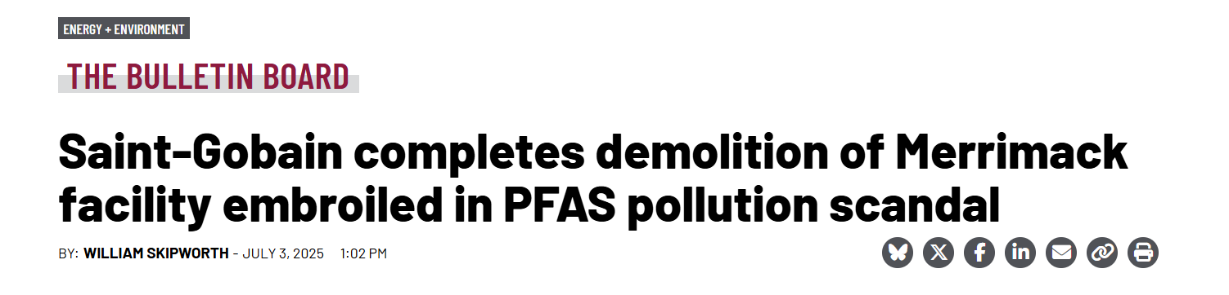
PFAS?
    Evolving regulatory structure
    Potential for dramatic impacts on material stream identification/characterization/disposal
Notes:
St. Gobain demolition – used PFAS as product application

Slide 16
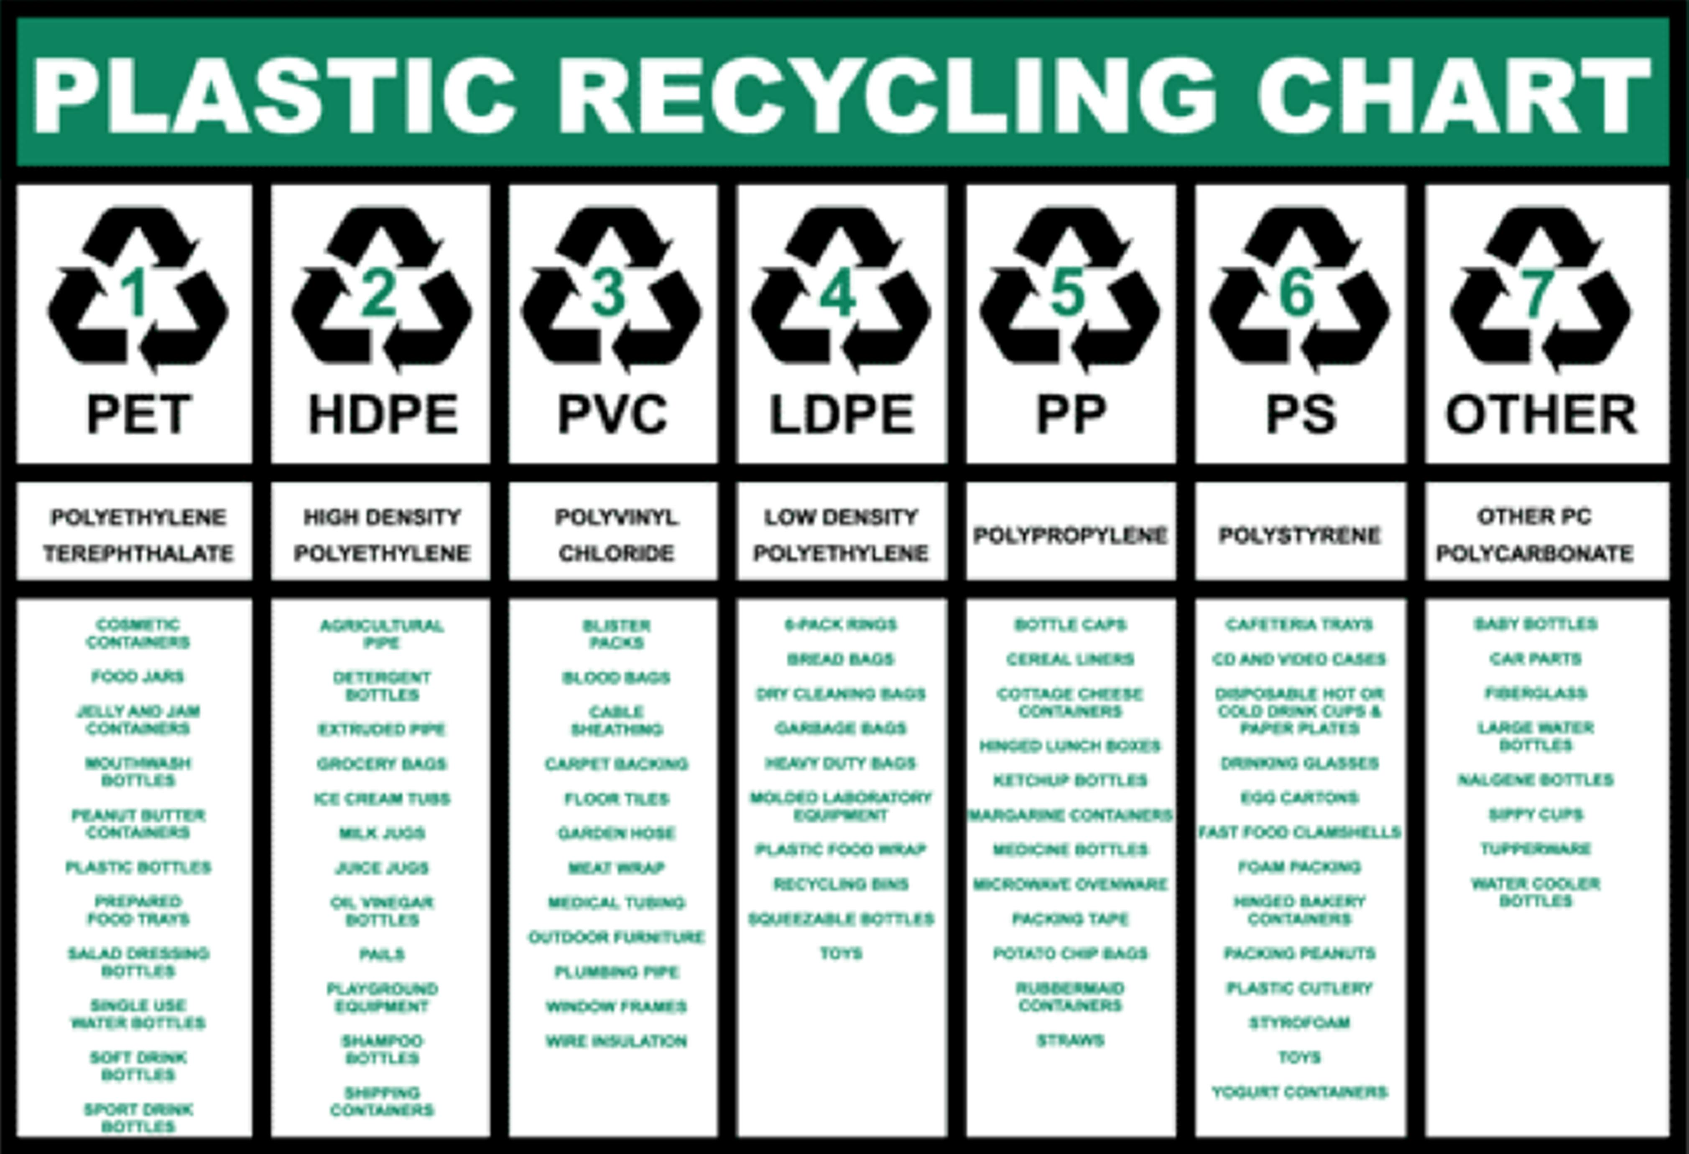
Improving Circularity for “Harder to Recycle” Material Streams
  What are “hard to recycle” materials? Carpets, mixed streams of foams, films, cardboard, wood scrap – often in same containers
  Various estimates on total tons recycled vs wasted; smaller projects can have higher waste rates
  Have a plan – what materials, how much, avoid accumulation – Disney goal is 90% diversion in construction projects

Slide 17
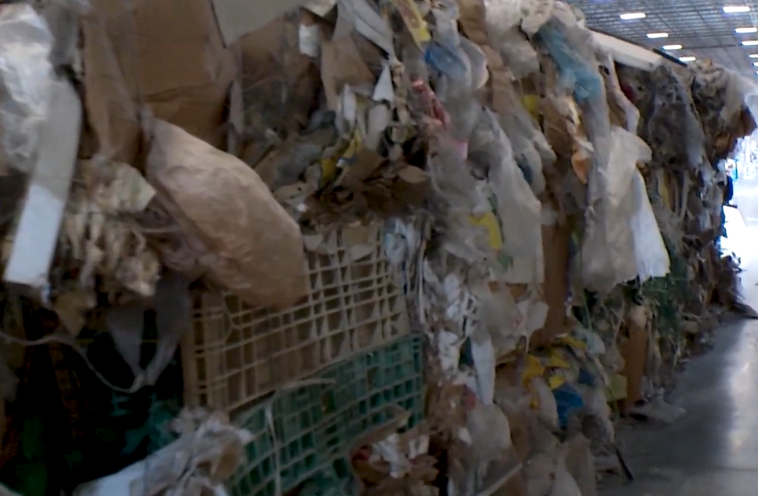
“National Sword”
Understand end market/user specifications for contamination/material stream conformance – there are quality standards – these bales were formerly “recycled” … somewhere else, but can be co-processed for cement
Notes:
National sword – 2018 banned 24 import streams of recyclables…..

Slide 18
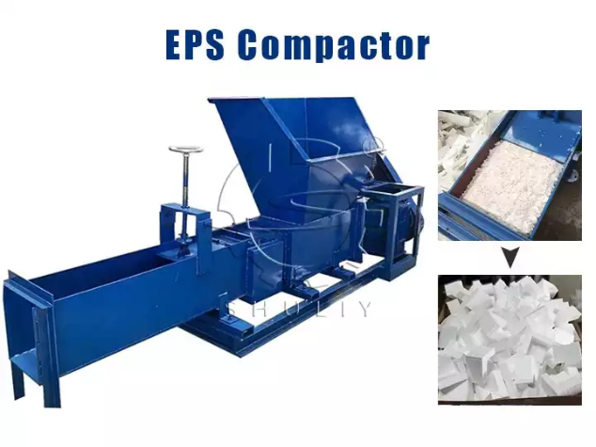
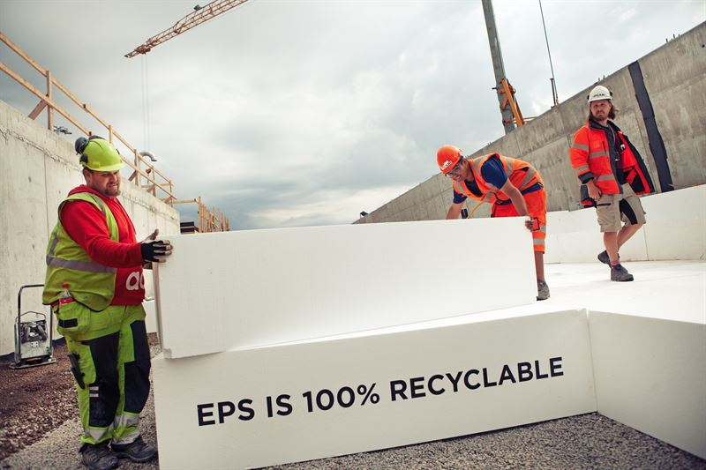
What level of “pre-processing” or on-site management is needed?
Notes:
this is often the only/best choice to recover these materials

Slide 19
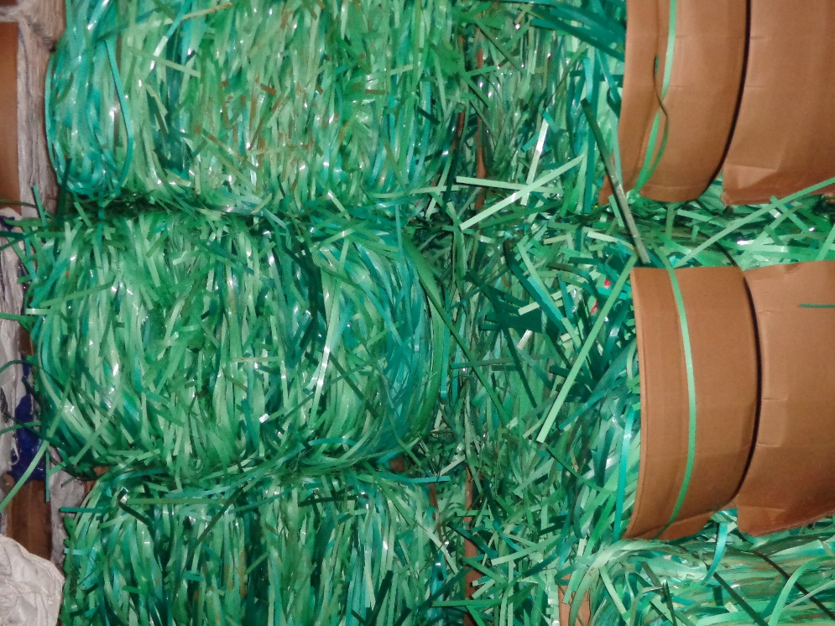
What do we do with this stuff?
Notes:
The more something isn’t supposed to fall apart, the more difficult it can be to recycle – even if it’s a valuable material.

Slide 20
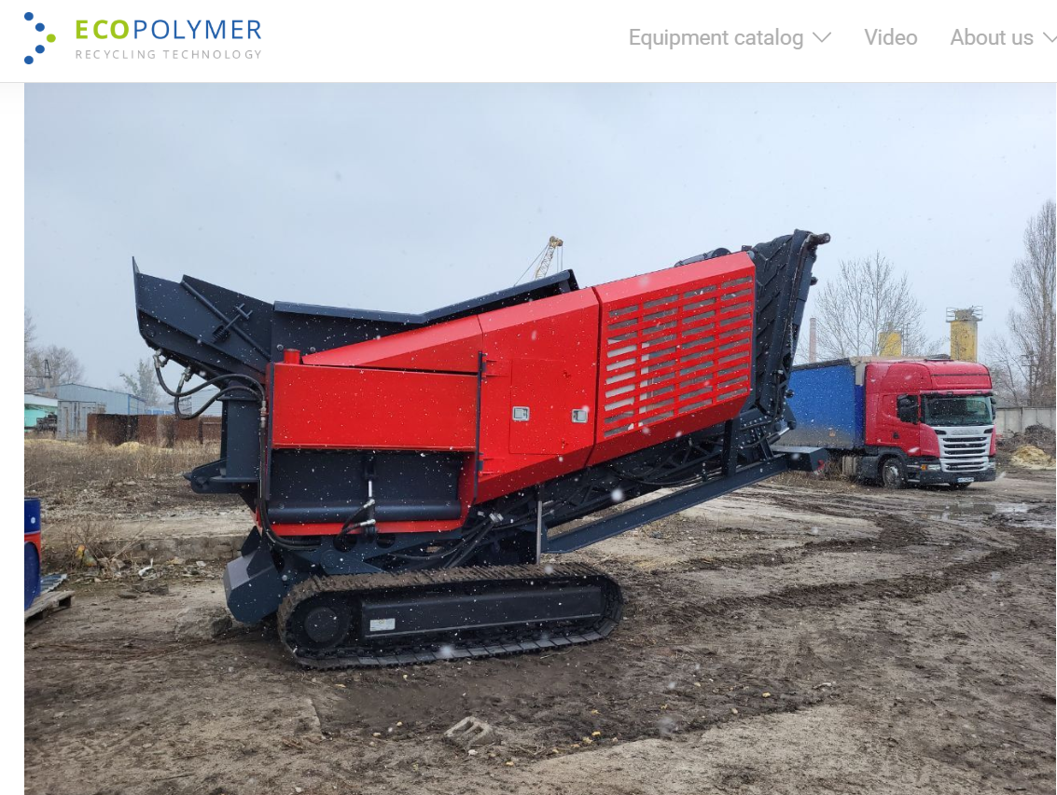
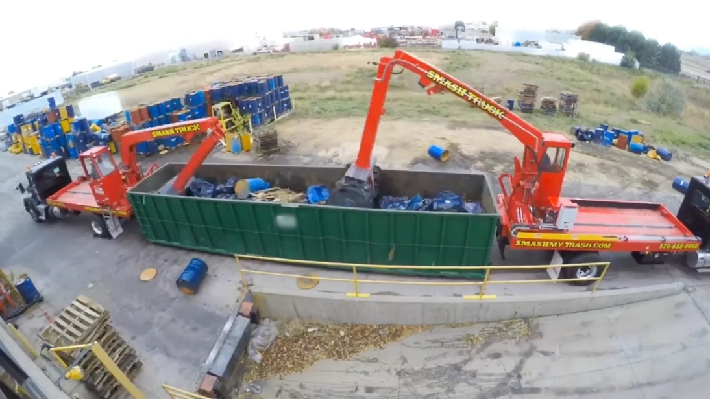
Other Options
Adopt a “supplier” mindset – quality in the product
On-site shredding and compaction
Notes:
(Smash my Trash, on-site processing) p
pix show on-site options for waste volume optimizing)

Slide 21

Prevention Through Design & Sustainability
Wastage rates can be reduced using this methodology & improve safety
ASSP ANSI Z590.3 – Prevention Through Design Standard
CDC NIOSH – Prevention through Design

Slide 22
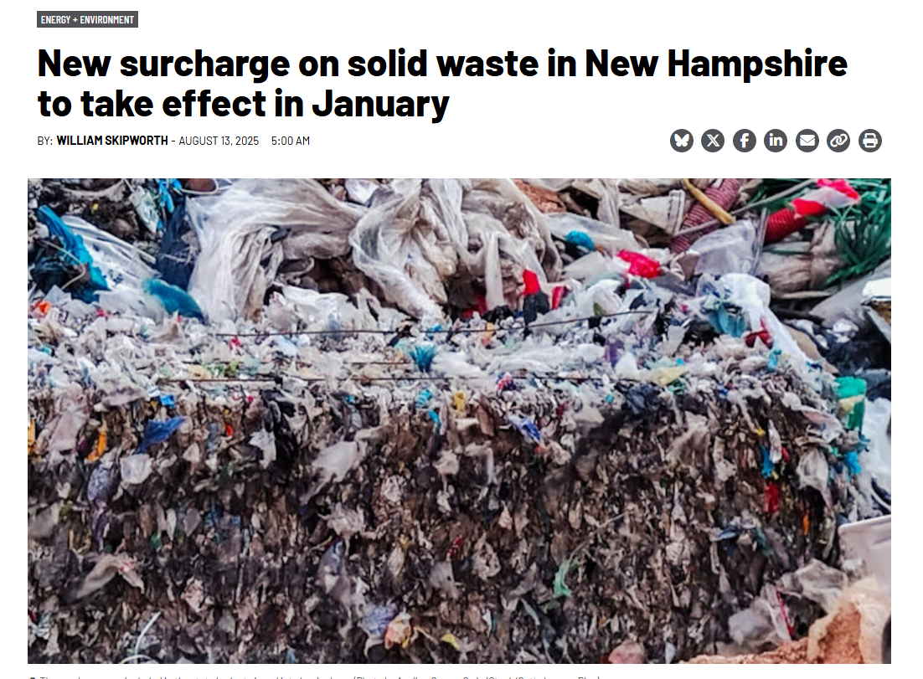
Landfills
  NH – is a “net importer”
  Seasonal and growing residential/MSW increase pressure
  Landfilling “cheapest” endpoint most of the time – though this can change
  Landfill Bans – NH just developing
Notes:
Other states can advertise “success” with in-state solid waste disposal by exporting to others.
Have to pay attention to Interstate Commerce Clause
Landfill bans – less comprehensive and slower to evolve here
Maine, Massachusetts, VT more extensive and closed to “imports”

Slide 23
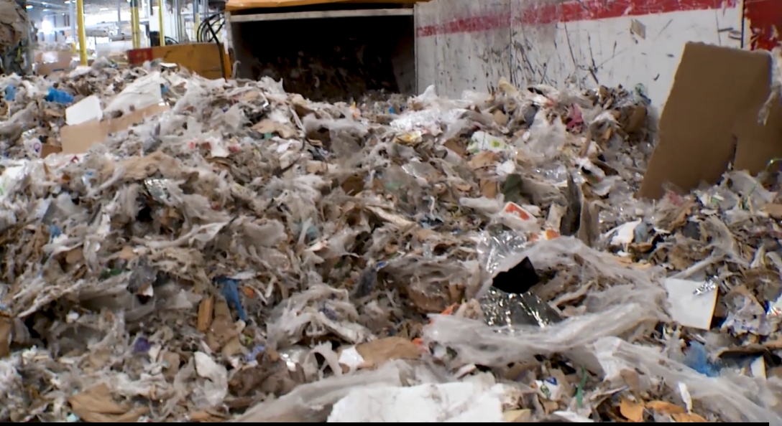
Other Options
  Economic, technology and logistical constraints
  Florida Recycles – Recovered Materials Rule
  Cement Co-Processing avoids both fossil fuel use and native materials extraction
  Energy Values - Engineered Municipal Solid Waste Fuel Streams – USEPA NHSM
  Reverse logistics driven by sustainability goals
  Higher costs for disposal = opportunity
Notes:
– growing concern over chemical recycling and expansion of incinerators is difficult
Florida Recycles – Recovered Materials rule allows for solid fuel manufacturing as a recycling activity
(Speaker Note – picture shows clean materials, difficult to recycle be blended into a coal replacement product)
(Walmart, Disney) – more opportunities for aggregated material streams

Slide 24
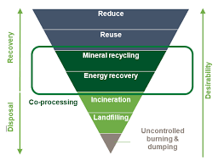
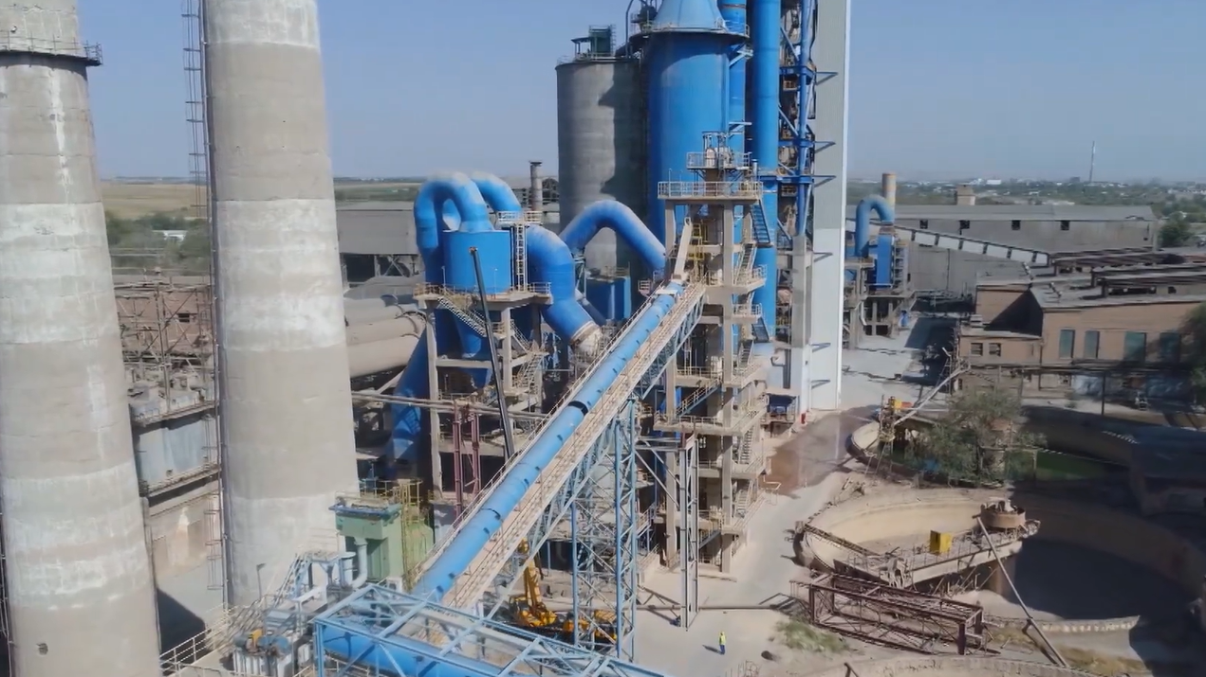
CONSIDER PARTNERSHIPS WITH CO-PROCESSORS
Notes:
this one kiln can take nearly 80,000 tons of non-hazardous recovered materials (paper, plastic and wood per year – and avoid nearly an equivalent amount of coal

Slide 25
Action Plan
  Control contamination (dirt, batteries, organics, mixed materials, difficult to process materials)
  Provide for site logistics and material stream integrity – organized area, clear markings
  Track generation
  Train teams to maintain integrity and quality control
  Look for aggregators and reverse logistics opportunities – have enough to make it worthwhile

Slide 26
Conclusion
Technologies and markets– new opportunities
Keep looking at waste minimization & “management in place” strategies for certain material classes – can we enclose, contain or encapsulate
Learn about aggregators and markets outside the Northeast
Evaluate streams of materials that may have higher market values, including foams, films and strapping.
Keep working with local partners for solutions
Plan for solid waste handling in new construction – how will it be handled?

Slide 27
Full-Service Environmental Health & Safety company:
Indoor Air Quality & Mold Concerns
Asbestos Management
Worker Exposure Analyses- Noise & Chemicals
Safety Training & Audits
Written Safety Programs
Among other EHS services
888.SAFE AIR
www.airpf.com
Notes:
RPF Environmental is your one-stop shop for all of your Environmental Health and Safety needs, whether you’re on a construction site, in a school, factory, health care facility, or real estate development. For more than 32 years, RPF Environmental’s experienced and qualified health and safety professionals have been assisting companies with a wide range of Industrial Hygiene services including mold inspection, water testing, and OSHA compliance.
We are also available to be your onsite Environmental Health and Safety partner to provide: safety audits, trainings, environmental and safety plans, respiratory protection, and machine guarding among other things.
That is to say that you can contact us to assist you with ANY and ALL of your environmental health and safety needs.

Slide 28
Thank you for attending!
Offices In
New Hampshire
Massachusetts
Maine
Illinois
Indiana
Questions and Comments are Welcome!
www.airpf.com
888.SAFE AIR

