Slide 1


PLAN NH 2026
September 15th, 2026

Slide 2
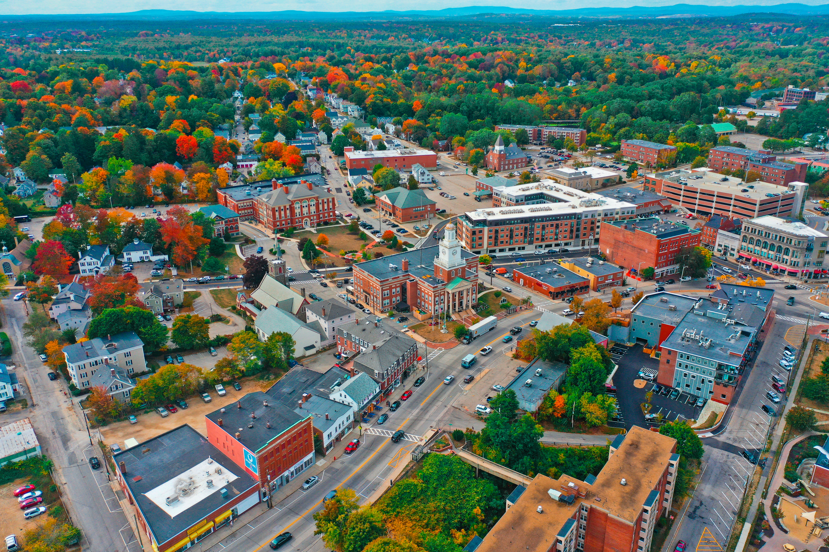
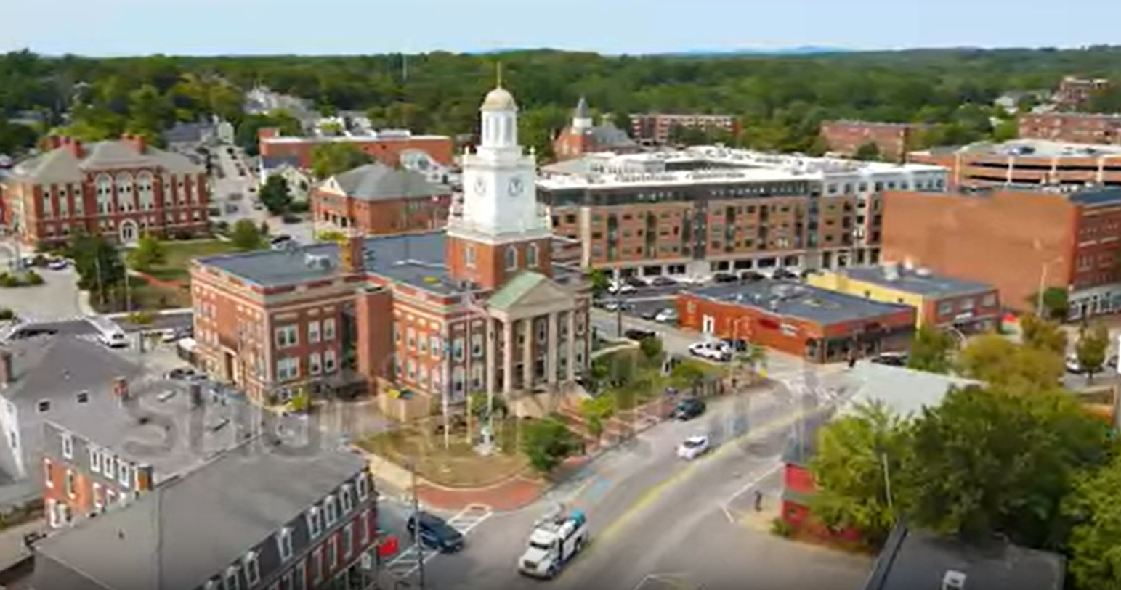
Dover

Slide 3
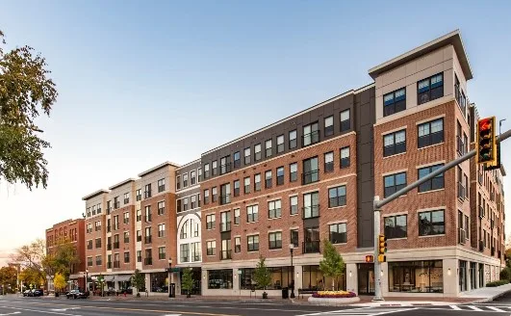
Orpheum

Slide 4
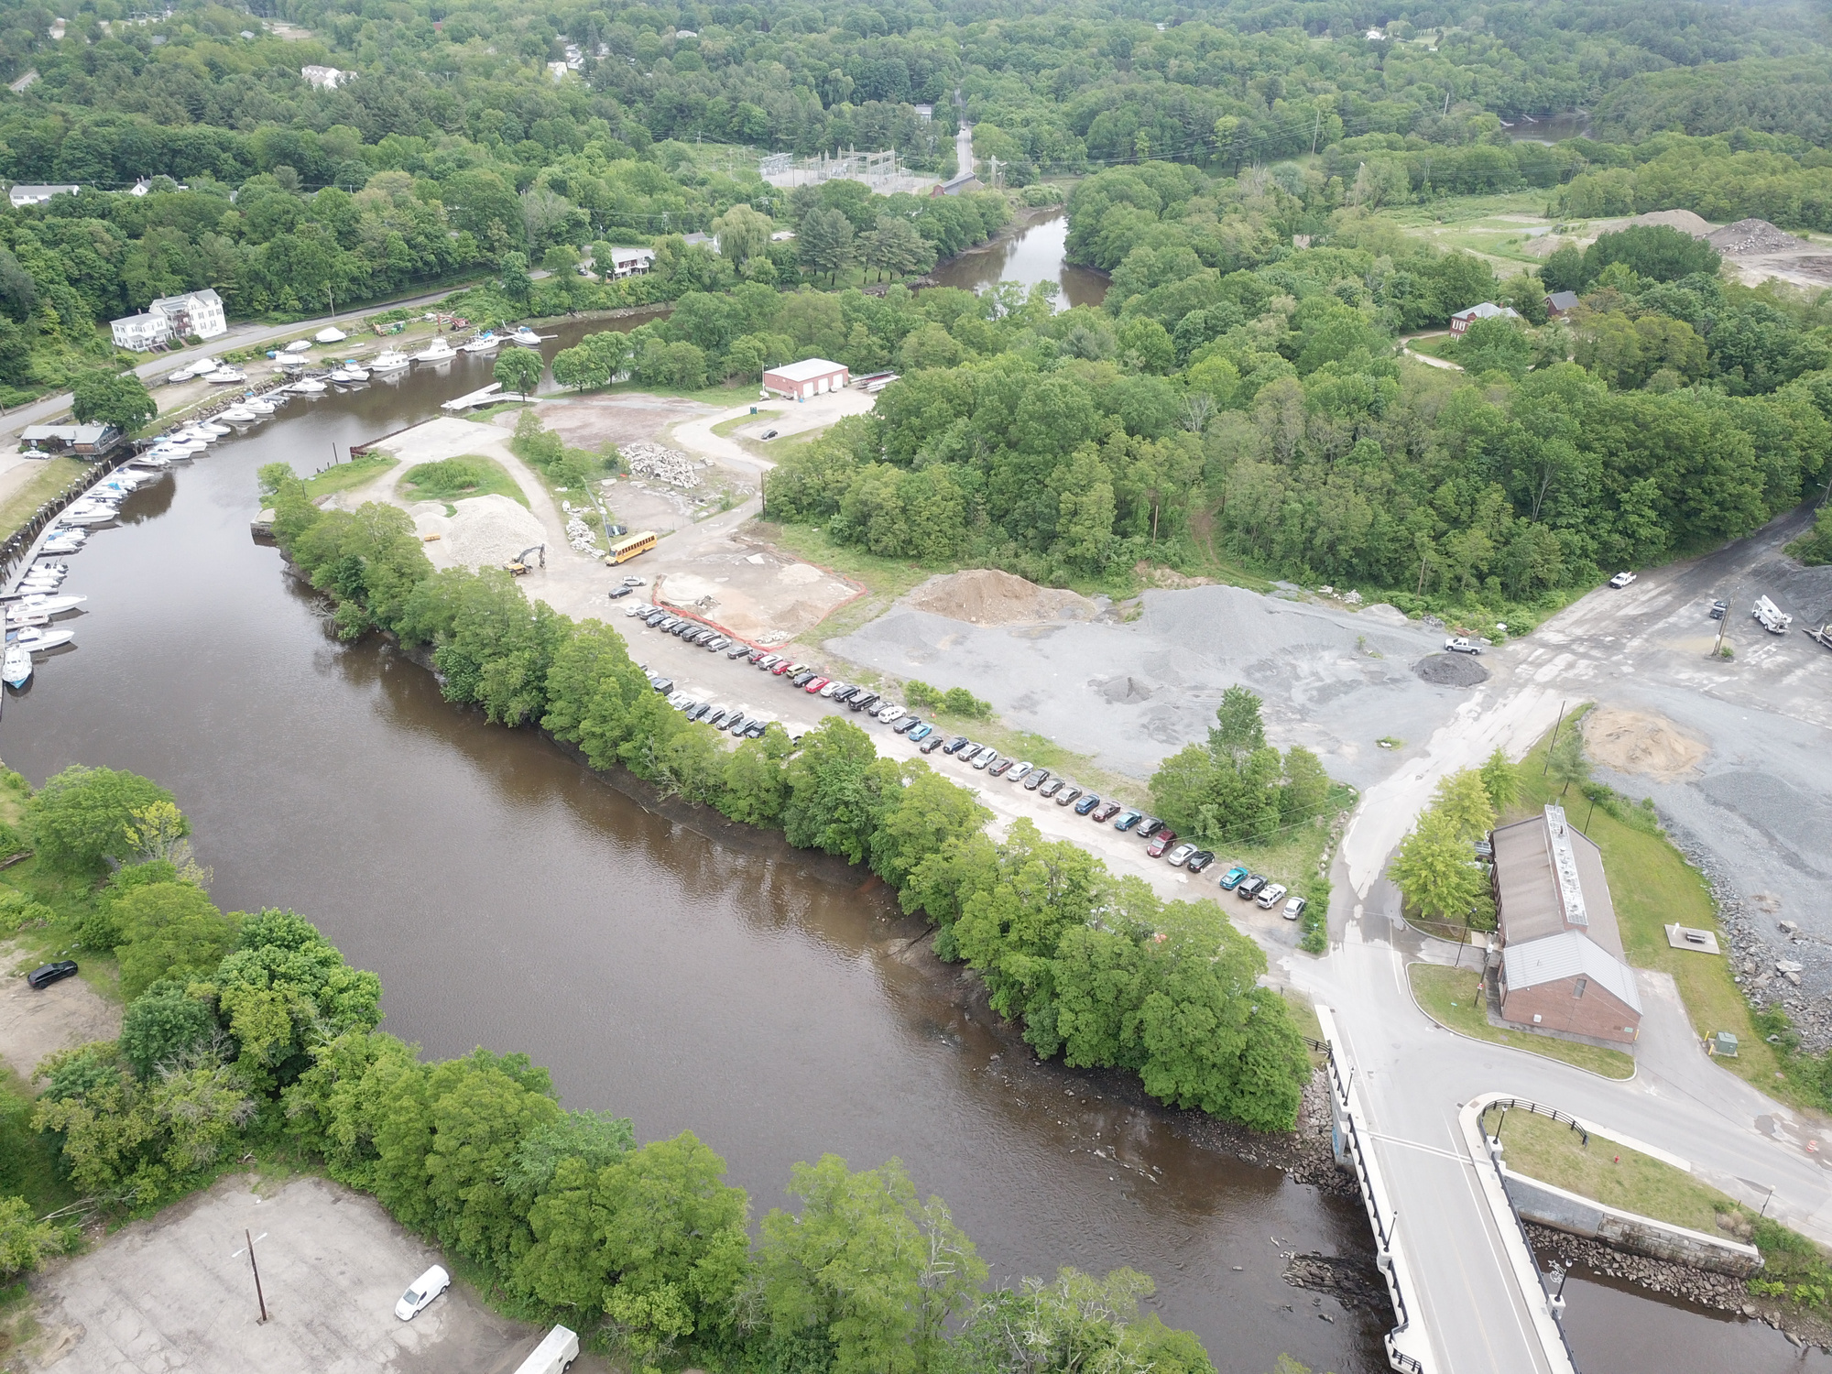
The Landscape
*Aerial from 2019

Slide 5
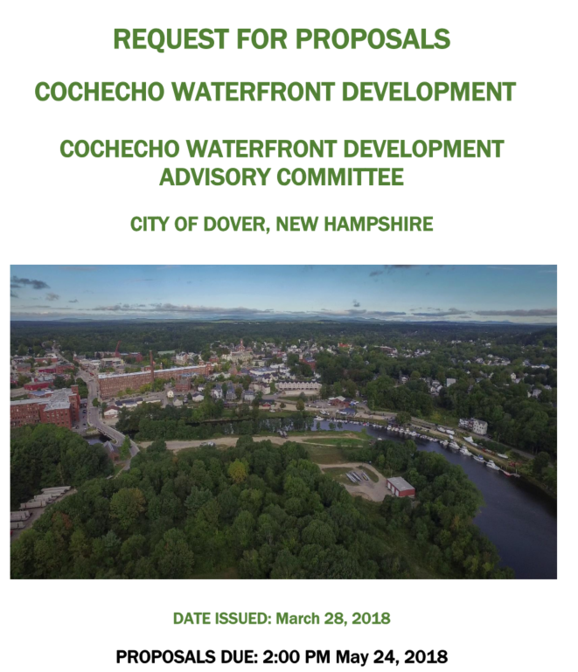

Slide 6
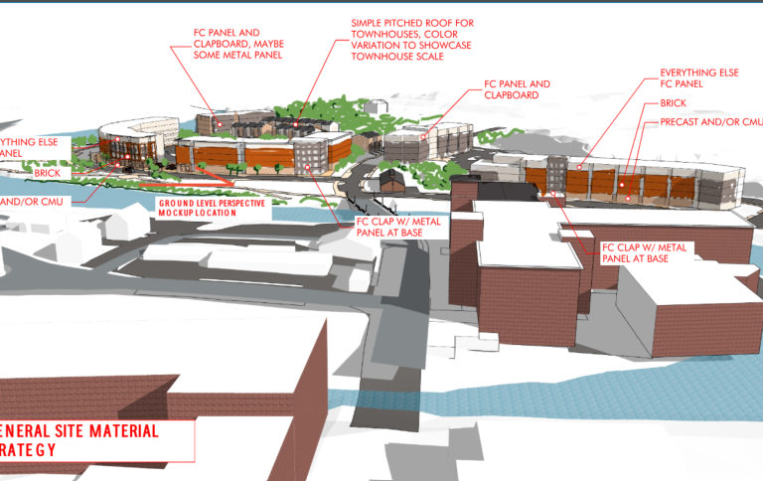
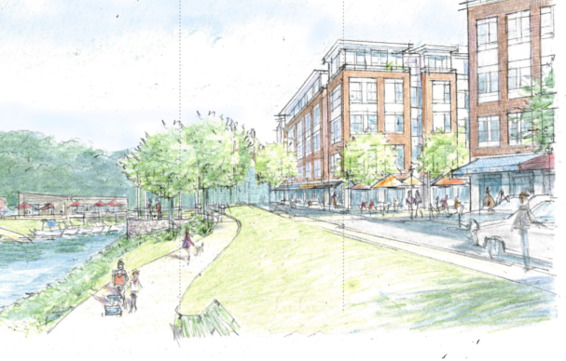
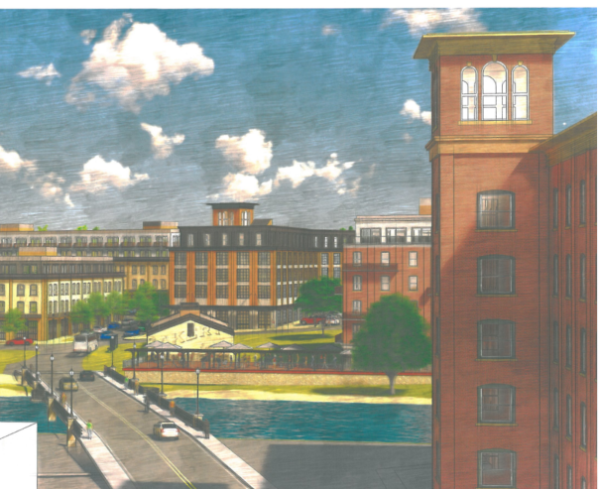
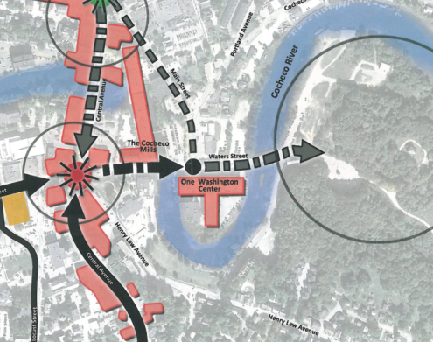
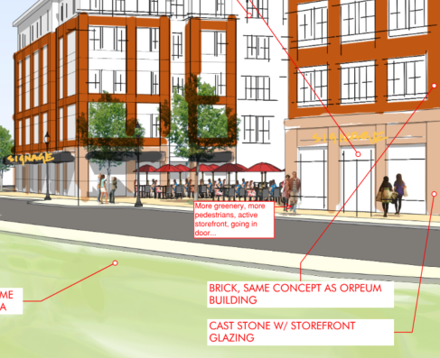

Slide 7

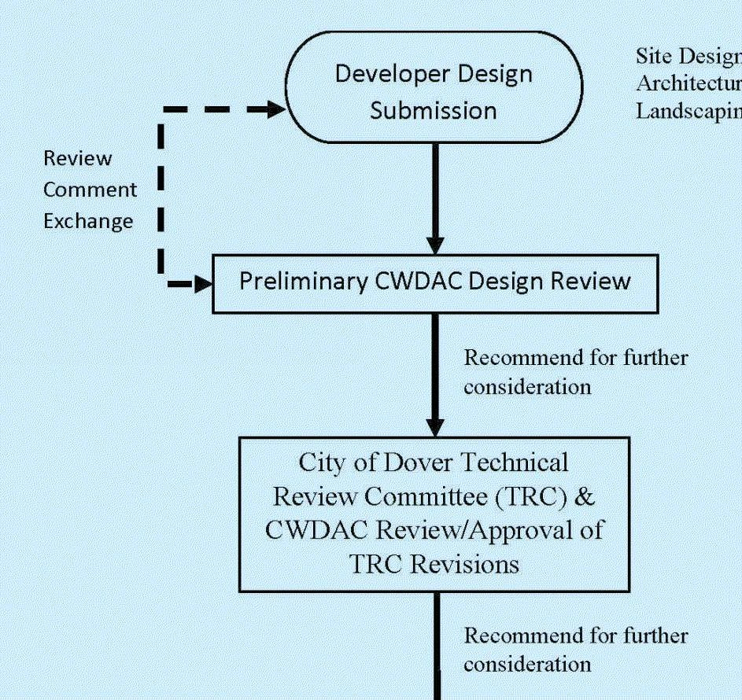

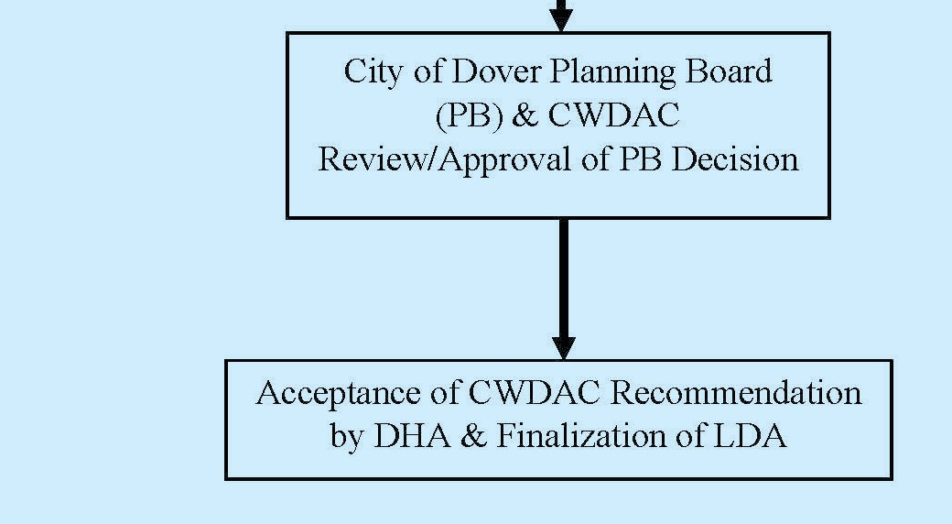
5-Star Review

Slide 8
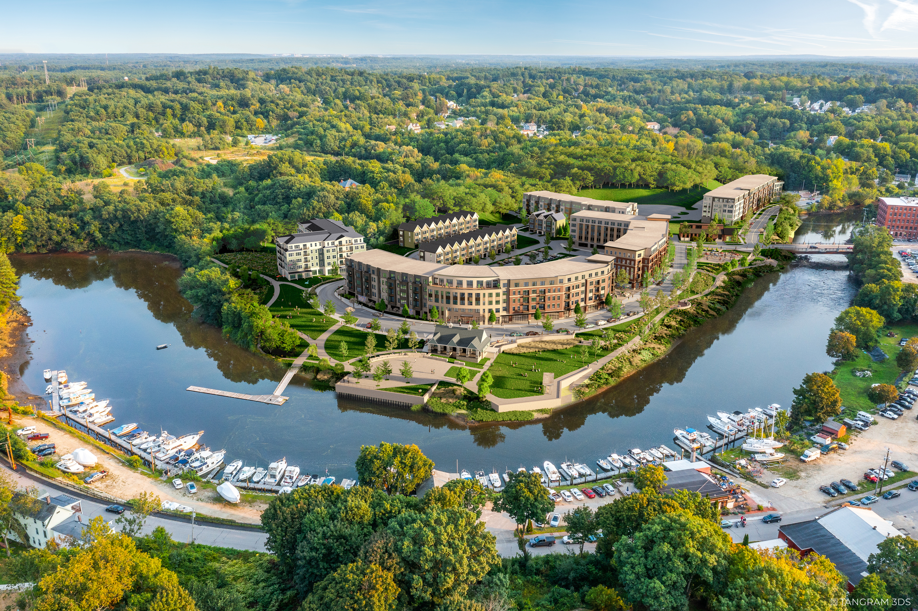
Master Plan
*Rendering by Tangram

Slide 9
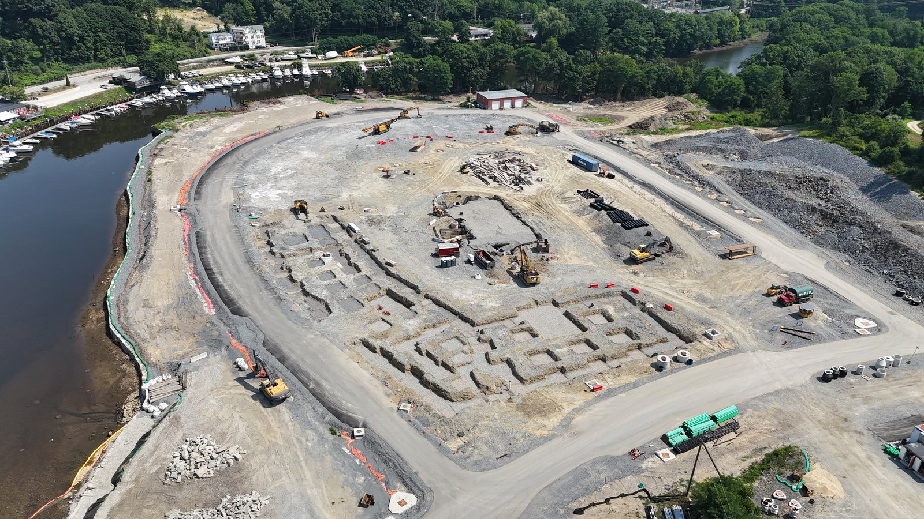
Public/Private

Slide 10
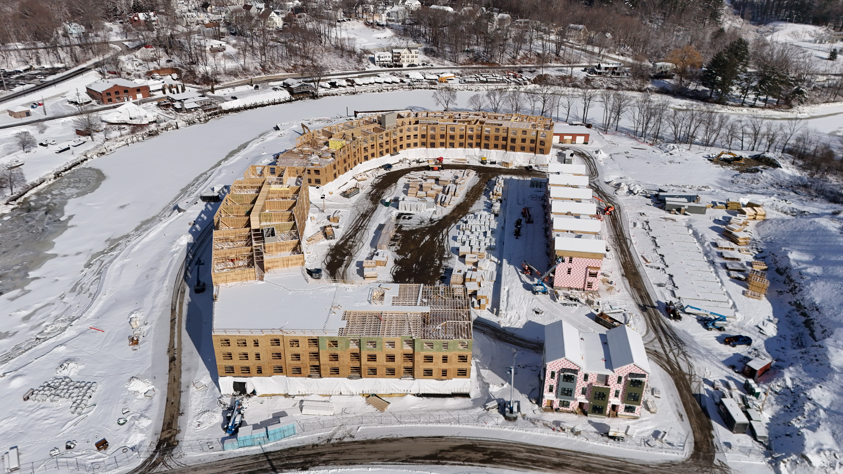
Capital

Slide 11



The Phases of The Waterfront District
Phase 2
Phase 3
Phase 1

Slide 12
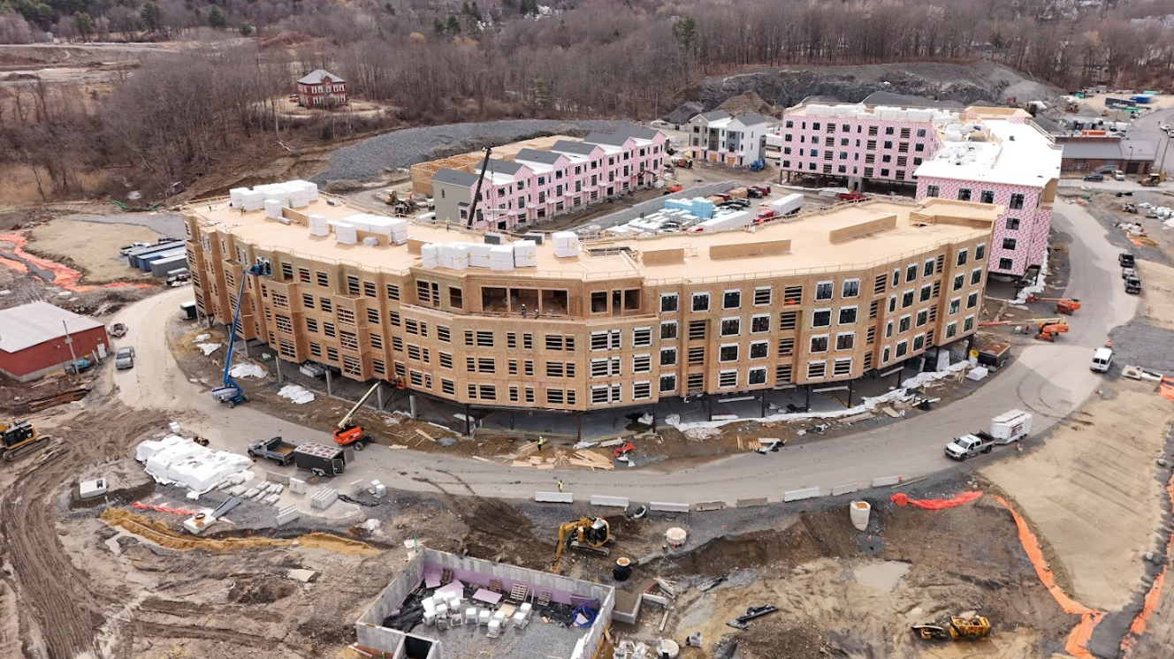
PHASE 1
Apartments: 197
Studio to 3- Bedrooms
650- 1,400 SF
Townhouses: 23
3 Bed/2.5 Bath
2,200 SF
Cowork
8,000 SF
Open to the Public
Commercial
12,000 SF
*Building D in March 2025

Slide 13

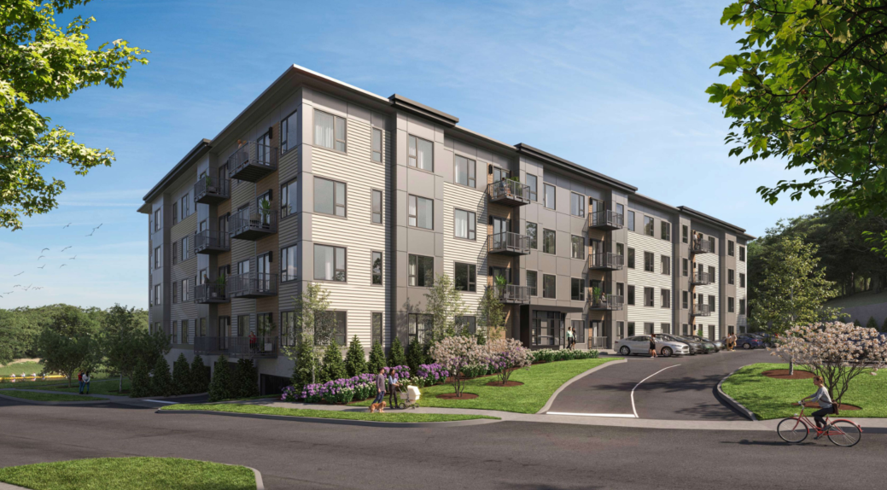
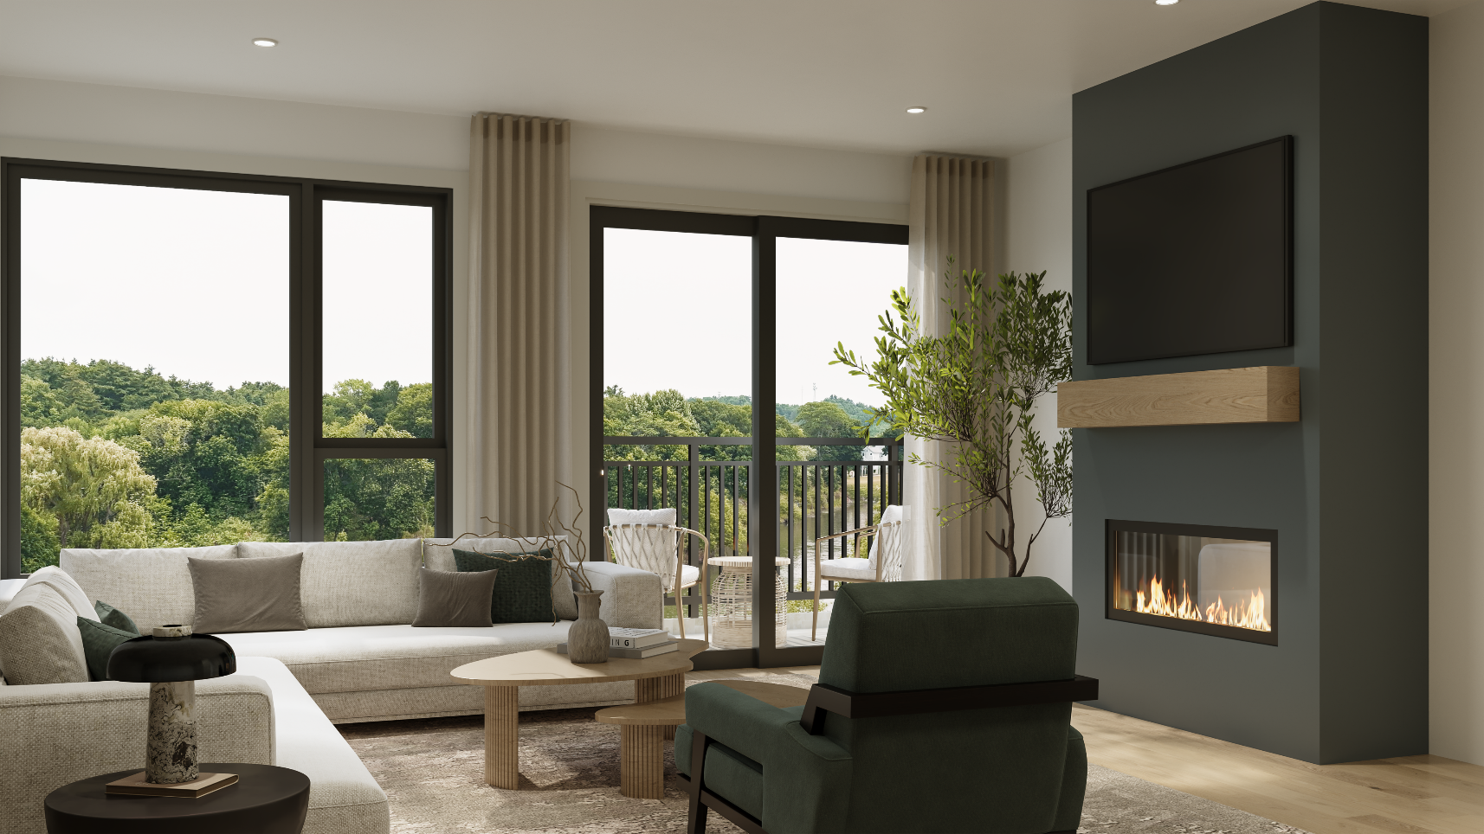
PHASE 2
43 For Sale Condominiums
Timing: Spring 2027

Slide 14
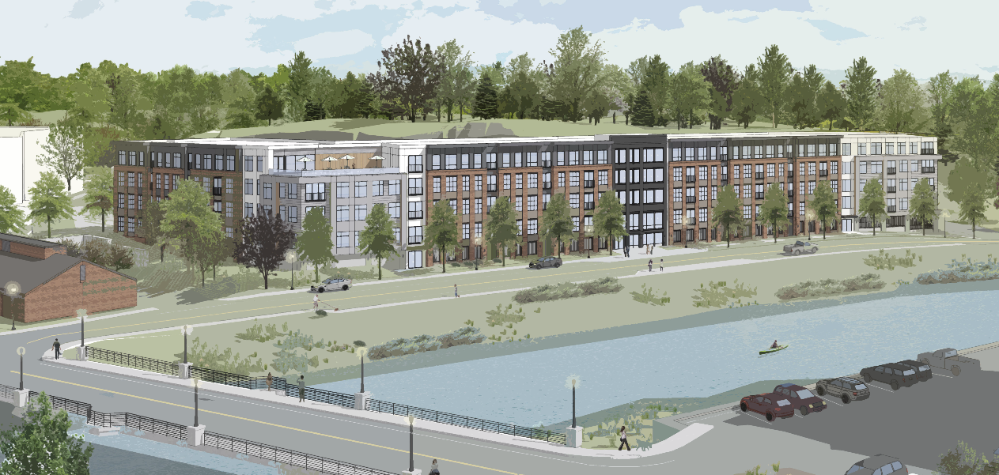
PHASE 3
Will include a range of floor plans from studios to three-bedrooms
Offering river views and rooftop amenities
*Rendering of Building A
Timing: 2027-2028

Slide 15
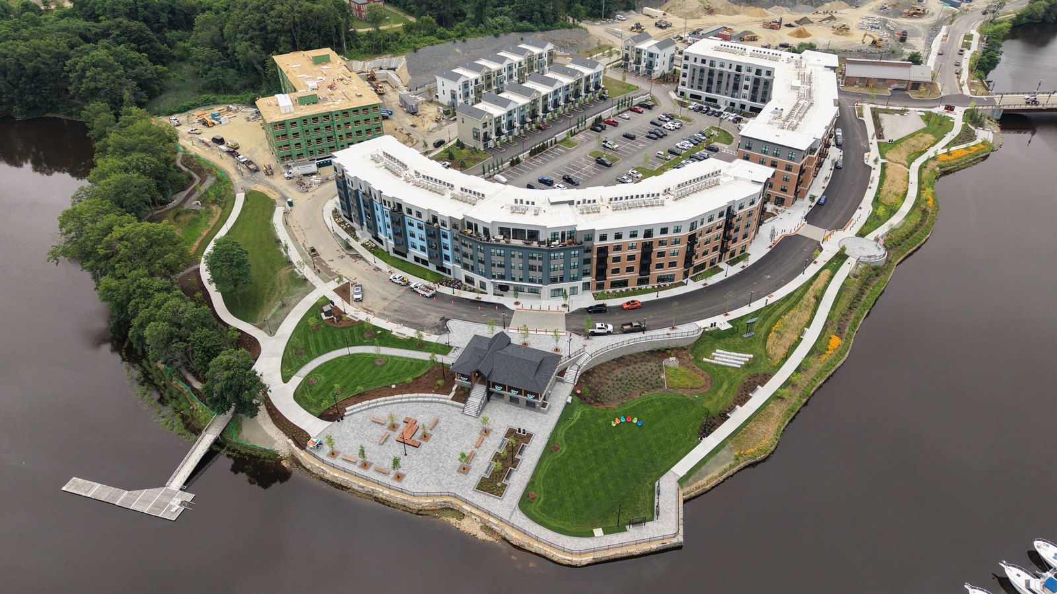

Slide 16
THANK YOU
City of Dover
City Officials
CWDAC
The Waterfront District would not be possible without your support!

