Slide 1
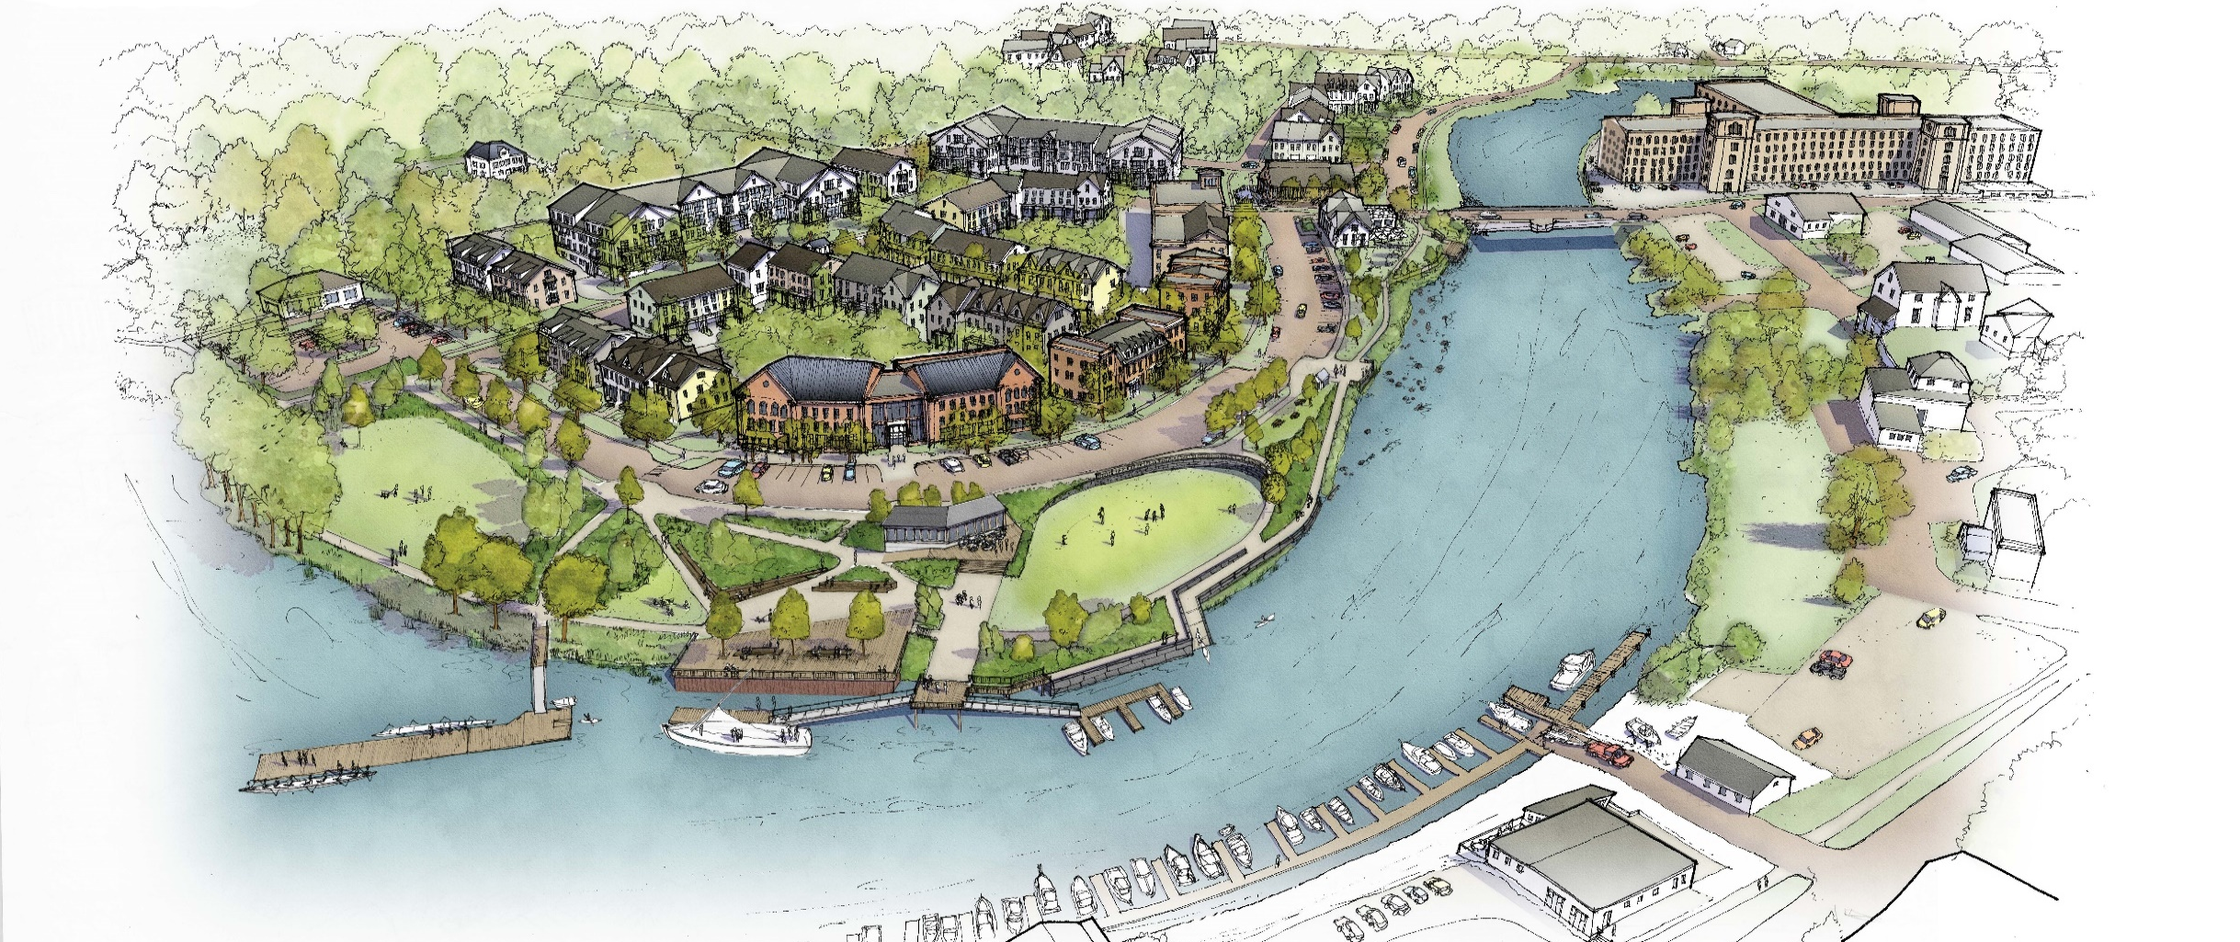
Plan NH 2026 Fall Conference
Built to Belong: Dover WAterfront
September 15, 2026
Notes:
Good morning, thanks to the Chamber for inviting me to provide you with an update on the waterfront redevelopment project. I have worked in the City’s Planning Department for 22 years and have been involved in the waterfront for about half that time.

Slide 2
4 Questions To Consider
Where have we been?
How did we get here?
Where are we now?
Where are we going?

Slide 3
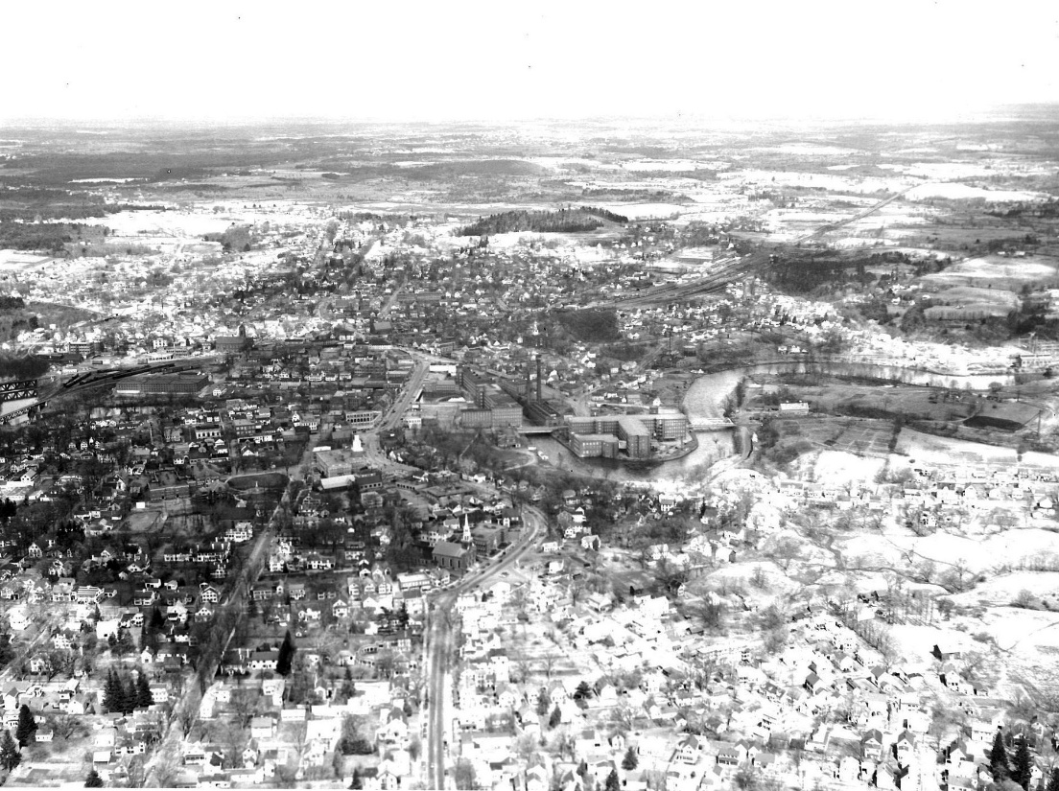
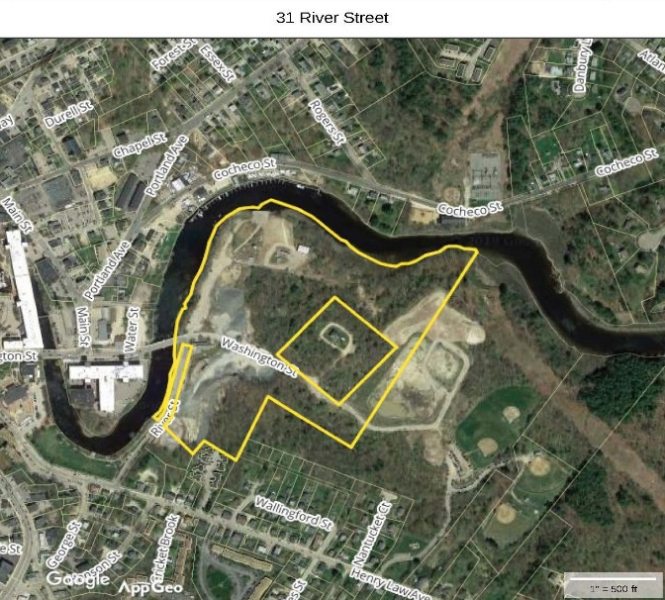
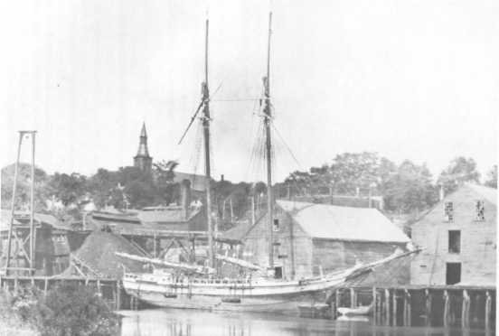
Where Have We Been?
Long indigenous history
Dover began as a fishing village in 1623
Cochecho River Trade on this site
Shift in Industry during Industrial Revolution to manufacturing
Eventually used for municipal uses such as WWTP and DPW facility
Notes:
So this is a map of the waterfront site.
The City’s efforts to redevelopment the City property along the Cochecho River started back in 1984, almost 35 years ago. A considerable amount of planning, studies, committee meetings and public participation has occurred since then. As I was preparing for this morning, I realized that I provided a similar update just two years ago. My presentation this morning will focus on the significant and exciting progress that has been made in the last two years.

Slide 4
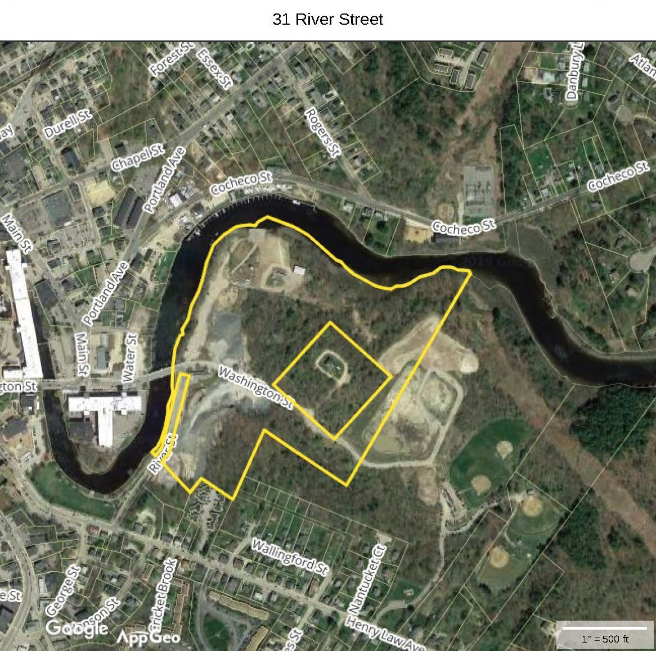
Waterfront Site
29 Acre City owned parcel
1,900 ft. of frontage on tidal Cochecho River
Adjacent to downtown, Henry Law Park and Maglaras Park
Long history of municipal uses such as WWTP and DPW facility
Access via Makem Bridge and Payne St. (Formerly River St)
Notes:
So this is a map of the waterfront site.
The City’s efforts to redevelopment the City property along the Cochecho River started back in 1984, almost 35 years ago. A considerable amount of planning, studies, committee meetings and public participation has occurred since then. As I was preparing for this morning, I realized that I provided a similar update just two years ago. My presentation this morning will focus on the significant and exciting progress that has been made in the last two years.

Slide 5
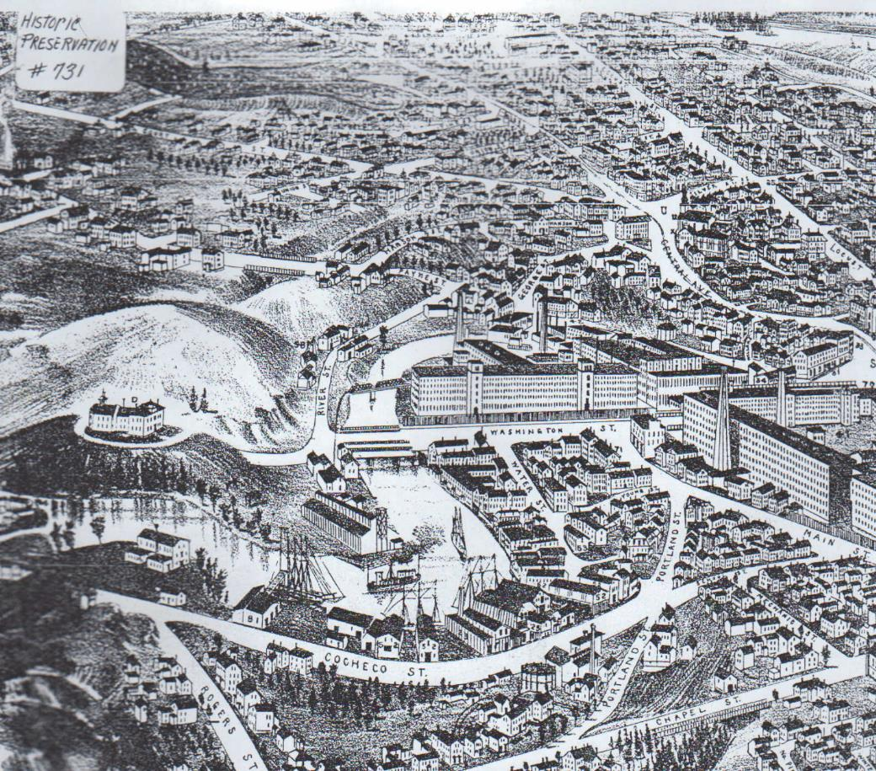
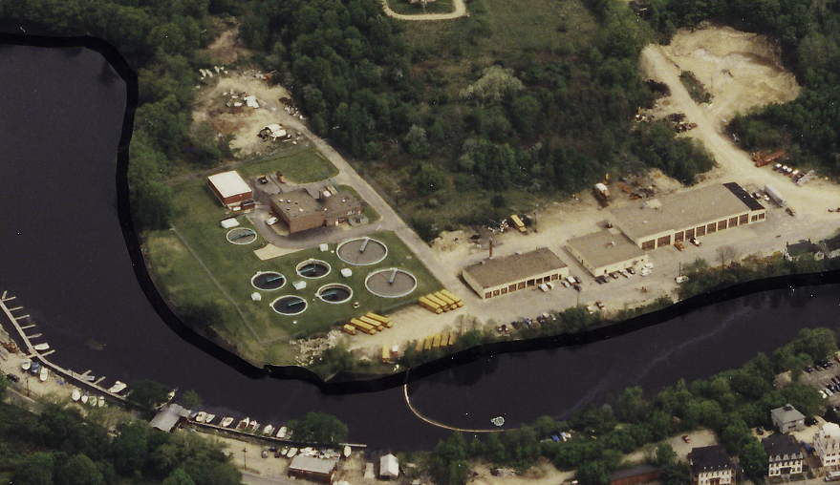
Waterfront Site

Slide 6
Vision
Goal was always an extension of the downtown and re-development of the site
Public input
Public-private partnership
Notes:
So this is a map of the waterfront site.
The City’s efforts to redevelopment the City property along the Cochecho River started back in 1984, almost 35 years ago. A considerable amount of planning, studies, committee meetings and public participation has occurred since then. As I was preparing for this morning, I realized that I provided a similar update just two years ago. My presentation this morning will focus on the significant and exciting progress that has been made in the last two years.

Slide 7
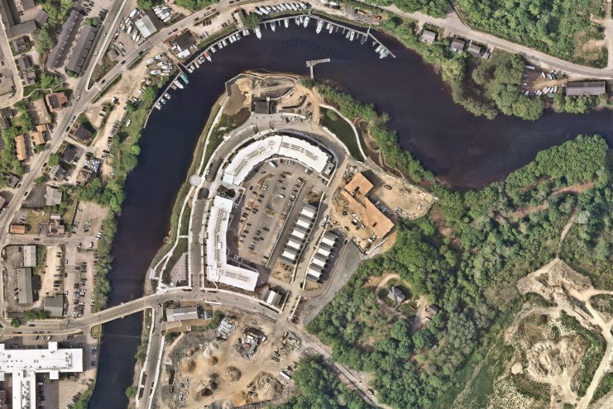
How did we get here? Zoning
Cochecho Waterfront District created
Goal was always an extension of the downtown and re-development of the site
Design Guidelines
Notes:
So this is a map of the waterfront site.
The City’s efforts to redevelopment the City property along the Cochecho River started back in 1984, almost 35 years ago. A considerable amount of planning, studies, committee meetings and public participation has occurred since then. As I was preparing for this morning, I realized that I provided a similar update just two years ago. My presentation this morning will focus on the significant and exciting progress that has been made in the last two years.

Slide 8
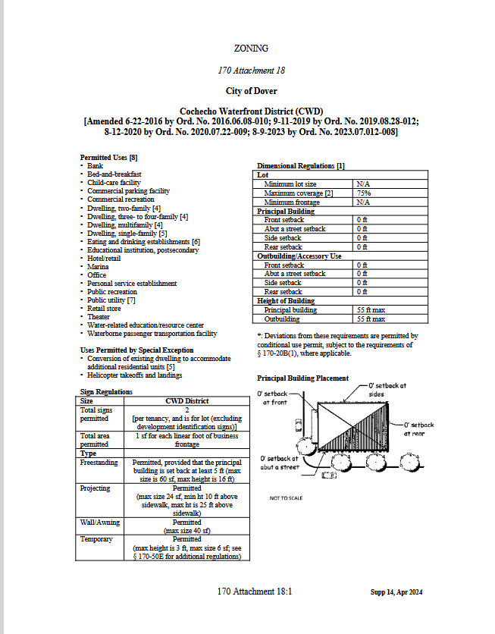
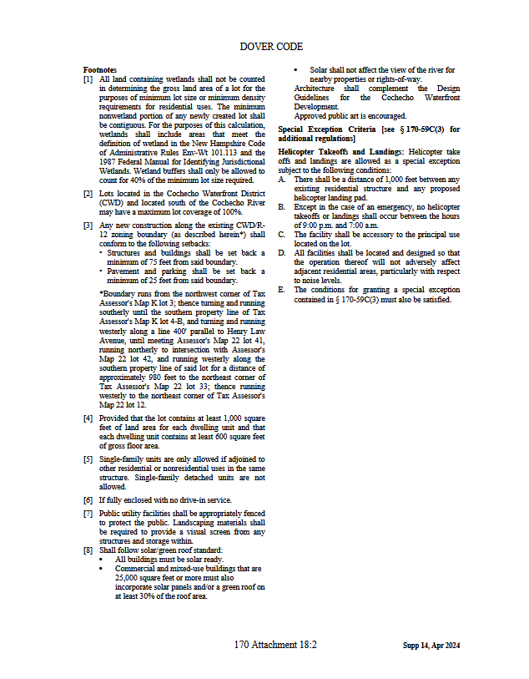
Notes:
So this is a map of the waterfront site.
The City’s efforts to redevelopment the City property along the Cochecho River started back in 1984, almost 35 years ago. A considerable amount of planning, studies, committee meetings and public participation has occurred since then. As I was preparing for this morning, I realized that I provided a similar update just two years ago. My presentation this morning will focus on the significant and exciting progress that has been made in the last two years.

Slide 9
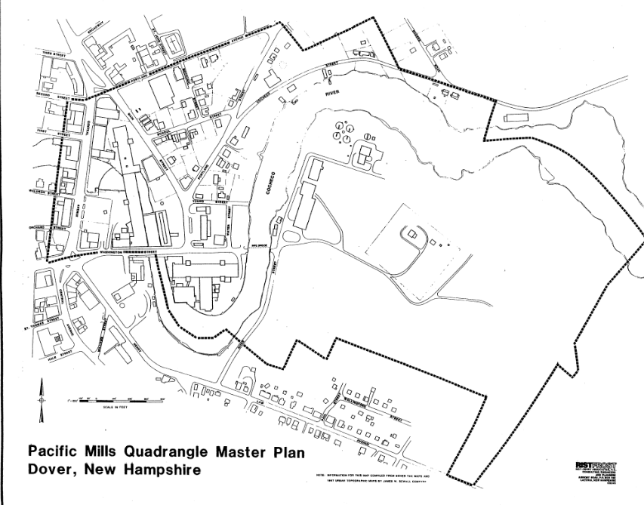
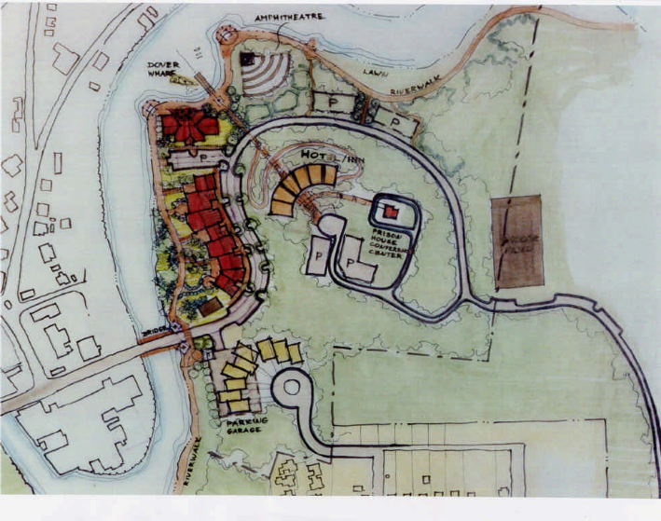
HOW DID WE GET HERE?
1984: Pacific Mills Master Plan
1990: Council Committee-
  Cochecho River Waterfront MP
1994: Chamber Waterfront Comm. 1996 Waterfront Design Charette
2002: Chamber Waterfront Comm.
2005: CWDAC established

Slide 10
Cochecho waterfront development advisory committee
Collaboration with The Dover Housing Authority
Tasked with redeveloping the waterfront property since 2005
15 members
  12 citizens
  3 ex-officio members
CWDAC’s vision is to provide a vibrant waterfront with public gathering places and access to the water, a place for people to live, meet, relax, encounter nature, conduct business and learn of Dover’s past. The social and economic benefits derived from a revitalized waterfront are shared by all of Dover’s residents.
Notes:
I don’t want to spend too much time on the history and background but it is important to understand the authority and responsibilities of the current waterfront committee.
Each member is appointed for a 3 year term, so in spite of what some dedicated long time members might feel, it is not a life sentence.

Slide 11
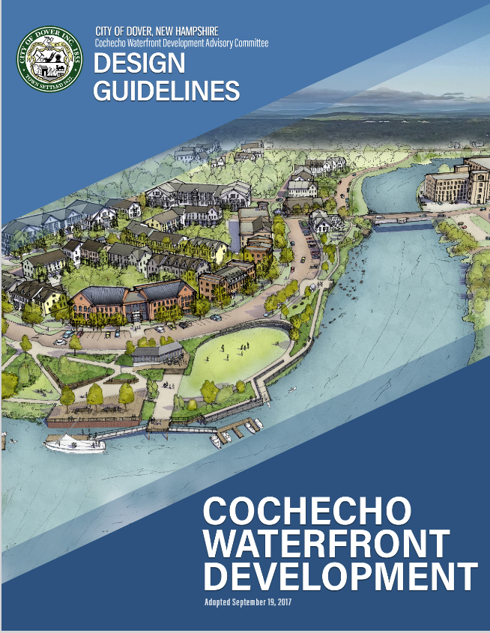
Where Have We Been?
Created a Vision
Held a charrette
Solicited/Selected Developer
2008 Recession
Created TIF District
Created Design Guidelines
Went back out to bid in 2018

Slide 12
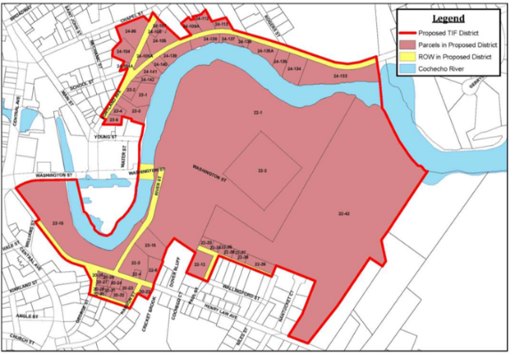
How did we get here? Financing
Set up a Tax Increment Financing (TIF) District
Notes:
So this is a map of the waterfront site.
The City’s efforts to redevelopment the City property along the Cochecho River started back in 1984, almost 35 years ago. A considerable amount of planning, studies, committee meetings and public participation has occurred since then. As I was preparing for this morning, I realized that I provided a similar update just two years ago. My presentation this morning will focus on the significant and exciting progress that has been made in the last two years.

Slide 13
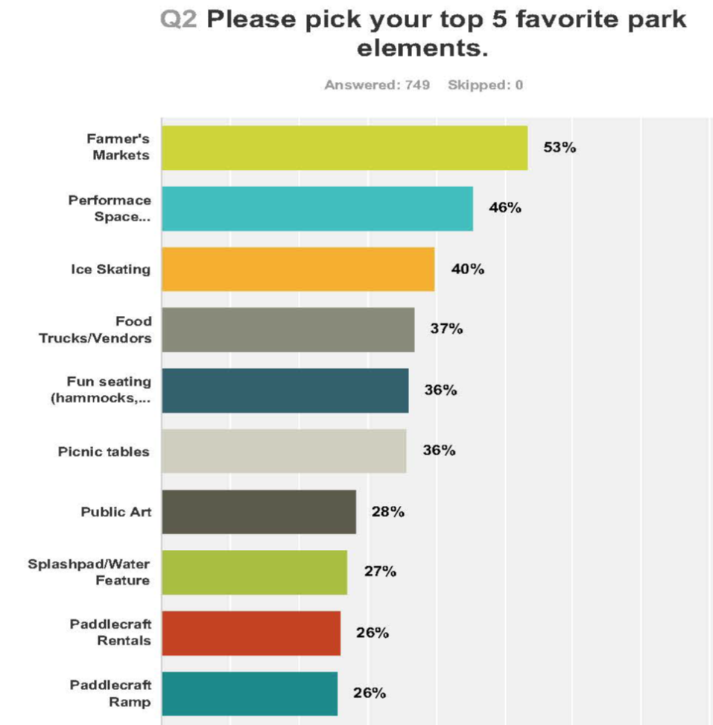
Public investments
Expand downtown area by 12%
Continue Riverwalk
Provide public access to the Cochecho
Create public gathering spaces
Enhance a vibrant community
Create pad ready development areas
Create public roadways/utilities

Slide 14
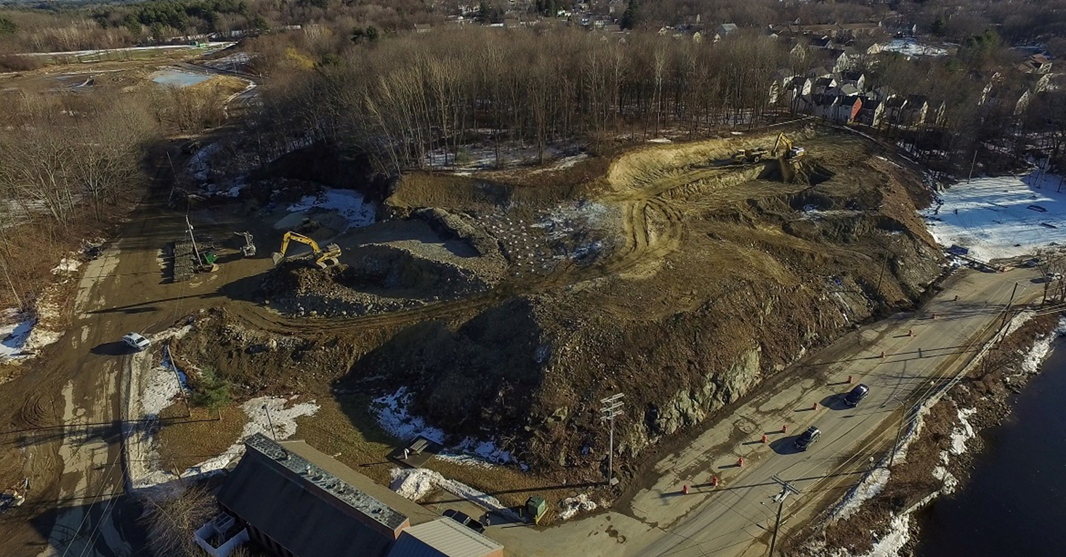
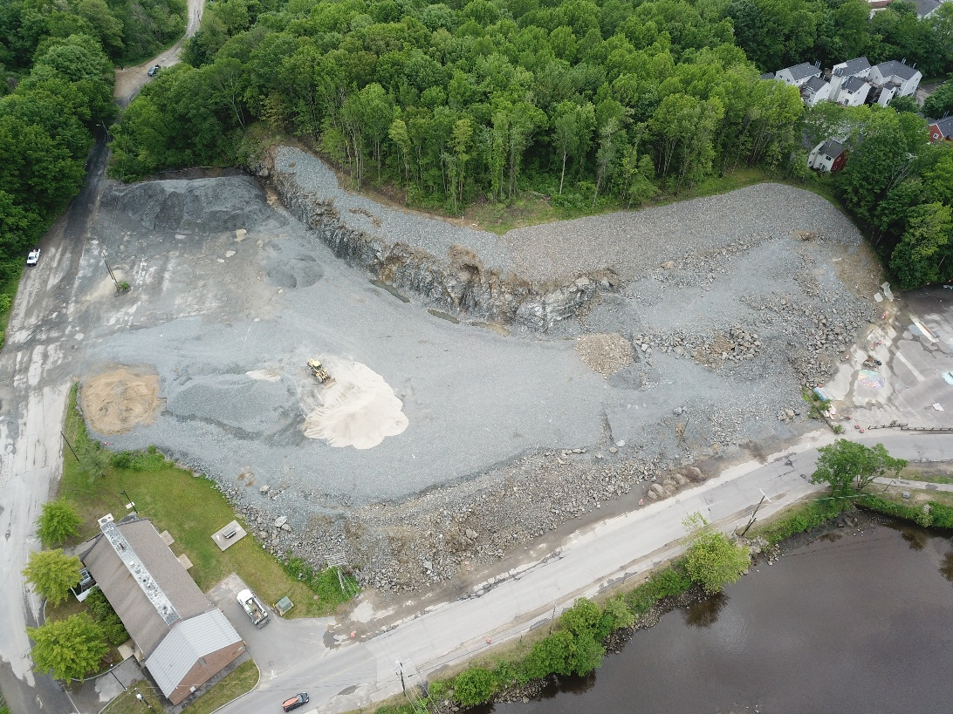
Bluff Excavation

Slide 15
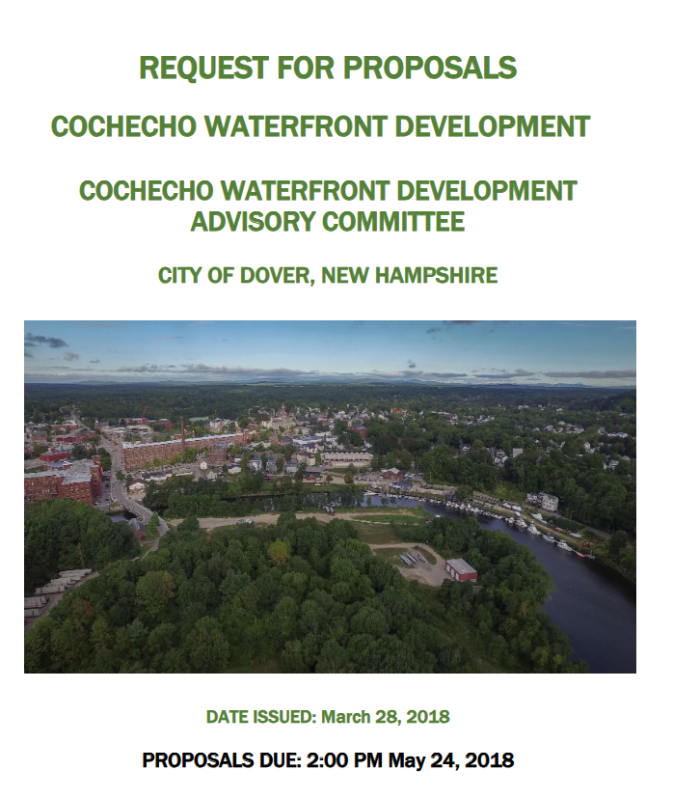
How Did We Get Here?

Slide 16
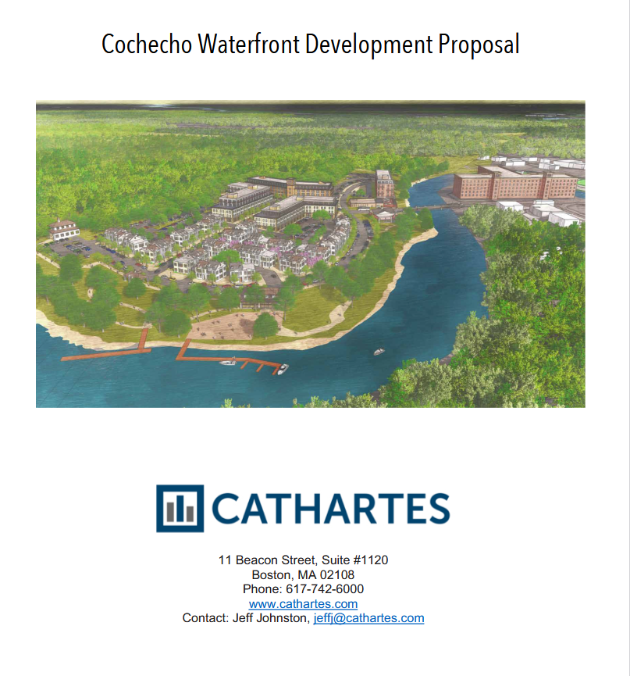
How Did We Get Here?

Slide 17
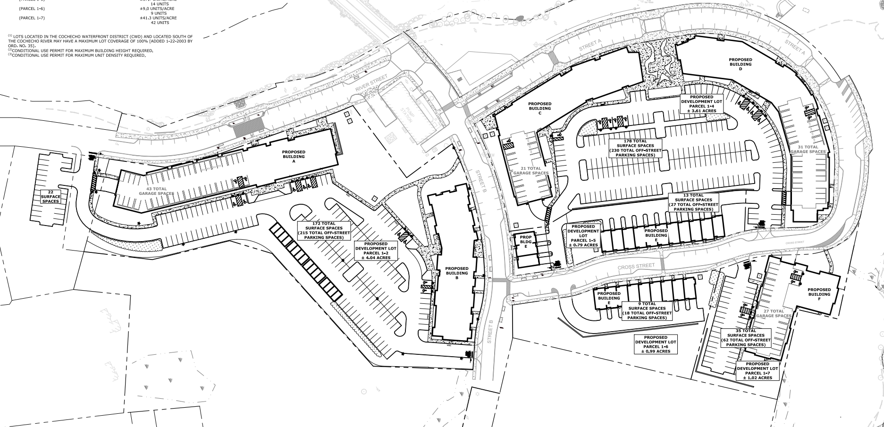
How Did We Get Here?

Slide 18
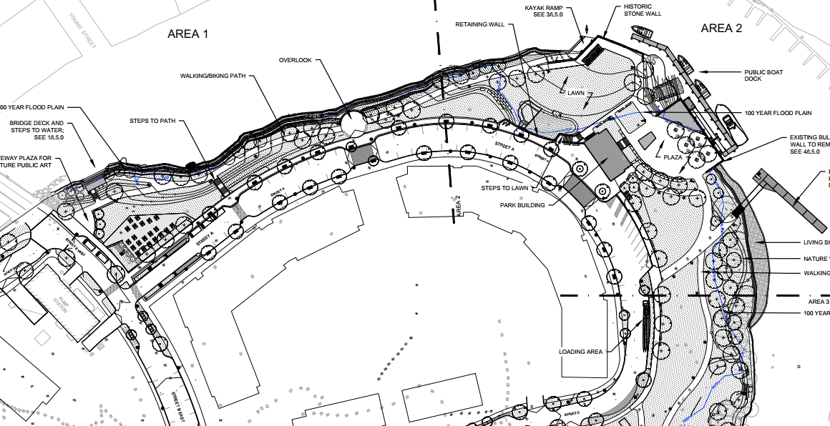
How Did We Get Here?

Slide 19
The Deal
Purchase price: $3,372,500
Mixed Use Development to include multi-family residential, retail and office, restaurant, and potentially a hotel
Total size: 500,000 square feet
475 multi-family residential units or hotel rooms
20,000 square feet of street level commercial/restaurant space
City to use $20+ million in TIF funding to complete public improvements: bluff excavation, site grading, shoreline stabilization, waterfront park, streets and public utilities
Guarantee $75,000,000 valuation

Slide 20
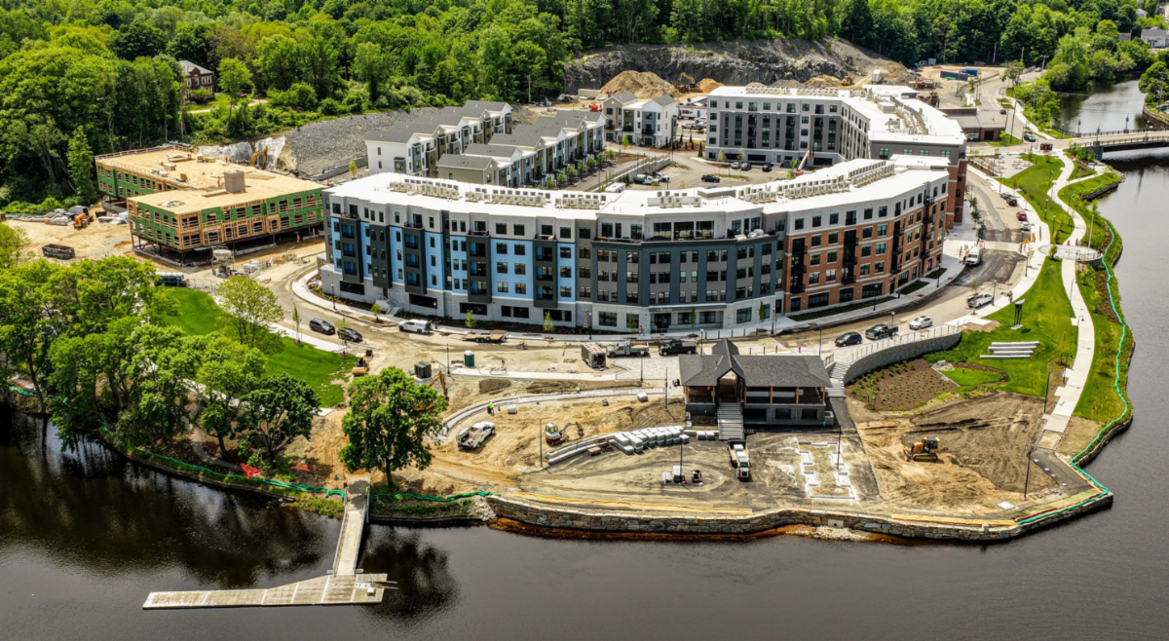

Slide 21








Consultants/vendors

Slide 22
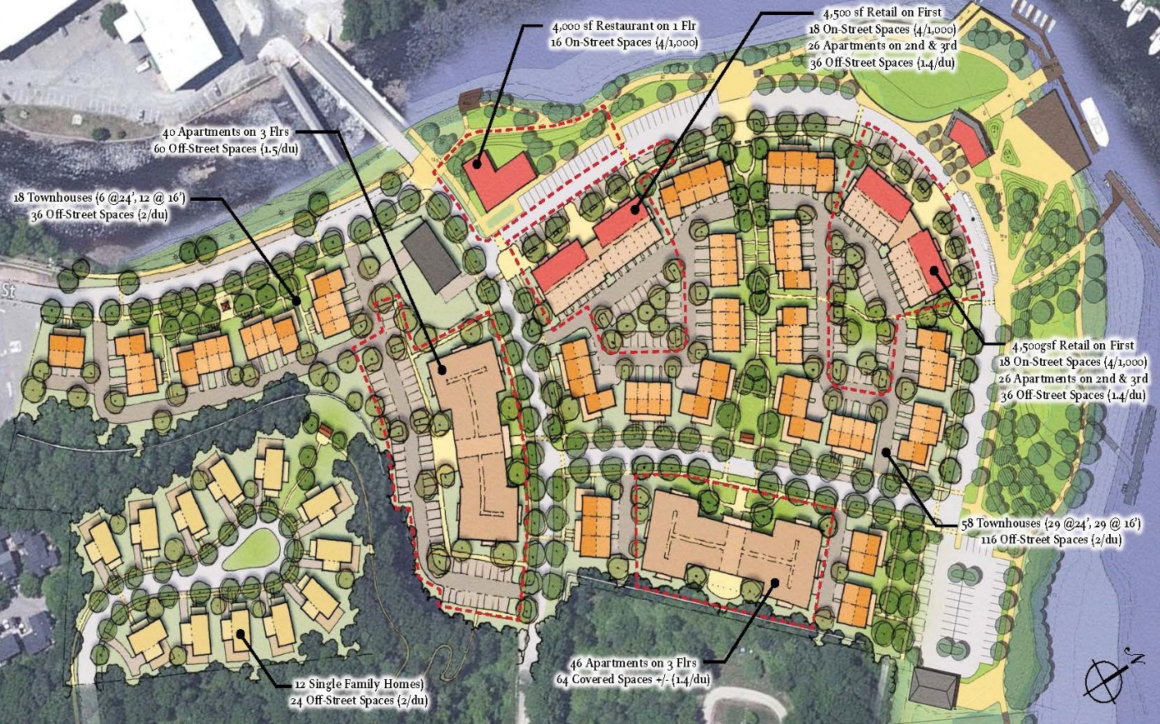
Concept

Slide 23
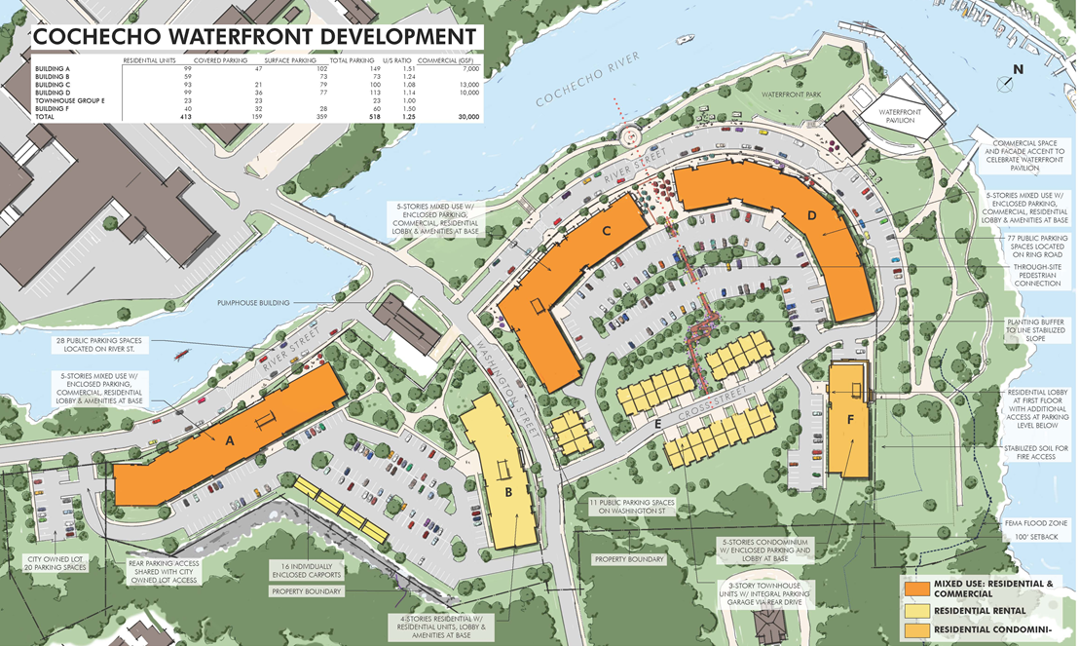
Reality

Slide 24
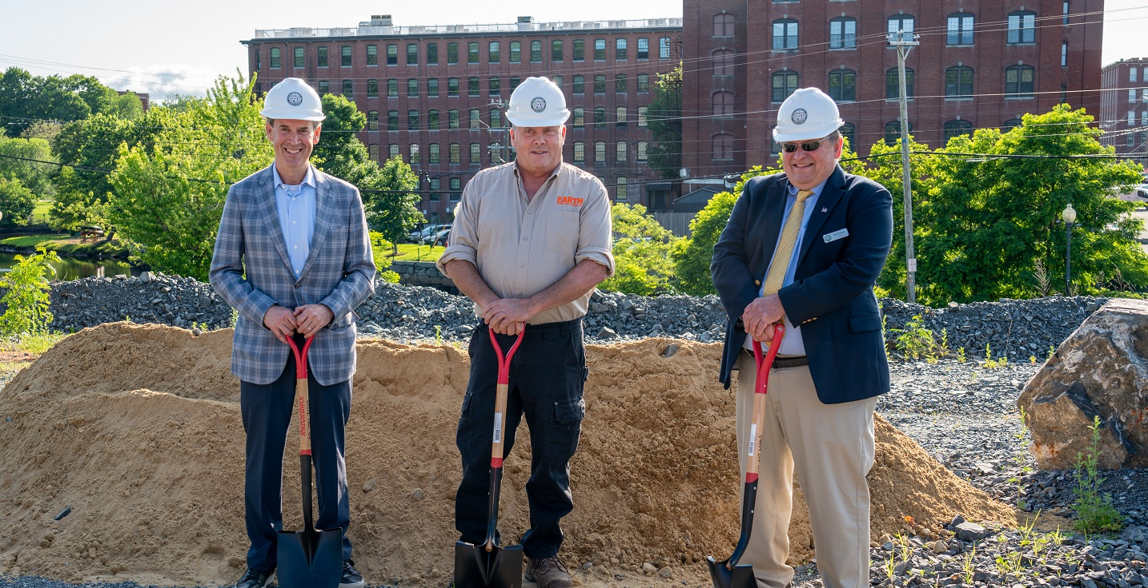

Slide 25
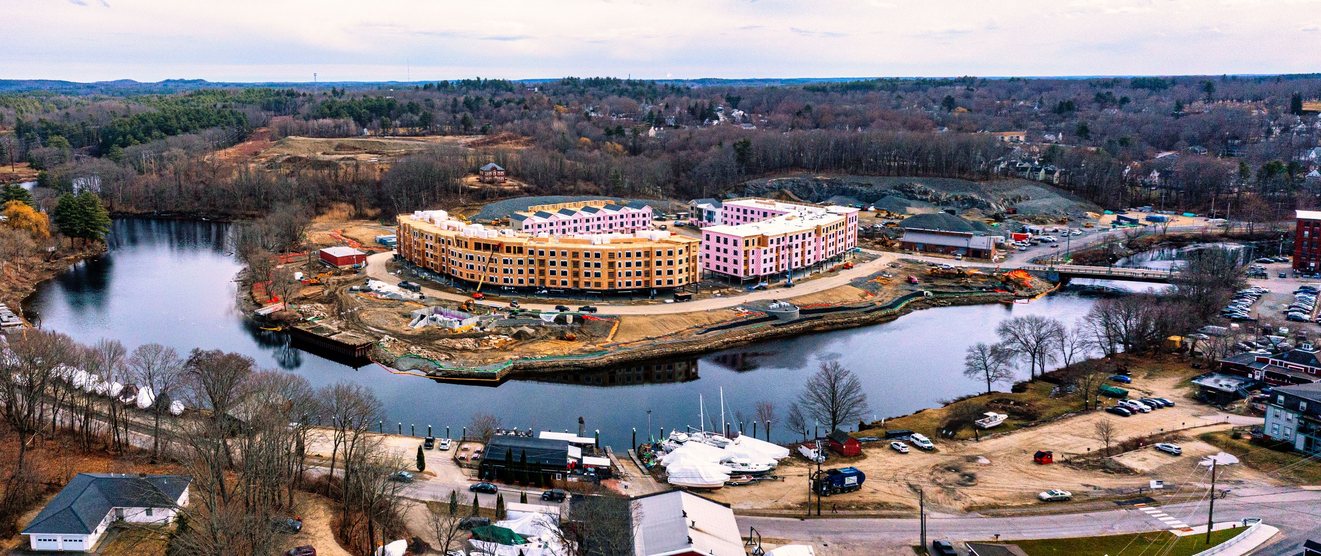
Notes:
Good morning, thanks to the Chamber for inviting me to provide you with an update on the waterfront redevelopment project. I have worked in the City’s Planning Department for 22 years and have been involved in the waterfront for about half that time.

Slide 26
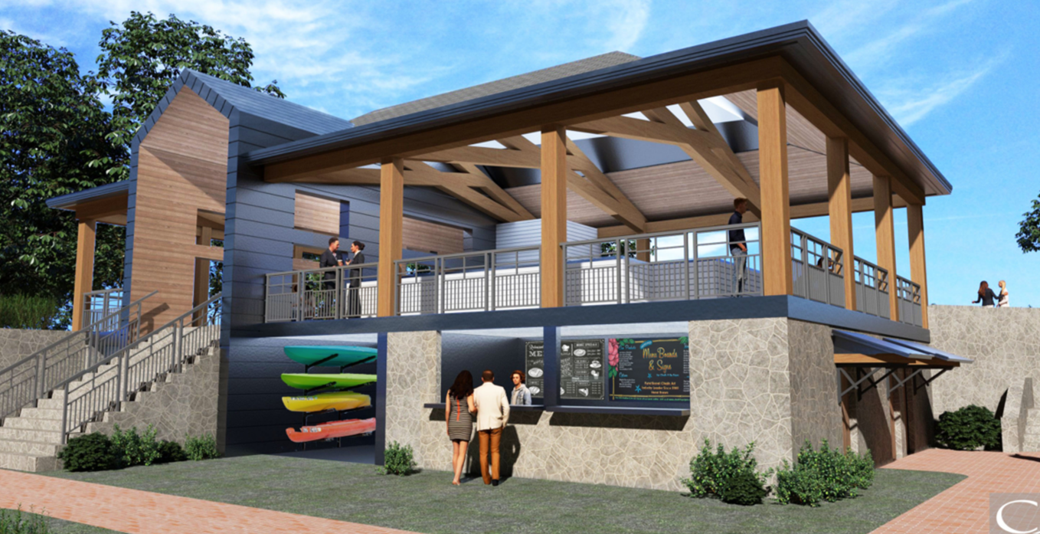

Slide 27
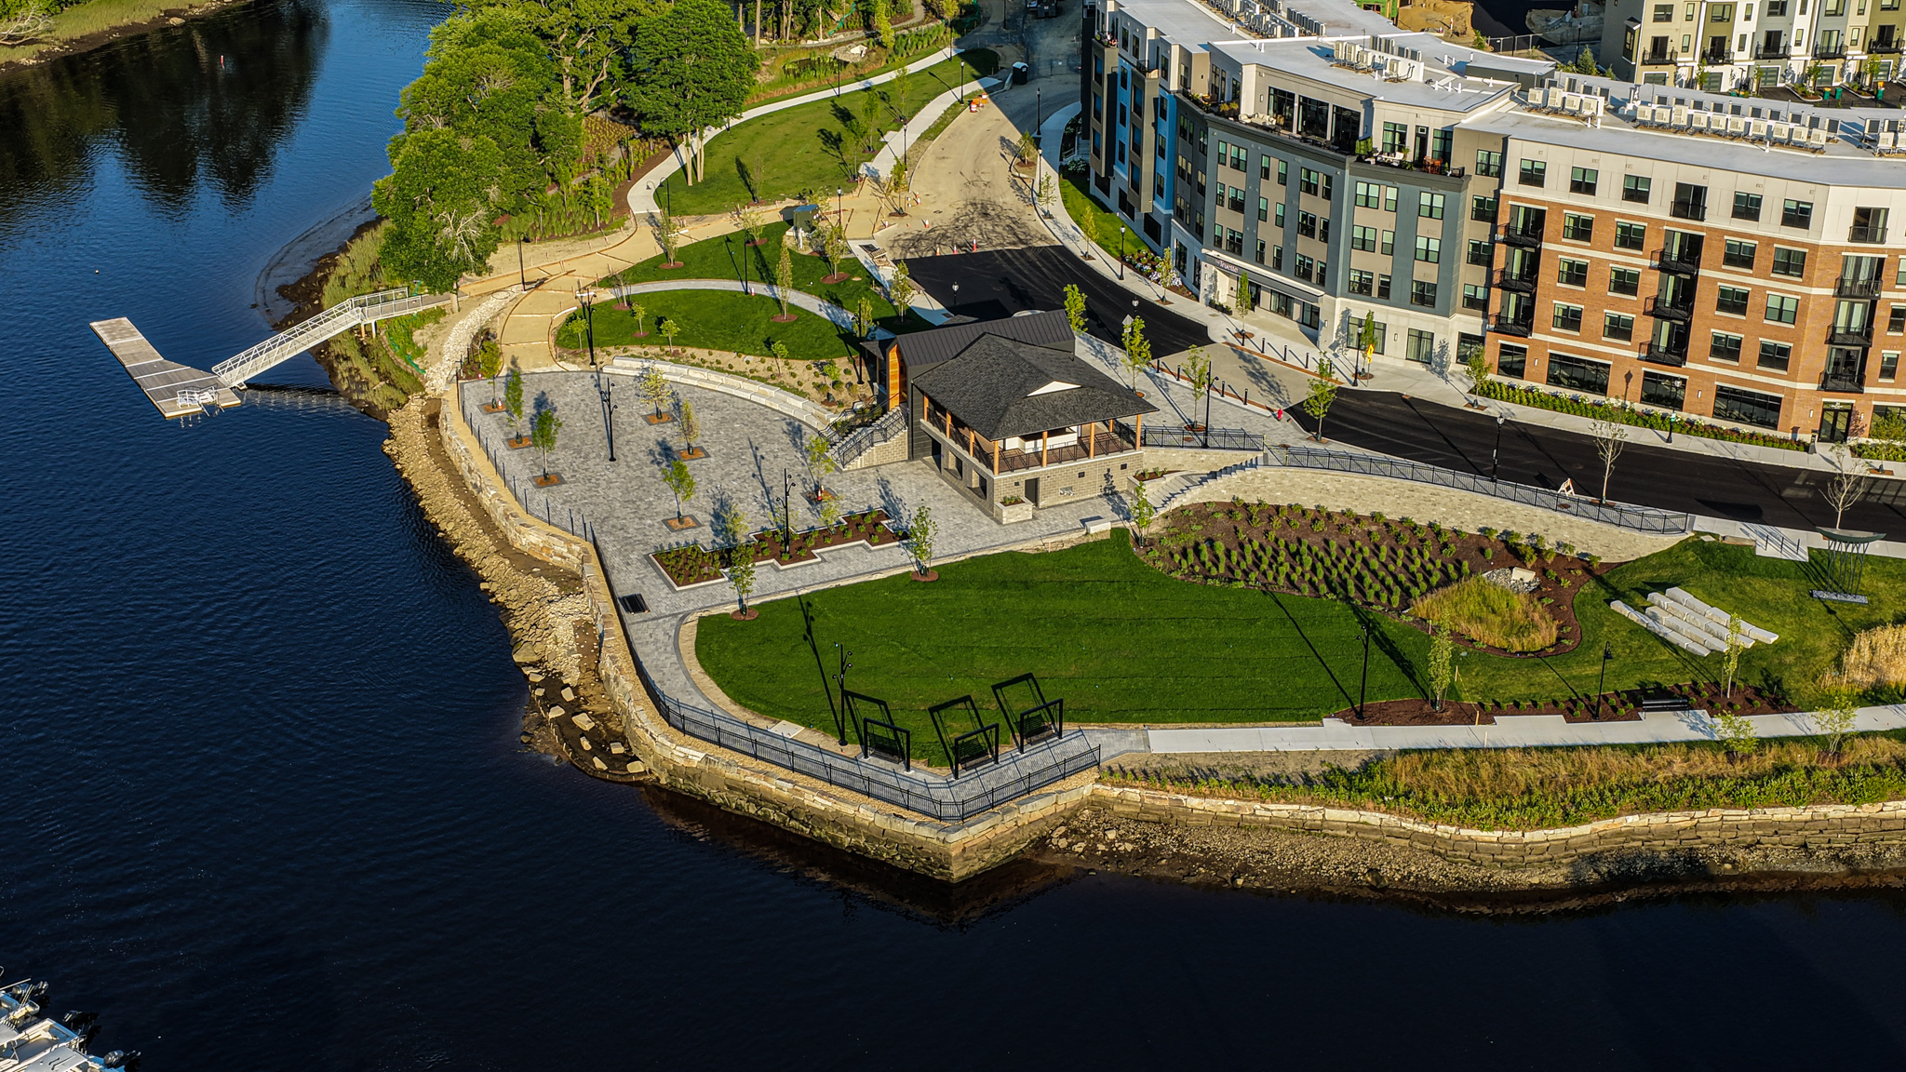
Where Are We Going?
Nebi Park 2026

Slide 28
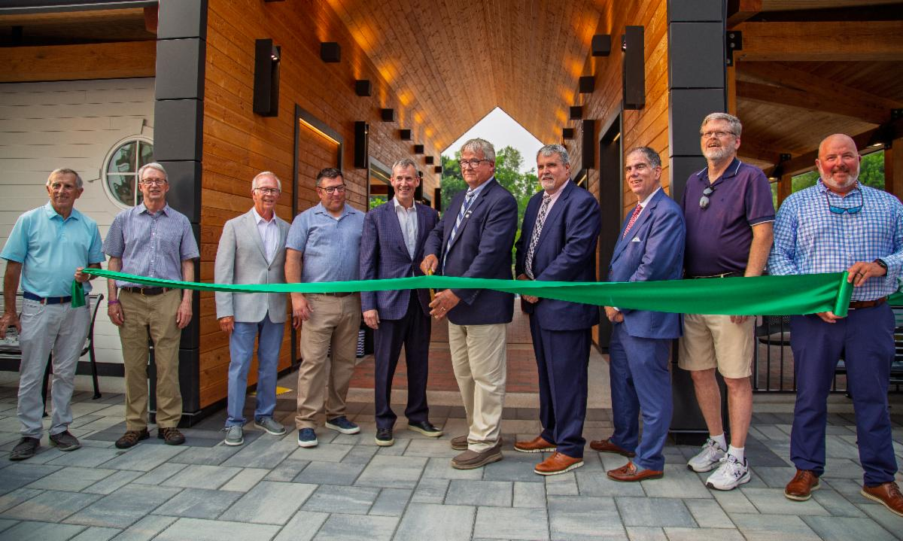
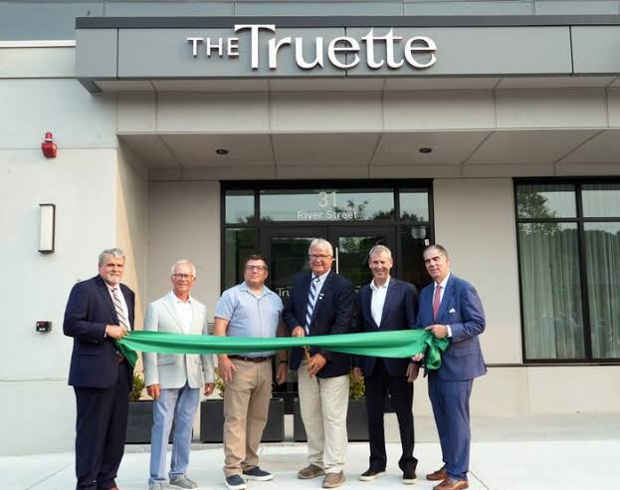
Where Are We Now?
Ribbon cutting ceremony July 14, 2026

Slide 29
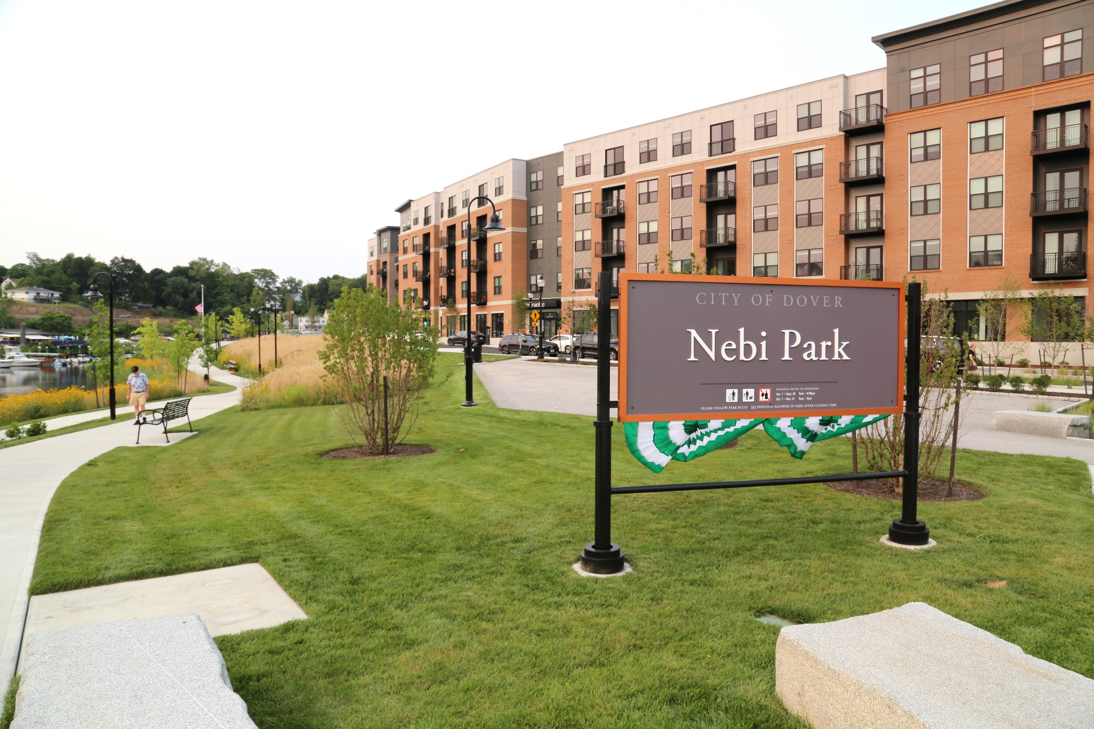
Where Are We Now?

Slide 30
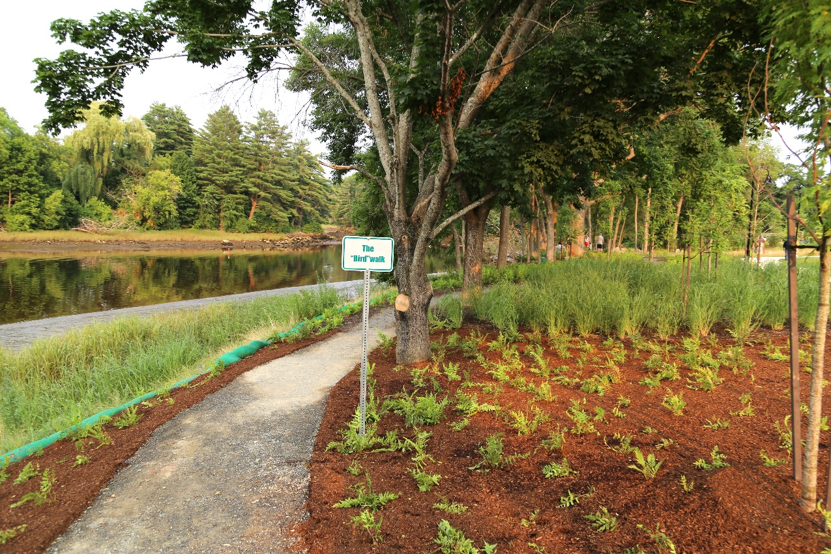
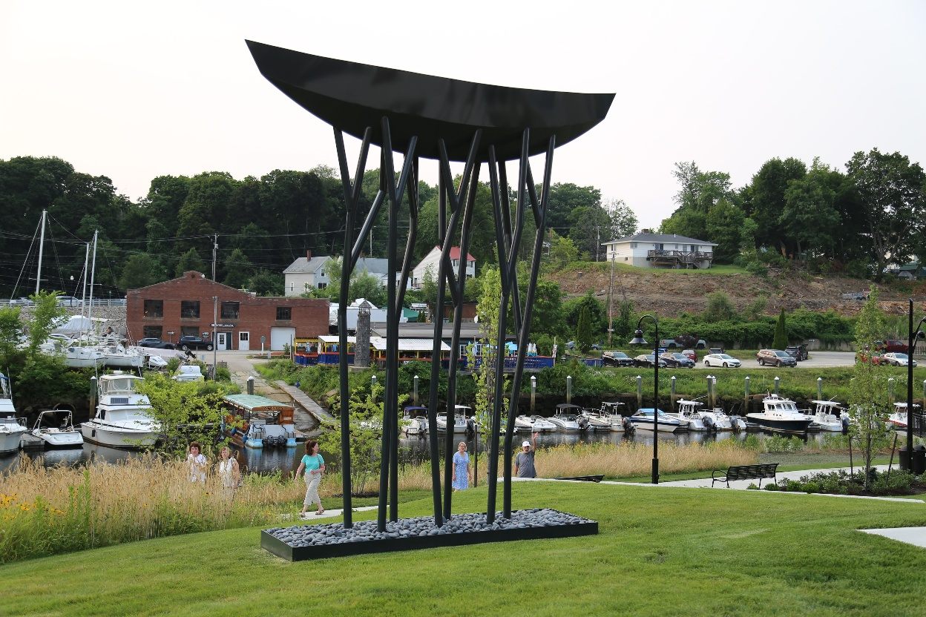
Where Are We Now?

Slide 31
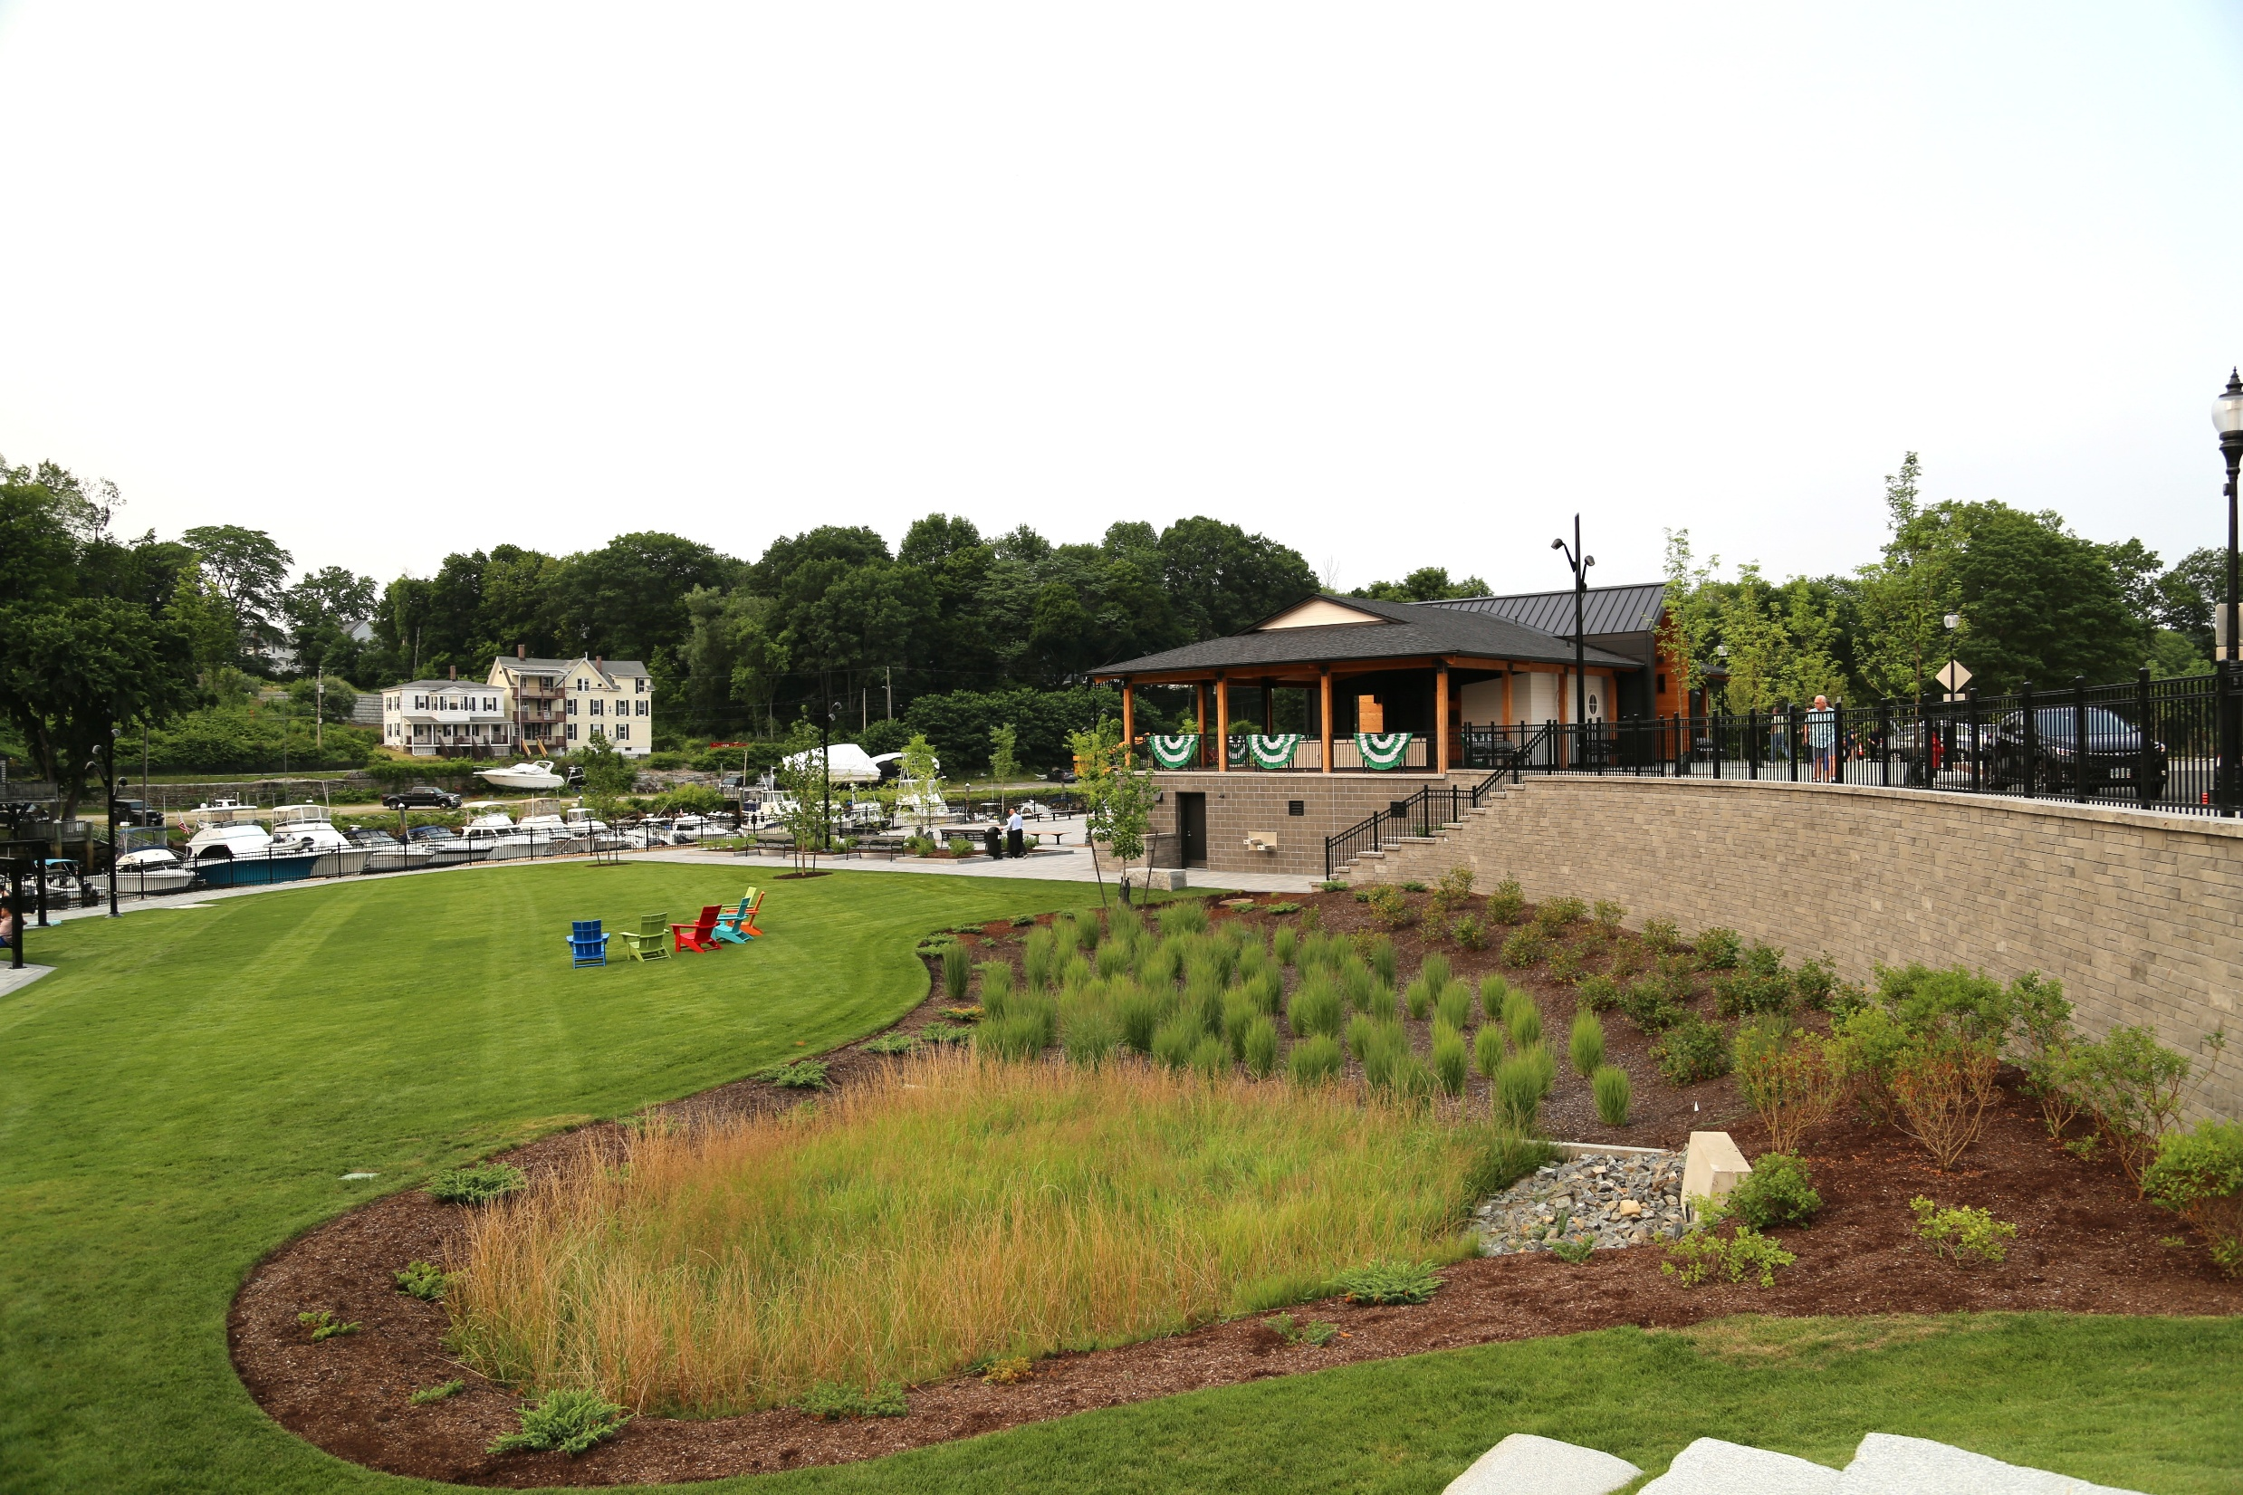

Slide 32
Where Are We Going?

Slide 33
Questions

