Slide 1

Plan NH Fall Conference
September 15, 2026
City of Laconia
Planning and Community Development
Rob Mora, Director
Tyler Carmichael, Assistant Director

Slide 2

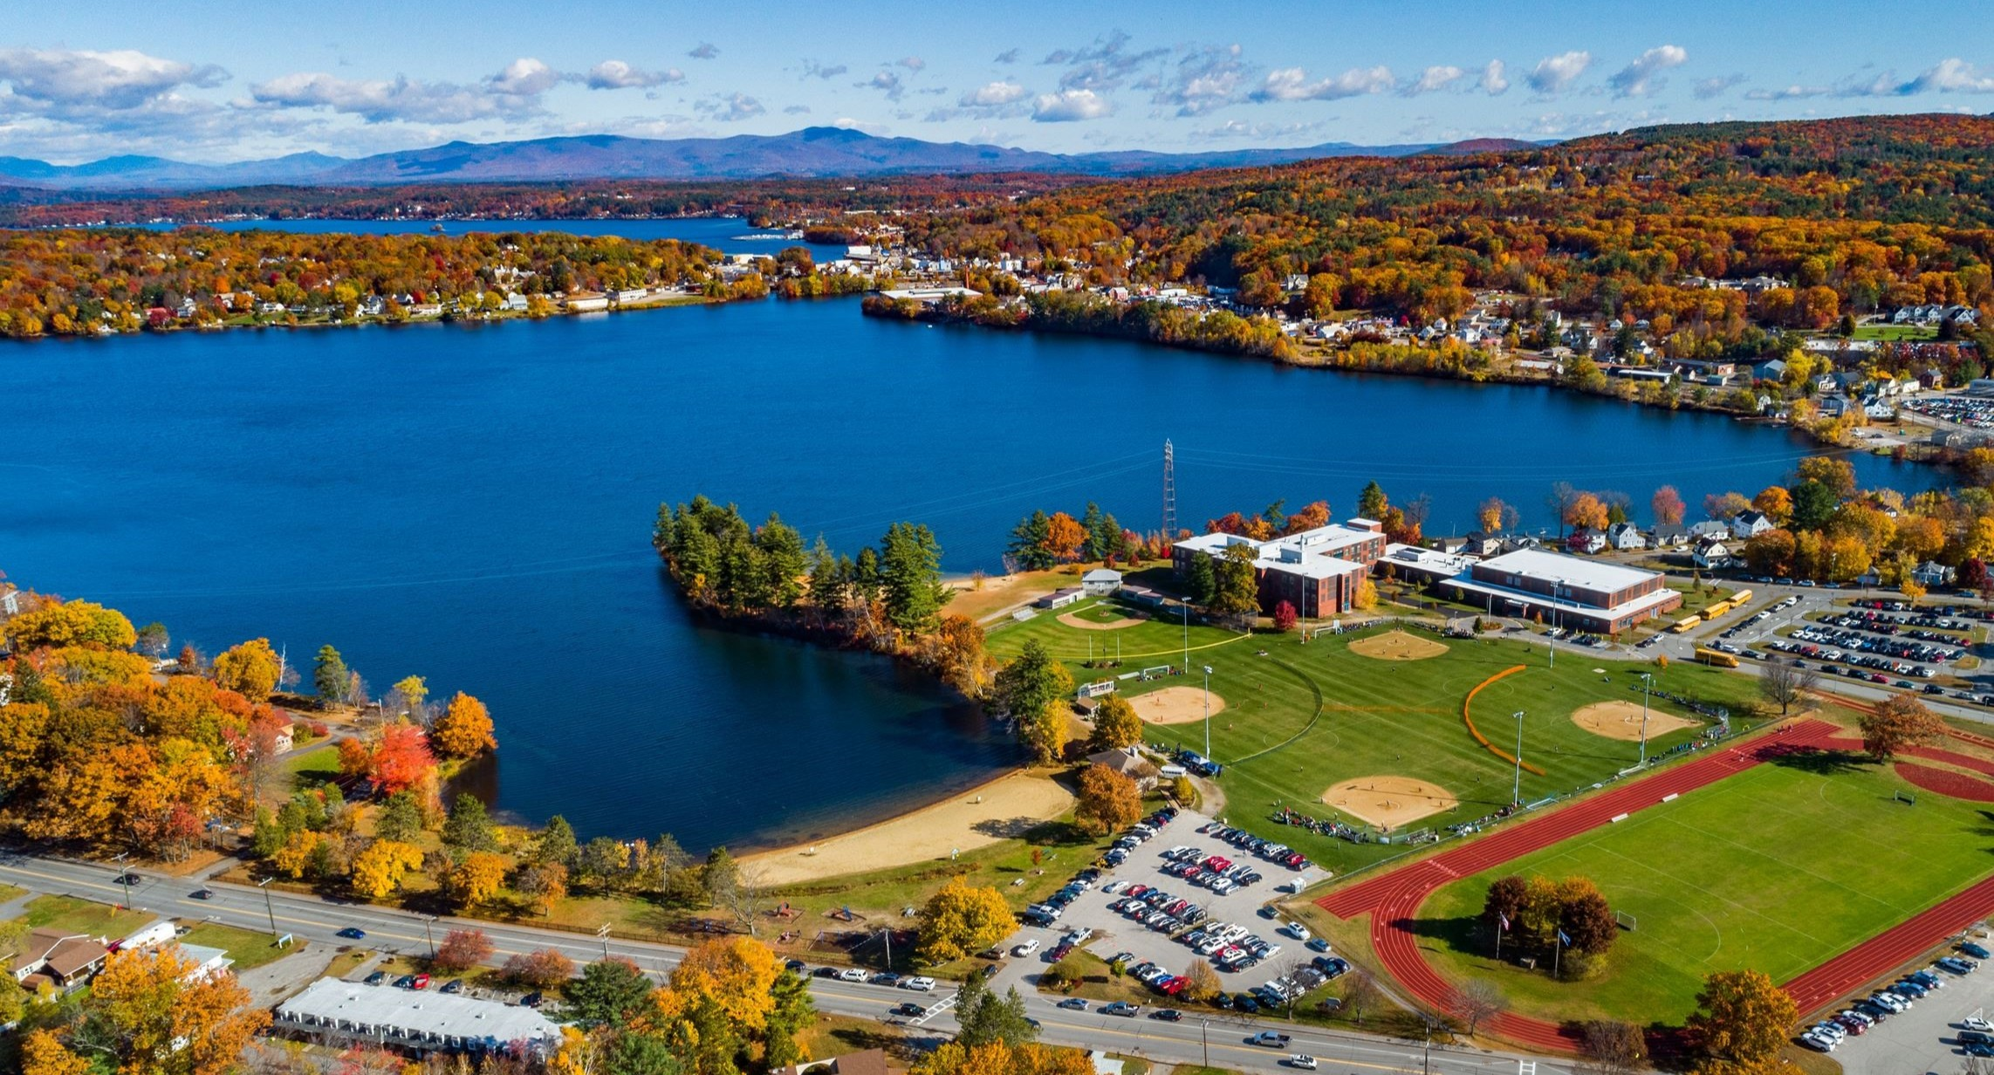

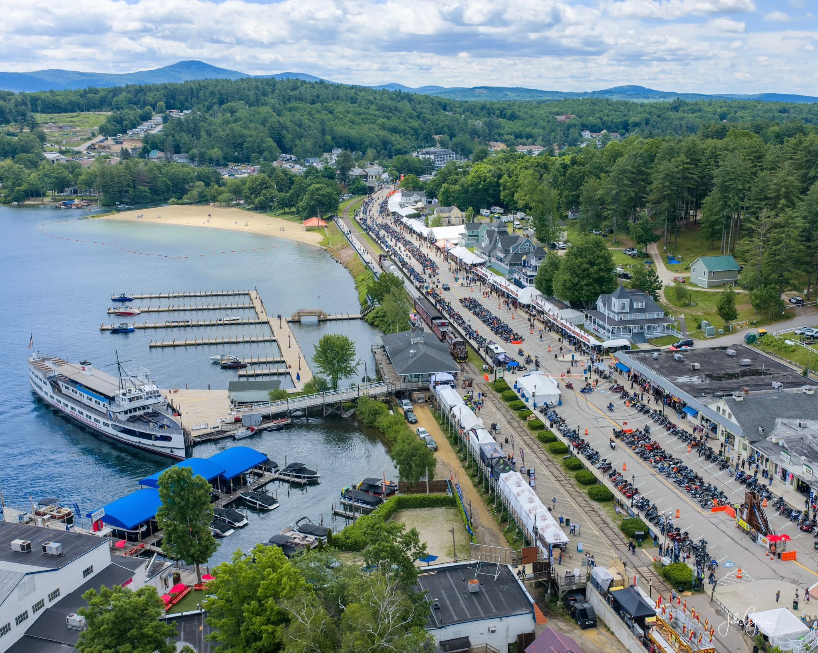
Community Profile
Location: Situated in the heart of New Hampshire's Lakes Region, between Lake Winnipesaukee and Lake Winnisquam, serving as the county seat of Belknap County
Population: Approximately 17,200 residents
Land Area: Approximately 20 square miles of land, plus over 6 square miles of water
Economy: Key sectors include healthcare, tourism, retail, manufacturing, and professional services
Tourism Destination: Home to Weirs Beach, the state's most visited public beach area, and host of the internationally known Laconia Motorcycle Week, one of the oldest motorcycle rallies in the United States
Housing & Development: Experiencing continued residential and commercial growth as a regional service center and recreation destination.
3,300+ Units
Planned
800+ Units
Under Construction

Slide 3
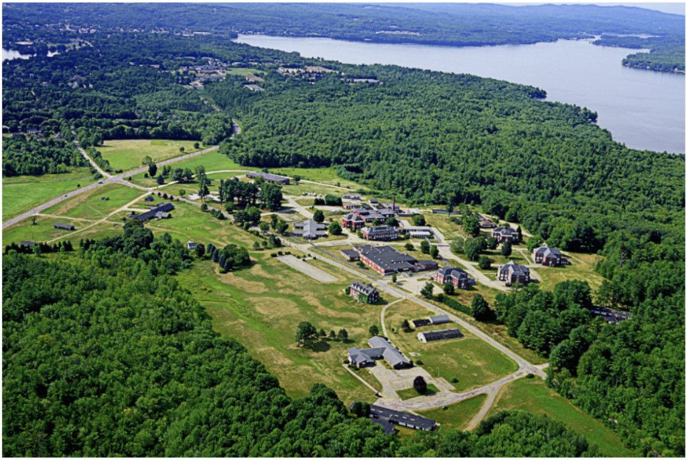
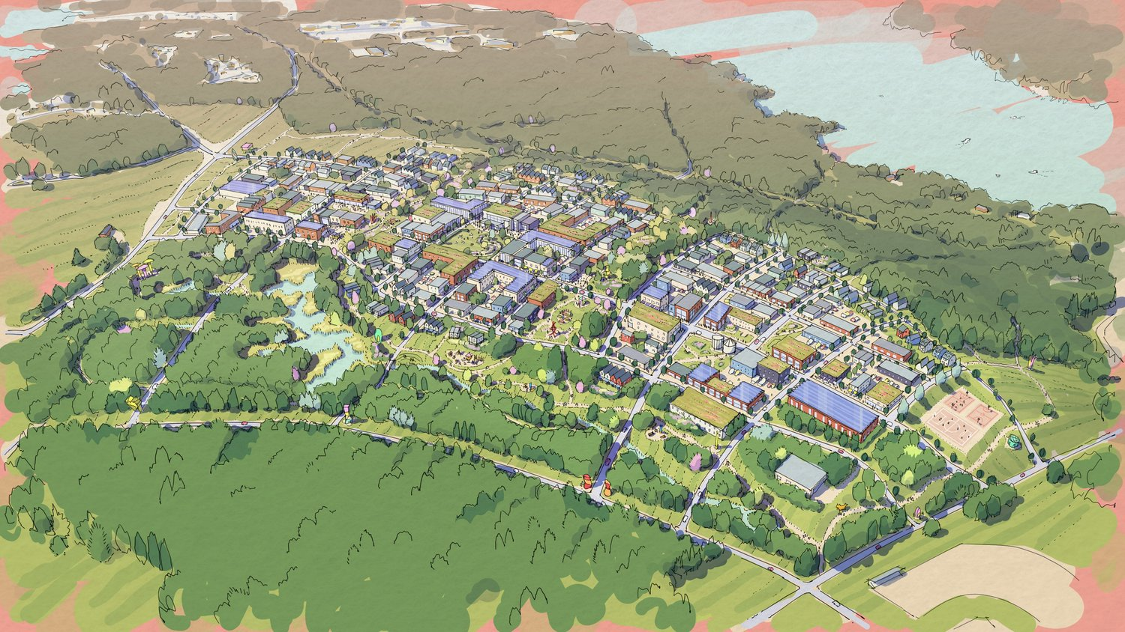
How We Got Here
1903 - State School Opens
  State of New Hampshire opens the State School.
1991 – State School Closes and Prison Opens
  State of New Hampshire closes the State School and repurposes it to the Lakes Region Facility in Laconia.
2009 – Lakes Region Facility Closes
  State of New Hampshire closes the underperforming facility.
2017 Lakeshore Redevelopment Planning Commission Created
  The General Court establishes the Lakeshore Redevelopment Planning Commission to determine how to best redevelop the derelict site.
2021 Authorization to Bypass Surplus Property Procedures
  The General Court approved HB2 to permit the Governor to bypass the standard process for disposing of state surplus property.
2024 Pillsbury Group Selected for Redevelopment
  The State of New Hampshire selects Pillsbury Group to purchase and redevelop the property through the RFP process.

Slide 4
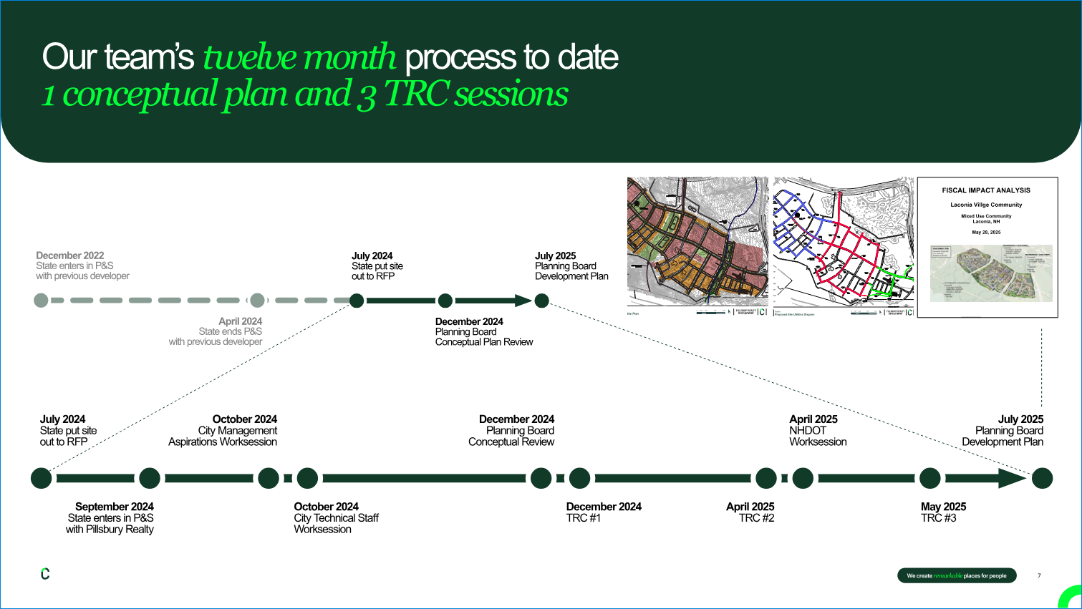
Review Process and Private-Public Partnership
October 2024 – City Staff Meetings
  Held several meetings with City staff to review goals, aspirations, review process, and infrastructure capacity.​
December 2024 - Conceptual Review
  Held a conceptual review with the Planning Board to utilize Performance Zoning.​
December 2024 – Technical Review Committee 1
  Held a conceptual review with the Technical Review Committee.​
April 2025 – Technical Review Committee 2
  Held a formal application review with the Technical Review Committee.​
April 2025 – NHDOT Scoping Meeting
  Held a formal a meeting with NHDOT and City staff to determine review and scope of Traffic Impact Analysis.​
June 2025 – Technical Review Committee 3
  Held a final application review with the Technical Review Committee.
July 2025 – Planning Board
  Application acceptance and approval of Overall Development Plan by the Planning Board.​
  ​

Slide 5
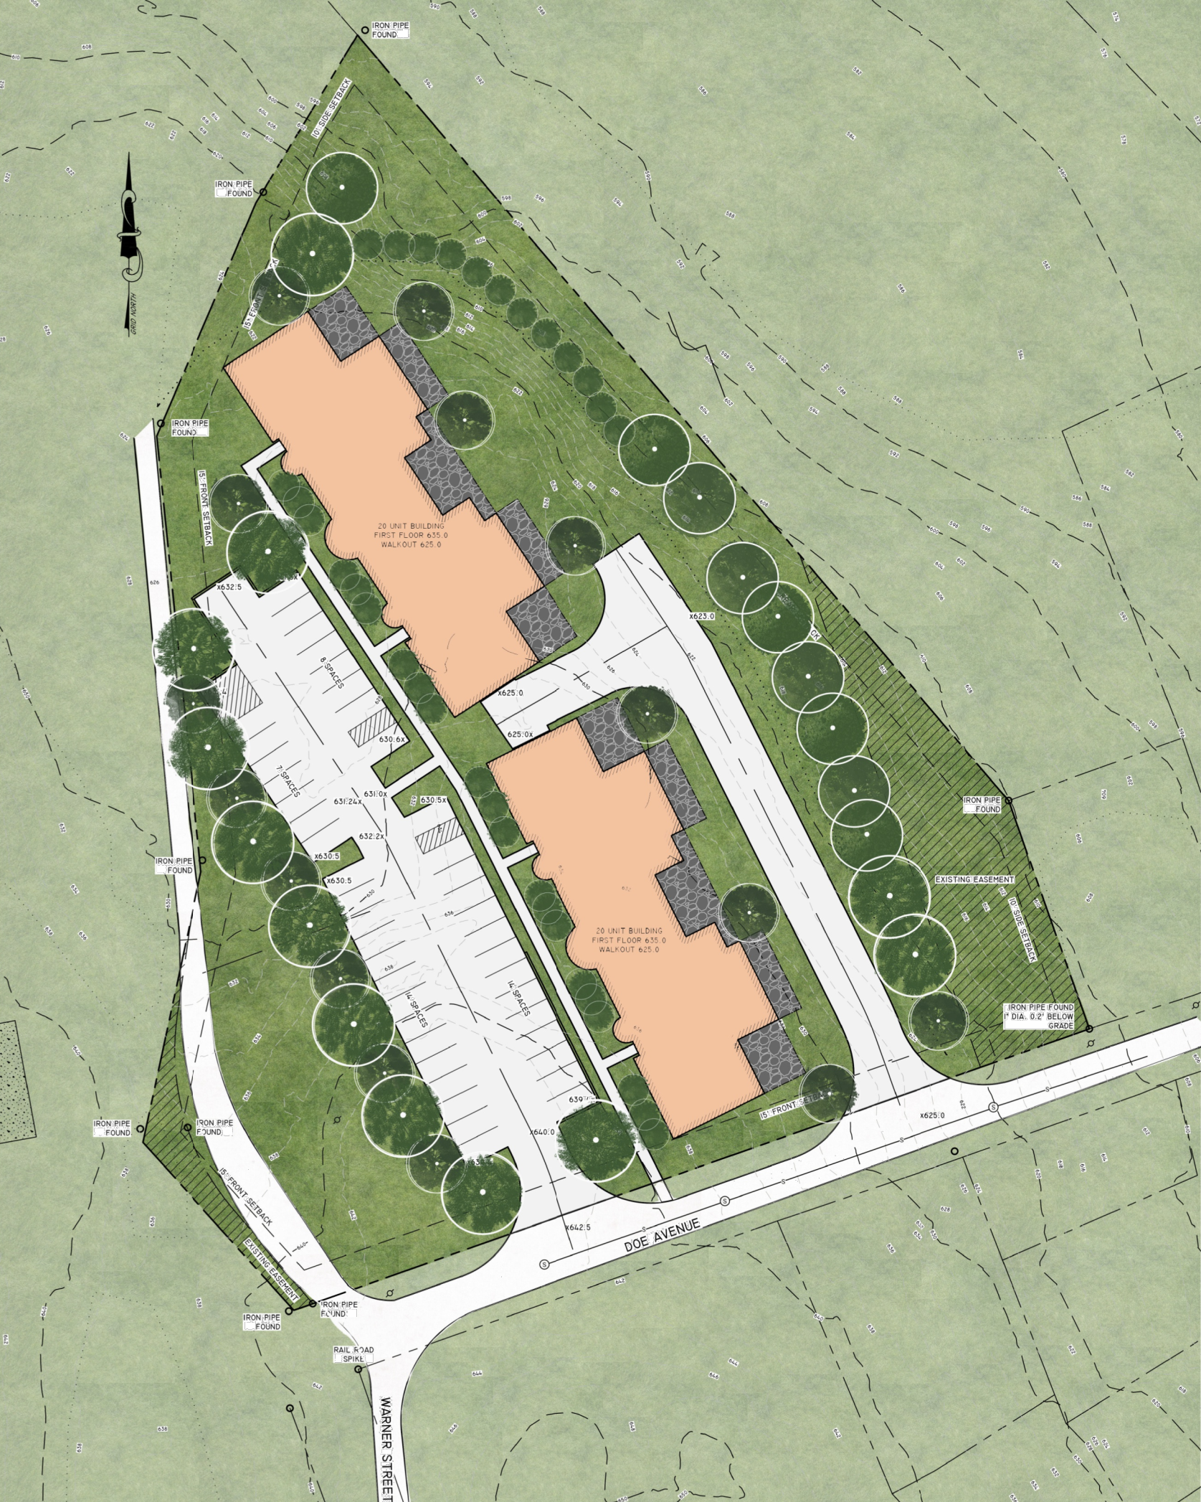
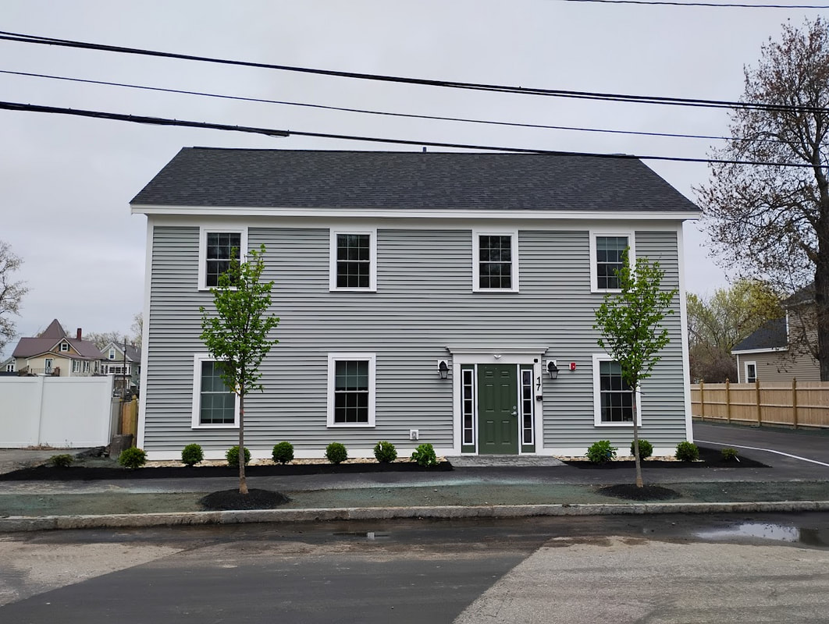
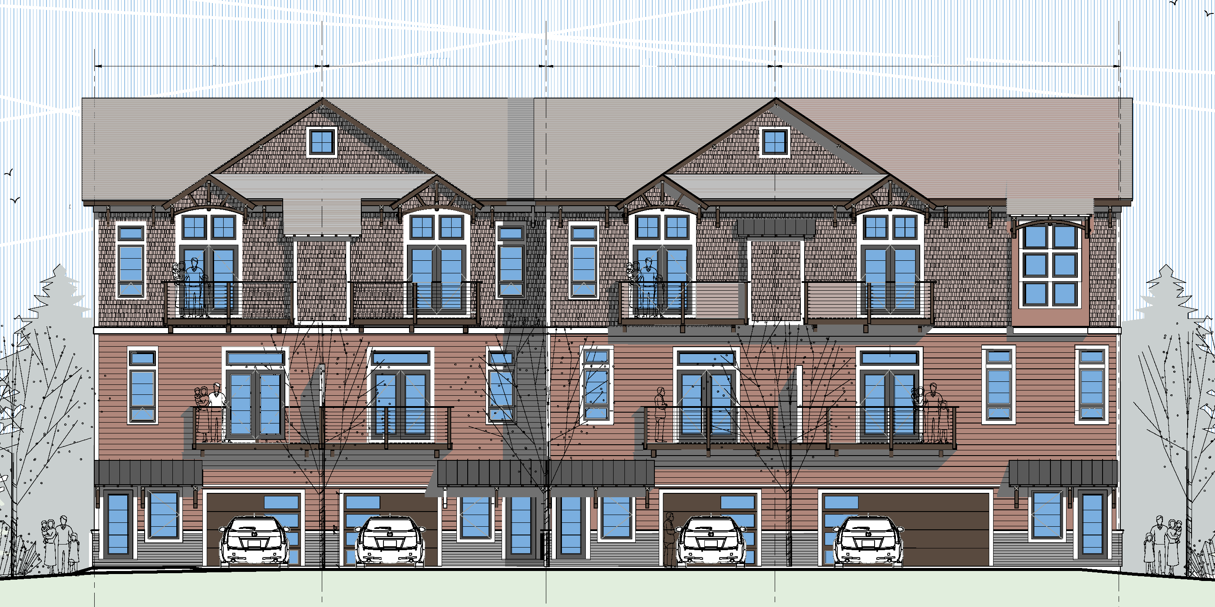
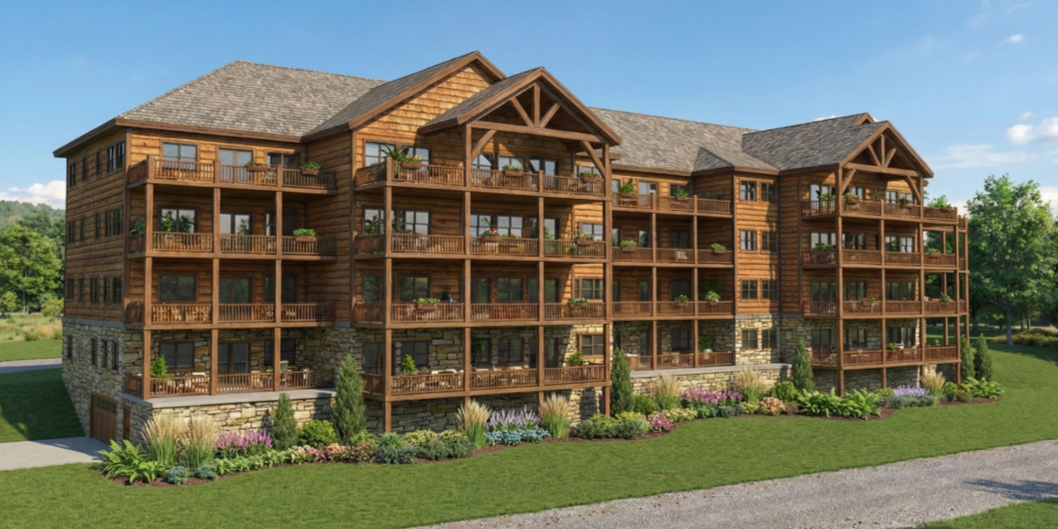
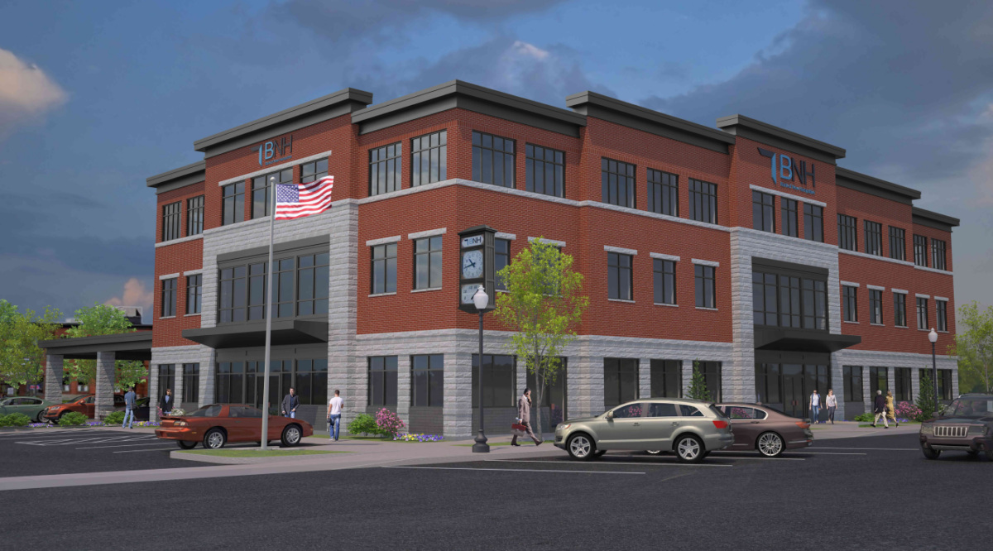
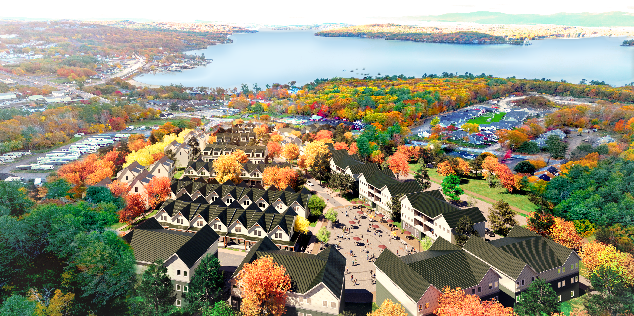
Performance Zoning Overlay District (RSA 674:21)
Impact-Focused Regulation​
  Performance zoning regulates land use based on measurable impacts like traffic and environmental protection.​
Flexible Overlay Mechanism​
  Implemented as an overlay, it allows flexible development reviewed through conditional use permits by the Planning Board.​
Encouraging Innovation in Development​
  Focus on outcomes enables creative projects and mixed-use developments beyond traditional zoning limits.​
Alignment with Community Goals​
  Supports balanced growth and safeguards neighborhood quality in line with the Master Plan objectives.​

Slide 6
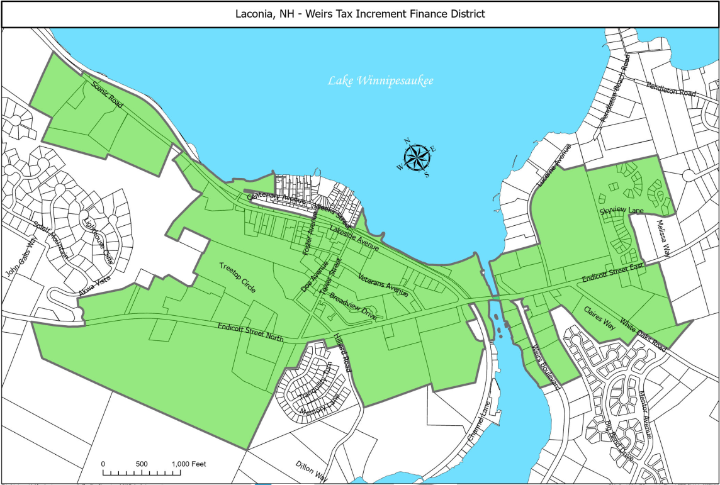
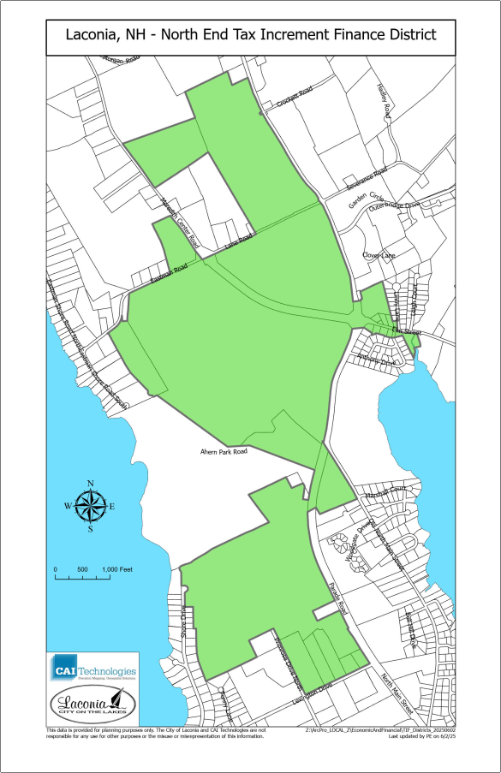
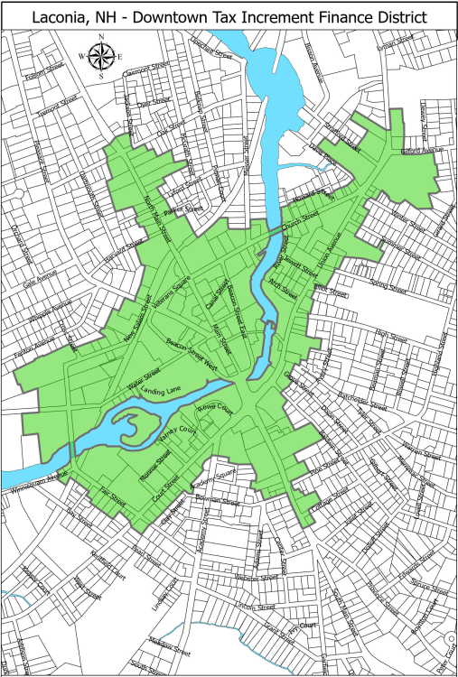
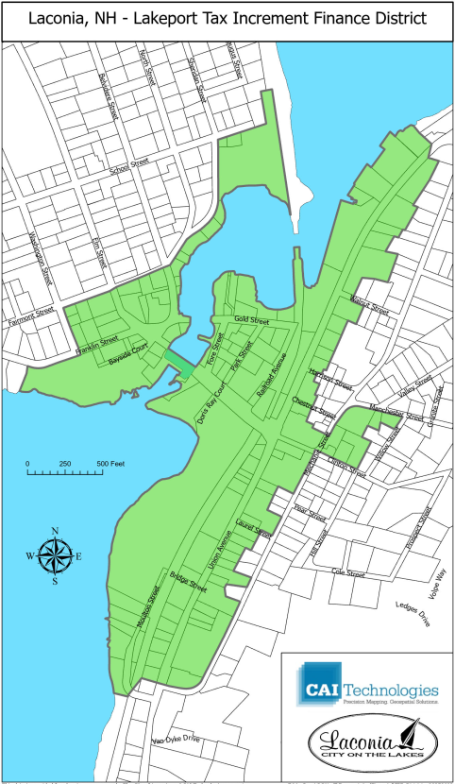
Tax Increment Financing Districts (RSA 162-K)
Existing TIF Districts
Conceptual TIF District

Slide 7
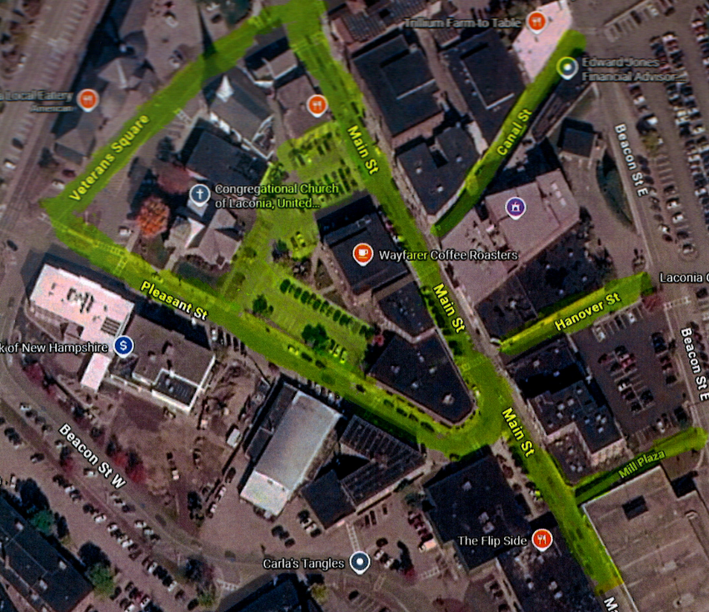
Social Districts (RSA 178)
Definition and Purpose​
  Social Districts allow designated outdoor areas for adult alcohol consumption to support local businesses and community engagement.​
Local Implementation in Laconia​
  Laconia established a downtown Social District to boost economic activity and encourage responsible consumption during set times.​
Governance and Control​
  Local rules, enforcement, and licensing ensure Social Districts operate safely and adapt based on community feedback.​
Urban Planning and Activation​
  Social Districts complement place-making strategies, enhancing walkability and economic resilience in downtown areas.​

