Slide 1

Plan NH – Sept 2026

Slide 2
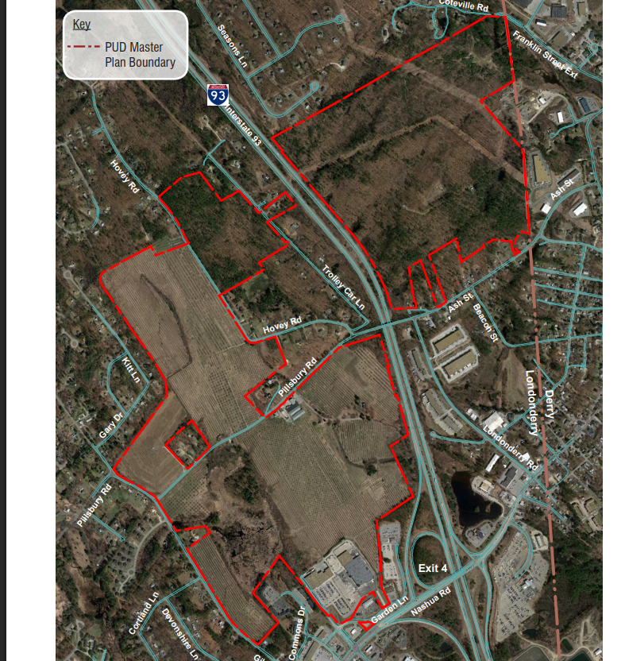
Woodmont - 603 Acres

Slide 3
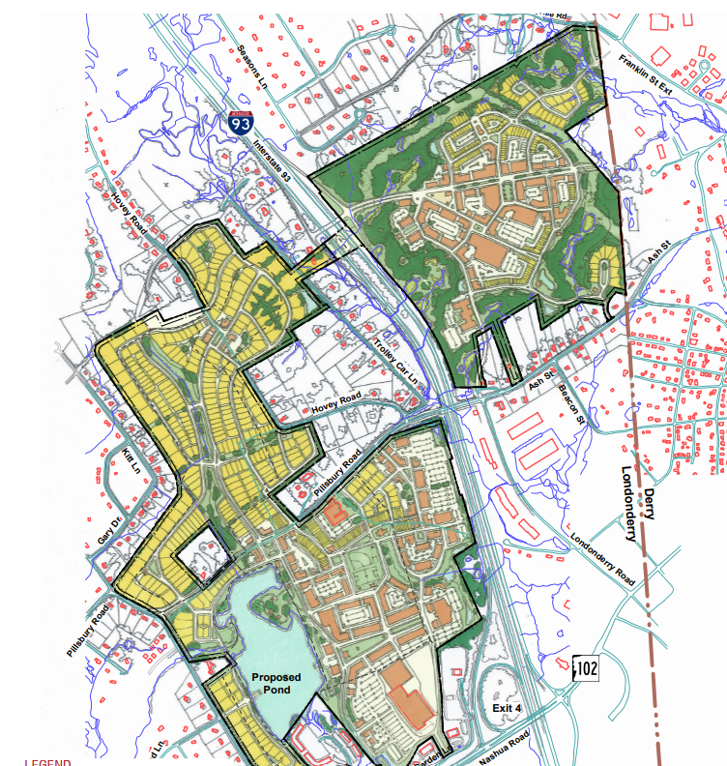
Woodmont - Master Plan

Slide 4
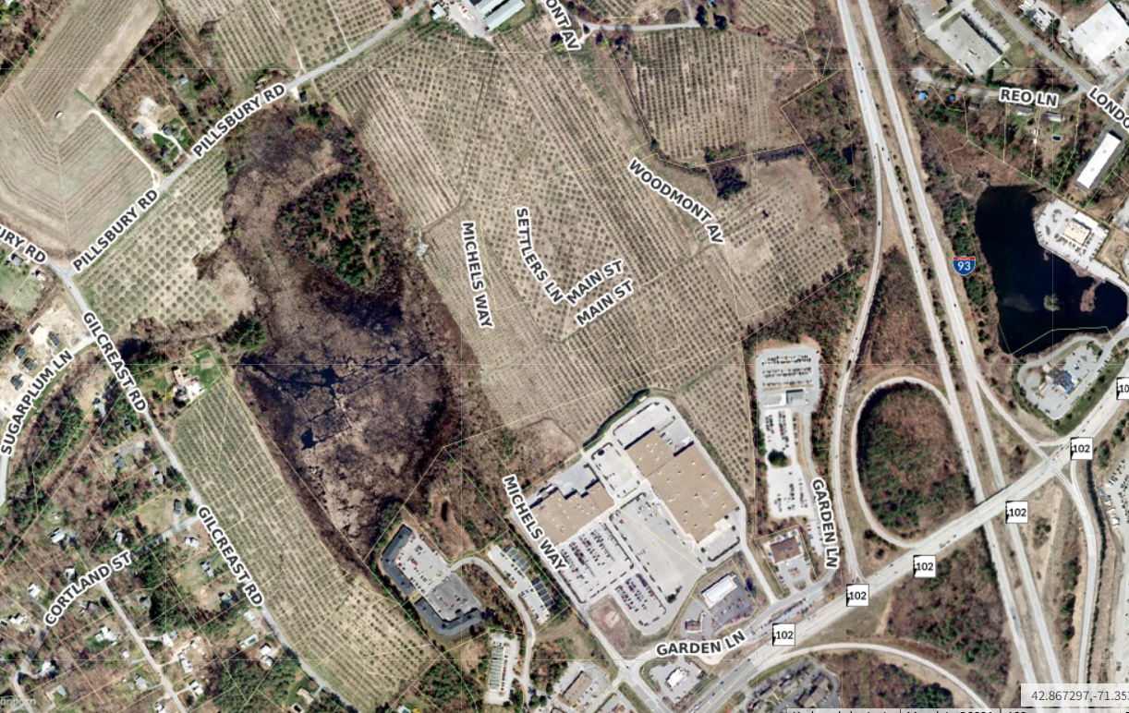
Woodmont 2015

Slide 5
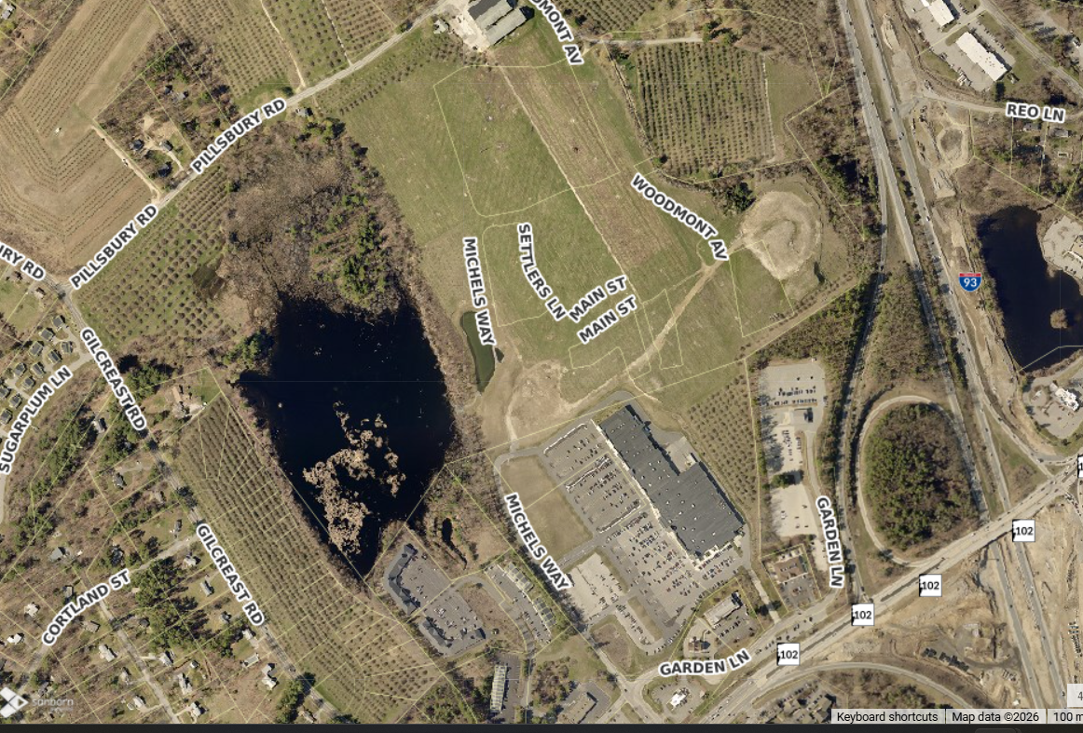
Woodmont 2017

Slide 6
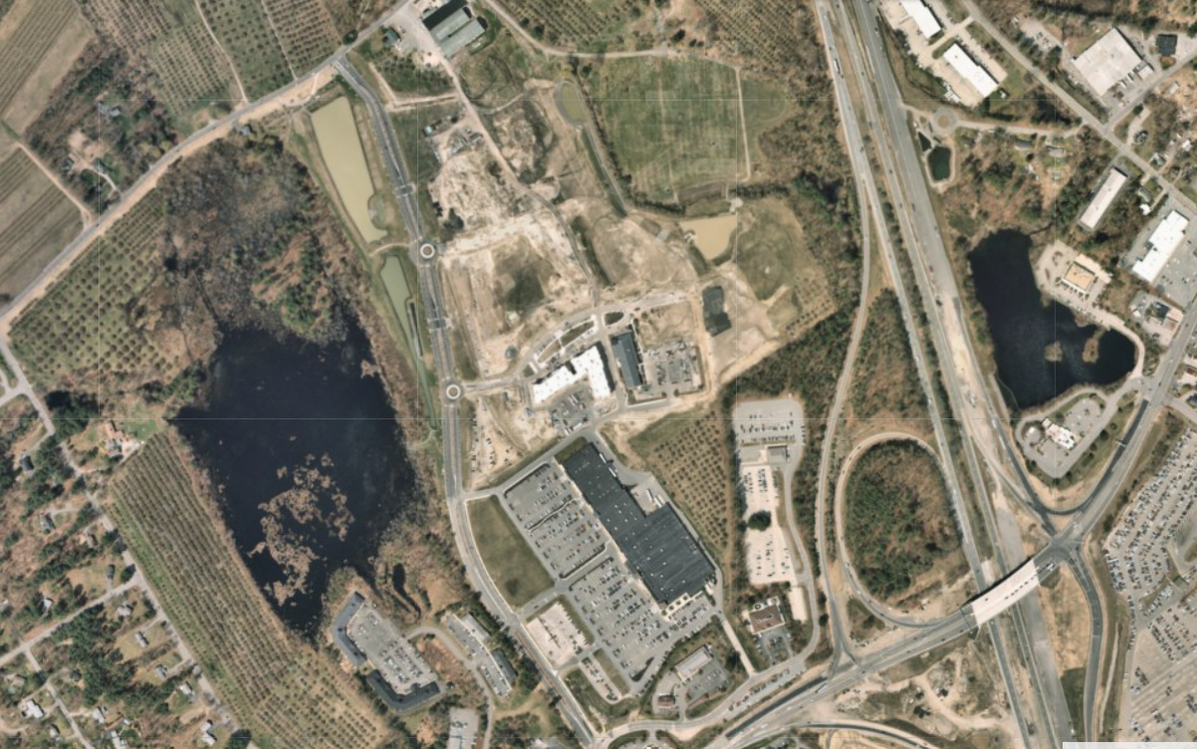
Woodmont 2019

Slide 7
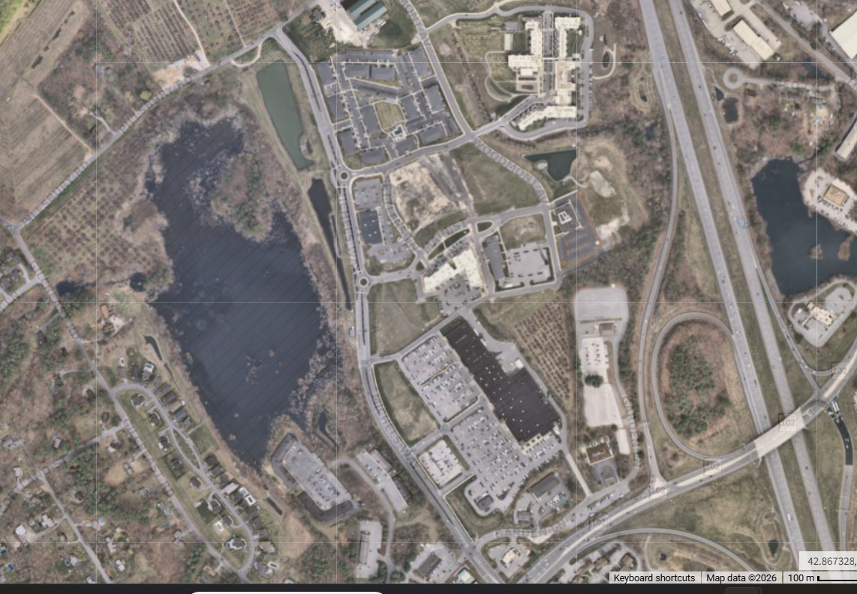
Woodmont 2026

Slide 8
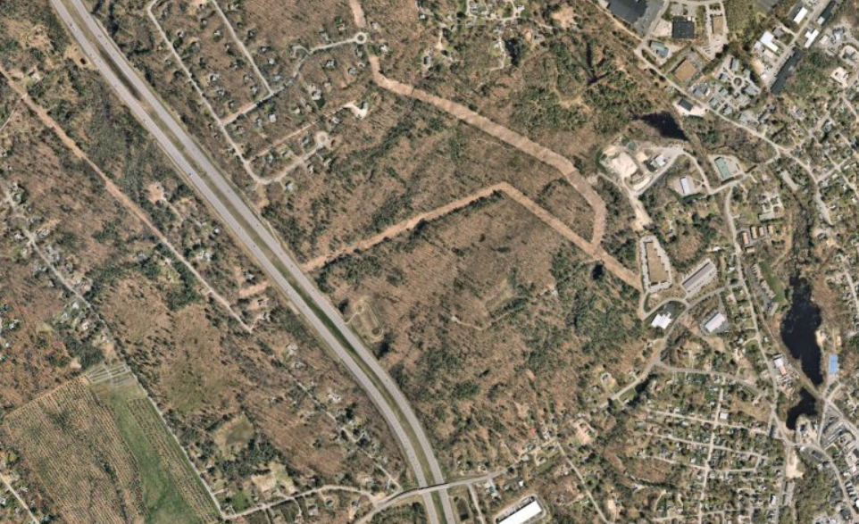
Woodmont Exit 4A 2022

Slide 9
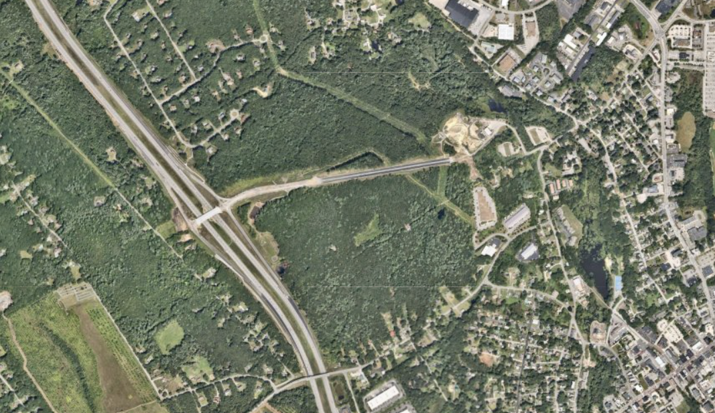
Woodmont Exit 4A 2024

Slide 10
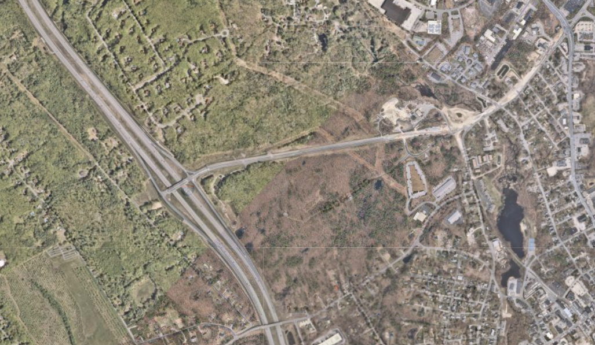
Woodmont Exit 4A 2026

Slide 11
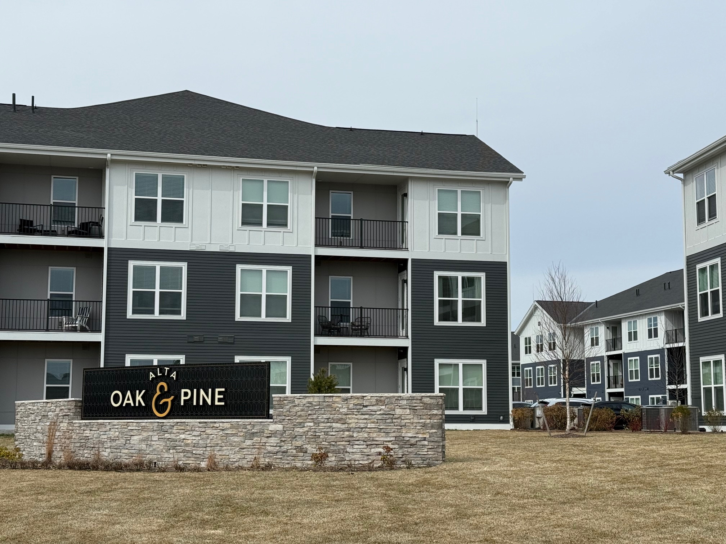
Woodmont – Oak & Pine

Slide 12
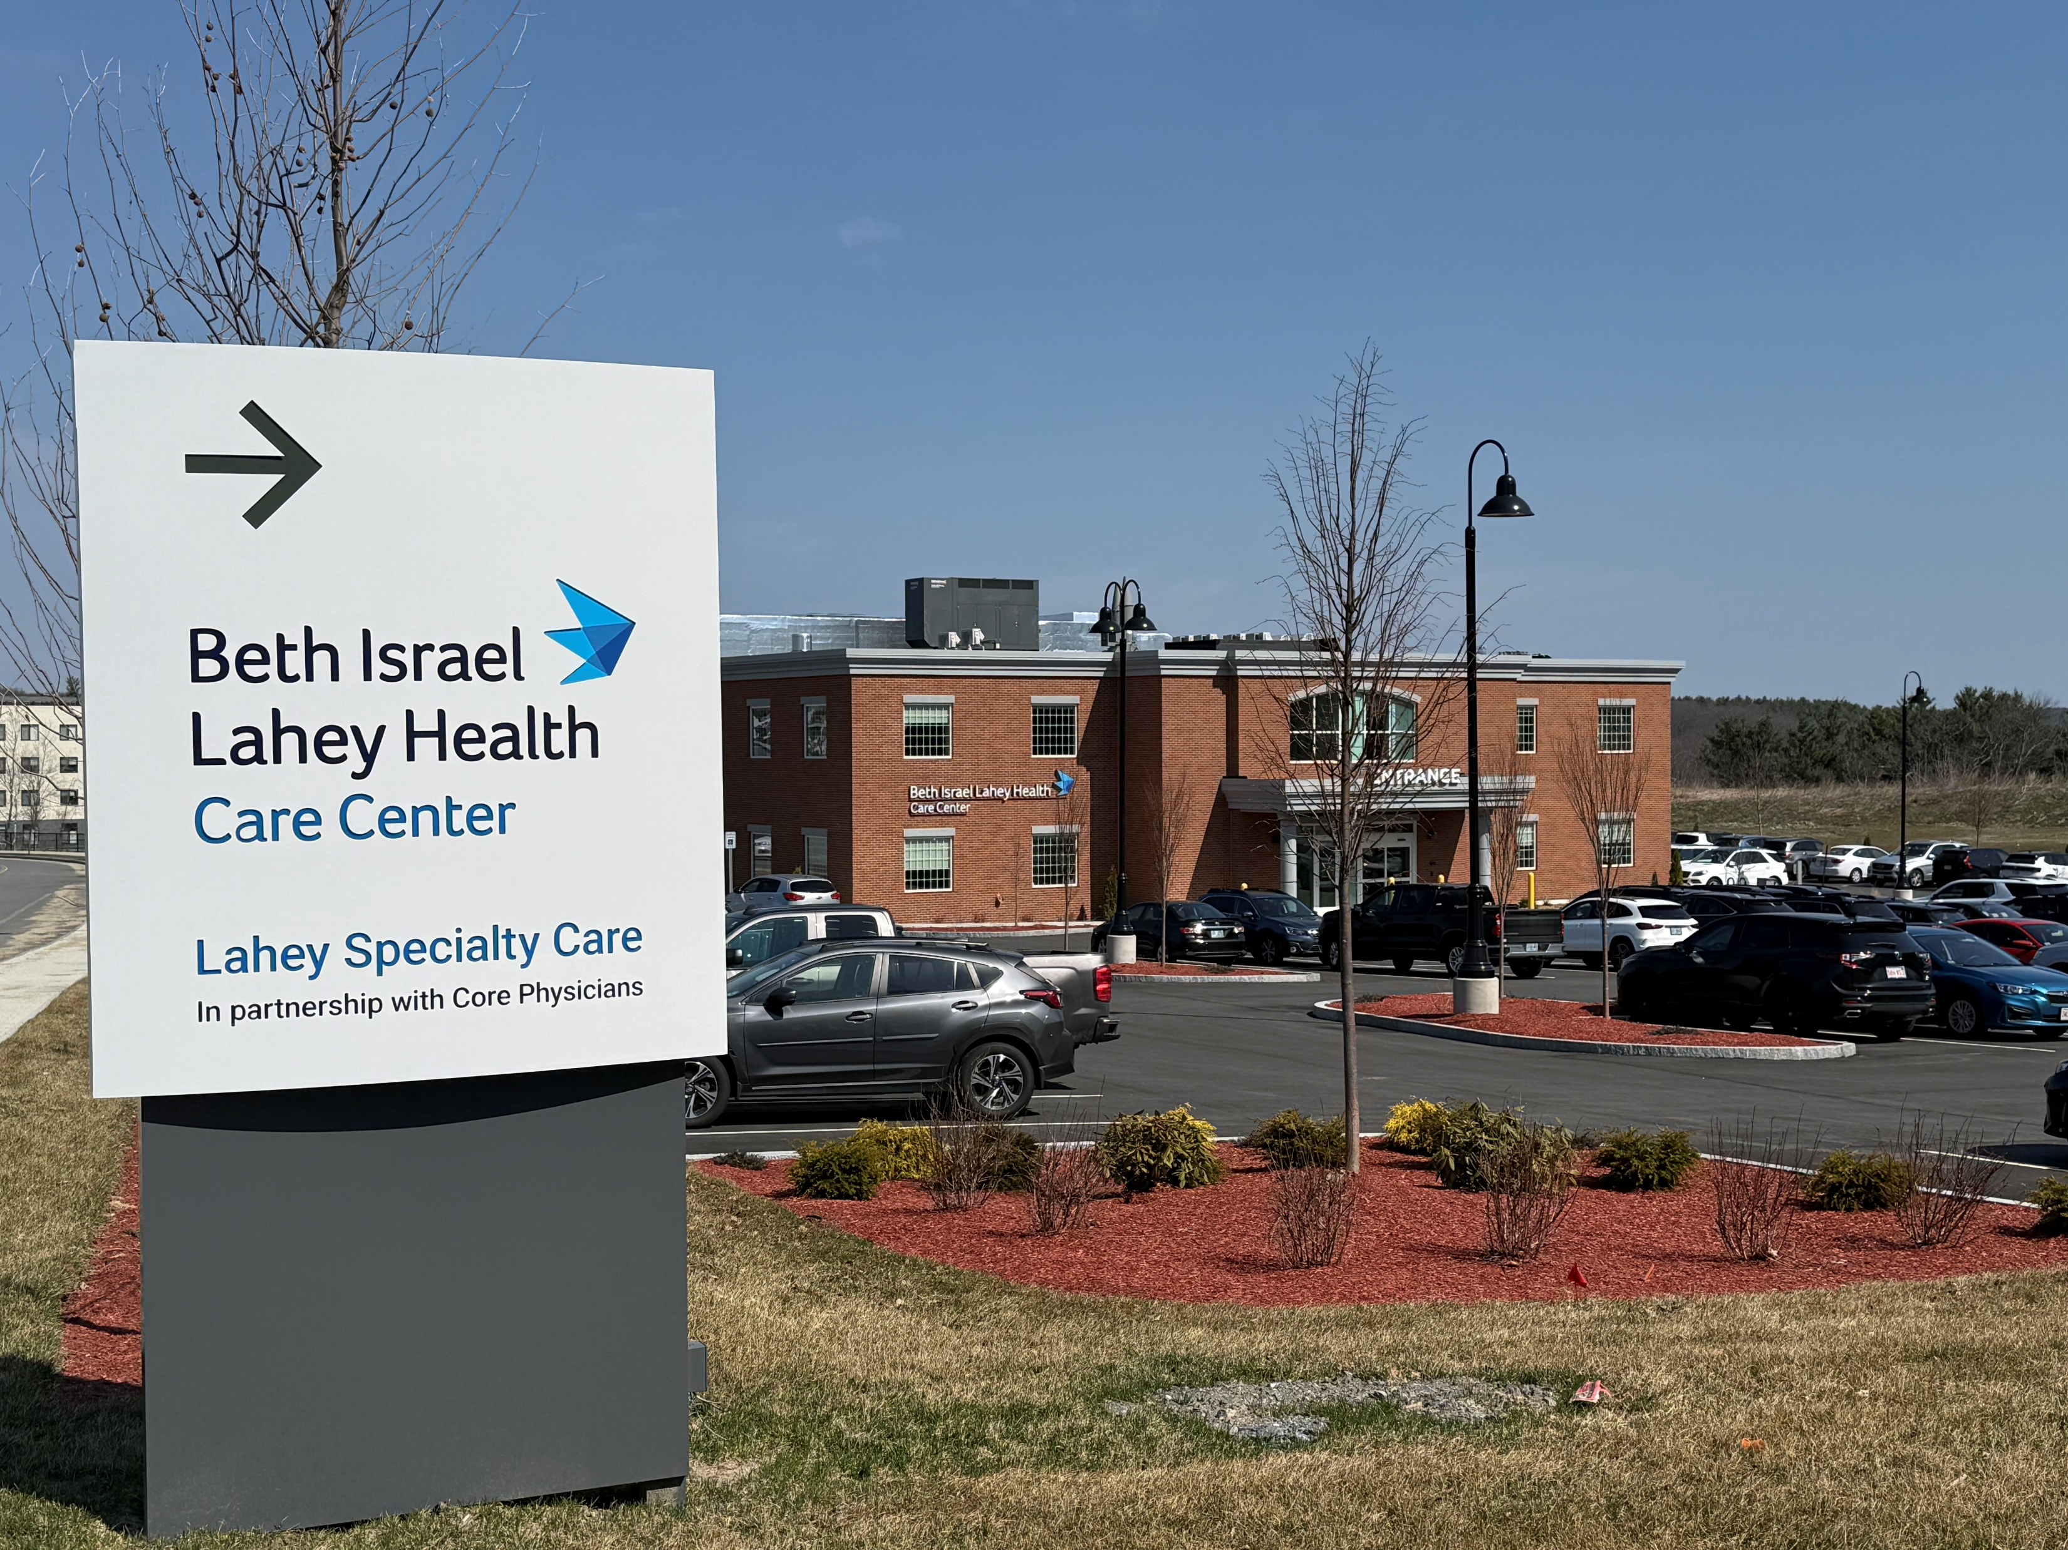
Woodmont - Lahey Clinic

Slide 13
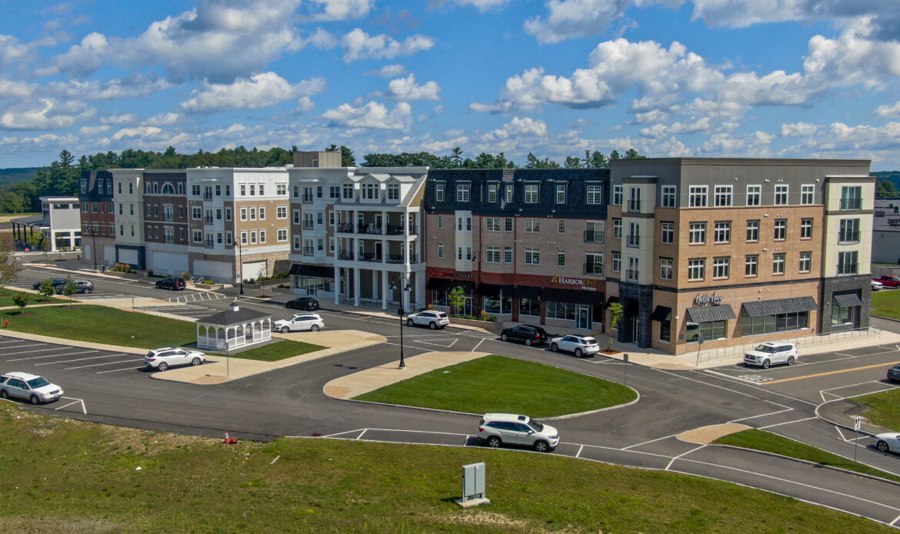
Woodmont - Mixed Use

Slide 14
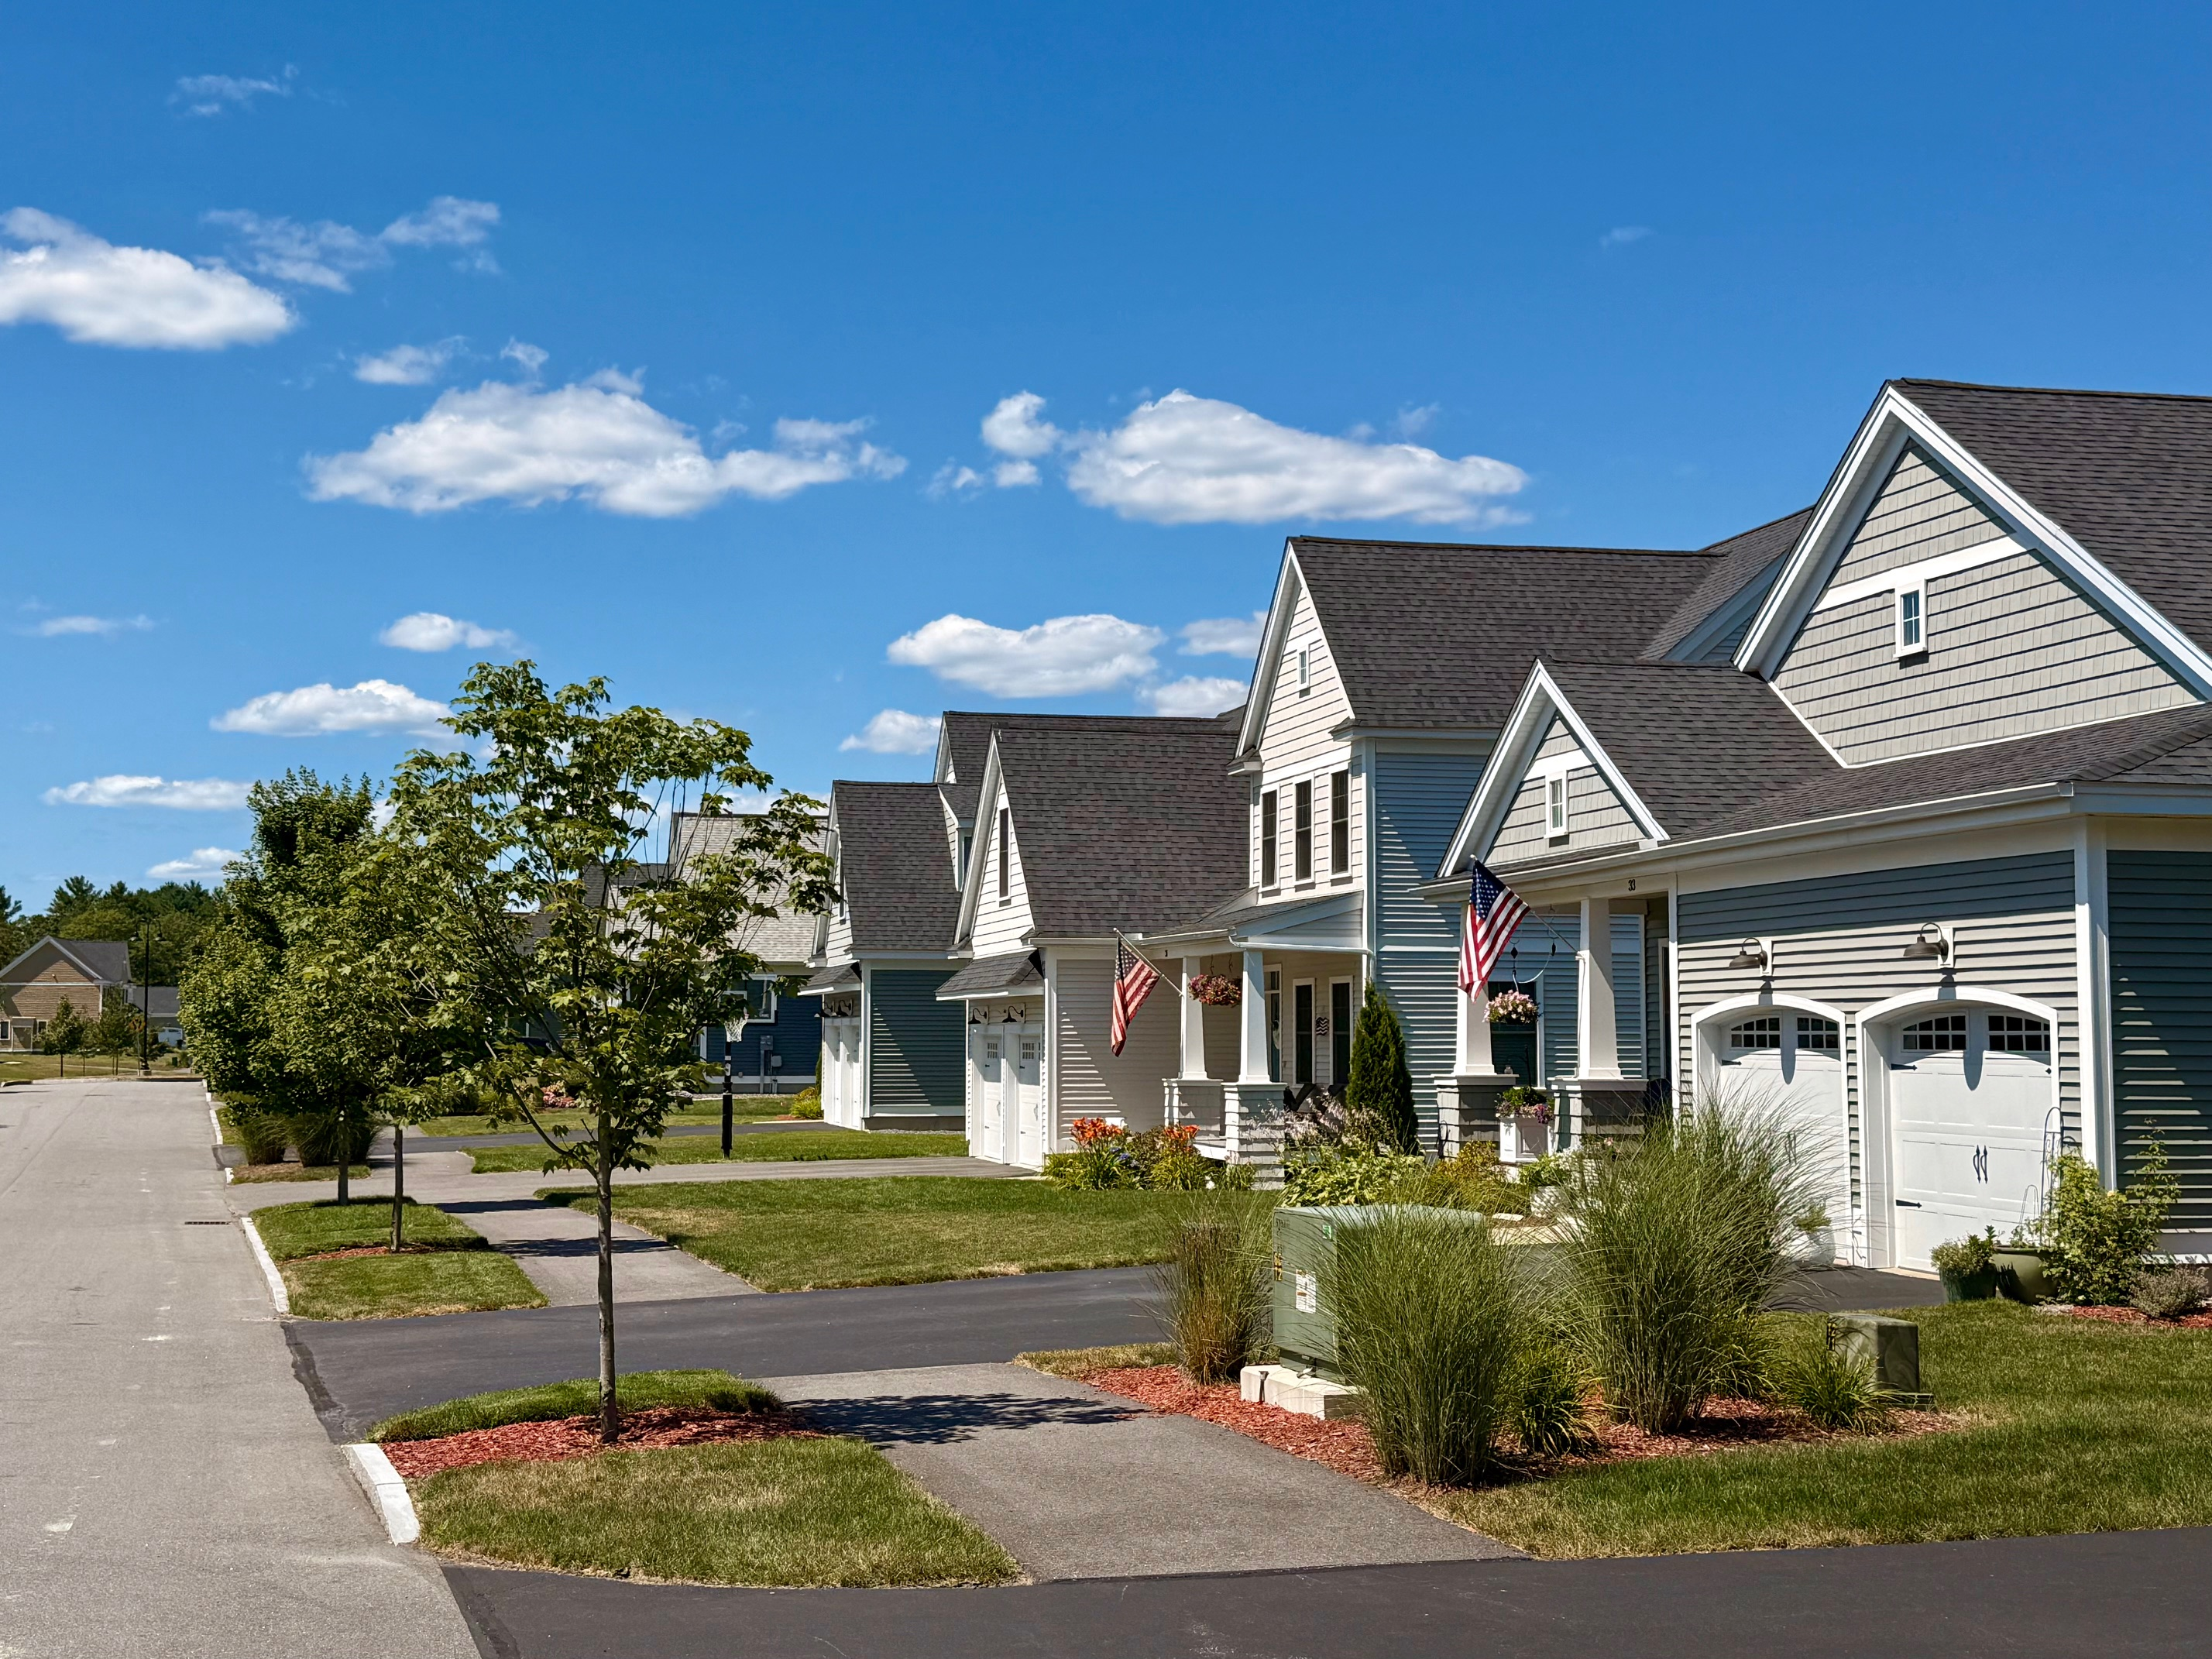
Woodmont – Single Family

Slide 15
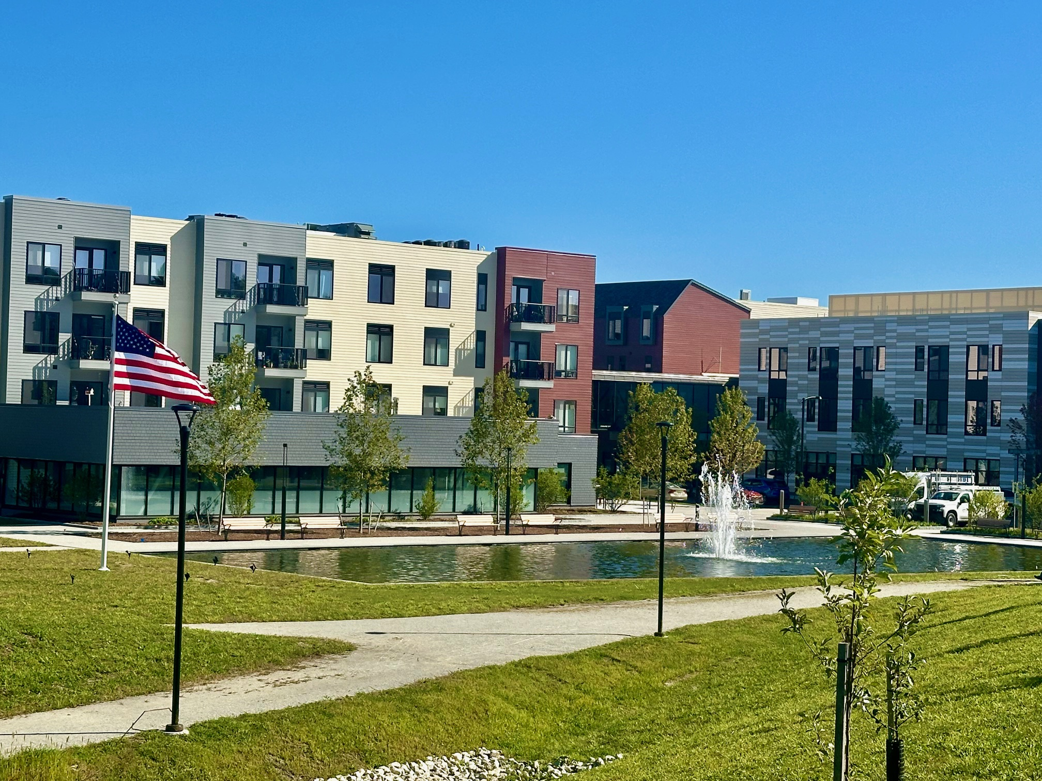
Woodmont – Baldwin CCRC

Slide 16
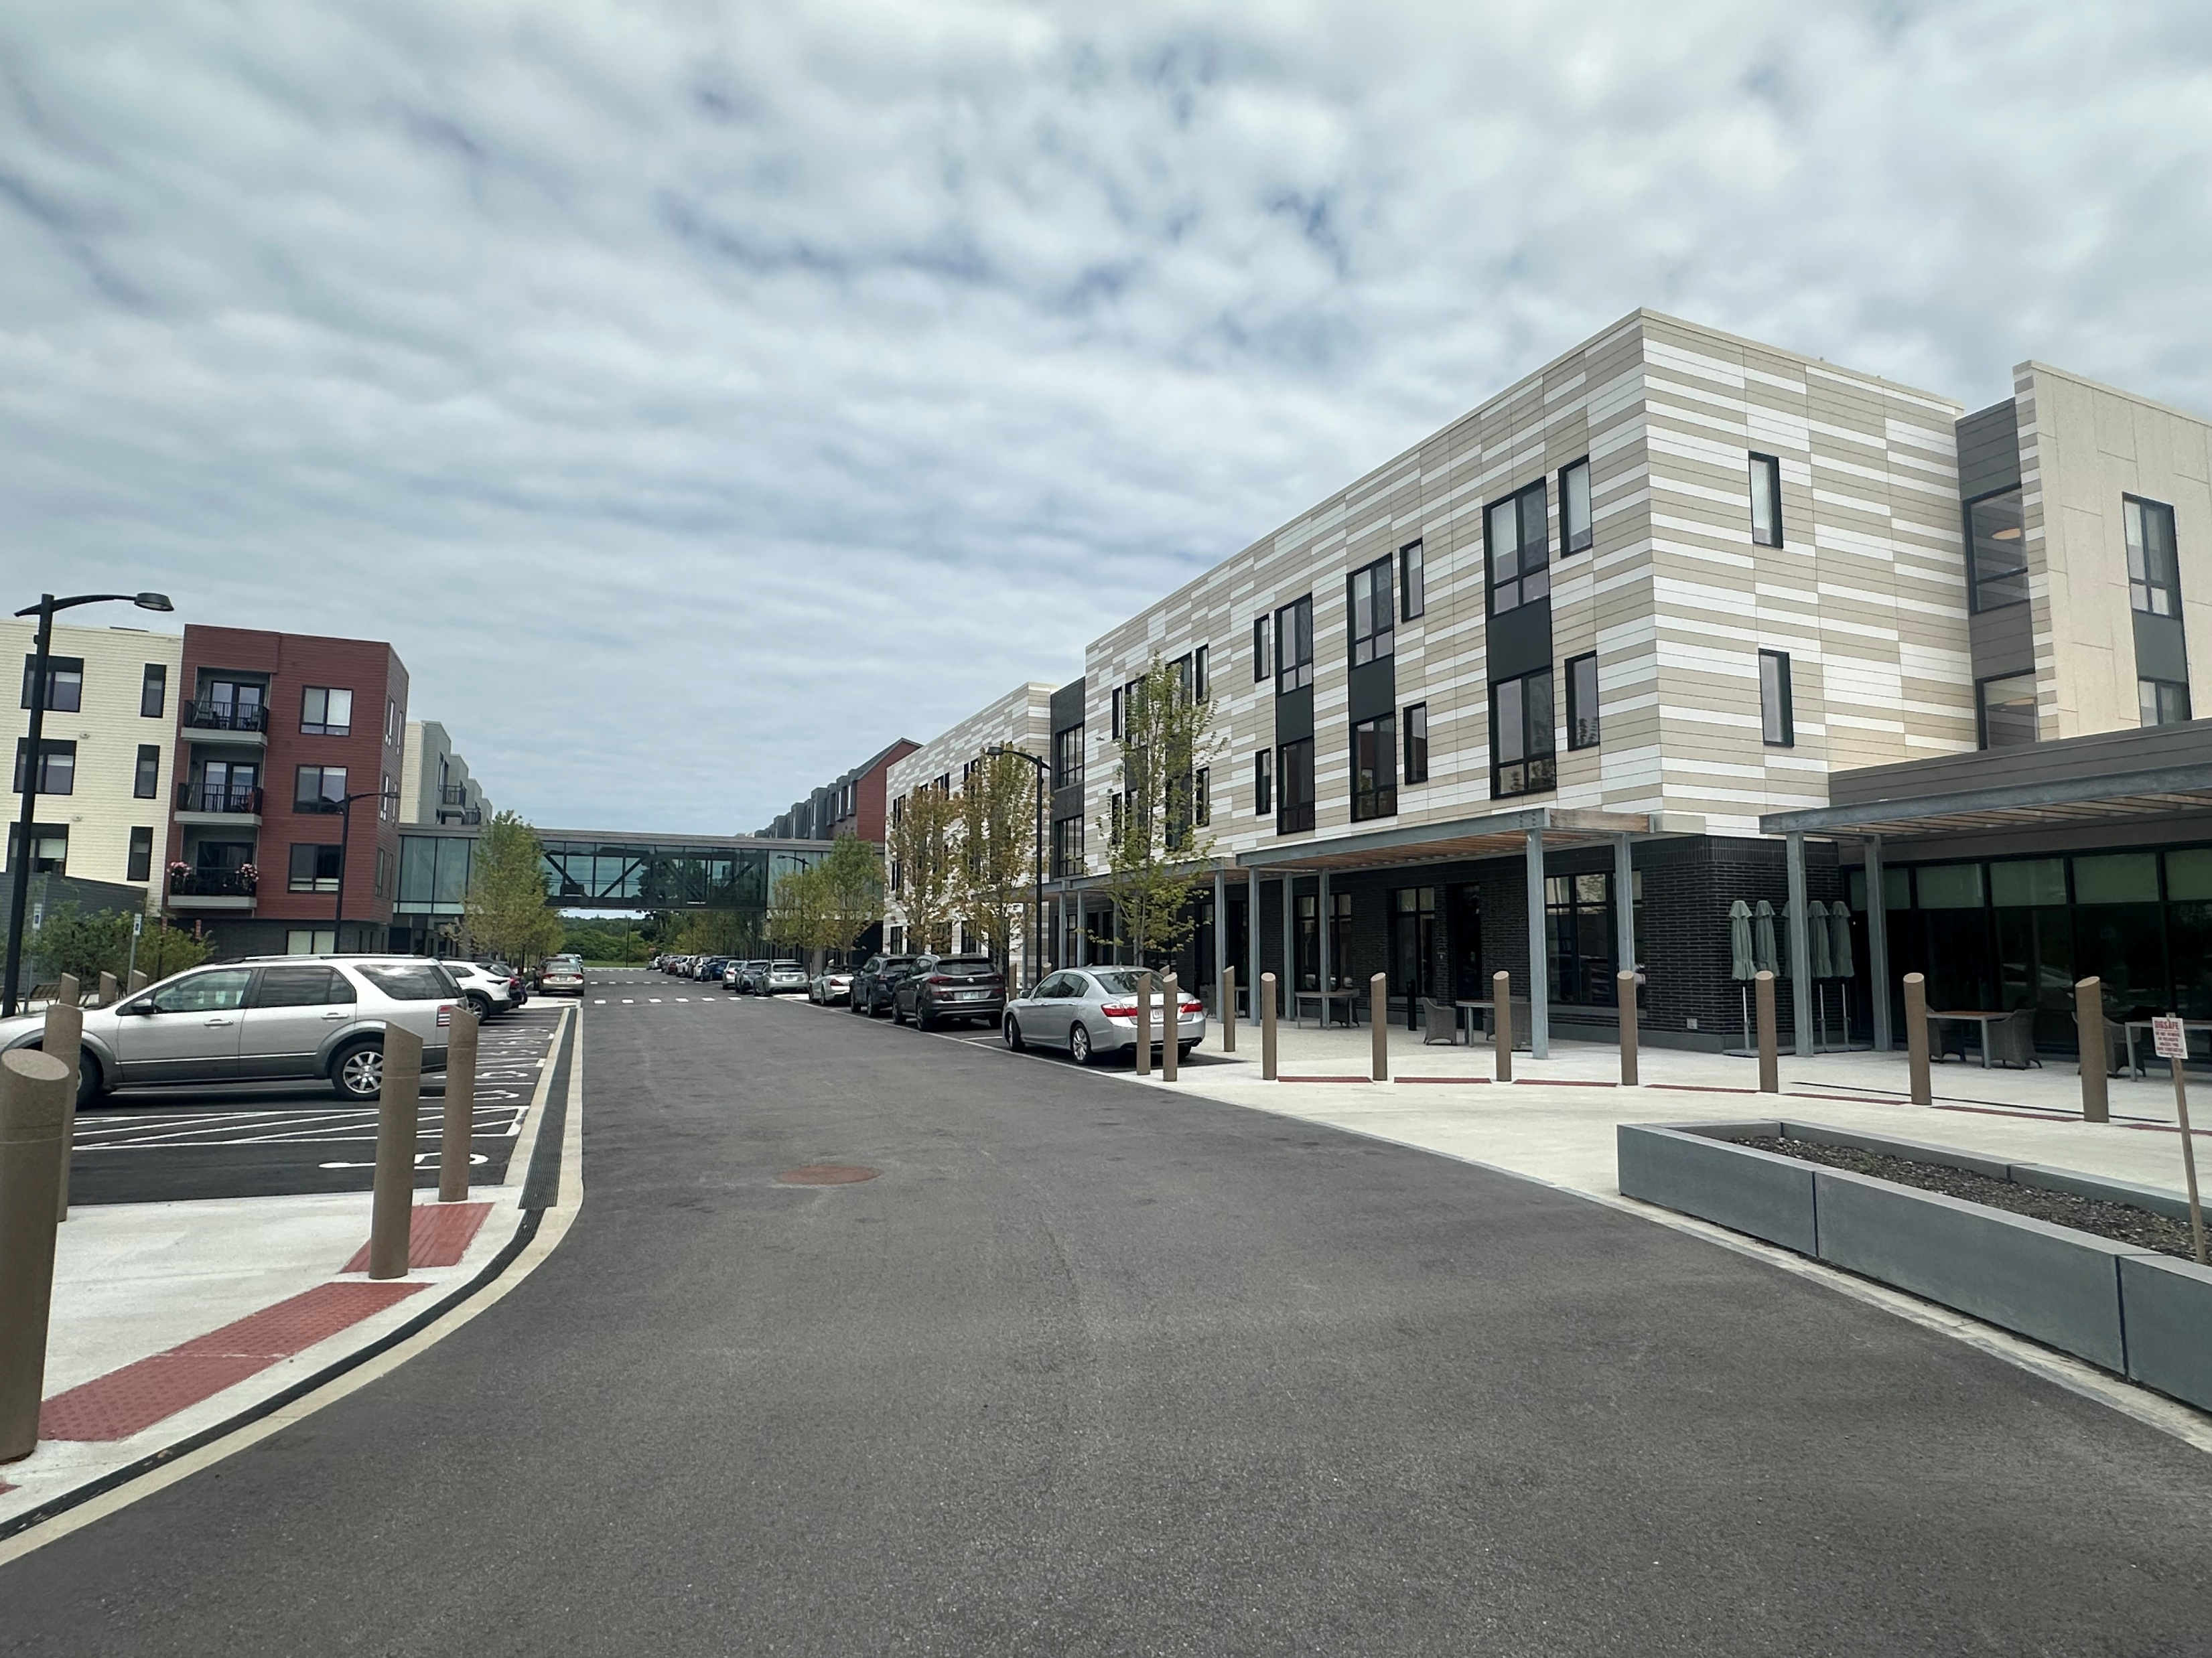
Woodmont – Baldwin CCRC

Slide 17
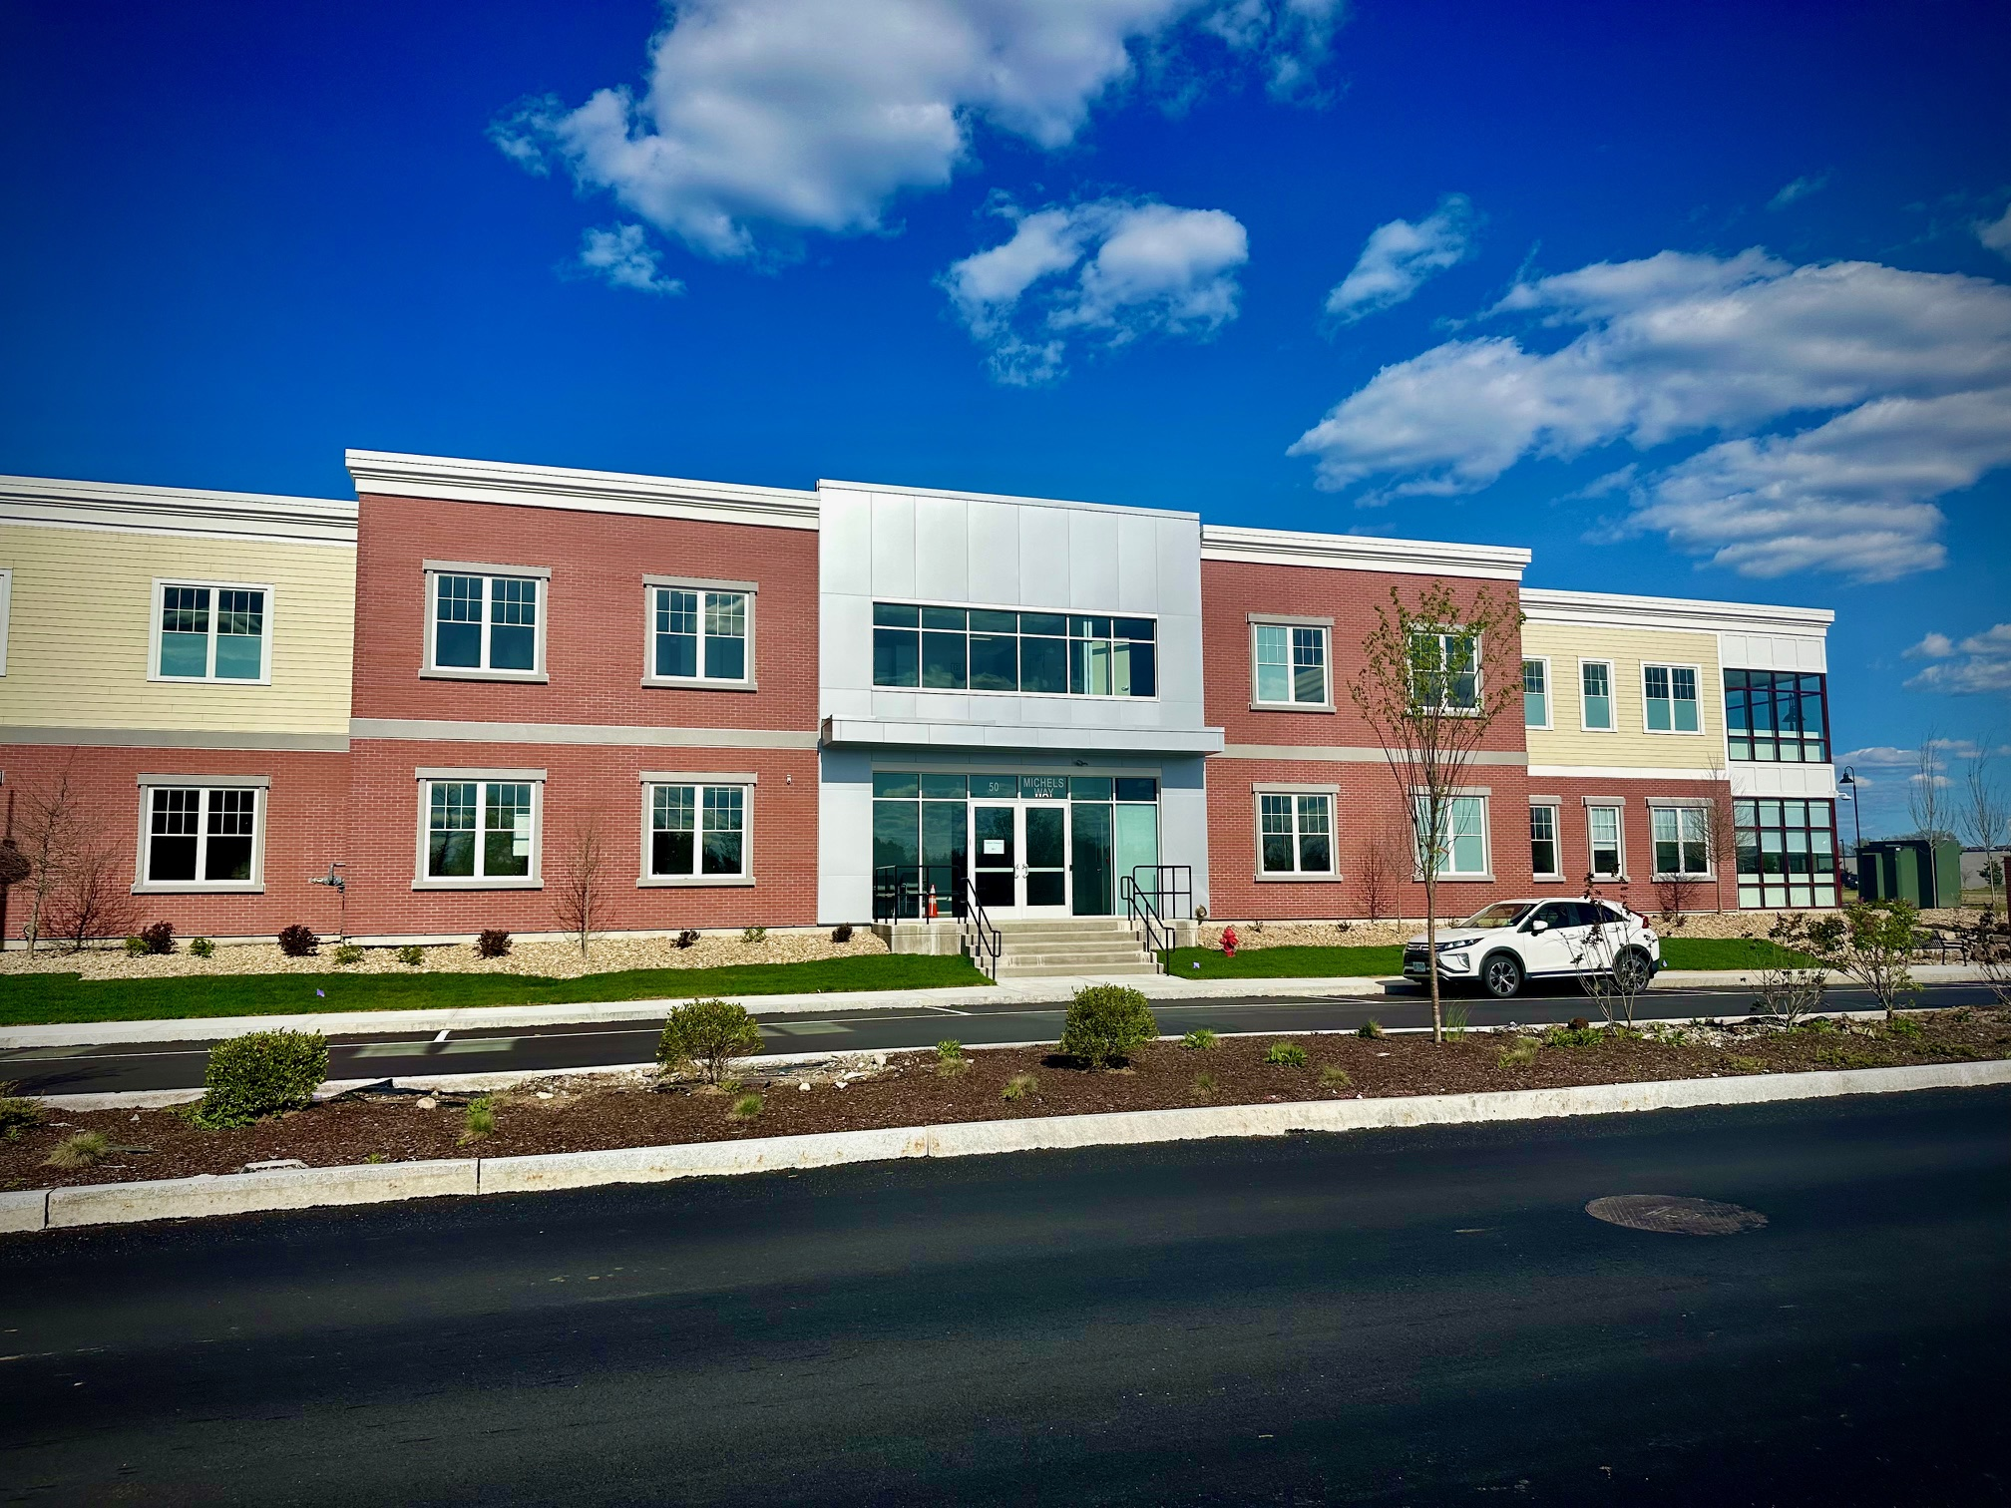
Woodmont – DMC

Slide 18

Woodmont – 603 Brewery

Slide 19
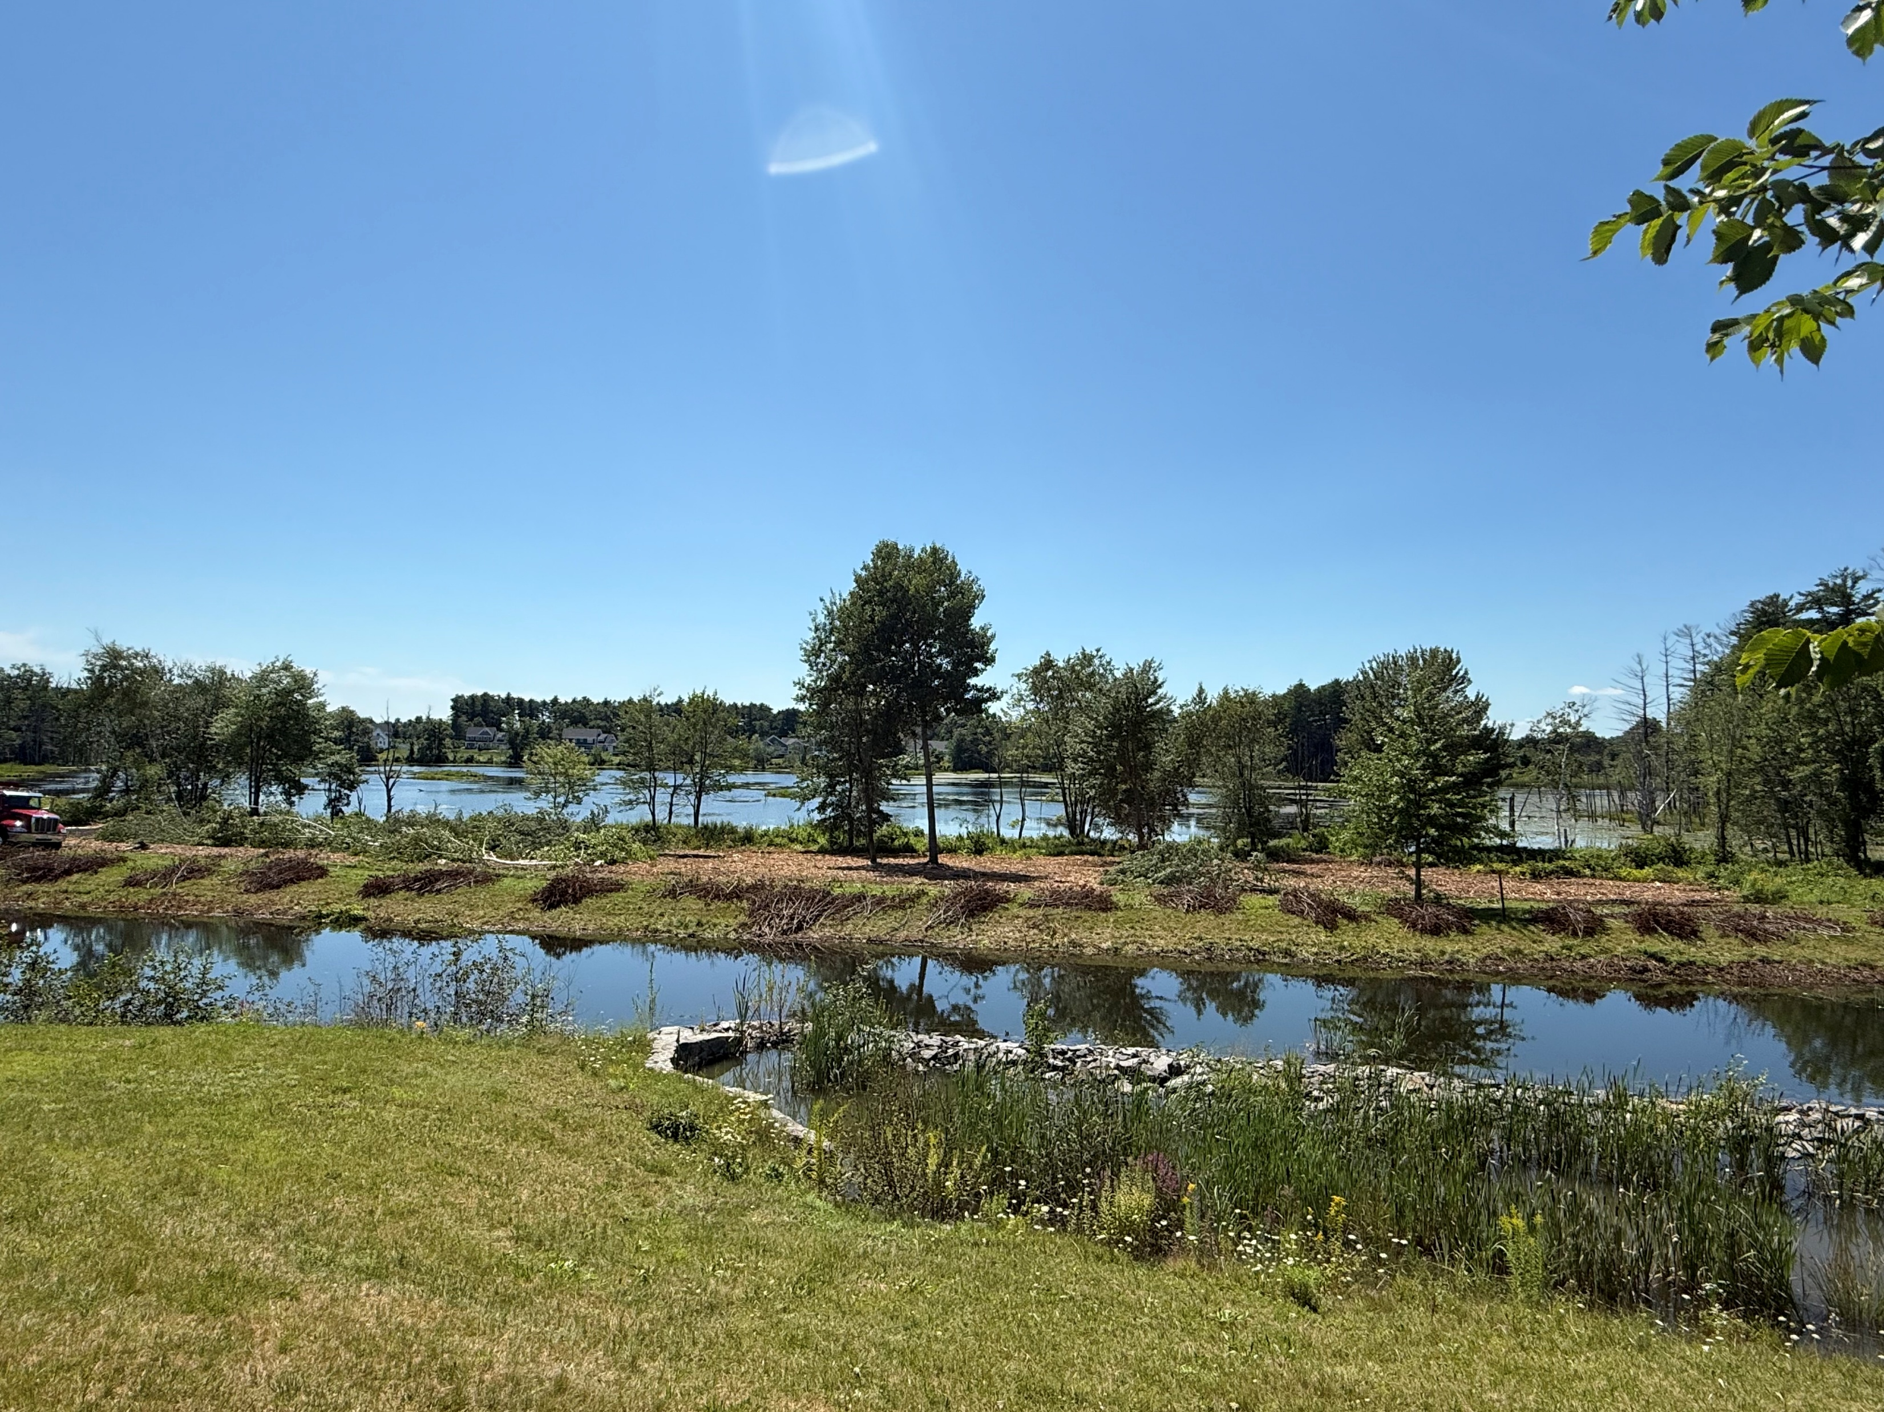
Woodmont – Natural Pond

Slide 20

Woodmont – Natural Pond

Slide 21
Woodmont – Lessons Learned
  “KISS” Keep it Simple Stupid
  Allow Flexibility to Adapt with Markets
  Not all Infrastructure Has to be done upfront
  Market Conditions WILL change over long build-outs
  Residential v Commercial – Chicken and Egg
  Variety Appeals to All

Slide 22
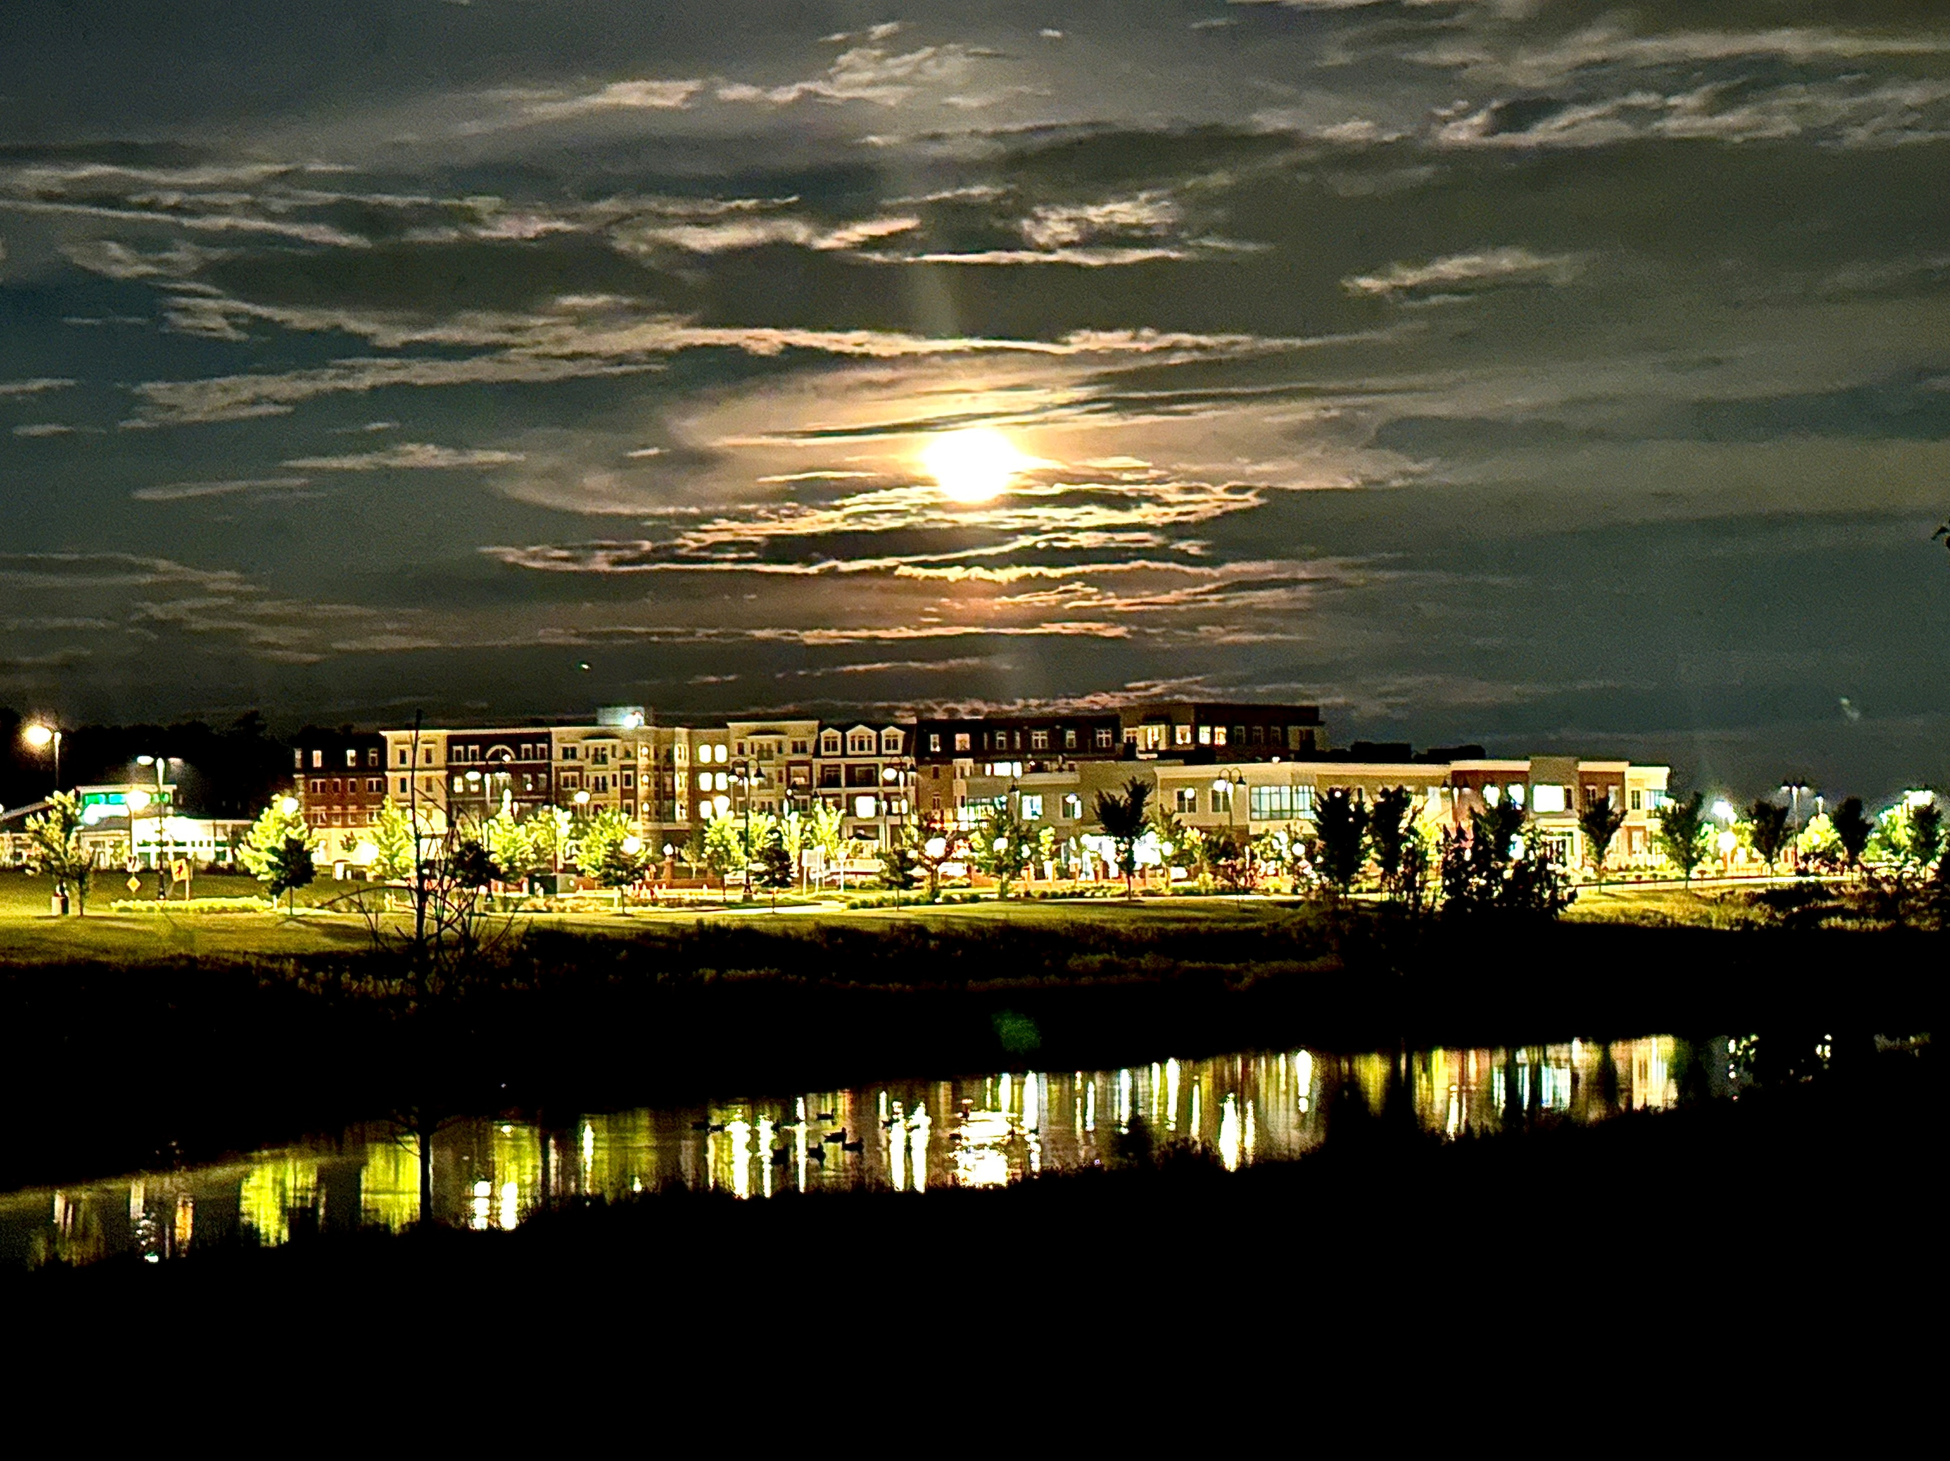
Woodmont – Questions

